Slide 1
Towards a Content-Centric Internet
Alex Jacoby
Alex Mullans
CSSE481: WBIS
10/26/2011

Slide 2
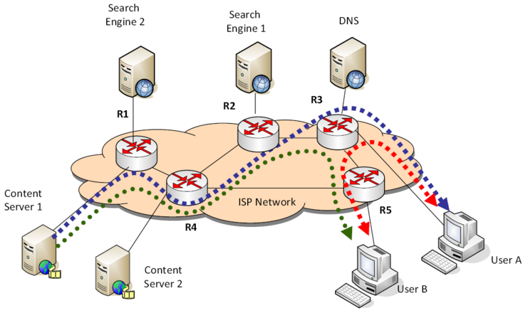
The way it is now
Notes:
Current architecture is device-oriented; the user has to go to a specific site (e.g. YouTube.com) or use a search engine (e.g. Bing) to find the content for which they’re looking
Content is served from a central server which may be near or far from the end user
Network infrastructure consists of “dumb pipes” that are unaware of what is being transmitted and therefore cannot optimize traffic by type/importance
Devices are not context-aware: a phone call cannot easily be transferred from a mobile device to the user’s television when they move into the living room
Important stuffs: Content discovered by search engines -> content discovered by the user -> content delivered
Problems occur when billions are connected, need to streamline the data delivery process.

Slide 3
A matter of perspective
Content
User
Service
Notes:
User-centric perspective: the Internet is a network of users rather than a collection of devices
The end-user is the endpoint, rather than his/her device. Users should be able to easily find each other and engage in interactions, even if they use multiple devices in parallel.
Service-centric perspective: Web applications can be built faster by using pre-existing services as building blocks – reference G+ rant https://plus.google.com/112678702228711889851/posts/eVeouesvaVX
Content-centric perspective: Content attracts users, and users are also becoming content producers
Content requires new services which in turn affect the experience and networking of users
Important Stuffs: This section is all definitions. Everything you need to know is ^^^

Slide 4
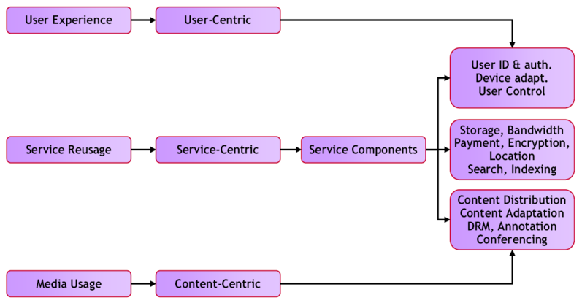
3 perspectives => unified experience
Notes:
The content centric perspective relies on new service-centric components (user identification, authentication and authorization).
Content centric services include content distribution for on demand and live media distribution.
All 3 combine to compliment one another.

Slide 5
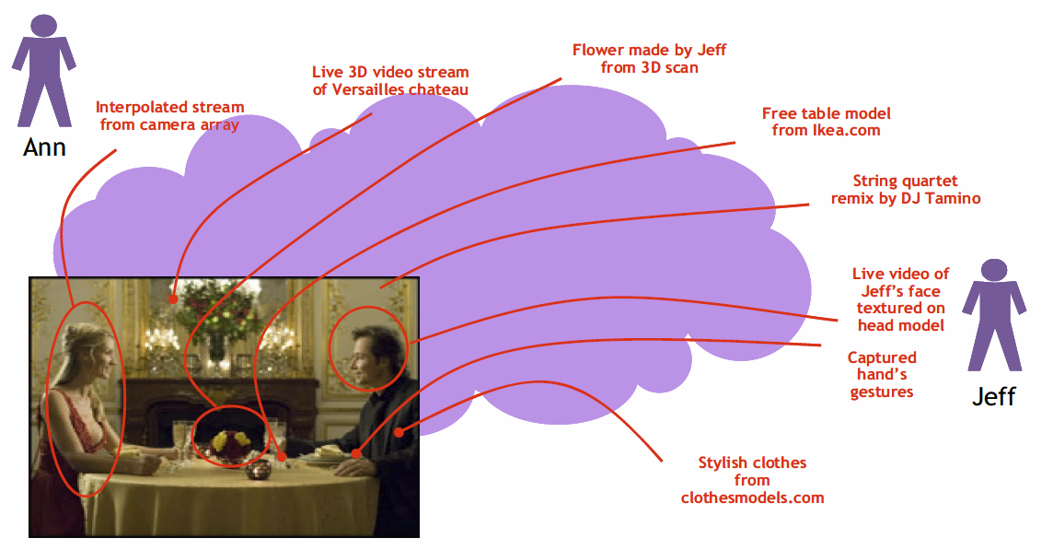
Content objects
Notes:
The authors envision a world where instead of a straight video stream, multimedia experiences could be made on the fly using content objects: autonomous, polymorphic, holistic containers containing media, rules, behavior, relationships, and/or characteristics.
Automatic Layer-Less Object Architecture: a clean-slate network design divergent from the existing 7-layer OSI model.

Slide 6
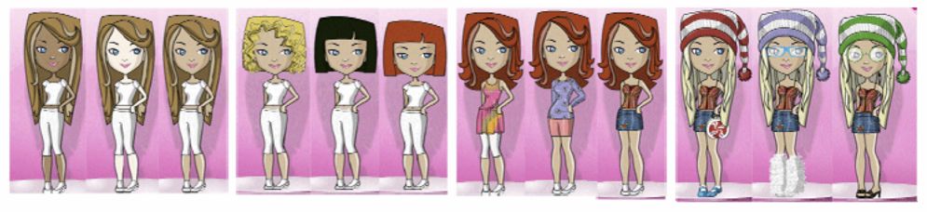
Content objects: An example
Notes:
The Barbie content object in the image would be composed of a number of other basic objects.
From the text: It has “skin”. The “skin” is a content object, which has different colours or textures. It has hair. The “hair” is a content-object, which has different colour, length, style. It has “eyes”. The “eyes” is a content-object, which has different colour, length, style, shadows. It wears “cloths” and carries “accessories”. Both “cloths” and “accessories” are components mash-ups, which may change based on the time, context school, da[n]ce, gym), emotions.

Slide 7
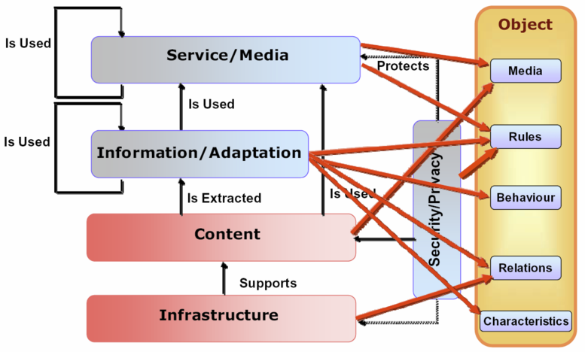
Problem: The Transition
Notes:
The authors note that a transition to a new content object-based system would require many structural changes to the existing structure of the Internet. From the text: “It is currently very difficult to imagine what a network architecture that support objects would look like. An attempt to map the characteristics of the layered approach which is depicted in Figure 2 into the novel “layer-less” concept of the object is shown in the Figure 7, where one or more layers are mapped to one or more entities of the object.”

