Slide 1
Agile Project Management – Applying Scrum to Botball
David Mutchler
Professor of Computer Science and Software Engineering
Rose-Hulman Institute of Technology
5500 Wabash Ave.
Terre Haute, IN 47803
mutchler@rose-hulman.edu
(812) 877-8426

Slide 2
Take-away (preview)
Botball teams need Project Management
  But Project Management is hard!
Current focus:
  Gantt Charts
  Waterfall processes
Another way:
  Agile processes
  Simplified Scrum for Botball

Slide 3
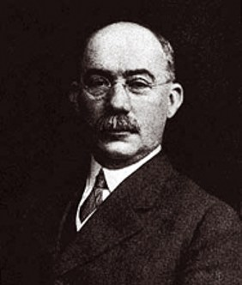
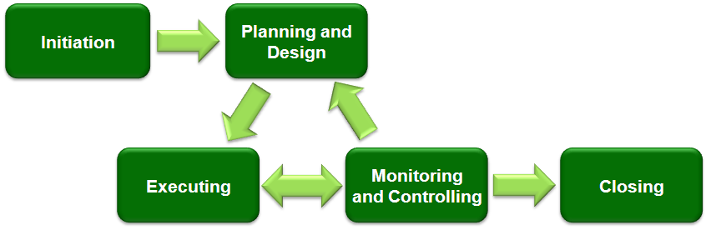
What is Project Management?
Henry Gantt (1861-1919), the father of planning and control techniques
Typical phases of an engineering project
Photo and diagram are from Wikipedia, http://en.wikipedia.org/wiki/Project_management

Slide 4
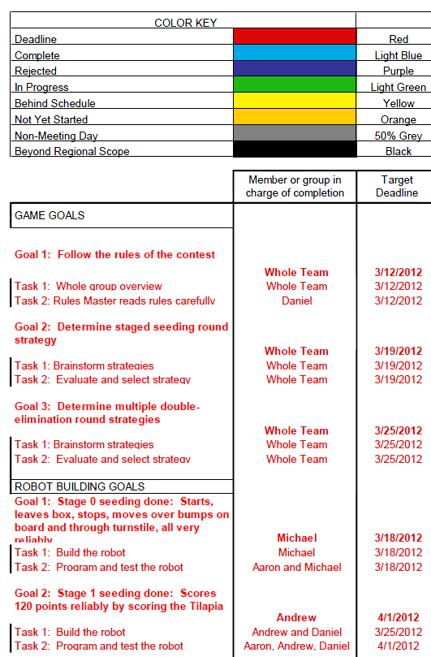
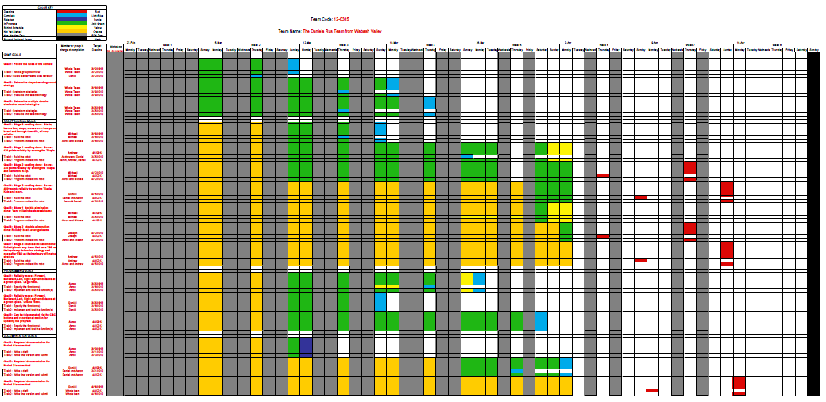
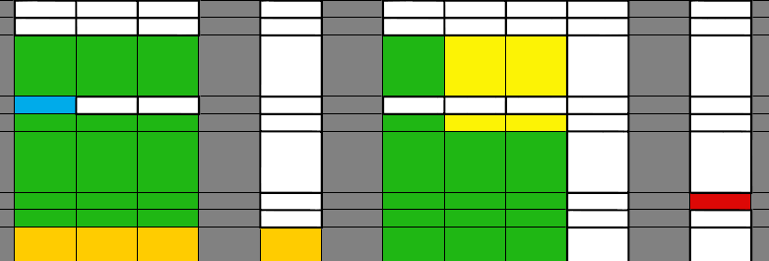
Project Management in Botball – Gantt Chart

Slide 5
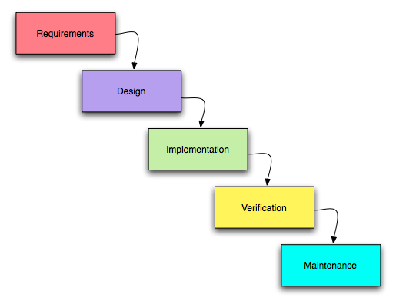

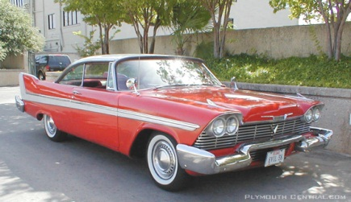
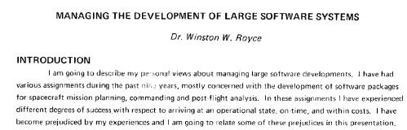
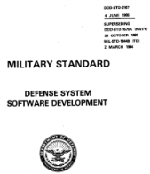
Waterfall Project Management
Building:
Cars ☺
Software ☹
The diagram is from Wikipedia, http://en.wikipedia.org/wiki/Project_management. It was adapted from Managing the Development of Large Software Systems, by Winston W. Royce, 1970, http://leadinganswers.typepad.com/leading_answers/files/original_waterfall_paper_winston_royce.pdf.
Waterfall was incorporated in DOD standards like the one shown above,
http://www.product-lifecycle-management.com/download/DOD-STD-2167A.pdf

Slide 6
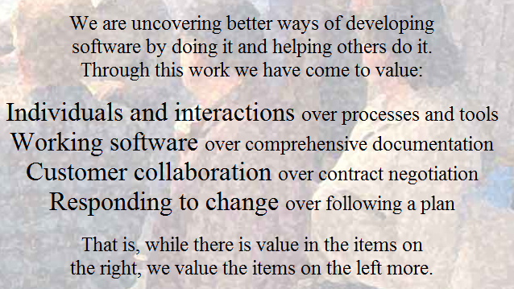
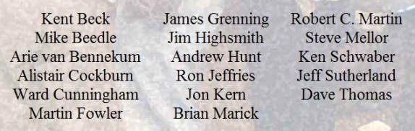
Agile Project Management
We follow these principles:
… Deliver working software frequently …
… Build projects around motivated individuals …
… Working software is the primary measure of success …
… Simplicity – the art of maximizing the amount of work not done – is essential …
These sound like good fits for Botball!
From http://agilemanifesto.org/ and http://agilemanifesto.org/principles.html.

Slide 7
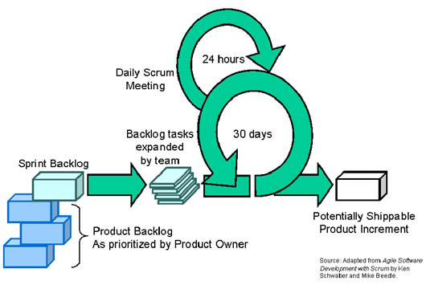
Scrum
Each big cycle is called a Sprint. Each Sprint begins with planning what to deliver and ends with a working product.
Diagram adapted from Agile Software Development with Scrum by Schwaber and Beedle, 2001, taken from www.iconatg.com/services/process/scrum.php.

Slide 8
Simple Scrum in Botball
Generic Release Plan
Deliverables for each Sprint, see next slide
Determine and assign Tasks to accomplish the deliverables for this Sprint
Sprint Alpha
→ Team building
Sprint Beta
→ Staged Strategy
Stand-up Meeting to adjust Tasks and assignments as needed
Sprints 1, 2, 3, …
Re-Plan for the next Sprint, based on what was learned from this Sprint
Each Sprint: Robots score more points

Slide 9
A generic Release Plan for Botball
Sprint Alpha:
  Plan for how to build the team
  Team rules: participation, decision-making, conflict-handling, …
Sprint Beta:
  Staged Strategies for Seeding and Double-Elimination
Sprint 1:
  Robots accomplish Stage 1 of Seeding Strategy
  Robots accomplish Stage 1 of Double-Elimination Strategy
Sprints 2, 3, 4…
  Robots accomplish Stage 2… of Seeding Strategy
  Robots accomplish Stage 2… of Double-Elimination Strategy

Slide 10
After Sprint Beta:
This and the next slides show an example of how the Release Plan might evolve. Only the Seeding Strategy is shown.
Sprint 1:
  Starts, leaves box, stops, moves over bumps on board and through turnstile, all very reliably.
Sprint 2:
  Scores 12 x 10 = 120 points reliably by scoring 12 of 12 Tilapia.
Sprint 3:
  Scores 180 additional points reliably by scoring 6 (or more) of 10 Kelp.
Sprint 4:
  Scores 410 additional points reliably by scoring 7 (or more) of 10 polyps from opponent's side and 3 (or more) from our side into reefs and into MPA.
Sprint 5:
  Scores TBD to TBD points reliably by scoring TBD.

Slide 11
After Sprint 1:
Sprint 1: Starts, leaves box, stops, moves over bumps on board and through turnstile, all very reliably.
Sprint 2: Scores 12 x 10 = 120 points reliably by scoring 12 of 12 Tilapia.
Sprint 3: Scores 180 additional points reliably by scoring 6 (or more) of 10 Kelp.
Sprint 4: Scores 410 additional points reliably by scoring 7 (or more) of 10 polyps from opponent's side and 3 (or more) from our side into reefs and into MPA.
Sprint 5: Scores TBD to TBD points reliably by scoring TBD.
Accomplished:
  Starts, leaves box, stops, moves over bumps on board and through turnstile, all very reliably.
Sprint 2:
  Scores 12 x 6 = 72 points reliably by scoring at least 6 of 12 Tilapia.
Sprint 3:
  Scores 60 additional points reliably by scoring 2 (or more) of 10 Kelp.
Sprint 4:
  Increases above scores for Tilapia and Kelp
  Scores 410 additional points reliably by scoring 7 (or more) of 10 polyps from opponent's side and 3 (or more) of 10 polyps from our side into reefs and into MPA.
Sprint 5:
  Scores TBD to TBD points reliably by scoring TBD.

Slide 12
After Sprint 2:
Accomplished: Starts, leaves box, stops, moves over bumps on board and through turnstile, all very reliably.
Sprint 2: Scores 12 x 6 = 72 points reliably by scoring at least 6 of 12 Tilapia.
Sprint 3: Scores 60 additional points reliably by scoring 2 (or more) of 10 Kelp.
Sprint 4: Increases above scores for Tilapia and Kelp. Scores 410 additional points reliably by scoring 7 (or more) of 10 polyps from opponent's side and 3 (or more) of 10 polyps from our side into reefs and into MPA.
Sprint 5: Scores TBD to TBD points reliably by scoring TBD.
Accomplished:
  Starts, leaves box, stops, moves over bumps on board and through turnstile, all very reliably.
  Scores 12 x 3 = 36 points reliably by scoring at least 3 of 12 Tilapia.
Sprint 3:
  Scores 12 x 9 = 108 points reliably by scoring at least 9 of 12 Tilapia.
  Scores 60 additional points reliably by scoring 2 (or more) of 10 Kelp.
Sprint 4:
  Scores 60 additional points reliably by scoring 4 (instead of just 2) or more of 10 Kelp.
  Scores 30 additional points reliably by scoring 7 (or more) of 10 polyps from opponent's side and 3 (or more) of 10 polyps from our side into reefs and into MPA.
Sprint 5:
  Scores additional points from polyps.
  Scores TBD to TBD points reliably by scoring TBD.

Slide 13
After Sprint 3:
Accomplished: Starts, leaves box, stops, moves over bumps on board and through turnstile, all very reliably. Scores 12 x 3 = 36 points reliably by scoring at least 3 of 12 Tilapia.
Sprint 3: Scores 12 x 9 = 108 points reliably by scoring at least 9 of 12 Tilapia.. Scores 60 additional points reliably by scoring 2 (or more) of 10 Kelp.
Sprint 4: Scores 60 additional points reliably by scoring 4 (instead of just 2) or more of 10 Kelp. Scores 30 additional points reliably by scoring 7 (or more) of 10 polyps from opponent's side and 3 (or more) of 10 polyps from our side into reefs and into MPA.
Sprint 5: Scores additional points from polyps. Scores TBD to TBD points reliably by scoring TBD.
Accomplished:
  Starts, leaves box, stops, moves over bumps on board and through turnstile, all very reliably.
  Scores 12 x 11 = 132 points reliably by scoring at least 11 of 12 Tilapia.
  Scores 30 additional points reliably by scoring 3 (or more) of 10 polyps from our side into MPA.
Sprint 4:
  Scores 30 additional points reliably by scoring 1 (or more) of 10 Kelp.
  Scores 50 additional points reliably by scoring 8 (instead of just 3) of more of 10 polyps from our side into MPA.
Sprint 5:
  Scores 90 additional points reliably by scoring 4 (instead of just 1) or more of 10 Kelp.
  Scores …

Slide 14
Take-away (summary)
Consider Simplified Scrum (an Agile process)
Make a Release Plan
Repeatedly:
  Do a Sprint
  Evaluate
  Re-Plan
KISS – don’t overplan at this point
Items in the Release Plan are Deliverables, not Tasks. Most items should score points.
Do detailed planning (i.e., assign Tasks) only for the current Sprint
Be agile! What the team has accomplished so far informs what the team can accomplish in the rest of the time!
Always have working robots that score points
Acknowledgement: I am grateful to Sandy Mutchler for her help with the ideas of this project and this presentation of them.

