Slide 1
Intertemporal Trades
•
•
Borrowing
in period 1

Slide 2
Intertemporal Trades
Patient preferences
Impatient preferences

Slide 3
Optimal Holding Period for an Asset
FV(t) = 100 + 6t + 2t² – 0.1t³
Rate of return from holding asset
t*

Slide 4
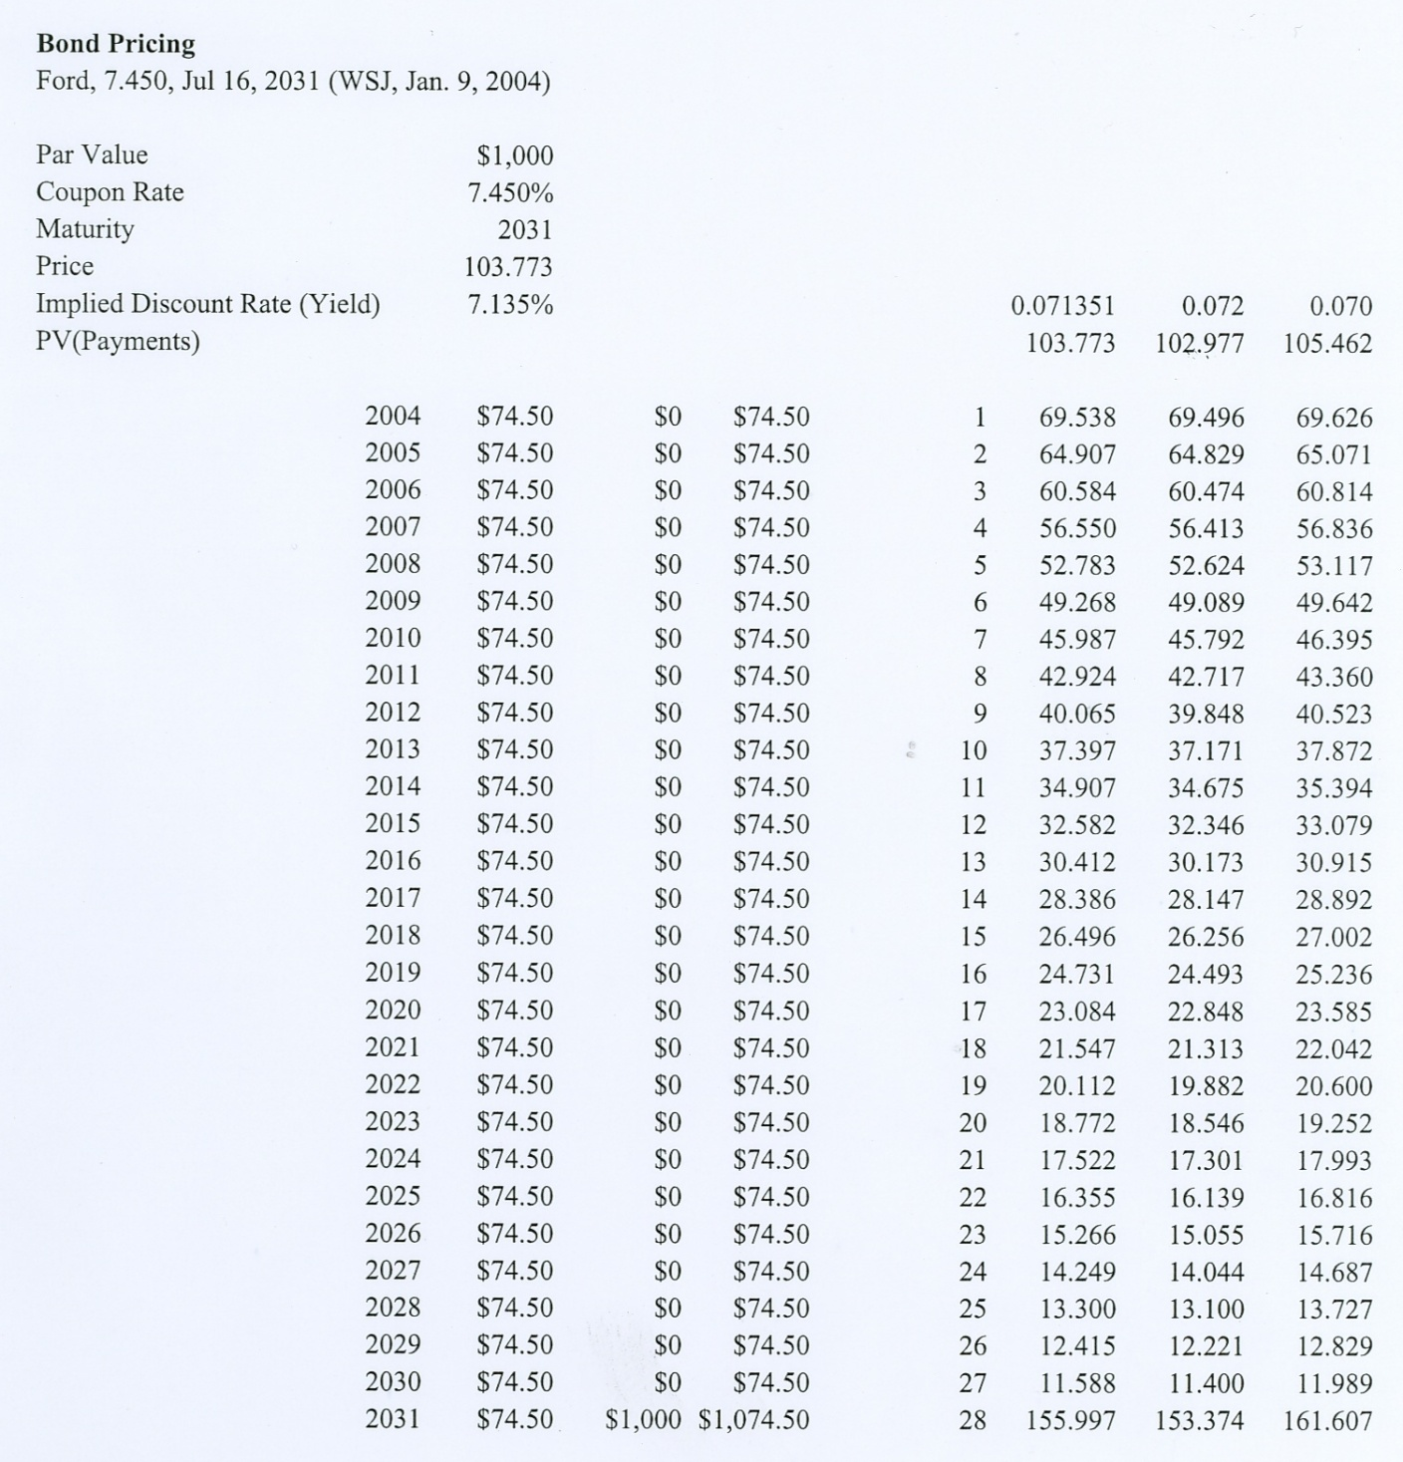
Asset Markets: Debt

Slide 5
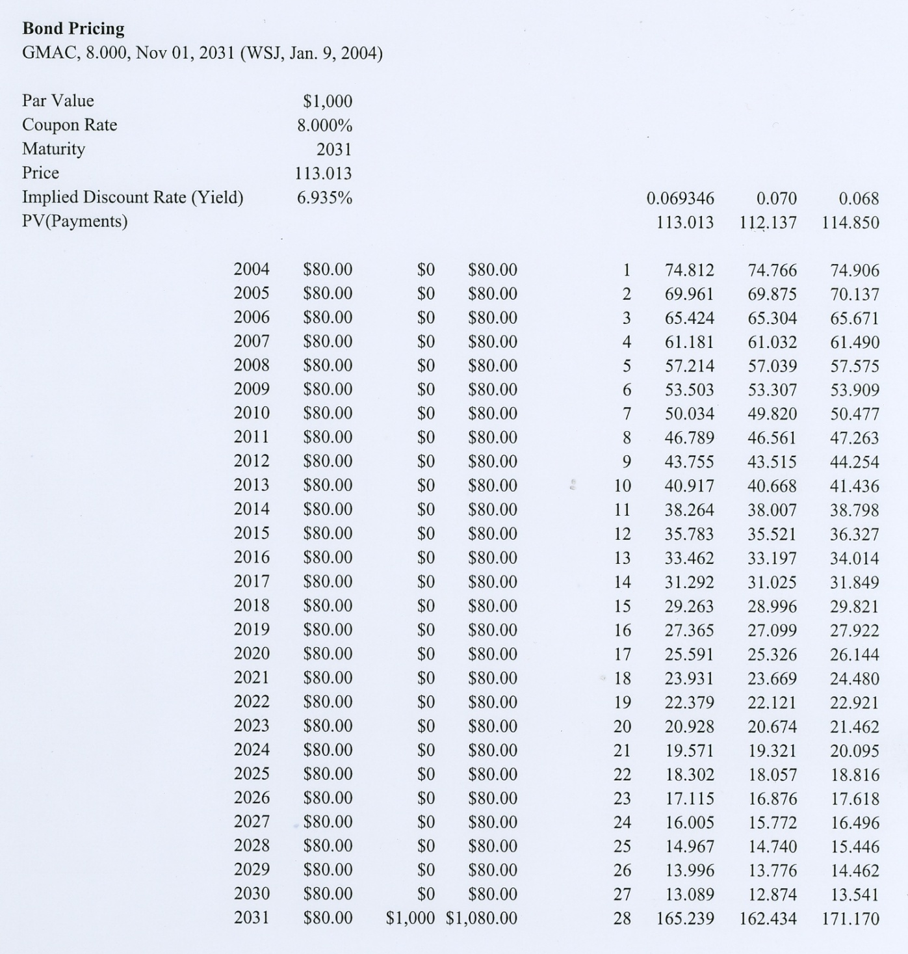
Asset Markets: Debt

Slide 6
Risky Assets: Equities
S&P 500
2007
Return: 3.67%
Volatility: 16.02%
2008
Return: - 38.52%
Volatility: 41.10%
2009
Return: 23.44%
Volatility: 27.27%

Slide 7
Risky Assets: Portfolios
S&P 500 and Malkiel Portfolio
2007
Return: 3.67%
Volatility: 16.02%
Return: 17.92%
Volatility: 18.05%
2008
Return: - 38.52%
Volatility: 41.10%
Return: - 35.97%
Volatility: 33.14%
2009
Return: 23.44%
Volatility: 27.27%
Return: 37.35%
Volatility: 20.81%

Slide 8
Capital Asset Pricing Model
Capital Market Line
Security Market Line
1

Slide 9
Beta as a Measure of Relative Risk

Slide 10
Capital Asset Pricing Model
r_{i} = 3 + 5β_{i}
 |  | 3-Year |  | 5-Year |  | 10-Year
Mutual Fund Name | Symbol | Beta | Returns | Beta | Returns | Beta | Returns
American Century Heritage A | ATHAX | 1.44 | 20.50 | 1.17 | 19.26 | 0.96 | 8.42
Fidelity Advisor Equity Growth T | FAEGX | 1.18 | 8.31 | 1.16 | 11.20 | 1.16 | 3.34
Fidelity Magellan | FMAGX | 1.33 | 6.88 | 1.03 | 10.42 | 1.04 | 3.53
Putnam International Growth & Income | PNGAX | 1.07 | 12.55 | 1.03 | 20.56 | 0.96 | 6.90
Fidelity Diversified International | FDIVX | 1.08 | 14.57 | 1.02 | 22.18 | 0.96 | 10.85
Templeton Growth A | TEPLX | 0.77 | 5.78 | 0.85 | 14.81 | 0.80 | 7.01
Vanguard 500 Index | VFINX | 1.00 | 5.72 | 1.00 | 11.18 | 1.00 | 3.43
Vanguard Total Stock Market Index | VTSMX | 1.04 | 6.19 | 1.04 | 12.27 | 1.01 | 3.89
Vanguard PRIMECAP | VPMCX | 1.01 | 9.63 | 1.06 | 15.78 | 1.08 | 8.50
Janis Growth & Income | JAGIX | 1.13 | 6.69 | 1.05 | 11.22 | 0.98 | 5.84
Dreyfus Premier Balanced B | PRBBX | 0.98 | 4.05 | 0.90 | 6.59 | 0.87 | 1.43
Dreyfus Founders Balanced A | FRIDX | 0.98 | 3.71 | 0.88 | 7.21

Slide 11
Efficient Market Hypothesis
A theory that asset prices reflect all publicly available information about the value of an asset.
Strong Form: Asset prices reflect all information, public and private, and no one can earn excess returns
Semi-Strong Form: Asset prices adjust very rapidly to publicly available new information and in an unbiased fashion, such that no excess returns can be earned by trading on that information. Semi-strong-form efficiency implies that neither fundamental analysis nor technical analysis will be able to reliably produce excess returns.
Weak Form: Future asset prices cannot be predicted by analyzing price from the past. Excess returns can not be earned in the long run by using investment strategies based on historical share prices or other historical data.

Slide 12
Diversification and Portfolio Theory
Expected Return of a Portfolio (2 investments):
E[r_{x}]= x₁E[r₁] + x₂E[r₂] (x₁ + x₂ = 1)
Expected Variance of a Portfolio (2 investments):
σ_{1,2}² = x₁²σ₁² + x₂²σ₂² + 2x₁x₂σ_{1,2}
= x₁²σ₁² + x₂²σ₂² + 2x₁x₂ρ_{1,2}σ₁σ₂

Slide 13
Diversification and Portfolio Theory
Portfolio Example
Weights:
 |  | 0.5 | 0.5
 |  | A | B |  | Portfolio
State | Prob. | Return | Return |  | Return
1 | 0.2 | -5.00% | 15.00% |  | 5.00%
2 | 0.2 | 0.00% | 10.00% |  | 5.00%
3 | 0.2 | 5.00% | 5.00% |  | 5.00%
4 | 0.2 | 10.00% | 0.00% |  | 5.00%
5 | 0.2 | 15.00% | -5.00% |  | 5.00%
Expected Return: |  | 5.00% | 5.00% |  | 5.00%
Variance: |  | 0.63% | 0.63% |  | 0.00%
Std. Deviation: |  | 7.91% | 7.91% |  | 0.00%
Covariance(A,B) |  |  | -0.0050
Correlation(A,B) |  |  | -1.0000
E[r_{x}]= x₁E[r₁] + x₂E[r₂]
σ_{1,2}² = x₁²σ₁² + x₂²σ₂² + 2x₁x₂σ_{1,2}
= x₁²σ₁² + x₂²σ₂² + 2x₁x₂ρ_{1,2}σ₁σ₂

Slide 14
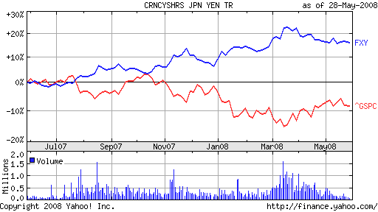
What does a negative beta asset look like?
Was the yen a negative beta asset in 2007 – 2008?
The blue line is FXY, an exchange-traded fund that tracks the yen. The red line is the S&P 500 index. Over the past year, the two time-series look like mirror images of each other. That is, holding yen seems to hedge U.S. stock-market risk.
Source: http://gregmankiw.blogspot.com/ 29 May 2008

Slide 15
What does a negative beta asset look like?
Was the yen a negative beta asset in 2007 – 2008?
Feb. 2007 to May 2008: |  |  | FXY | ^GSPC | BLEND
Average Weekly Returns |  |  | 0.19% | 0.01% | 0.10%
Std. Dev. of Weekly Returns |  |  | 1.60% | 2.37% | 0.92%
Annualized Returns |  |  | 10.51% | 0.33% | 5.29%
Annualized Volatility |  |  | 11.56% | 17.06% | 6.62%

Slide 16
What does a negative beta asset look like?
Was the yen a negative beta asset in 2007 – 2008?

Slide 17
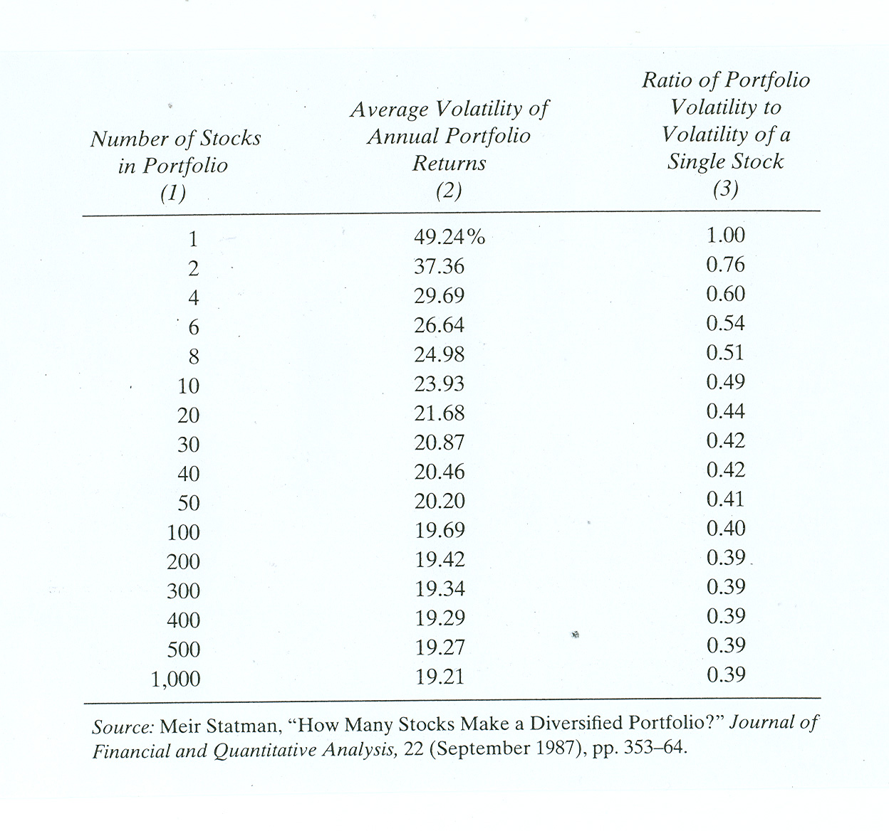
Dealing With Risk: Diversification (Portfolio Theory)
Effect of Additional Investments / Assets on Diversification

Slide 18
Risk and Uncertainty: “Contingent Consumption Plans”
Case 1:
A person with an endowment of $100 is considering the purchase of a lottery ticket that costs $5. The winning ticket in the lottery gets $200. 40 tickets will be sold.
Case 2:
A person with an endowment of $35,000 faces a 1% probability of losing $10,000. He is considering the purchase of full insurance against the loss for $100.
$100
$35,000
Lucky
day
Outcome A:
Do not
purchase
Do not
purchase
Unlucky
day
$25,000
Lucky
day
$295
Lucky
day
$34,900
Pr(Lucky) = 0.025):
Purchase
Purchase
Outcome B:
Unlucky
day
Unlucky
day
$95
$34,900

Slide 19
Risk and Uncertainty: “Contingent Consumption Plans”
$35,000
Lucky
day
Do not
purchase
Unlucky
day
$25,000
Lucky
day
$34,900
•
Purchase
Unlucky
day
$34,900
•
K = the “expected loss” ($10,000), and γK is the insurance premium.

Slide 20
Defining Risk Aversion
1. Risk aversion is defined through peoples’ choices:
2. Non-linearity in the utility of wealth.
Given a choice between two options with equal expected values and
different standard deviations, a risk averse person will choose the option
with the lower standard deviation:
Given a choice between two options with equal standard deviations and
different expected values, a risk-averse person will choose the option
with the higher expected value:

Slide 21
Risk Aversion and the Marginal Utility of Money
Utility
A
U₃
l
U($)
U₂
l
l
B
D
U₁
l
Risk Premium
C
Risk Premium
$0
$
$99,415
$99,500
$100,000
$50,000

Slide 22
Modeling Different Risk Preferences
Utility
U($)
U($)
U($)
Risk Aversion
Risk Neutral
Risk Seeking
$

Slide 23
Classification of Auctions
What is the nature of the good being auctioned?
What are the bidding rules?
English ascending bid
Private values
Dutch descending bid
Common value
Sealed bid
Vickrey second price

Slide 24
Evaluative Criteria for Auctions
Pareto Efficiency
Does the auction design guarantee that the item will go to the bidder with the highest value?
Revenue or Profit Maximization
Does the auction design guarantee the highest revenue (or profit) for the seller?

Slide 25
Types of Auctions and optimal bidding strategies
Independent Private Values Auctions
Each bidder knows precisely how highly he/she values the item,
and these values vary across all bidders.
English (ascending bid)
Dutch (descending bid)
First-price, sealed bid
Second-price, sealed bid

Slide 26
Types of Auctions and optimal bidding strategies
Common (or Correlated) Values Auctions
The item being bid has an underlying objective value, but no bidder knows precisely what that value is.
Winning bids tend to come from those with the most optimistic estimates.
If estimate errors are randomly distributed around zero, then the winning bid will be greater than the true value of the item (the “winner’s curse”):
Distribution of bids:
Winning
Bid
True
Value

