Slide 1
New opportunities for Rose-Hulman to partner with funders and non-profit organizations
Steve Chenoweth
CSSE Department
Rose-Hulman Institute of Technology
Friday, April 1, 2011

Slide 2
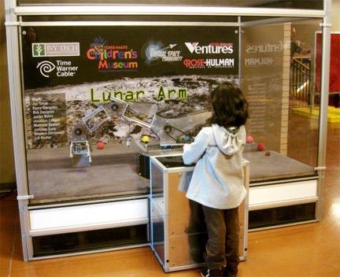
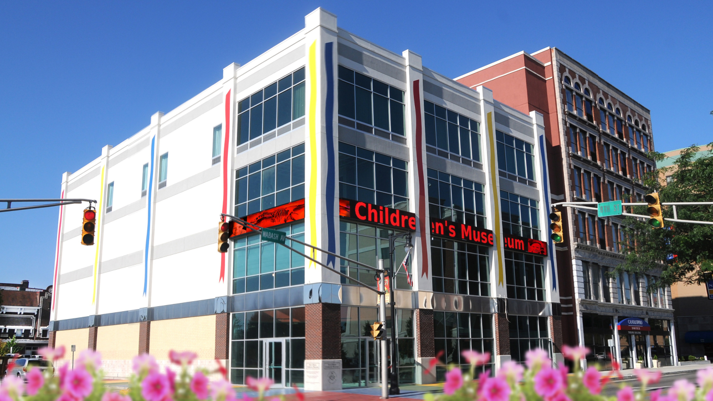
A typical non-profit collaboration opportunity we took advantage of
At RHIT -
Terre Haute Children’s Museum -
We have a “Lunar Arm” robot exhibit installed there.
Began as a robotics senior design project, last year.
It attracts large numbers of children to use it

Slide 3
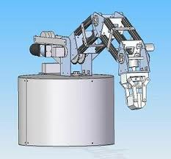
And…
At RHIT -
The Lunar Arm costs - ongoing money and time,
from RH Ventures, and
from additional student teams,
…to keep it running at the Museum.
The original project benefitted from having a corporate partner (Time-Warner, via the Museum).
It still needs a corporate partner!
Design of the Lunar Arm, as it was envisioned by the Robotics Senior Design team before building it.

Slide 4
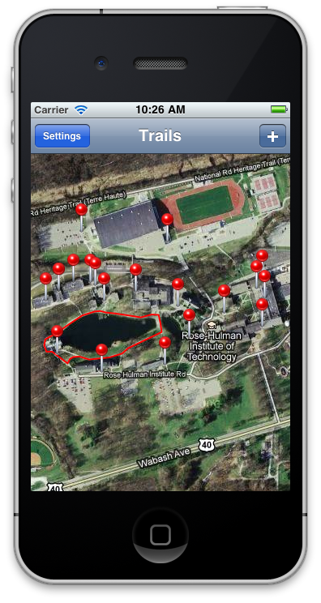
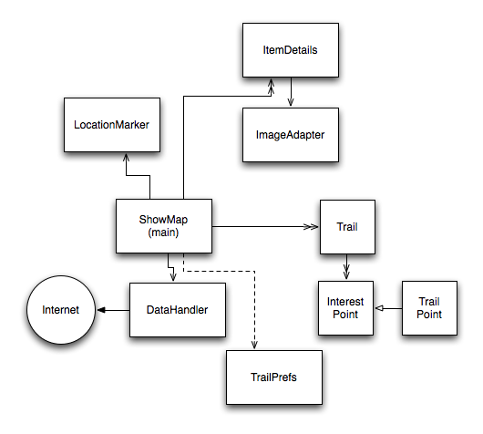
Another instance of what we already are doing
At RHIT -
In our CSSE department this year, one senior project team is doing a Trail Mapping project for a park system.
Enhances the trail experience of the hikers
E.g., they get guidance to sights and facilities.
E.g., they can post pictures from any location, and other people can then see these.
Runs on Androids and iPhones.
Will be Open Source, available to other park districts. See https://github.com/Mobile-Trail-Mapping/Architecture/wiki.
Above, right – Prototype mapping area – Rose-Hulman! Right – Software architecture diagram of this application, for the Android, done by the team as part of their open source documentation to make their system also understandable by other developers.

Slide 5
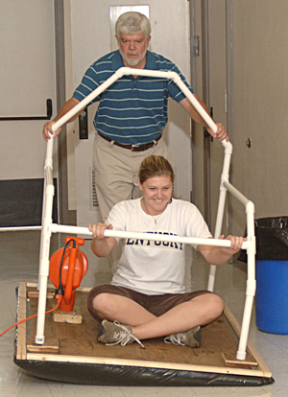
What else could we do? An example…
Elsewhere -
Schools have a need for new educational devices and software that would benefit students in STEM areas or students with special needs.
Typically these would be robotics type devices with mechanical engineering, computer engineering, and software elements.
This translates to interdisciplinary Rose-Hulman projects.
Above right – A typical STEM teaching aid – a Hovercraft that aids in learning math, built at University of Kentucky, part of a STEM project funded by a $ 2.3 Million grant. http://education.uky.edu/news/2009/10/19/Bottge-IES-Grant
= Money
Helps

Slide 6
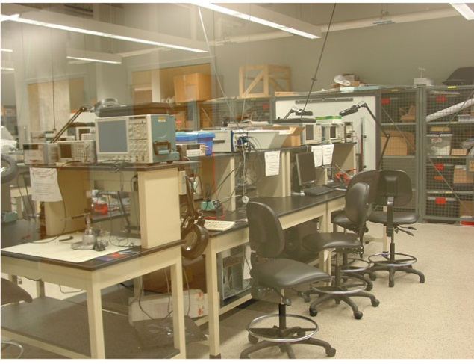
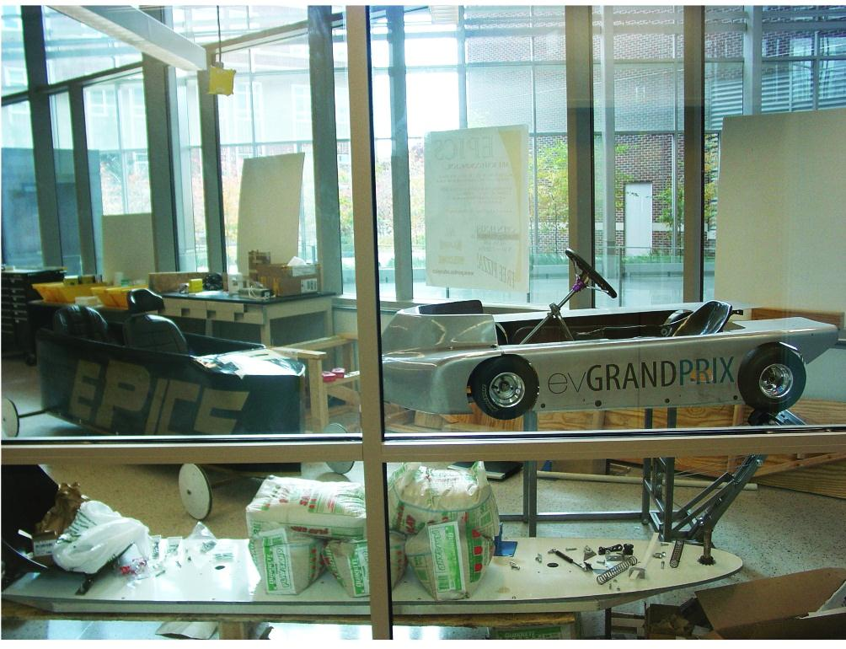
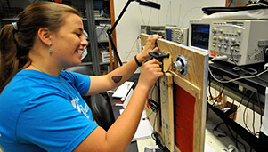
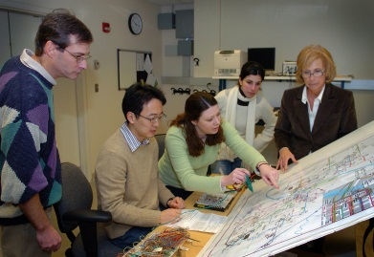
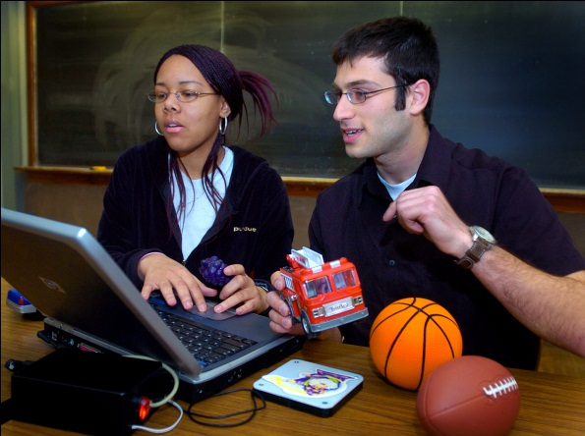
What else could we do? Another example…
Elsewhere -
From Purdue, where I spent my sabbatical last year, as Academic Administrator of their EPICS program…
400 students on 30 teams, each of which has a long-term relationship with a non-profit client.
= Money and
Organization
and good PR
and High-level,
Long-term
Commitment
All Help

Slide 7
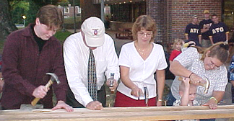
Non-profit student activity in general
Some can be done on a volunteer basis
A number of RHIT clubs are active in this
We would like to integrate more non-profit projects in with the regular curriculum
Like the Lunar Arm and Trail Mapping projects
Make such projects regular opportunities, integrated into classwork
All these efforts require one overriding piece…
Above – RHIT’s Habitat for Humanity chapter in action.

Slide 8
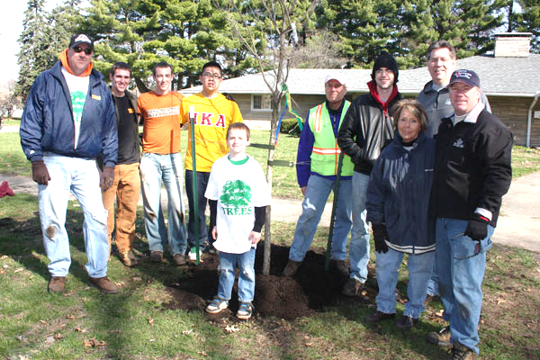
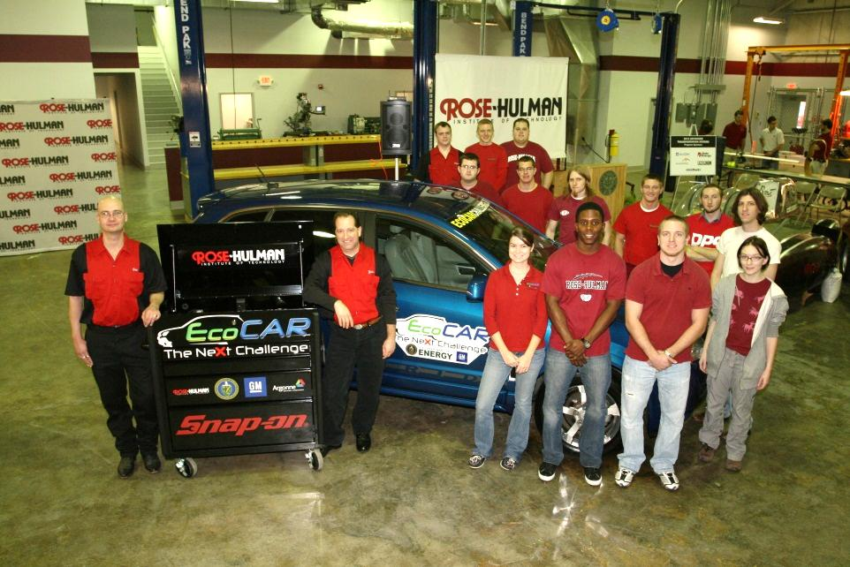
Continuity is Vital
Easy – RHIT PIKE team plants trees.
There needs to be an ongoing relationship with the clients:
To fix what they already have
To learn what else they need that RHIT students could do
To deliver those things well
Faculty advisors need to be in place who know these clients.
Funding needs to be available on an ongoing basis.
Hard – RHIT EcoCAR team builds a green car.

Slide 9
We should have a wide range of opportunities for students to get involved
Achieving continuity –
Our students would benefit from having more kinds of courses and activities involving non-profits.
We know what these would look like,
As projects in existing courses, and
As additional courses which would benefit our students, and
As volunteer activities done by focused student clubs.
One new kind of course → An ongoing program to work with a particular non-profit, which students could sign up for, one or more times, as a “special topics” course.
This is the key to the EPICS program, now at over 20 colleges and also in 30+ high schools
I ran the Purdue program during my sabbatical in 2009-10, as a means of learning how to bring this to Rose

Slide 10
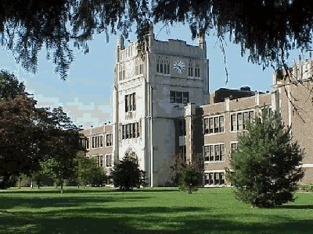
What are the Needed Components?
Achieving continuity –
Clients: There are many local non-profit clients who would be eager to participate
Schools
Charitable organizations
Other institutions like museums and hospitals
Most of these organizations, however, do not have:
The technical ability to support things we build for them
Real budgets to create or support them
Above – Woodrow Wilson Middle School in Terre Haute – year after year a client for RHIT Botball collaborations.

Slide 11
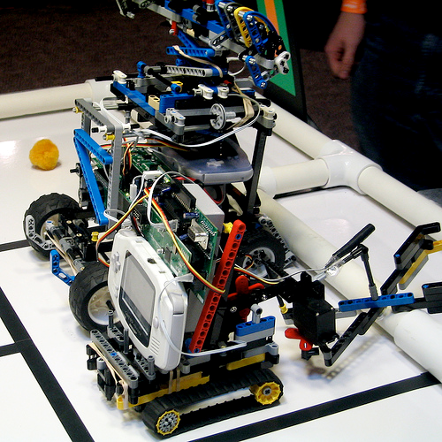
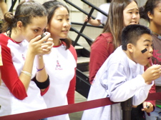
Another component – Our students
Achieving continuity –
RHIT students: Respond enthusiastically to such opportunities to work on non-profit projects.
For example, our CSSE dept is currently teaching a “Robotics and Teamwork” class, in which 17 RHIT students develop ways to help middle school and high school Botball teams – and provide the guidance to those teams.
This program required funding to provide each school with the needed Botball “kit.”
Above, right – one of the robots built by students aided by RHIT students in this class, and a typical middle-school reaction to watching their robot do its stuff.

Slide 12
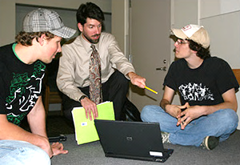
To go with this – Faculty and Staff
Achieving continuity –
Projects delivered to non-profits typically have to be more like real products, than if they were done for companies.
E.g., if a senior design team doesn’t get done, someone still has to deliver it.
If the project continues on from year to year with new students, faculty often need to help bridge the gaps.
Some organization needs to be in place to maintain relationships with the clients.
Above – Matt Boutell works with robotics students.

Slide 13
The final component – Funders
Achieving continuity –
Successful programs involving non-profits have ongoing backing from key funding organizations and individuals.
E.g., the “EPICS” program at Purdue, now ongoing for 15 years, has a long list of backers. See https://engineering.purdue.edu/EPICS/Sponsors.
Providing similar opportunities at RHIT would mean having a similar level of ongoing support.
Right – A student at Greater Lafayette Special Services who was provided with a learning aid by the EPICS “GLASS” team at Purdue.
From https://engineering.purdue.edu/EPICS/Projects/Teams/viewTeam?teamid=35.

Slide 14
Potential benefits to Funders
Building an association with RHIT students who also are interested in non-profit work.
Deep opportunities for good publicity.
E.g., name associated with a successful non-profit project, like Time-Warner with the Lunar Arm.
Support of STEM education in K-12 via RHIT programs which impact this.
E.g., our Robotics and Teamwork program.
Helping to attract a diverse student population to Rose.
Students who come to Rose to work with non-profits tend to be socially motivated.

Slide 15
Funding Opportunities - 1
Funding the development of a particular relationship between a non-profit client and RHIT, so that faculty can work on developing project ideas with them, creating the curriculum and building a student base working on those projects.
This could include direct involvement of people from the funding organization, if desired.
E.g., as a co-adviser to the team working with this non-profit client.
Typically these clients are local to RHIT, so that students can volunteer there, or otherwise stay in close touch.
A team of students, working with a nonprofit client

Slide 16
Funding Opportunities - 2
Funding the development of non-profit projects around a particular technology of interest.
E.g., funding robotics projects which would be donated to non-profit organizations, like at the Terre Haute Children’s Museum
E.g., funding usability projects, for student-developed products which would go to schools, utilizing RHIT’s usability lab.
Teams of students, working with nonprofit clients
Enabling tools and technologies

Slide 17
Funding Opportunities - 3
Program-level funding: An overall program to build new student activity with non-profits requires
Time from faculty and administrators,
Funds to support additional lab facilities, and
Special funding to provide program visibility, such as for student awards.
Teams of students, working with nonprofit clients
Enabling tools and technologies
Program supporting all the teams and clients

Slide 18
For now, we are looking for…
Your response to these ideas.
Thoughts on what aspects of this you would be most interested in.
People in your organization who might have a special interest in working with us.
Other ways we could create specific proposals that would be good for you and for Rose.
Teams of students, working with nonprofit clients
Enabling tools and technologies
Program supporting all the teams and clients

