Slide 1
Logbook Examples

Slide 2
We write things down to know what we did, what we are doing, and what we will do. All of this knowledge contributes to creating and realizing new designs.

Slide 3
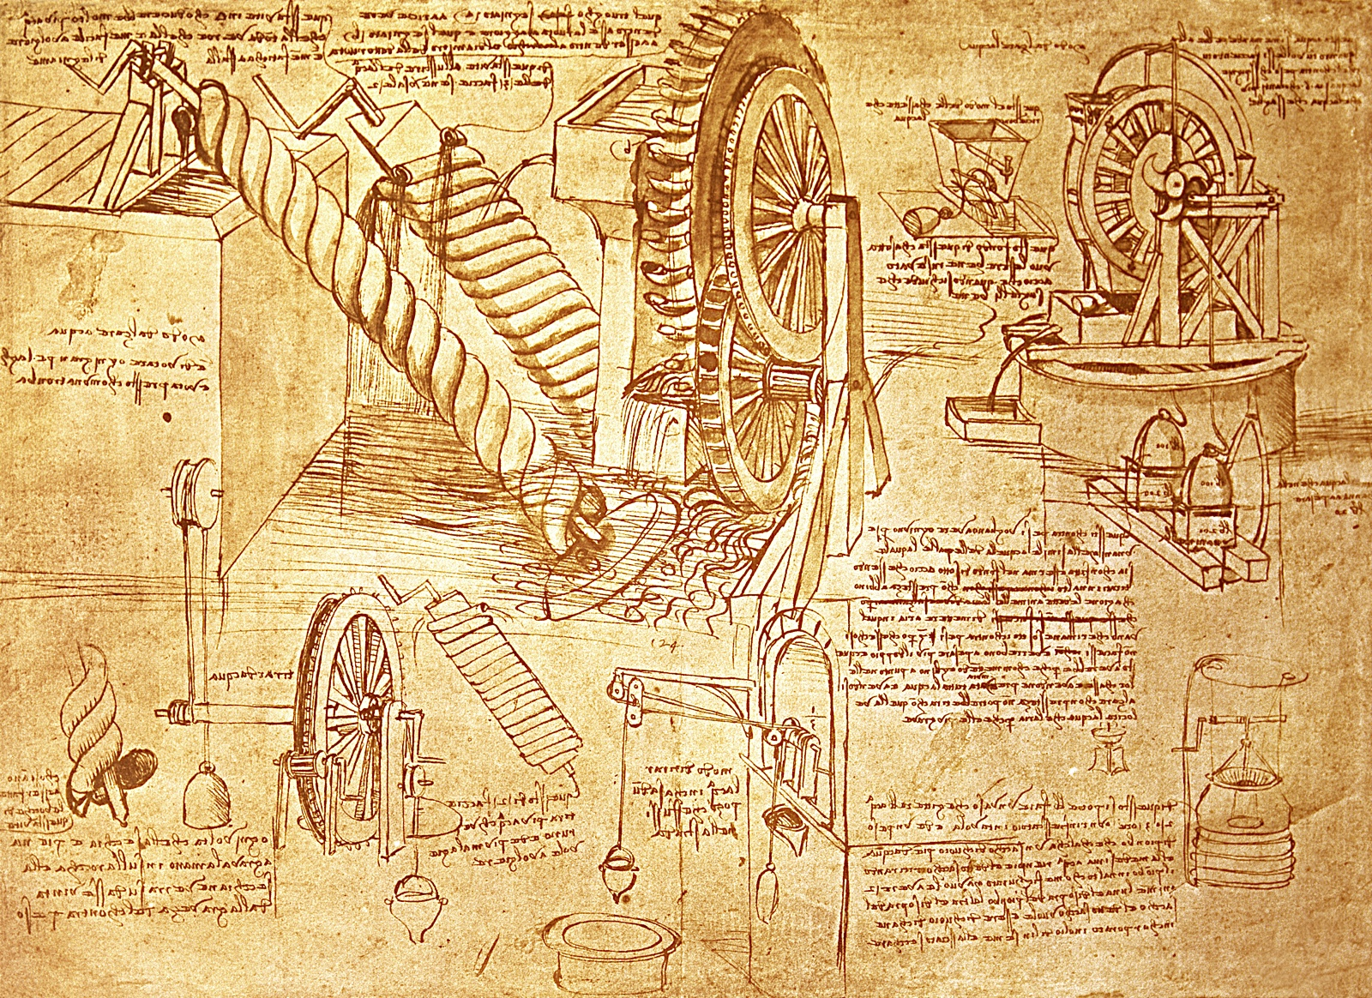
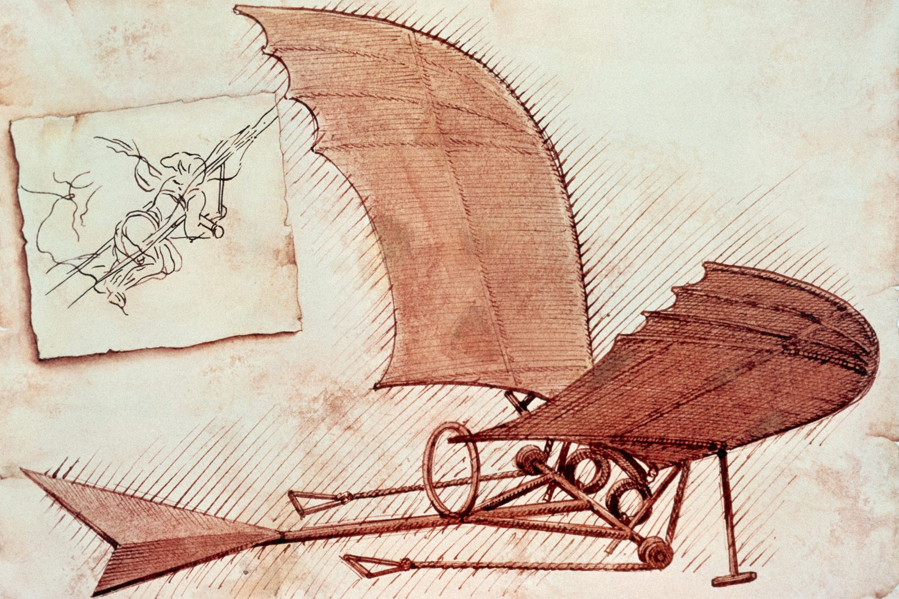
Leonardo da Vinci

Slide 4
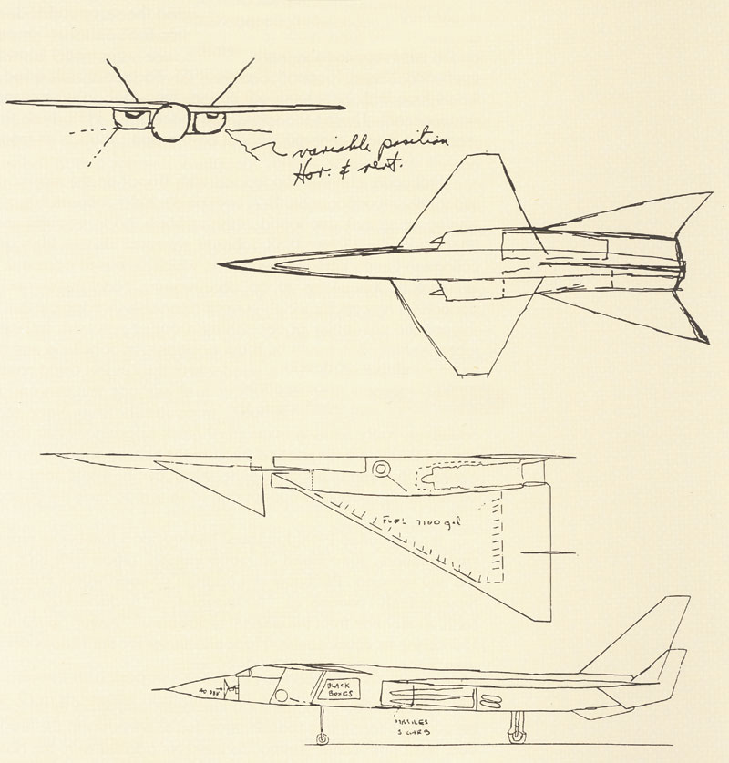
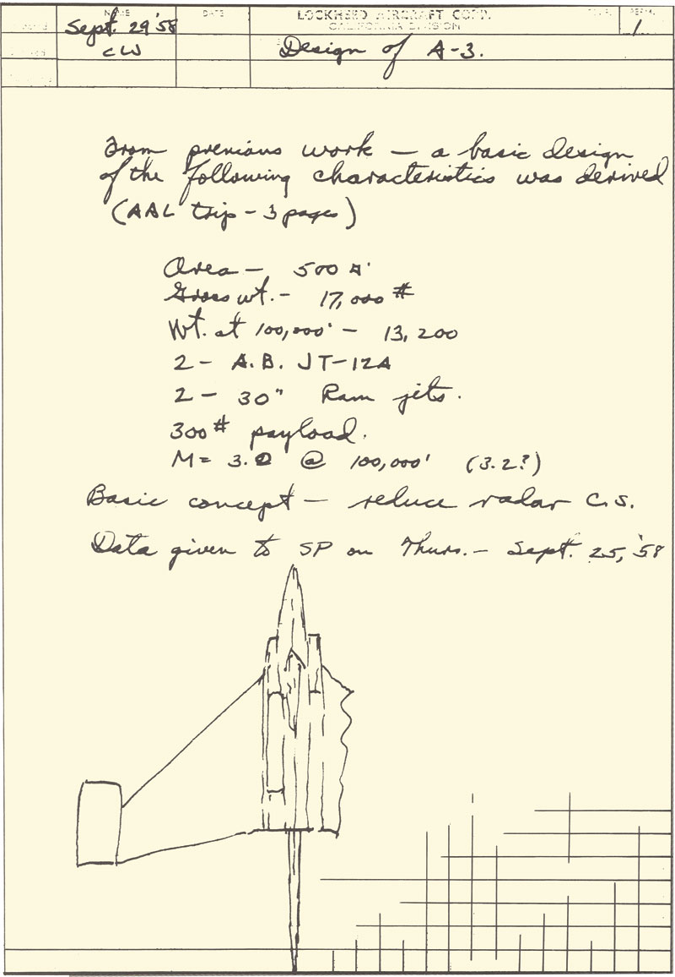
Kelly Johnson - Lockheed

Slide 5
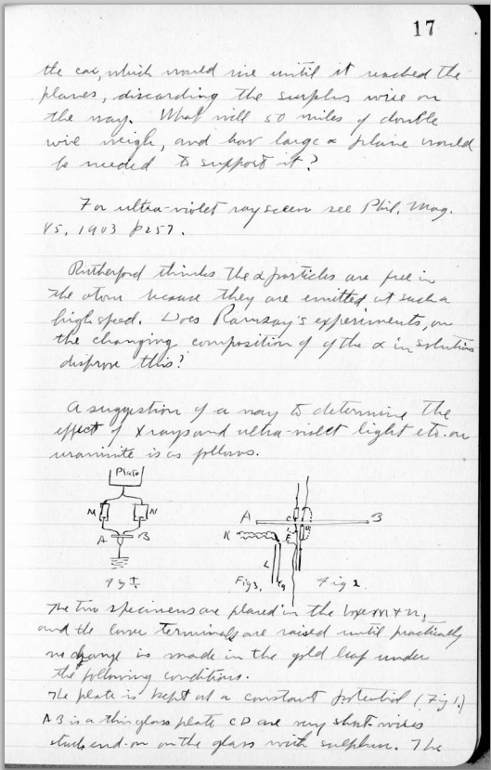
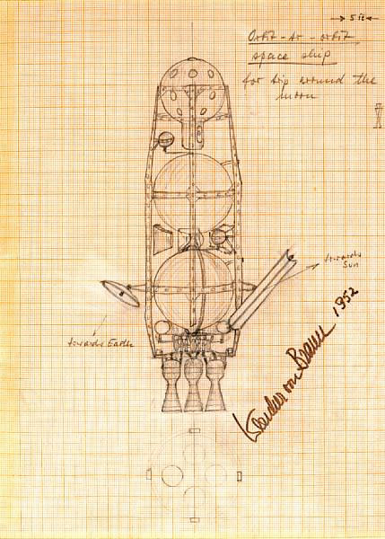
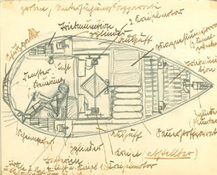
Robert Goddard
Wernher von Braun

Slide 6
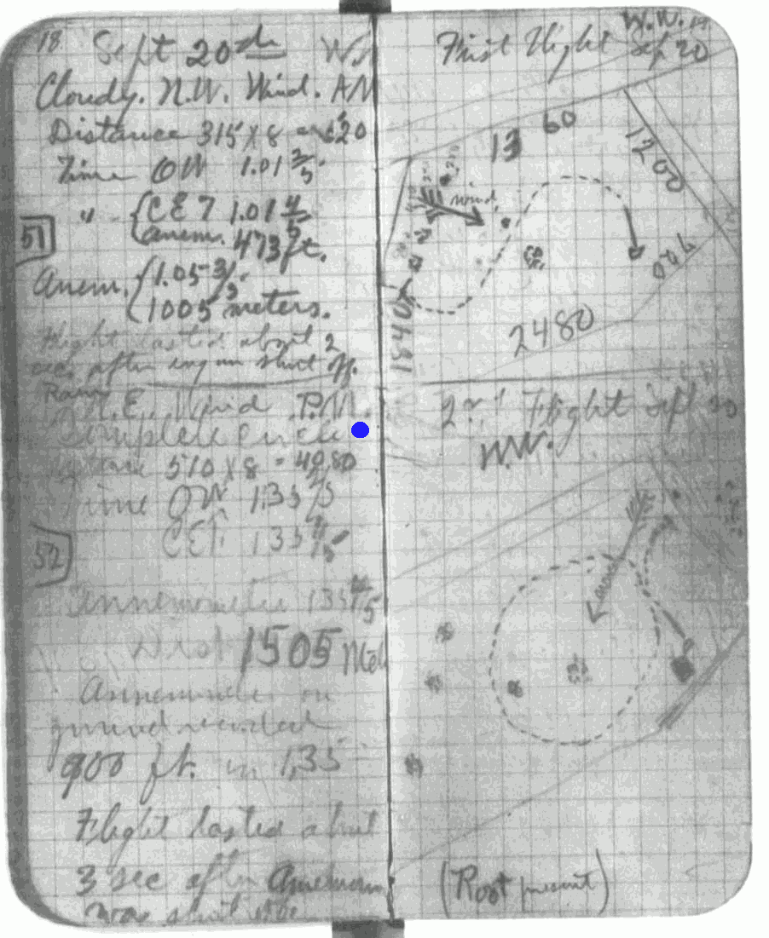
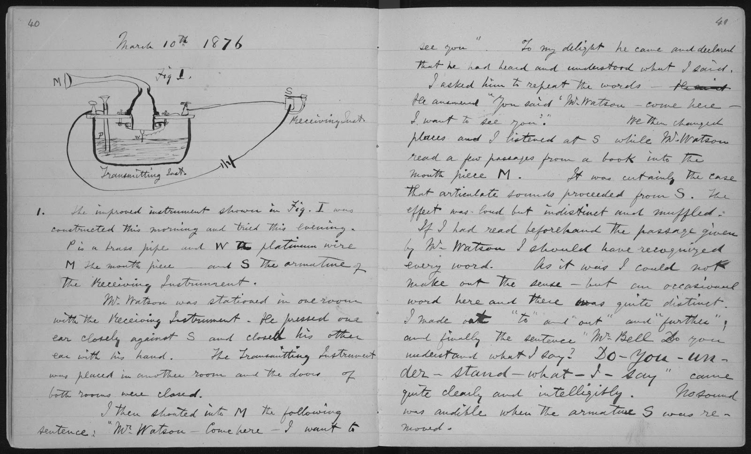
Wilbur Wright
Alexander Graham Bell

Slide 7
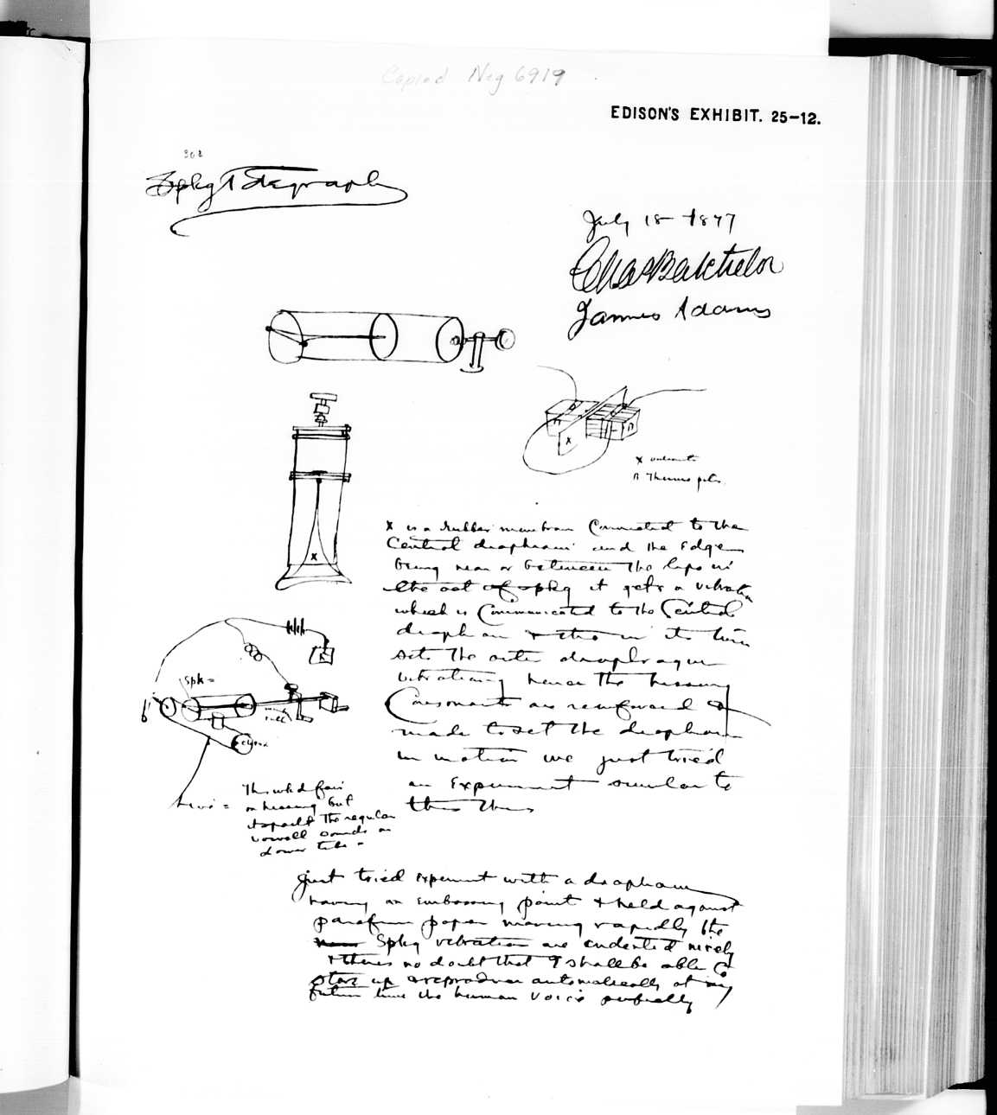
“Although Edison began his career as a professional inventor in 1869, he did not attempt to keep systematic records of his experiments until 1871. A pocket notebook from October 1870, in which he entered specifications and drawings for printing telegraph apparatus, contains the concluding note: ‘all new inventions I will here after keep a full record.’“- http://edison.rutgers.edu/papers.htm
Thomas Edison

Slide 8
Some Example Logbook Entries
Some examples of what you should do (better)…

Slide 9
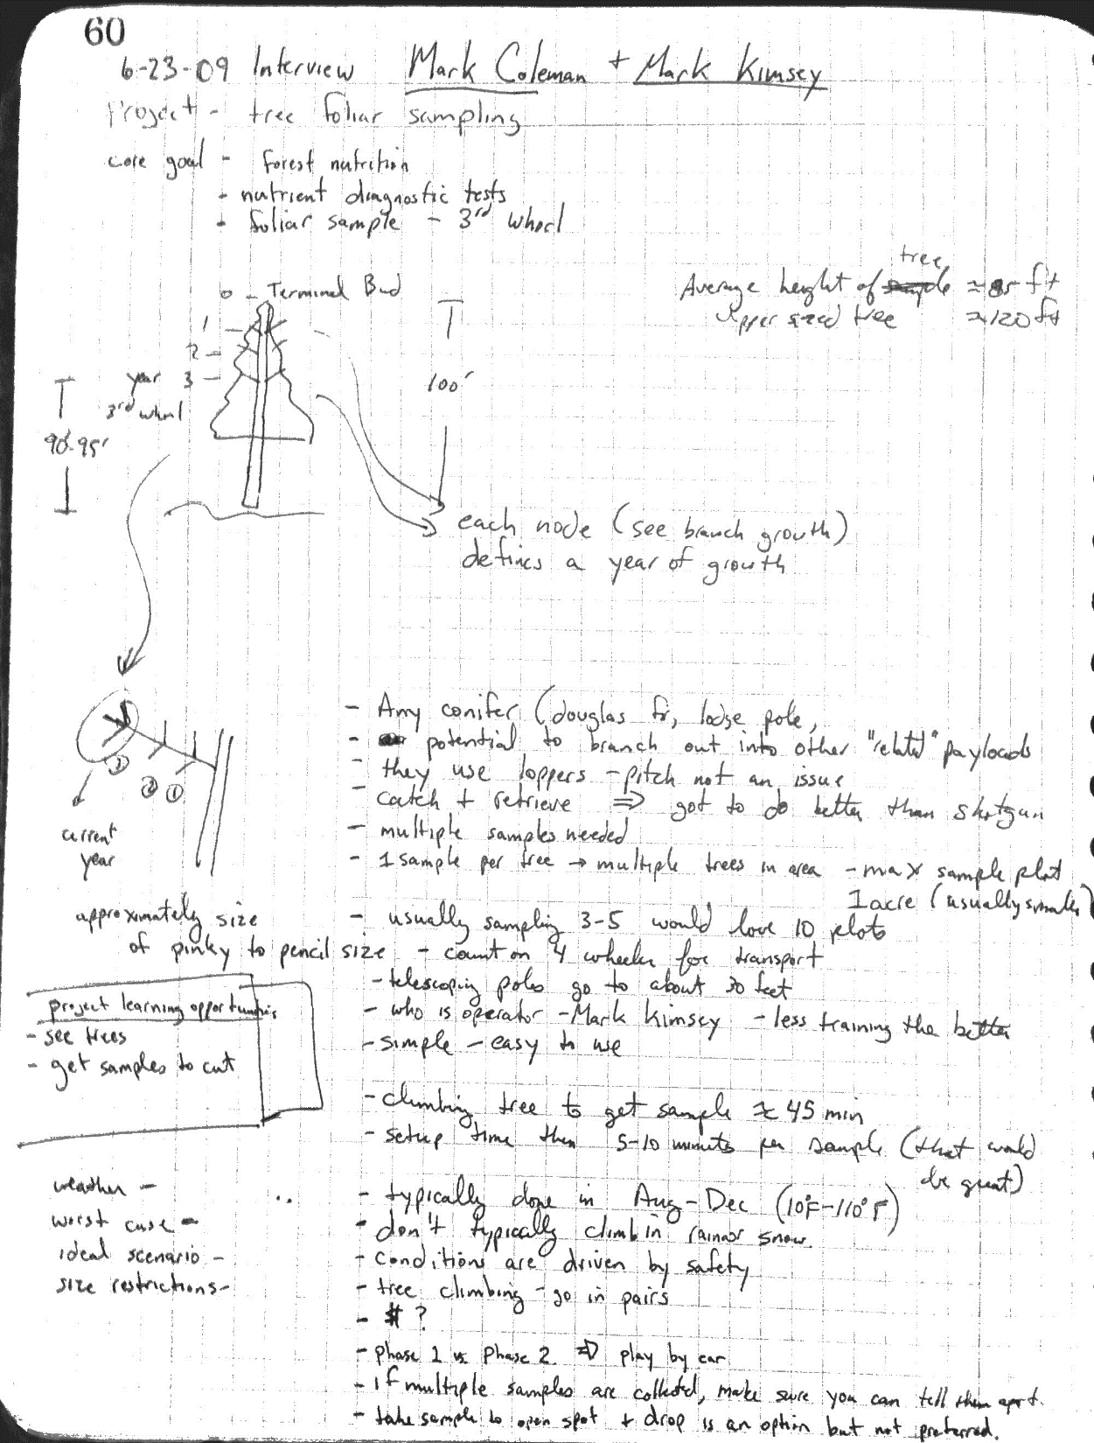
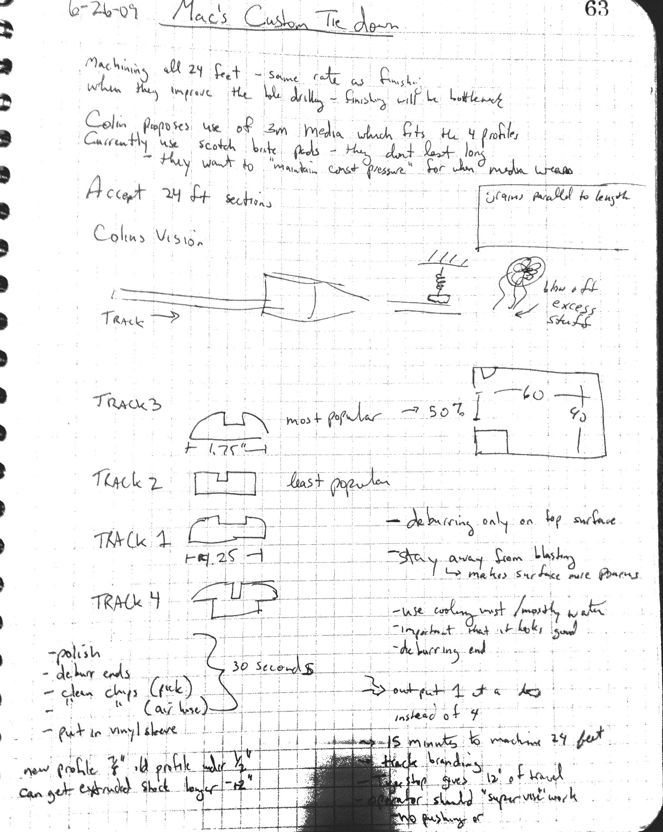
Title, date, goal statement, incorporating sketches,
appropriately detailed notes

Slide 10
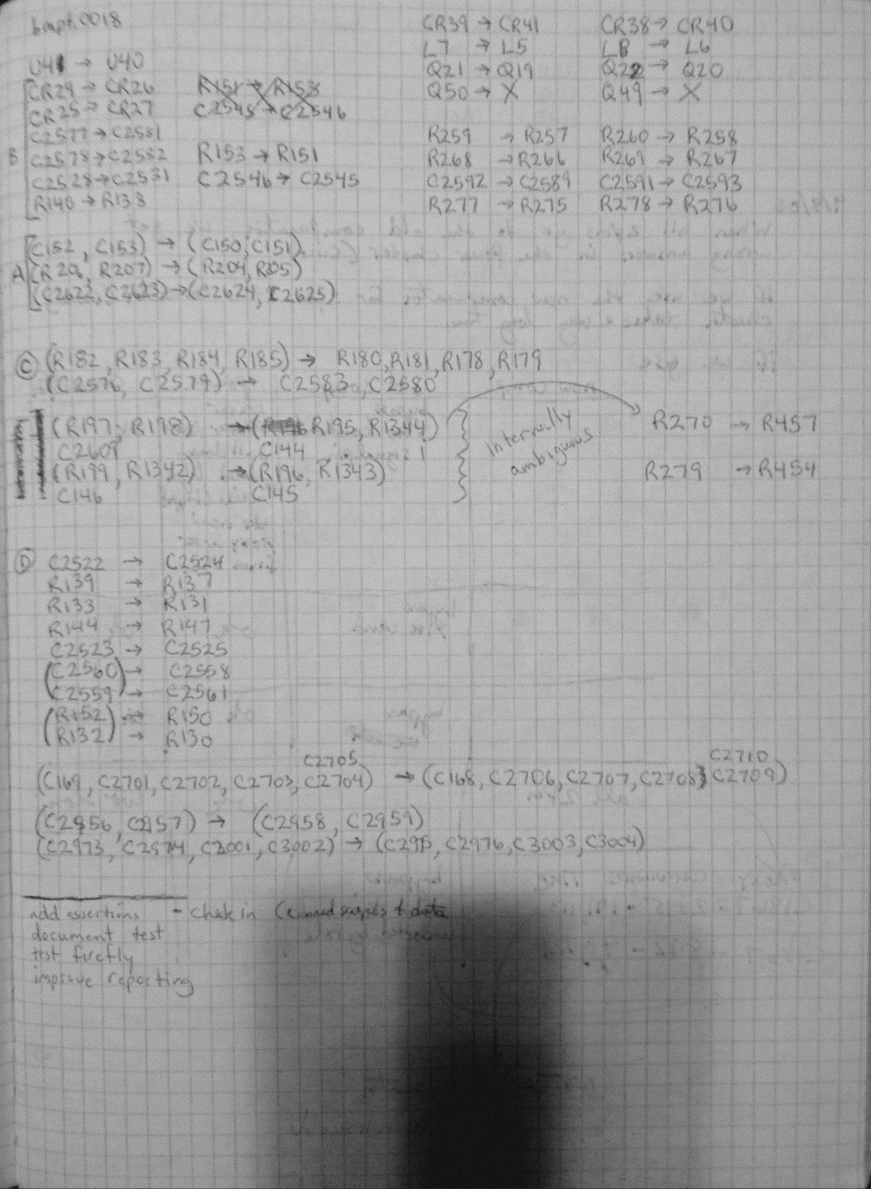
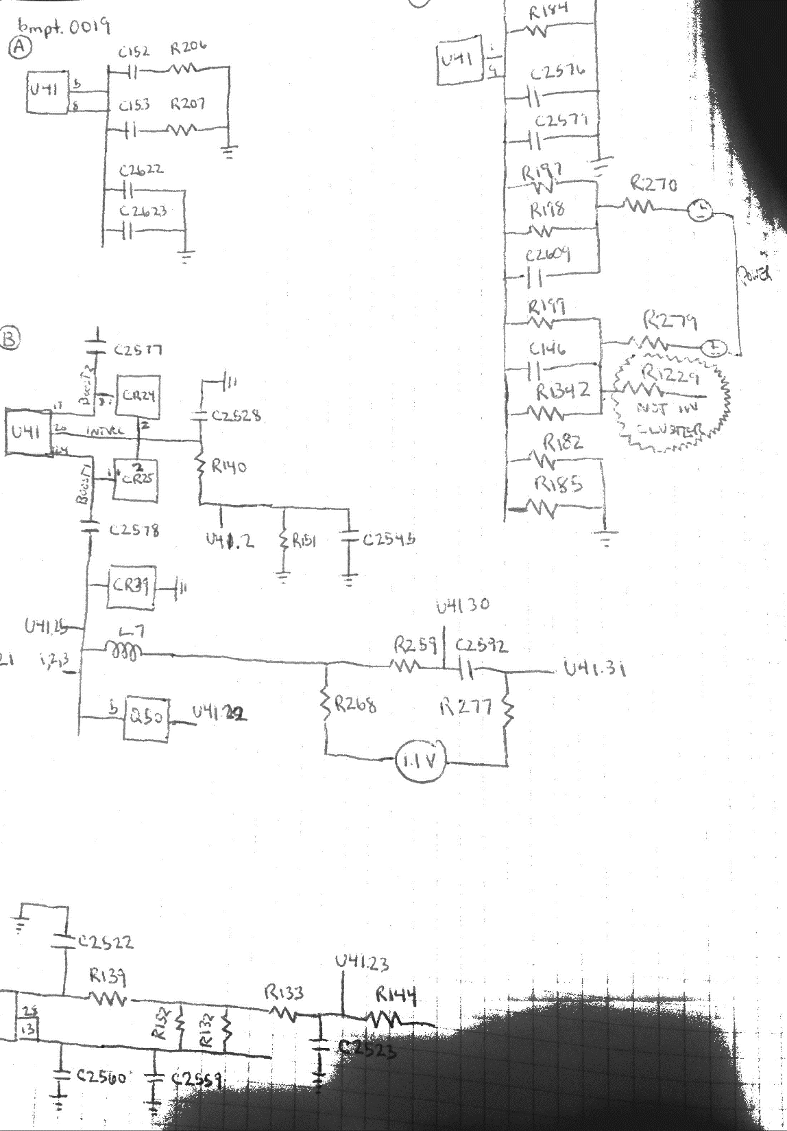
Diagrams, notes, and sketches used to debug a PCB design algorithm

Slide 11
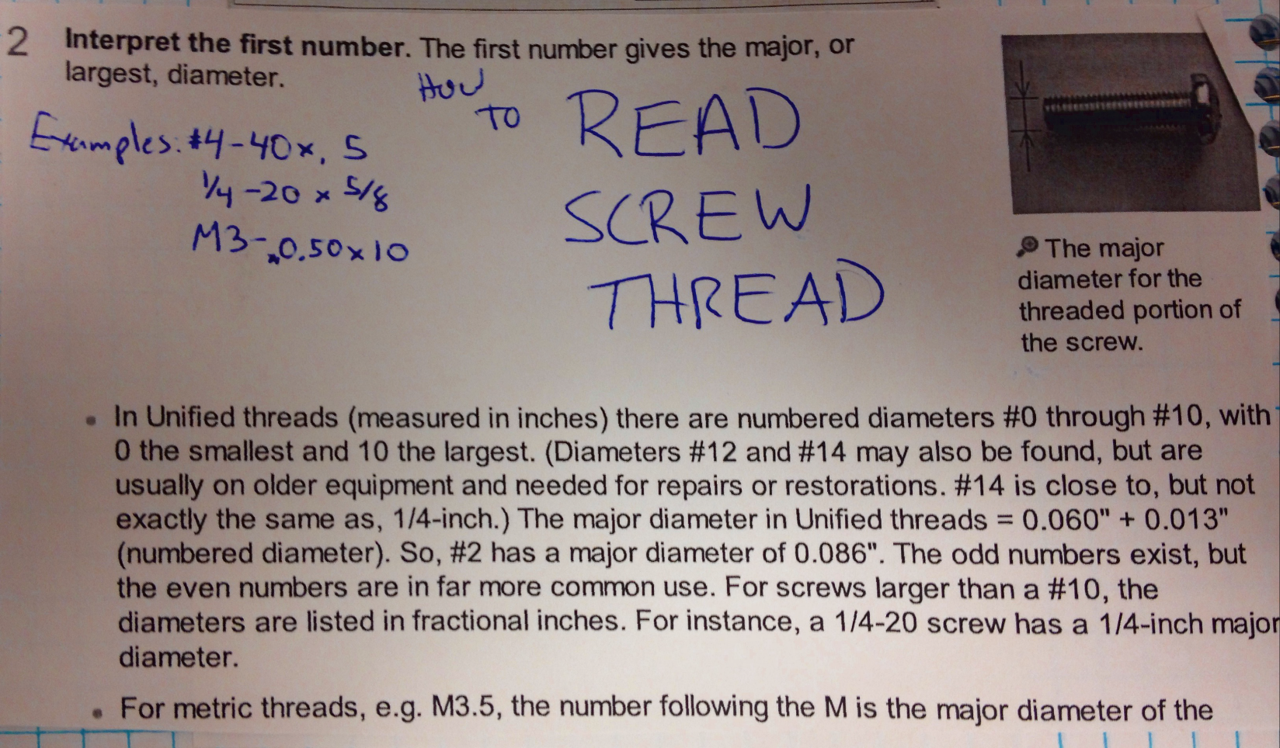
Printout is pasted into logbook with supplementary notes.

