Slide 1
Columbia Transcript
‘Consider all contingencies’

Slide 2
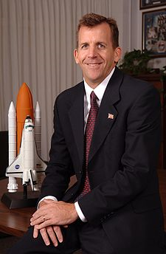
CAIN: GC, Flight. GC, Flight.
FOSTER: Flight, GC.
CAIN: Lock the doors.
FOSTER: Copy.
CAIN: FDO, do you have any tracking.
JONES: No, sir.
MOD (Mission Operations Representative Phil Engelauf): Flight, MOD. On the flight loop.
………………………….
CAIN: OK, all flight controllers on the flight loop, we need to kick off the FCOH (flight control operations handbook) contingency plan procedure. FCOH checklist, page two, point eight, dash five.
CAIN: FDO, Flight. FDO, Flight.
JONES: Go ahead.
CAIN: Do you have any information or reports from Space Command?
(pause)
UNKNOWN: OK.
CAIN: OK, and all flight controllers on page nine of the FCOH procedure. You need to make sure you step through the actions required in step 20. That's for your work station logs, display printouts, there's a whole list of data collection items that we need to make sure we log through.
CAIN: GC, flight.
FOSTER: Flight, GC.
CAIN: FDO, Flight. We need to take the equivalent of a command server, TSU checkpoint.
UNKNOWN: Yes, sir.
CAIN: We don't have the old DFC checkpoint, but we've got an equivalent capability that we need to do.
UNKNOWN: We'll get that done.
CAIN: GC, Flight.
FOSTER: Flight, GC.
CAIN: You understand how to do the end of file log tapes that we need in the checklist.
FOSTER: Yes, sir.
CAIN: OK.
CAIN: "And folks, listen up again on the flight loop, no, no phone calls off site, outside of this room, our discussions are on these loops on the recorded DVS (digital voice communications system) loops only. No data, no phone calls, no transmissions anywhere into or out."

Slide 3
So where should the SE process have detected this potential problem ?

Slide 4
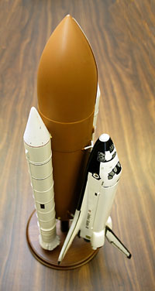
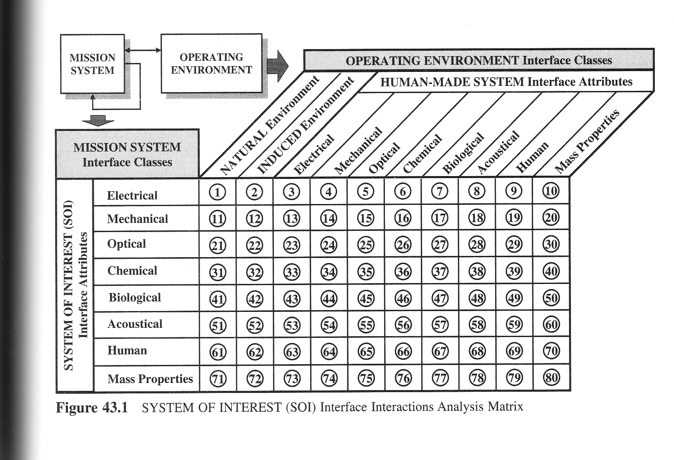
Wasson Interface Thoughts
Consider interactions between system and environment.
Often focus on a few, not all interactions
Environmental effects are natural, induced, and human-made.

