Slide 1
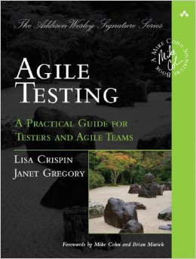

Testing – Part 2 Agile Testing
In which we talk about nothing, because having unit tests solves all problems forever. Really. It’s not a subtitle balance of competing pros and cons – just have unit tests and your code will have no bugs forever.
Notes:
Your reading was from Agile Testing: A Practical Guide for Testers and Agile Teams, by Lisa Crispin and Janet Gregory, 2009.

Slide 2
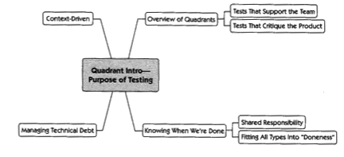
So you’ve got unit tests…
What are unit tests bad at testing?
Integration
Interactions
UI’s
Unanticipated bugs
-Ilities
They’re good at this!

Slide 3

Scrum: “Definition of Done”
An important detail…
When is it “done”?
Even given Scrum, is there a fixed definition?
Notes:
Image from https://strategyn.com/jobs-to-be-done/.

Slide 4
Scrum: “Definition of Done”*
An important detail
Is a story done when…
A developer checks it in (perhaps with unit tests)?
The customer looks at it and says it’s probably right?
It’s incorporated into a particular candidate build?
Testing signs off on it?
*This is something the team decides, “What it means to complete a particular story.”
Like, coded – committed – tested – tested by customer?

Slide 5
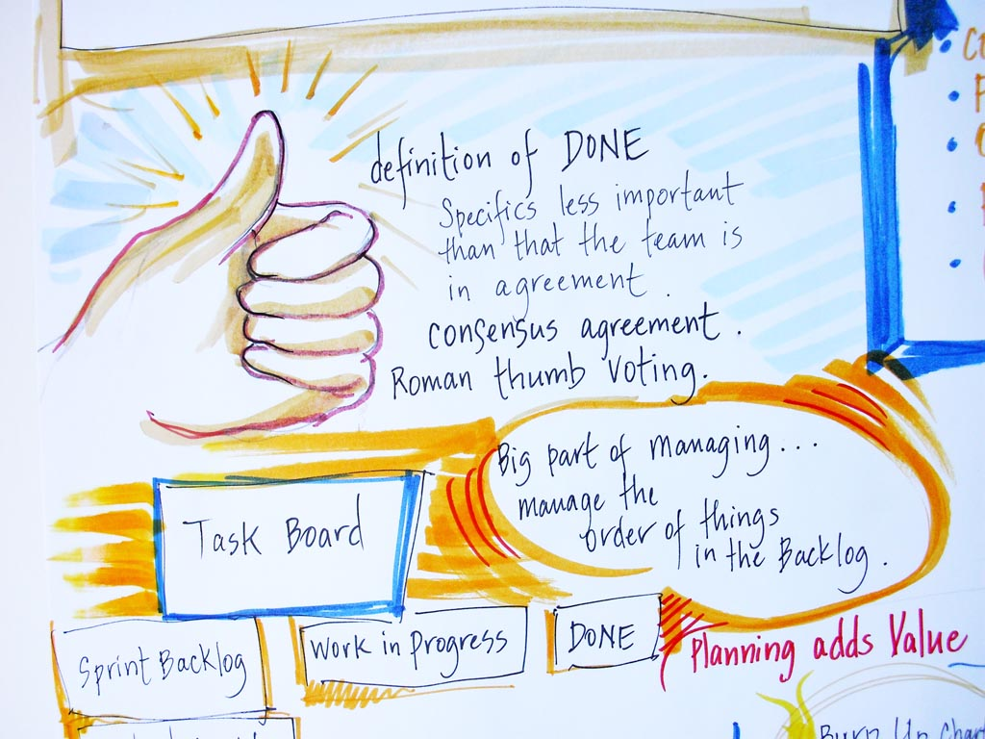
Scrum: “Definition of Done”*
An important detail
Is a story done when…
A developer checks it in (perhaps with unit tests)?
The customer looks at it and says it’s probably right?
It’s incorporated into a particular candidate build?
Testing signs off on it?
*This is something the team decides, “What it means to complete a particular story.”
Like, coded – committed – tested – tested by customer?
Notes:
Image from http://coach-agile.com/2014/08/definition-of-done/

Slide 6
Crispin & Gregory’s Argument
More Tested Software from Developers
Greater focus on more interesting test issues. In particular more Automation in Q2 and more Q3 and maybe Q4

Slide 7
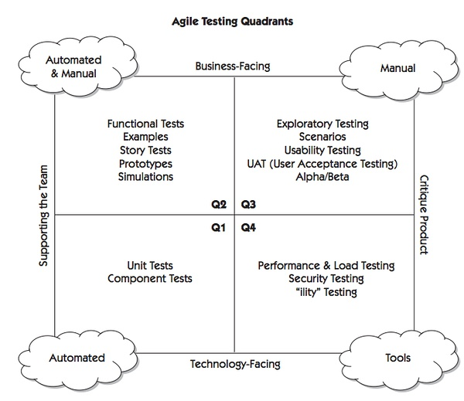
Quadrants
?
?
Notes:
What is “supporting the team”? What is completing the project?
Image fromhttp://book.douban.com/subject/3307177/

Slide 8
Quad 2
Functional Tests
Individual things
Like, “When I hit print, does it print?”
Story Tests
Is a user story complete?

Slide 9
Quad 3
Exploratory tests (difficult to understand!)
A hunting expedition
Unscripted
Uncover problems we don’t already know about
Scenarios (difficult to understand!)
A realistic simulation of the whole product working
Usability Testing

Slide 10
Quad 4
Developers and professional testers – who should do Quad 4?
On your own project, do you have “testers” who could do, say, performance tests?

Slide 11
Use the Quadrants to test if you’re done?
Notes:
Is this sufficient?

Slide 12
Crispin and Gregory say all of these are related to keeping technical debt low. How?

Slide 13
How would you TEST this? (Revisited) What tools would you build?
Imagine you’re working with a company that’s building a deployment process. You’ve got several “services” each of which maintains content. The deployment consists of 3 steps:
Prepare
Deploy
Rollback (maybe)
Managed by a “Deployment Manager” (DM) service. Both the services and the DM are under development. The final deployment can’t be tested unless every service has correctly deployed.

