Slide 1
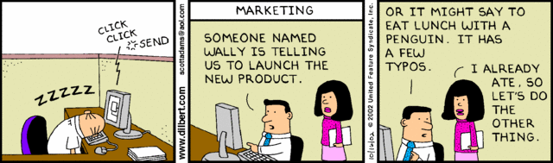

Agile Release Management
Notes:
Cartoon from http://search.dilbert.com/comic/Product%20Launch

Slide 2
Recall - Highsmith’s remedies for schedule risk
Team involvement in planning and estimating
Early feedback on delivery velocity
Constant pressure to balance the number and depth of features with capacity constraints
Close interaction between engineering and customer teams
Early error detection/correction to keep a clean working product

Slide 3
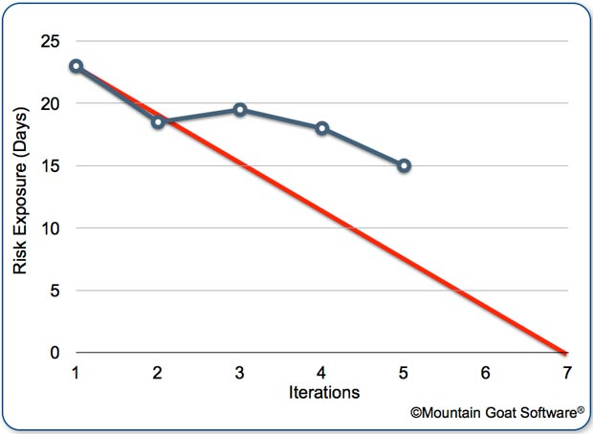
Recall the focus on burndown –
A good idea for agile?
Risk burndown chart
Notes:
From http://www.mountaingoatsoftware.com/blog/managing-risk-on-agile-projects-with-the-risk-burndown-chart

Slide 4
You’re doing iterations, right?
But what are you delivering, that’s really being tested out in production?
Are real users using a new version, every two or three weeks? No!
You may be delivering things, piecemeal, just to the one customer you see regularly…
Teams get caught-up in iteration-at-a-time development plus backlog building.
  They aren’t planning out an entire release or project.
Notes:
Highsmith, p 157

Slide 5

This is why Highsmith recommends
A separate manager who’s main responsibility is getting releases out.
Versus just the next Scrum iteration.
“And the press has already been invited…”
Notes:
Image of Google project release, from http://www.idigitaltimes.com/google-project-ara-release-date-head-ara-claims-were-1-year-away-launch-engadget-394078

Slide 6
Same problem as lack of design
Only in reverse.
Need to:
Time
And you need this vision!
Start with a holistic idea of the product and its design
End up delivering a whole product that makes sense
You need this vision!
In between, do all those iterations to make it happen
Initial Problem Statement and Design in “Inception”
Real Release of a Viable Product

Slide 7
Purpose of an agile release plan
Foster better understanding of project viability and feasibility
Outline assessment and mitigation of risk
Enhance a team’s ability to prioritize capabilities and stories
Give the team a “feel” for the entire project

Slide 8

Highsmith is not in favor of
“wish based planning”
Need to balance product goals with your capacity to deliver the product.
Don’t plan on a pace equal to the wildest success story.
  “An agile team delivered this big
  product in 1/10th of the usual time!”
  More on Agile pushback, next week.
It’s complex to move fast(er):
  Staff motivation
  Escalating requirements
  Risk and uncertainty
Notes:
Image of Jim Highsmith from http://www.technologytransfer.eu/speaker/49/Jim_Highsmith.html
Discussion from p 159

Slide 9
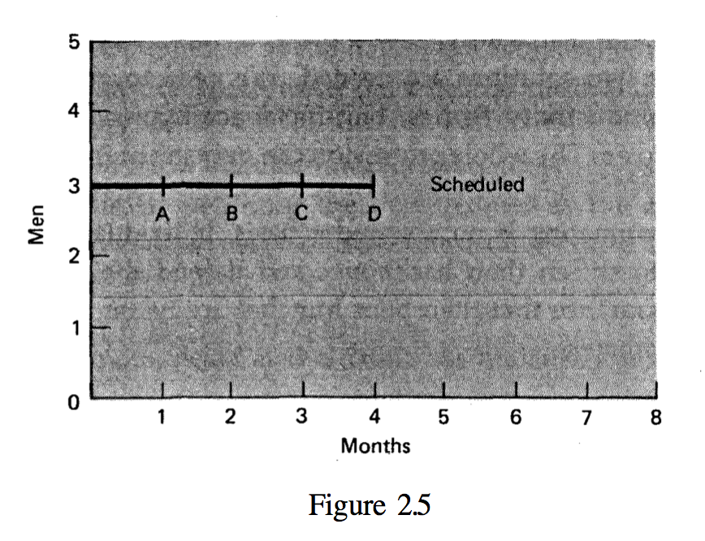
Remember Fred Brooks
(from the 1960’s)!
Being realistic:
What we wished for, in 4 months…
Notes:
From The Mythical Man Month, 1975, pp 22-23.

Slide 10
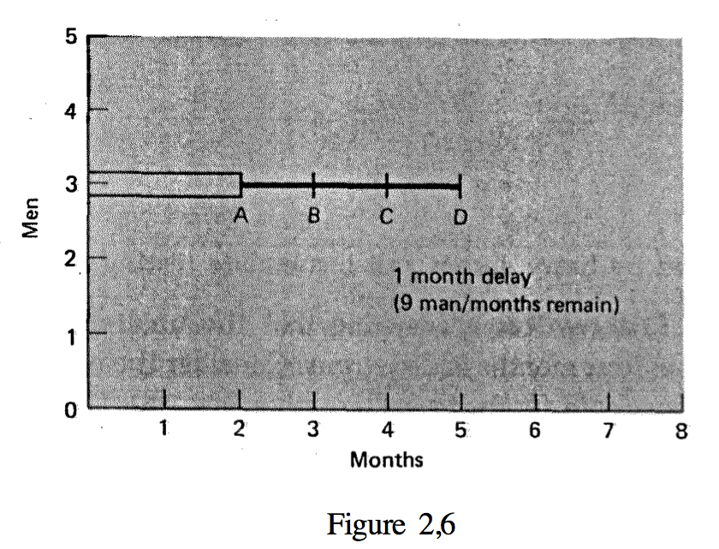
But…
What happened in Brooks’s first milestone:
What do you do?

Slide 11
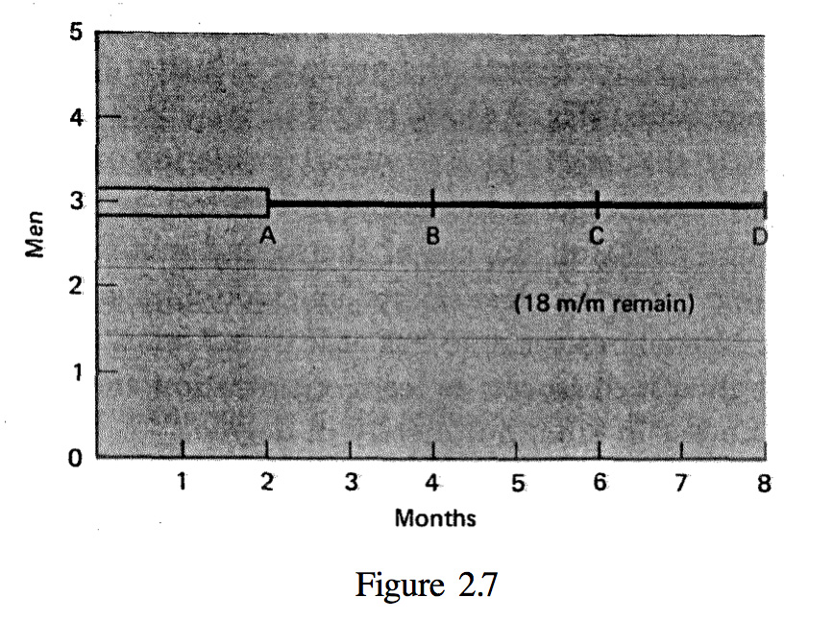
Brooks recommends what we now do in agile projects, if possible:
Brooks says, figure that reality trumps wishing…
It’s an 8-month project, not a 4-month project.
Notes:
Brooks was surprisingly “agile”!

Slide 12
For multi-level projects
Like your project?
Story-level planning is too fine-grained.
The whole thing has to fit together.
Product Roadmap
Release (this year)
And this is just the time complexity of planning! Not considering size…
Wave (this term)
You are thinking down here!
Next Iteration
Notes:
See the reading on this, APM pp 294-304.

Slide 13
Product Backlog
Needs to consider the backwards view from eventual goal, as well as immediate direction.
  Need to know the “minimal releasable product”
Product Roadmap
Release (this year)
Wave (this term)
Next Iteration
What’s left this year?

Slide 14
Estimating realistically
Cost and value should be equally emphasized.
If the team doesn’t have time to estimate value points, it doesn’t have time to estimate costs.
Put “value points” on story cards…

Slide 15
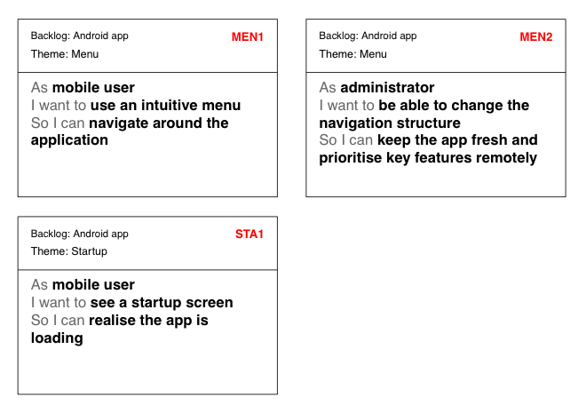
Example
V = 13
C = 5
V = 2
C = 3
V = 3
C = 8
Notes:
From https://easybacklog.com

Slide 16

Key question to ask yourselves
“What is keeping us from shipping a product right now?”
Notes:
Image from http://www.angelamaiers.com/2011/01/pondering-makes-for-a-perfect-new-year.html

Slide 17
Repeat - For project managers
Risk management is a tricky proposition.
  Must be realistic about dangers
  Denial leads to surprise
  Which leads to last-minute scrambling and firefighting.
But,
  Harping on risks can demoralize developers!
Notes:
P 185

Slide 18
Highsmith’s position
In summary:
Agile teams can place to much emphasis on adaptation or evolution, and too little on anticipation (in planning, etc.)
Failure to take advantage of knowable information leads to sloppy planning, reactive thinking, excessive rework, and delay.
Agility is the art of balancing.
Notes:
P 186

Slide 19
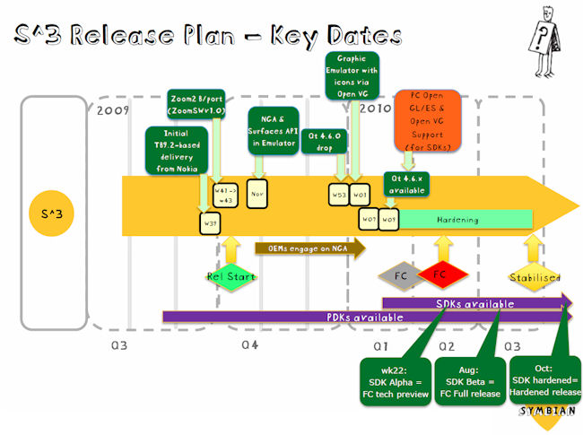
A composite release plan
Notes:
Highsmith’s version is on p 192
Image is from http://www.allaboutsymbian.com/news/item/11684_Symbian3_is_functionally_compl.php

Slide 20
How is release management done?
Ensure that release governance process is understood.
Communicate to external stakeholders.
Have appropriate deployment/distribution plan.
Coordinate with marketing and product management.
Validate that the product meets criteria.
  Including what actual features go in this release!
Do release process improvement.
Authorize the release.
Liaison to portfolio management.
Notes:
From the second reading, http://www.scaledagileframework.com/release-management/

