Slide 1
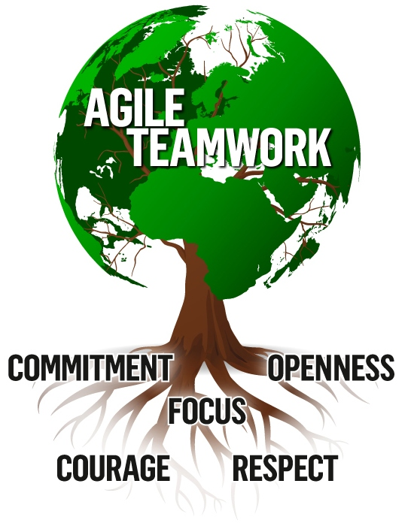

Teamwork – Agile style
From APM, Ch 3
Notes:
Image showing typical “agile values” from http://www.tcelectronic.com/corporate/core-values/.

Slide 2
This week
This week’s new topic – teamwork, with more on leadership!
  Agile – this slide set, plus the issue of “structureless” (from the optional reading)
  Old school and “in general” – the second slide set
The usual questions, this time on how design and testing are a part of project management in your world.
Extra activity – “My Colorful Portrait” – on Moodle
  What was your color?
  What do you think?
Next week’s (Week 9) topics – “Maintenance & metrics”
  Software maintenance versus development
  Critical chain
  Software metrics and risk identification
  EVT in Agile, cost basis of estimating vs points
Week 10 topics – “Ethics and trends”
  Advanced topics & new trends
  Planning for continuous integration and automation
  Ethical decision making
Third exam will be put out on the web site during Week 10, due Monday, May 25 (hard deadline).

Slide 3
In this slide set – Agile teamwork
It’s all Theory Y!
Group activity – what’s tough about agile teamwork?
The customer relationship
Issues about “self-organizing”
  And “structurelessness”
Additional topics you asked for – Many!
  Start on Slide 24. →
  Group activity – How was your current team formed?

Slide 4
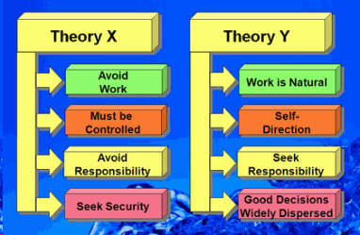
Agile - It’s all “Theory Y” management
Let the team make lots of decisions on their own.
Don’t be a filter on what they are allowed to do.
They are eager to do the right thing, and get the project done.
They are closer
to having
knowledge of
what that right
thing is.
Notes:
Image from http://www.studylecturenotes.com/management/mcgregor-theory-x-and-theory-y-for-staff-and-employees-motivation.

Slide 5
Why Theory Y
Thomas McGregor argued that it’s crazy to assume people only work for money and security, and have to be motivated by management, above and beyond that.
This assumption is “Theory X” and it becomes self-fulfilling.
Once these needs are satisfied, people become un-motivated.
“Theory Y,” in contrast, assumes people will work for needs that are never completely satisfied, like:
  The need to be self-directed.
  The need to feel responsibility, set one’s own objectives and work toward them.
  The need to be creative.
  The need to belong, for meaningful social involvement integral to work.
To harness these things, an organization needs to be decentralized, with “job enlargement” and participative management.
Sound like “Agile”?
Notes:
http://www.netmba.com/mgmt/ob/motivation/mcgregor/

Slide 6

But, historically, Agile cheats
Agile teams tend to recruit for people who are “self-starters” and good team players.
In his Ch 3, Highsmith emphasizes
the need to get the right people
on the team:
  For self-discipline.
  For accountability.
  To encourage collaboration.
Some of this may be a problem of transitioning to agile:
  People’s expectations were different before.
  And they learned to interact to fit the old ways.
Notes:
Image of cherry picking from http://wiki.ironchariots.org/index.php?title=Cherry_picking

Slide 7
Group activity – What’s most difficult about agile teamwork?
If you haven’t done it, what do you see as being the biggest, trickiest change?
If you have, what’s your experience?

Slide 8

An expected hurdle in every project
Customer collaboration –
  They are not us.
    Not programmers.
    Live in a different world of work.
    Work for a different company.
  They have different interests.
    Their values, relative to us, are also financial.
      Like getting the product as soon as possible, at the lowest cost. And,
      Interpreting project risks as issues with our organization.
“We’re not sure we can do it that way…”
Notes:
Image from http://www.wikihow.com/Negotiate.

Slide 9
Customer responsibilities
Create and manage the feature/story backlog.
Set priorities in release and iteration planning.
Identify and define features/stories.
Define acceptance criteria.
Review and accept completed features and stories.
Interact on a continuous basis with the development team.
Accept accountability for results and adapting constraints.
Notes:
Highsmith, p 59

Slide 10
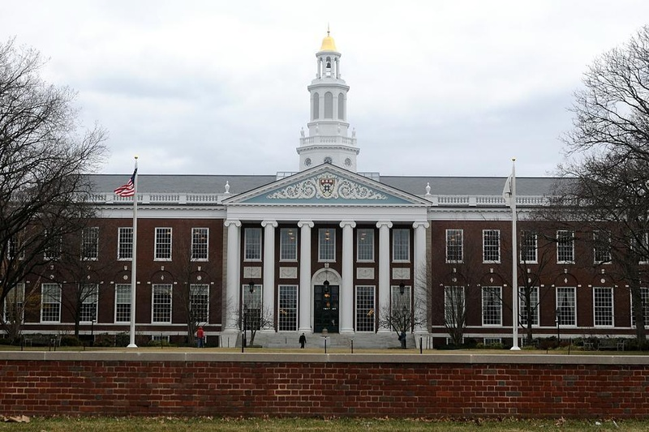
Self-organizing issues?
It’s hard to sell “situational leadership” to people trained at HBS.
  They believe good leaders
  make a difference.
  Any delegation comes from the top
  down, judiciously.
  There’s a limit, in complex situations.
We technical people, on the other
hand, remember the impacts of
poor leadership, and see “agile” as
a way to get out from under heavy-handed traditions.
  Everything else in our agile projects is “situational,” why not the leadership?
  Every other vestige of process is not to be trusted – so why this one?
City hall – alias Harvard Business School.
Notes:
Highsmith, pp 60-1.

Slide 11
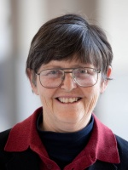
What does Jo Freeman say is the problem with “structureless” organizations
From the Optional Reading…
They are not really structureless
Elites form based on social relationships
between the group – then they wield
disproportionate power
#2 is bad news
How does structure – even a non-democratic structure like a hierarchy – help this problem?
→ The issue in feminism is that hierarchical organizations are inherently “paternalistic.” So, what’s the alternative, for a less male-dominated culture?
Notes:
Article you read, which is from 1970.
http://www.bopsecrets.org/CF/structurelessness.htm
Jo Freeman picture from http://www.wilsoncenter.org/staff/jo-freeman

Slide 12

What Is Not Stated?
Details of how things get done.
Ways you learn to be productive / social.
Conflict resolution
How you “move up”
Mentoring?
Who needs to
know what?
Worst case scenario of structurelessness?
Notes:
Image of “the Blob,” from the original movie, found at http://www.comicvine.com/forums/battles-7/the-blob-vs-thor-1664915/

Slide 13

“A Lot Like High School”
“She doesn’t even like to play Super Smash Bros.”
Notes:
From http://www.foolquest.com/cliquebusters.htm

Slide 14
The Tyranny of Structurelessness
If you read this optional article (see link on Moodle), what are your thoughts?
Do informal elites become more influential?
How would you elect a representative to speak up for your team’s interests?
Do you agree that in Agile there is lower skill specialization?
Do you agree with the author about how to make a low-structure group effective? →
Notes:
See http://www.bopsecrets.org/CF/structurelessness.htm

Slide 15
Making structureless work in Agile!
The author’s (Jo Freeman) tips:
Delegation of specific authority to specific individuals for specific tasks by democratic procedures.
Requiring all those to whom authority has been delegated to be responsible to those who selected them.
Distribution of authority among as many people as is reasonably possible.
Rotation of tasks among individuals. Responsibilities which are held too long by one person, formally or informally, come to be seen as that person’s “property” and are not easily relinquished or controlled by the group. Conversely, if tasks are rotated too frequently the individual does not have time to learn her job well and acquire the sense of satisfaction of doing a good job.
Allocation of tasks along rational criteria.
Diffusion of information to everyone as frequently as possible. Information is power.
Equal access to resources needed by the group.

Slide 16
What is unique about these environments?
Planning?
Decision making?
Who’s responsible?
How to get something done?
  Say, integration testing?
Advice: Always be aware of the risks of structureless environments.
Giving folks autonomy has the potential to reap huge rewards.
Nobody has a perfect way to do it at scale.

Slide 17
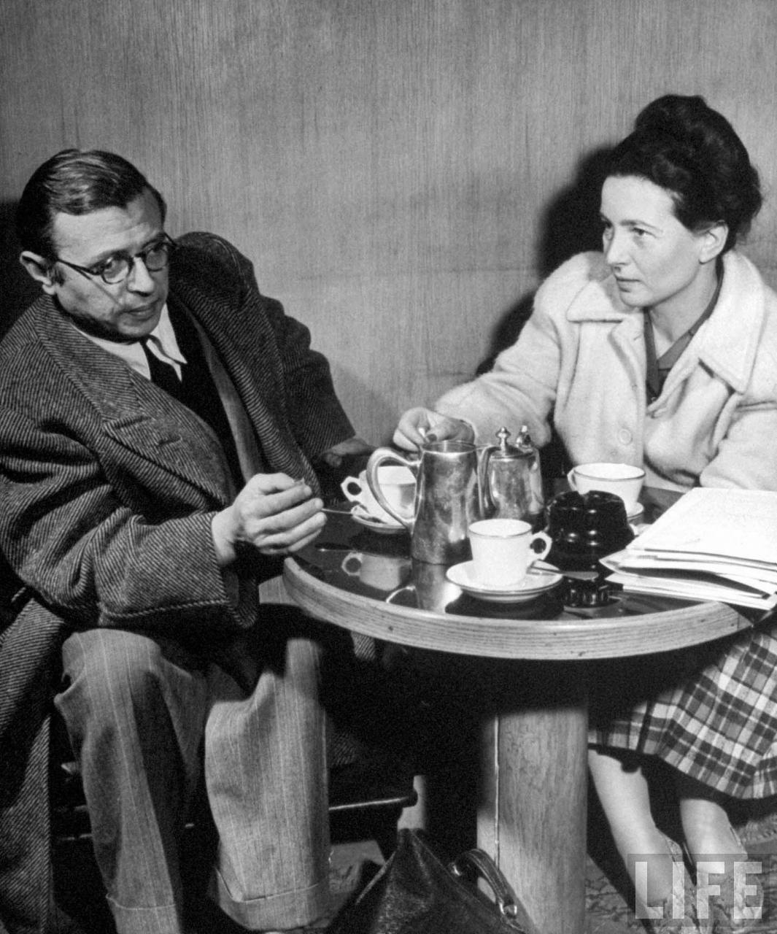
Another couple of philosophers weigh-in on social structure
Why do most people want to follow a hierarchical leadership, in their work, without asking a lot of questions?
Answer: We want to believe in what the leaders say.
Sartre and de Beauvoir postulated that we use “bad faith” to convince ourselves this is all working, even when we know it’s not.
  We choose, in anguish, to go along.
  Same as believing what politicians say, if we think they are on “our side.”
Jean-Paul Sartre and Simone de Beauvoir discuss life at a Paris coffee shop – a place that isn’t far off from Valve’s cultural model.
Notes:
See http://en.wikipedia.org/wiki/Bad_faith_(existentialism)
Image of the philosophers from http://theredlist.com/wiki-2-24-224-268-view-culture-art-fashion-profile-simone-de-beauvoir-jean-paul-sartre.html

Slide 18
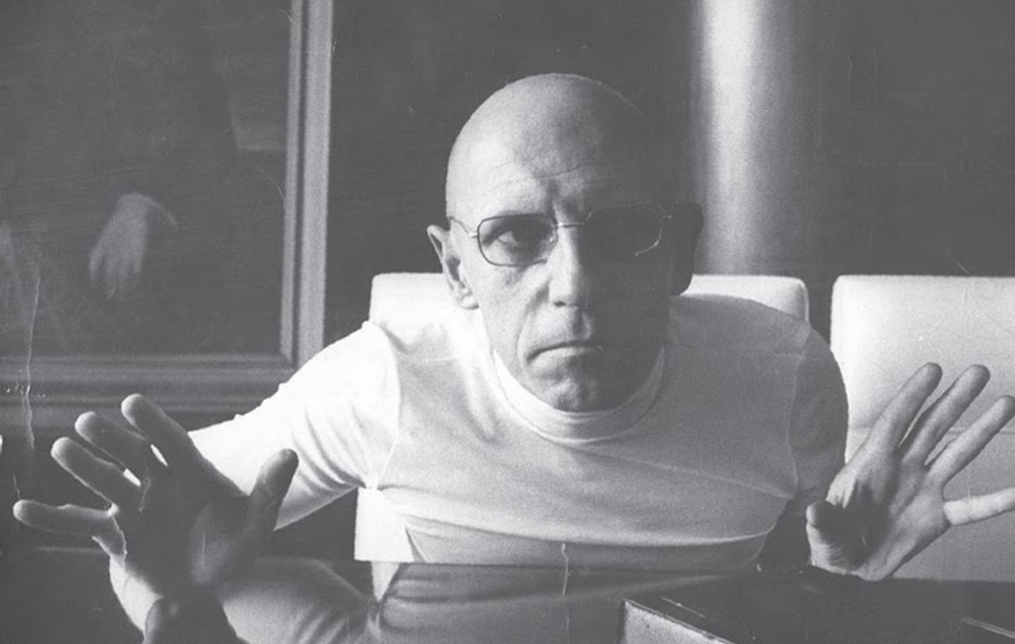
One more philosopher –
Michel Foucault
Agrees – “It’s all about power,”
regardless of structure.
Power is diffuse rather than
concentrated,
Embodied and enacted rather
than possessed,
Discursive rather than purely coercive, and
Constitutes agents rather than being deployed by them.
Power defines truth, and who is charged with saying what’s true.
It’s both negative and positive in its effects.
Foucault believed most expressions of power are only semi-conscious – It would ruin things for us if we realized we were slinging our weight around. Members of elites often usually deny that they keep others down.
Notes:
Comments from http://www.powercube.net/other-forms-of-power/foucault-power-is-everywhere/
Foucault photo from http://iphilo.fr/2014/09/04/michel-foucault-ou-la-theorie-comme-un-roman/

Slide 19
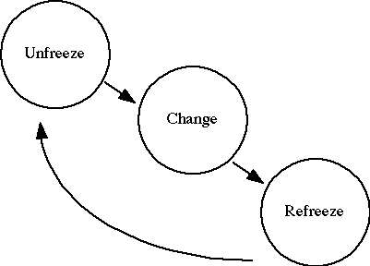
And a psychologist
Why don’t we all change to the “best” process, from whatever we have now?
Changing even something simple, say, your team’s development environment, invokes Kurt Lewin’s organizational change model:
  People know change is hard – requires “unfreezing.”
  You have to “learn” how to do the
  new stuff.
  Includes internalizing new meanings.
  Then “refreeze” around that.
Notes:
Image from http://www.adaptivecycle.nl/index.php?title=The_Importance_of_Change_Management_(Group_2)_Part_2

Slide 20
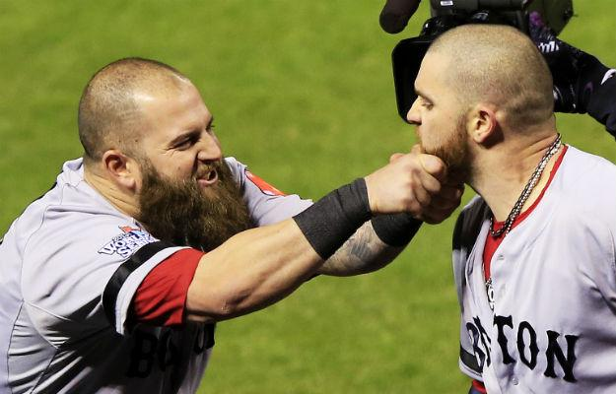

And a business person
Kurt Lewin’s model was adopted by Edgar Schein to explain what’s necessary to cause “transformational” organizational change:
Everyone assumes current success is based on everything about the current ways of acting.
  “Culture” is a learned defense
  mechanism, to avoid uncertainty
  and anxiety.
  All the cultural elements of
  behavior have “secondary value.”
Notes:
Images from http://www.foreignpolicy.com/posts/2013/11/21/licorice_buffalo_teeth_and_chicken_dinners_don_t_tell_the_ap_but_baseball_is_all_ab and http://www.recruiter.com/i/employer-pushing-your-social-boundaries-online/.

Slide 21
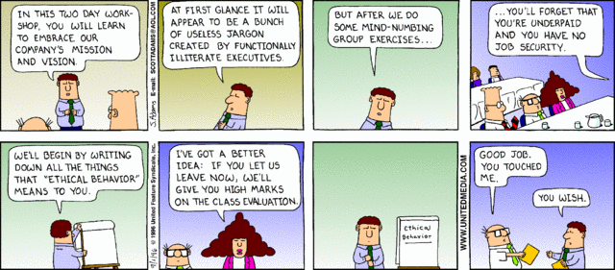
And Dilbert
Notes:
Cartoon from http://search.dilbert.com/comic/Company%20Vision

Slide 22
My Colorful Portrait
Orange – Witty, charming, spontaneous
Gold – Loyal, dependable, prepared
Blue – Enthusiastic, sympathetic, personal
Green – Analytical, global, conceptual
How many of us are which?
What does it mean, when we work with someone different on this survey?
How would you write a memo for all 4 groups, say, announcing the start of a new project?
Notes:
An informal personality exercise

Slide 23




What “leadership style” for agile?
Say, for a Scrum Master?
Transformational?
  Stresses the charismatic and affective.
  Create intrinsic motivation and follower development.
Authentic?
  Focuses on being genuine, “real.”
  Build a sense of trust, being timely and worthwhile.
Servant?
  Lead by serving, lead by example.
  Be attentive to the concerns of followers, empathize.
Adaptive?
  Face and deal with problems, challenges, changes.
  Respond to situations, prepare and encourage people in a context.
Notes:
From Leadership: Theory and practice,, 7th Ed., by Peter G. Northouse. ISBN 9-781483-317533.
Butterfly from http://www.brightonleadership.com/menu/bright-ideas/transformational-tips/.
Cap image from http://blogs.psychcentral.com/couples/2015/03/are-you-authentic/.
Servant image from http://www.crmswitch.com/crm-value/crm-not-salesperson-servant/.
https://www.google.com/url?sa=i&rct=j&q=&esrc=s&source=images&cd=&cad=rja&uact=8&ved=0CAcQjRw&url=https%3A%2F%2Fpicturepark.com%2Fdam-blog%2Fpicturepark-tips%2Fwhat-is-adaptive-metadata%2F&ei=AytBVa2hOMmwsAXgoIH4BQ&psig=AFQjCNHzdBsLU37Ji1DCD4L-nx8yrqoBoA&ust=1430420605010692.
Chameleon image from https://picturepark.com/dam-blog/picturepark-tips/what-is-adaptive-metadata/.

Slide 24
Additional topics you asked for –
Let’s answer about agile teamwork
Acquiring the software staff.
Building a team communication plan and "run" rules.
Arranging for training for the software team.
Negotiating involvement of all project groups in the software activities.
  What’s the right level of customer involvement?
  How to maintain a good relationship?
  How to convince them to interact more like agile?
What are good ideas for status reports from developers?
Planning for staff transitions.
How do you talk to team members differently based on personality and leadership style? (Yours and theirs!)
What teamwork practices lead to success?
How to do team assessments (peer, etc.).
How does Agile fit with Six Sigma?
Notes:
From our “To Do List,” slide 18 of Session 5 Part 4 slide set.

Slide 25

Acquiring the software staff
Mechanically, staffing depends on lots of organizational practices / variables.
Group activity: How was your current project team formed?
That’s the most likely answer to how you will be allowed to do it.
How you’d like to do it – different. E.g.:
  Be able to recruit “good people” you know.
  Be able to find the best experts on key subjects.
  Getting priority because of your project’s value.
  Getting priority because it’s going to be “agile.”
  Having people able to start when you need them.
Notes:
Image from http://www.ltstaffing.com

Slide 26
Acquiring the software staff, cntd
What do leaders look for in followers (at first)?
  Enthusiasm
  Participation
  Gregariousness
  Extraversion
What do followers look for in leaders (at first)?
  Pleasant
  Trusting
  Cooperative
  Agreeable
Notes:
From Leadership: Theory and practice,, 7th Ed., by Peter G. Northouse. ISBN 9-781483-317533, p 142,

Slide 27
Acquiring the software staff, cntd
Wild card options for staffing:
  Hire another organization to do it for you.
  Find another, qualified group that’s just finishing what they do now, hire all of them!
  Get people to defer what they were going to do next.
  Others?
Notes:
From Leadership: Theory and practice,, 7th Ed., by Peter G. Northouse. ISBN 9-781483-317533, p 142,

Slide 28
Building a team communication plan and "run" rules
Start with what you have now.
Ask key people, who will be on the team, if theirs are the same.
What has to be sent up and down to people above? Ask whoever is up there!
What other groups are building related components?
  What are their practices going to be?
  How are you going to communicate to them?
Are you changing to Agile?
  If so, what has to be different?
    Scrum meetings at beginning and end of sprints.
    Daily stand-up meetings.
  Try to establish minimum acceptable documentation.

Slide 29

A jovial example of team rules
The Cider House Rules:
Please, don't operate the grinder or the press if you've been drinking.
Please don't smoke in bed or use candles.
Please don't go up on the roof if you've been drinking—especially at night.
Please wash out the press cloths the same day or night they are used.
Please remove the rotary screen immediately after you've finished pressing and hose it clean WHEN THE POMACE IS STILL WET ON IT!
Please don't take bottles with you when you go up on the roof.
Please--even if you are very hot (or if you've been drinking)--don't go into the cold-storage room to sleep.
Please give your shopping list to the crew boss by seven o-clock in the morning.
There should be no more than half a dozen people on the roof at any one time.
Notes:
From http://faculty.washington.edu/jtenenbg/courses/tgh303/s08/docs/ciderHouseRules.html

Slide 30
An example of Agile rules
We have the standup meeting at 8:30 AM every morning, in the conference room.
  The Scrum Master leads the meeting.
    If you will be late, call them ahead of time.
  The Product Owner will listen.
  If you are traveling, try to connect to the conference phone!
  Everyone gives the status of their work.
  Describe, briefly any blocks!
    We’ll identify
  Meeting will last no more than 15 minutes.

Slide 31
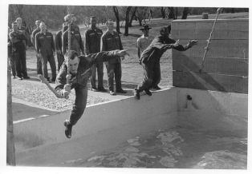
Arranging for training, for the software team
Ideal is “just in time.”
What has someone else used / like?
What has been shown to be effective?
Can you get “pioneers” to try training first?
What does your company already have available?
  Things you own / did in-house
  Your own experts / trainers
  Things another group bought a
  license for
  When can you get these resources?
Can you judge level of acceptable
expense?
  Time required.
  What it costs!
  When it’s available.
“Next!”
Notes:
Image of basic training, from 1962, found at http://en.wikipedia.org/wiki/United_States_Air_Force_Basic_Military_Training.

Slide 32

Negotiating involvement of all project groups in the software activities
What’s the right level of customer involvement?
  Ideal is XP-like – they’re sitting next to you.
  All of them.
  Start with that, and work back to what they
  are willing to do.
How to maintain a good relationship?
  Level of perceived communication.
  Level of trust.
How to convince them to interact more like agile?
  Talk about how much more they can influence factors they care about.
  Talk about the increased likelihood of
  getting key features fast.
How would they respond?
“Better or worse than what you saw this morning?”
Notes:
Image from http://www.thedemoscene.nl/cms/5-tips-for-a-great-software-demo/.

Slide 33
What are good ideas for status reports from developers?
Agile answer – Almost none. Or,
  Do it all with stand-up meetings.
  It’s done when it’s fully tested.
  You watch Kanban cards move on a whiteboard.
    Or on a screen.
  “Burn-up” also is created automatically from the development process. (Jira, etc.)
    More next week, when we talk about metrics and measurement.

Slide 34
Planning for staff transitions
Agile answer is:
  Make as easy as possible, because everybody knows what everybody else did.
  And what everybody else is working on.
  Because you switch who’s-working-with-whom regularly.
And you discover, from experience, the minimum level of documentation needed to make this just an ouchy, not a hospital stay.
  Like well-documented code which can change hands.
  And a well-organized repository.
  And well-understood testing to go with that.

Slide 35
Talking to team members
How do you talk to team members differently based on personality and leadership style? (Yours and theirs!)
Wow – that’s like learning from your whole lifetime’s socialization!
Listening is the most important skill.
  Like, how they react when you say something.
  Try to put yourself in their position.
  (Like you also should do in picturing users interacting with your system.)
  “Be” them.
Double-edged sword – asking other people their advice on how to approach another team member.
  Don’t forget that “everything is in play.”
Be willing to listen for surprises about your own behavior.
  We all have like 8 levels of agendas going in what we do and say.
    And we are only fully aware of a small part of that.
    Be ready to be told you meant something you didn’t think you meant, etc.
    Social fabric is infinitely deep.
Notes:
Examples of leadership styles – see for example https://www.legacee.com/types-of-leadership-styles/.

Slide 36
Talking to team members, cntd
Be aware of your own strengths and weaknesses, as a leader and team member.
  Ask other people, encourage them to be candid.
  Don’t be defensive in hearing their reactions.
Many people try to play off their strengths and avoid their weaknesses.
  Alternatively, try to improve on areas of weakness.
All this becomes much more important in critical situations.
  Above all, be direct and clear!
If you’ve been a regular contributor, and then you’re promoted to PM (PE)…
  The social fabric suddenly changes.
  What you say to everyone else has a different “aura.”
  You should consider this before moving up to such a position.

Slide 37
What teamwork practices lead to success?
Phillips has a list of “Secrets” we’ll see in the next slide set.
No set of these is ever complete.
You learn from experience:
  Taking things slowly at first
  Then you tend to do them automatically
  It’s like philosopher Alva Noë’s explanation of how humans play chess – see next slide. →

Slide 38
How humans play chess
“From the standpoint of the intellectualist conception of the mind, … chess presents a daunting computational challenge. The chess player must select, from among an astronomically large number of possible legal moves, the single move that most optimally serves to realize the goal of victory. To do this, the player must, in effect, form an accurate representation of the state of play and then work out or calculate the consequences of possible moves; he must then evaluate those consequences in light of their overall desirability; and he must do this under time pressure. [But] the competent chess player does not face [this] computational problem… The problem does not even arise.”
Notes:
From the book Out of Our Heads, by Alva Noë, pp 105-6, at https://books.google.com/books?id=llUvnqcEKTcC&pg=PA105&lpg=PA105&dq=alva+noe+chess&source=bl&ots=Ox7BbozW4O&sig=1irx2bf-_B_hRDVsv3qs9odH3So&hl=en&sa=X&ei=l4A2Vc70EpHroAS12IFQ&ved=0CDAQ6AEwAw#v=onepage&q=alva%20noe%20chess&f=false.

Slide 39
Similarly – Phases in leadership making
 | Phase 1 - Stranger | Phase 2 - Acquaintance | Phase 3 - Partnership
Roles | Scripted | Tested | Negotiated
Influences | One way | Mixed | Reciprocal
Exchanges | Low quality | Medium quality | High quality
Interests | Self | Self and other | Group
Time
A key predictor of relationship quality – performance.
Phase 2 starts with one party offering to share more information.
Then there is a testing period, where follower is offered more roles and responsibilities, assessed on those.
Notes:
From Leadership: Theory and practice,, 7th Ed., by Peter G. Northouse. ISBN 9-781483-317533, p 143,

Slide 40
How to do team assessments
(peer, etc.)
Most logically, you rate people on exactly what you asked them to do.
The assessment of the whole team should play a large role.
What did you think of the article on Compensation?
  Is there a real conflict with corporate compensation “curve fitting”?
  Is there an issue that corporate compensation assumes individuals primarily compete?
  How could your system be motivational with agile teams?
  How do you get people to work for intrinsic rewards (the Theory Y assumption)?
  Does merit pay conflict with a promotion system?
    And, can you have a promotion system, with Agile?
    Is there an issue with “What was under my control?”
Notes:
The article is on Moodle, next to the quiz.

Slide 41
How does Agile fit with Six Sigma
Areas of tough fit:
  Six sigma came from manufacturing.
    Repeated processes.
    Goal to get it right the first time, with waterfall model.
  Elaborate statistics for decision making.
  Reliance on lots of tools – roadmaps, checklists, multivariate models.
But…
Notes:
See, for example, http://www.isixsigma.com/industries/software-it/remove-obstacles-six-sigma-within-agile-development/, from which this material was taken.

Slide 42
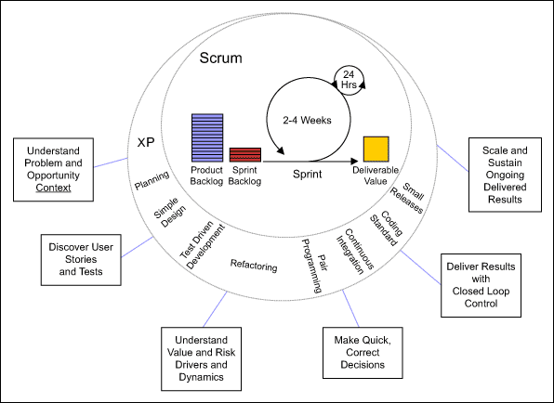
How does Agile fit with Six Sigma, cntd
There are “leverage points” where they fit:
Notes:
From http://www.isixsigma.com/industries/software-it/remove-obstacles-six-sigma-within-agile-development/

Slide 43
How does Agile fit with Six Sigma, cntd
Example – the need to make quick, correct decisions, which include complexities about:
  Number of decision goals and relationships or tradeoffs between them
  Number of alternatives and related choices
  Evaluation of the merits and gaps of each alternative with respect to the goals
  Solution-deployment dynamics including choices about people, other resources and schedules connected with making the solution happen
  The number of people who need to be involved with evaluating the goals, alternatives and solution-deployment dynamics
  Documenting the decision thought process to inform others and compel them to align with the decision
Notes:
From http://www.isixsigma.com/industries/software-it/remove-obstacles-six-sigma-within-agile-development/

