Slide 1
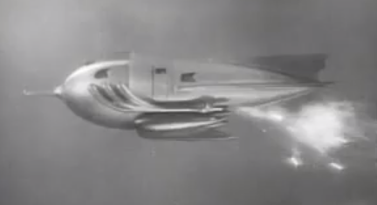

SPMH: When things go wrong
CSSE579
Session 5
Part 3
And a preview of tomorrow –
See last slide
Notes:
Flash Gordon spaceship from http://www.theregister.co.uk/Print/2011/11/24/spaceship_design/.

Slide 2

Quick Survey
Do you have a working list of risks for your current project?
Do you have strategies for handling these risks?
Notes:
Risk-taking behavior from http://articles.latimes.com/2012/oct/02/news/la-heb-teens-risk-averse-20121001

Slide 3
Let’s go through Phillips’ Risks
With the other people here, who are on your project, say, discuss:
Do the customers and developers agree on the project objectives?
Have you done a project like this before?
Have you worked with the tools before?
Will the project solve a new problem or use new technology?
Implies “feature creep”
Increased likelihood of “backtracking”
Is the technical infrastructure in place?
What is the relationship between customers, users, and the team?
Is the implementation date realistic?
Do you have the project management skills needed?
Notes:
P 240

Slide 4
What do the managers do?
All managers do these things:
Plan – ahead of time
Lead - during
Control – “after” (and during)
Project managers are “first level” managers:
Typically don’t hire and fire.
Do keep projects on schedule.
Often also are “lead developers.”
These are the “risk managers”!
Notes:
For Steve’s section, a repeat of Slide 11 from Week 0, Day 3

Slide 5
Control = plan + status + corrective action Control – as in “Control the risks”
What problem would Highsmith have with this? (hint: think Fowler’s ‘feature devotion’)
Notes:
Martin Fowler’s article on Feature Devotion is at http://martinfowler.com/bliki/FeatureDevotion.html.
Basically, you need “adaptive planning.” Some “risks” are really changes your project needs to adapt to.

Slide 6

Steve’s example
NCR Corp, Dundee Scotland
Risk assessment review, 1993
New generation of ATM
Concluded they should develop two different cabinets, in case the riskier one failed.
Notes:
NCR ATM from http://www.ncr.com/products/banking/deposit-atm-machineshttp://a4a0f6939b58c150df1e-8685fe7e4e24133c371aae6679c184ac.r40.cf1.rackcdn.com/v3/feature/selfserv-34-drive-up-atm-machine.jpg/cbaa4d4af86cd604ff08b92b0b605c80/selfserv-34-drive-up-atm-machine.jpg

Slide 7

Should people be allowed to “go dark”?
Notes:
Image from http://www.thecareermuse.co.in/2013/11/30/isolated-working-work/, which is an interesting article!
The success of “agile” rides on visibility. But, providing visibility is an interruption in our coding, too.

Slide 8
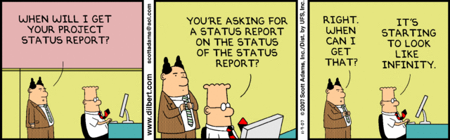
Is there a point at which developers should push back on manager status requests?
Notes:
Dilbert is from Nov 9, 2007. http://search.dilbert.com/comic/Project%20Status

Slide 9
What Data to collect?
Measure Everything – or it will seem like you’re measuring nothing
LOC, Function Points, GUI Screens
Errors, Cost-Per-Product, total time for specific features
Do not ask people to collect status without explaining why the project and organization need it!?

Slide 10
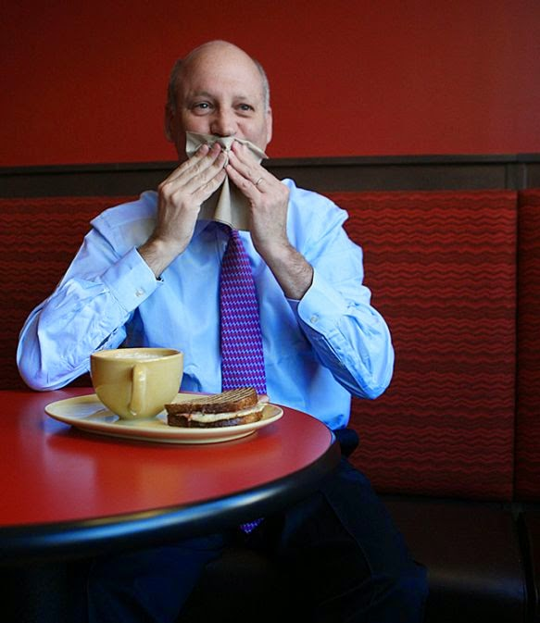
Common Control Tool – A Management Information Center
To us, Mickey Mouse
What’s the point?
But, we’d also like Management keeping everyone else in line!
Will that third party deliver the software to plug into ours, next week?
Will the integration test lab be available for our project before the end of this sprint?
Can we keep the customer from changing his mind, again?
Over lunch, your client suddenly realizes what the system you’re building for him really has to have!
Notes:
Image from http://www.successfulcustomeroutcomes.net/2014/09/customer-experience-trumps.html

Slide 11

The Control Goal is Risk Management
Risk avoidance –
Act ahead to reduce the chance it occurs
Risk transfer –
Pass the “hot potato”
Risk mitigation –
Have a plan in place, in case it occurs
Have some “reserves” to apply when risks actually arise.
This includes, especially, “slack” time / people
Have alternatives you can “jump to” if necessary.
Notes:
Risk avoidance image from http://newenglandcondo.com/articles/147/1/Risk-Avoidance/Page1.html.

Slide 12
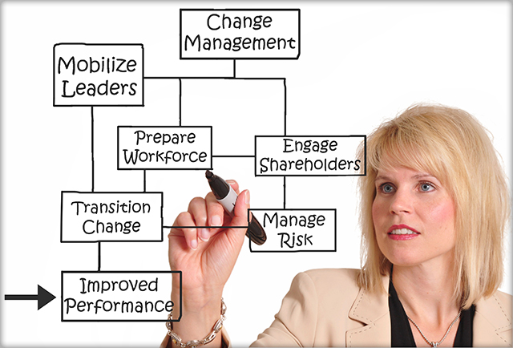
Phillips’ “Proactive” Ideas
Prevention – act early
Elimination of error - TQM
Anticipation of failure – And plan around it
Management of change – Adapt the organization to reduce risks
Notes:
pp 246-7
TQM = “Total Quality Management”
Change management image from http://www.narvermanagement.ca/business-services/change-management-services/.

Slide 13

Well-known “bad ideas”
The ostrich approach: Ignoring all risks, or pretending they don’t exist.
The prayer approach: Looking to a higher being to solve all your problems or to making them disappear.
The denial approach: Recognizing that certain situations may cause problems for your project but refusing to accept that these situations may occur.
Notes:
From http://www.dummies.com/how-to/content/how-to-develop-a-riskmanagement-strategy.html
Ostrich image from http://glee.wikia.com/wiki/File:Ostrich_head_in_sand.jpg

Slide 14
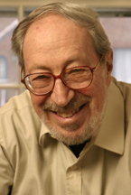
Why do people dislike risk management?
Risks are threats. (See p 253)
We like being optimistic.
Do you have to be confident to code well?
We are unhappy when making choices.
See Barry Schwartz’s TED talk
“Freedom of choice” is painful!
Change is hard. Ref Edgar Schein’s theory of organizational change:
Principle 1: survival anxiety or guilt must be greater than learning anxiety
Principle 2: Learning anxiety must be reduced rather than increasing survival anxiety.
MIT’s Edgar Schein
Notes:
Barry Schwartz’s TED talk is at http://www.ted.com/talks/barry_schwartz_on_the_paradox_of_choice?language=en
Edgar Schein’s change ideas are introduced at http://www.catalign.in/2010/04/edgar-scheins-fundamental-laws-of.html.

Slide 15

3 Options When Making “Global” Project Decisions
Continue on your current course
Take corrective action
Cancel the project
Quantify the decision?
“How much is that going to cost?”
Notes:
Design change image from http://www.tbitsglobal.com/field-design-change-note-engineering-change-request-engineering-change-order-engineering-change-notice-engineering-change-proposal.

Slide 16

A good place to work?
How much risk do you want?
Startups – Maybe 3% - 5% success rate?
Working for the government – 100% success rate?
In-between – Working for Apple, IBM, Microsoft, or Google.
Notes:
Success rate for startups is from http://www.businessinsider.com/startup-odds-of-success-2013-5. Image also from that site.

Slide 17
Risk Examples
Personnel shortfalls
Unrealistic schedules and budgets
Developing the wrong software functions
Developing the wrong user interface
Goldplating
Continuing stream of requirements changes
Shortfalls in externally furnished components
Real-time performance shortfalls
Straining computer science capabilities

Slide 18
Common ways software teams manage risks
Matrix showing risks showing both:
Probability of occurrence, and
Consequence if it does occur
Teams then use this matrix to manage the risks over time.
Notes:
See Phillips p 248

Slide 19
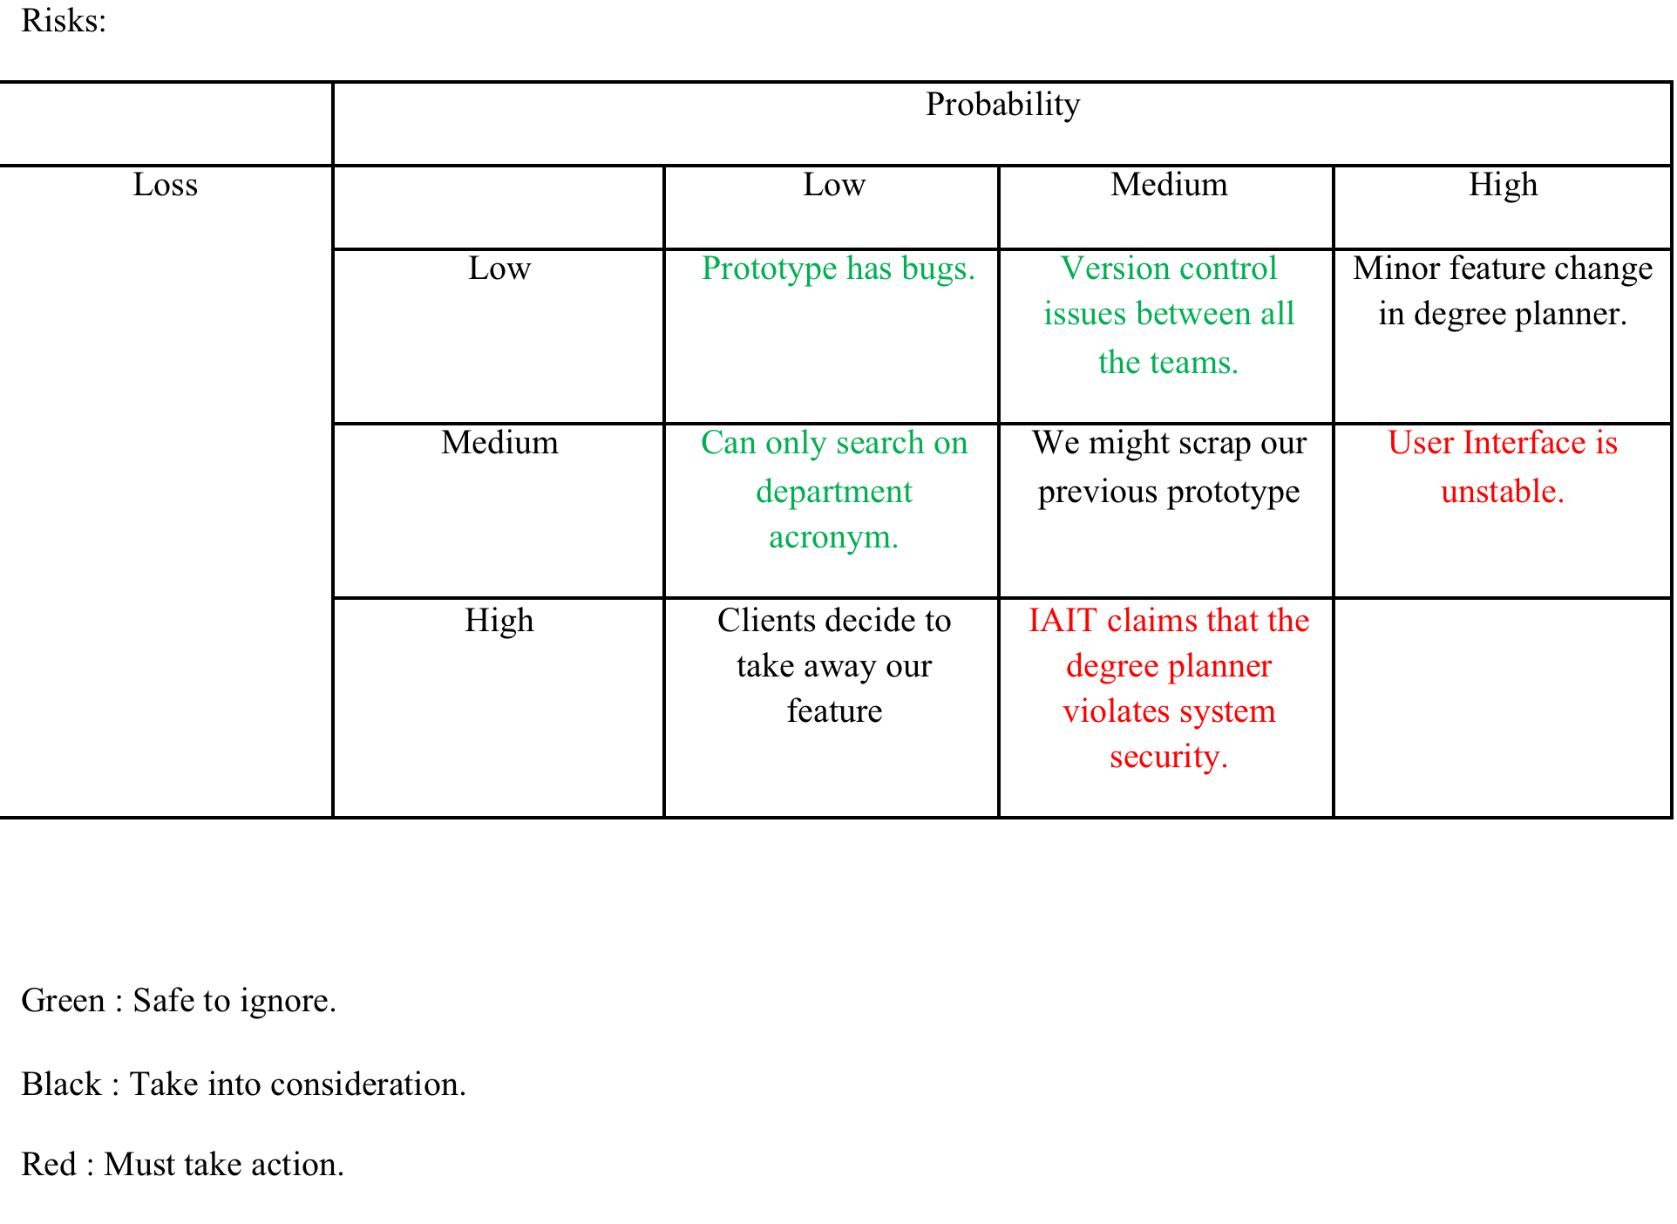
Example risk matrix - showing some “scenarios” -
This is “An ongoing whiteboard risk management”!
Notes:
This project might look familiar to some of you!
Whiteboard risk management is on Phillips p 254.

Slide 20
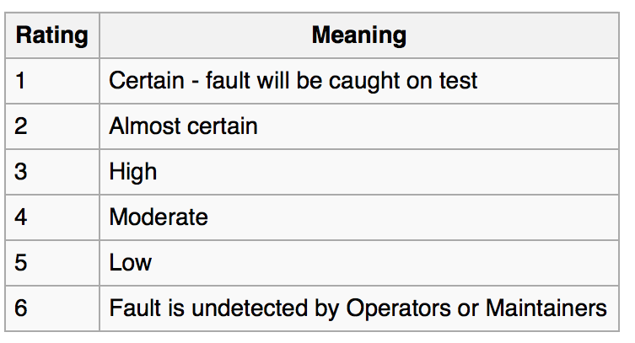
One more risk perspective - FMEA
You probably already use this!
Or other engineers around you do.
“Failure mode and effects analysis”
Often applied to designs, but also processes.
“How many ways can this fail?”
A part of reliability engineering.
Consider dimensions, with 1 -10 ratings for each:
Probability
Severity
Detection
Notes:
Detection rating system from http://en.wikipedia.org/wiki/Failure_mode_and_effects_analysis#Detection_.28D.29.

Slide 21
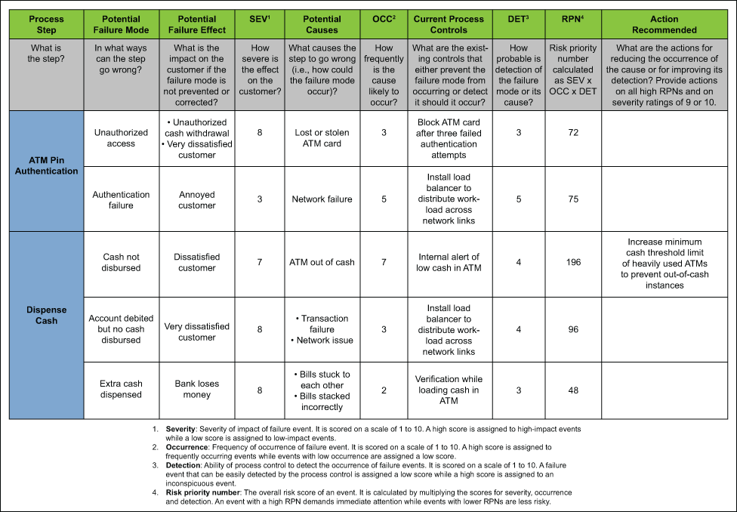
Typical FMEA Spreadsheet
Notes:
Image from http://www.isixsigma.com/tools-templates/fmea/avoid-failure-when-using-failure-modes-and-effects-analysis-fmea/

Slide 22
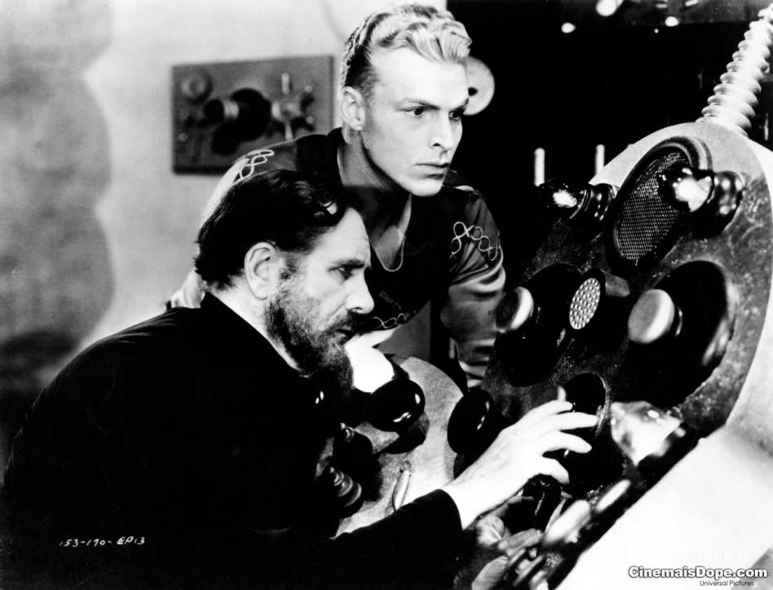
A preview of tomorrow
There’s a fundamental issue with predicting the future based on the past:
When you are about to to a much larger project than before…
Things don’t scale.
Many successful software organizations assume results will continue to be good.
Large projects are the source of bad results!
Huge IT projects are a perfect example!
See the article at https://hbr.org/2011/09/why-your-it-project-may-be-riskier-than-you-think/ar/1
Notes:
Flash Gordon original movie serial image from http://www.comicmix.com/2008/10/11/review-the-flash-gordon-serials-1936-1940-a-heavily-illustrated-guide/

