Slide 1
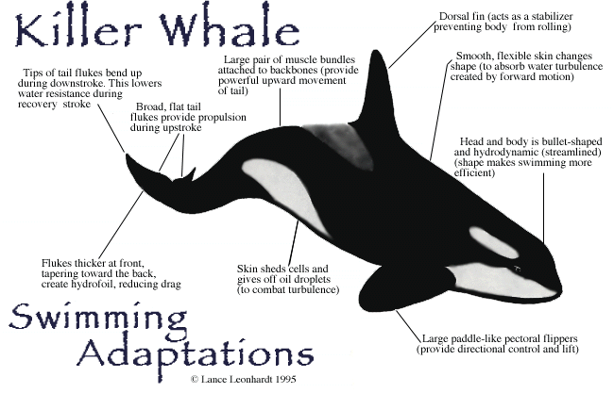

Adapting the agile plan
CSSE579
Session 5
Part 2
How planning leads to success
Parts of Highsmith, Ch 10
Notes:
Image from http://whyevolutionadaptation.weebly.com/question-one.html

Slide 2
All the skills we just discussed…
Still in play for Agile!
Management has to be aware of…
Product value
Product quality
Team performance
Project status
But, the “management” role is more distributed around the team.

Slide 3
Adapt for many reasons…
As in change how things are going, in some appropriate way,
In response to some perceived problem.
In agile, this is not “corrective action”!
It’s team learning.
Could be that the plan has to change…
Notes:
APM, p 253

Slide 4
Critical questions for the team
Is value being delivered?
We’re building a releasable product.
Is it a reliable, adaptable product?
Is progress within acceptable constraints?
Is the team adapting to changes imposed by:
Management,
Customers,
Technology?
Notes:
APM, p 254

Slide 5
How it looks
Team works at a high intensity
Yet not “hurrying”
Then reflects during reviews and checkpoints:
Customer focus groups
Technical reviews
Team performance evaluations
Project status reports →
Which results in adaptive action

Slide 6
Project status reports
Should have value to stakeholders and team.
Value and scope status – parking lot
Quality status
Schedule and risk status
Agility measurements
Cost status
Project team information
Adaptive action results from this.
Notes:
APM, pp 261 +

Slide 7
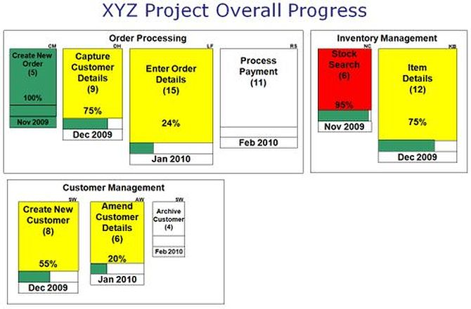
Examples - 1
Highsmith’s Parking Lot of value and scope status, like the figure on p 263:
Notes:
From http://www.infoq.com/articles/visualize-big-picture-agile

Slide 8
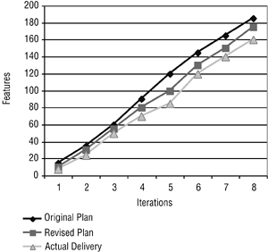
Examples - 2
Highsmith’s Burn-Up chart, p 264:
Notes:
From http://whyevolutionadaptation.weebly.com/question-one.html

Slide 9
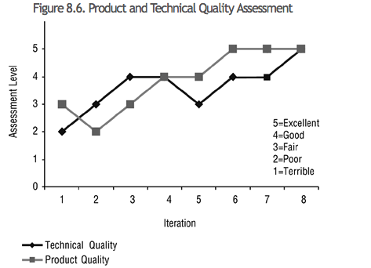
Examples - 3
Highsmith’s product quality assessment, p 265:
Notes:
From http://flylib.com/books/en/1.211.1.76/1/.

Slide 10
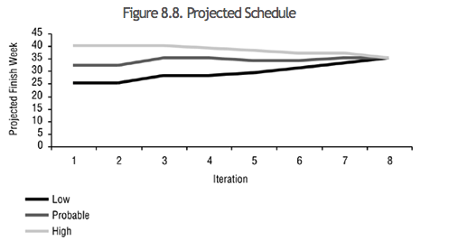
Examples - 4
Highsmiths’ Projected Schedule on p 266:

Slide 11
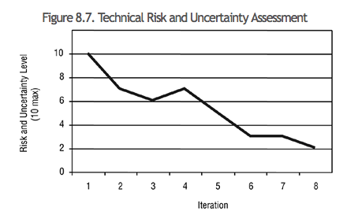
Examples - 5
Highsmiths’ Technical Risk on p 266:

