Slide 1
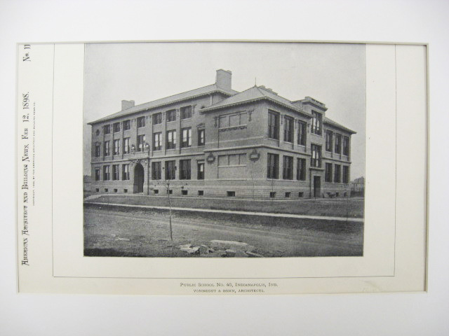

Planning – Old School Phillips, Ch 6
CSSE579
Session 3
Part 2
Plus a lot of stuff about process
Note: Additional questions from the reading quiz – See slide 11
Notes:
Print is of School 45 in Indianapolis, my grade school. Built in 1898. Architects were Vonnegut and Bohn. The Vonnegut was novelist Kurt Vonnegut’s grandfather. See http://en.wikipedia.org/wiki/Vonnegut_%26_Bohn. Image from http://www.stcroixarchitecture.com/products/public-school-number-45-indianapolis-in-1898-vonnegut-and-bohn

Slide 2
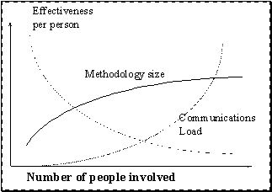
Alistair Cockburn’s principles for selecting a methodology
A larger group of people needs a larger methodology.
A system whose undetected defects will produce more damage needs more publicly visible correctness.
A relatively small increase in methodology adds a relatively large increase in cost.
The most effective way to transmit ideas among people is face-to-face interaction at a whiteboard.
Notes:
See http://alistair.cockburn.us/Methodology+per+project, which the figure also is from.

Slide 3
Our class groups profile a planning method - Each balances the 3 P’s differently
Ref your SPMH book, or Phillips’ Sec 6.2.1 – 6.2.6 copy out on Moodle.
Mt Laurel – Prototyping, 6.2.1
On my left – RAD, 6.2.2
On my right – Spiral, 6.2.4
Matt – Scrum, part of 6.2.5
Answer the 3 questions on the next slide!
Notes:
Section 6.2 starts on p 161.
Also see Section 6.4.5 starts on p 222.
Other resources - Fig 6.48 and 6.46 are on pp 230 and 228, respectively.

Slide 4
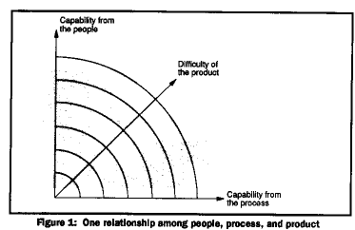
Questions for your planning method
People/process/product can be related as shown in this figure. Which dimension does your method focus most on, and why?
How do you include the other two aspects of people/process/product?
Describe a type of project where your method might work well.
Notes:
Figure from http://dwaynephillips.net/CutterPapers/ppp/ppp.htm, essentially like Fig 2.2 on p 18.

Slide 5
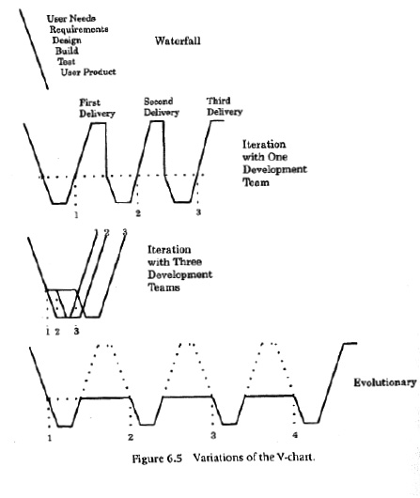
Behold the Waterfall and some V-charts
Notes:
Image from SPMH p 162

Slide 6
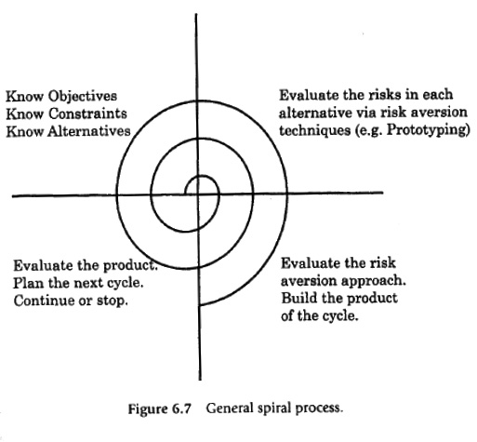
Behold the Spiral
Notes:
Image from SPMH p 169

Slide 7
Internal planning documents
Do you have a “project context” document or diagram?
Shows company and project policies, in addition to external requirements
Sometimes called a “vision” document:
Idea is to show what you expect to get out of a project, beyond the customer’s goals.
E.g., Is this project strategic to a future direction?
How does it fit in with your big-scale work flow?
How does it contribute revenue, etc.?

Slide 8
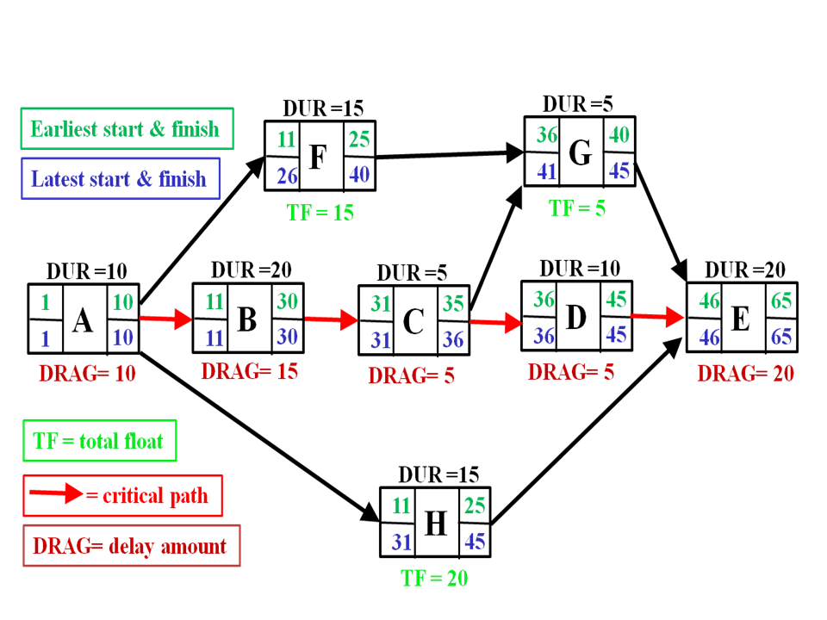
Making the PERT chart
Strategic question – Do you already know how to make these?
Cards on the wall
Find critical path
At the end of the day, we’ll broaden this familiarity question!
→
Notes:
See SPMH pp 198+
Image is from http://en.wikipedia.org/wiki/Critical_path_method

Slide 9
Philip’s Waterfall Example
“Your primary customer wants a new report capability. This is similar to many of the projects you have done in the past. You and your customer know the product well, so you select the straight waterfall process…”
Notes:
SPMH p 223

Slide 10
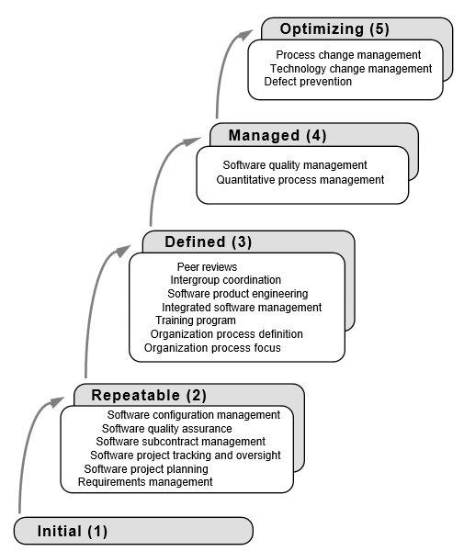
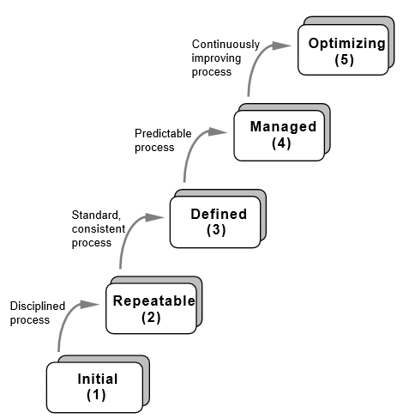
CMM - Can this be agile?
Notes:
See SPMH pp 184+

Slide 11
Addition - Your questions from the reading quiz
CMMI and Agile? – An elaboration:
The classic conflict is that CMM appeared to require additional process documentation.
E.g., To make your development process “repeatable” (Level 2), it had to be written down, without loopholes about how key things were done.
E.g., Any extraneous process goal is perceived by Agile proponents as a return to “Old school.”
The SE people now claim that was only one interpretation.
They share goals of employing “best practices” like peer reviews, retrospectives and version control.
Notes:
See, for example, https://www.scrumalliance.org/community/articles/2008/july/agile-and-cmmi-better-together

