Slide 1


Extreme Programming

Slide 2
12 Practices
The Planning Game
Small Releases
System Metaphor
Simple Design
Continuous Testing
Refactoring
Pair Programming
Collective Code Ownership
Continuous Integration
40-Hour Work Week
On-Site Customer
Coding Standards

Slide 3
An activity for your groups
Which 6 of these 12 would be most easily adopted by your own group, and why?
A follow-up for next week – Asking people in other groups about these practices.
As part of the project / presentation

Slide 4
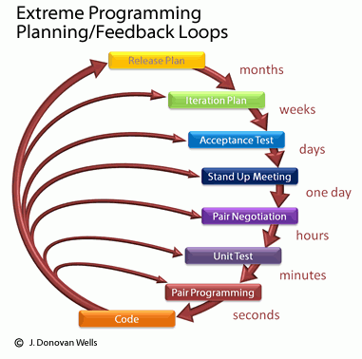
Day to day life on an XP team
Hint: starts with a daily “standup” meeting much like Scrum’s scrum
Notes:
Image of XP process from http://accelerateddevelopment.ca/blog/tag/requirements/.

Slide 5
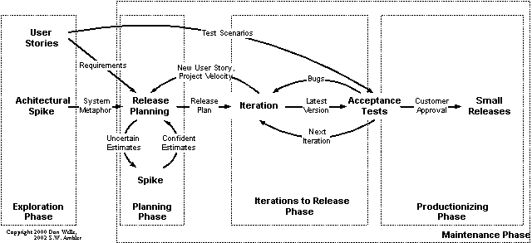
How does XP remove the need for extensive up-front requirements analysis?
Notes:
Image from http://eternalsunshineoftheismind.wordpress.com/2013/03/04/extreme-programming-xp-method-of-developing-i-s/.

Slide 6
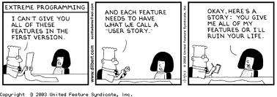
Or,
Notes:
Image from https://samup4web.wordpress.com/tag/user-story/.

Slide 7
How does XP remove the need for extensive design?
What about API conflicts?
What about the code getting bad?
What about making bad design decisions and finding out about it later?
“simplest thing that could possibly work”

Slide 8
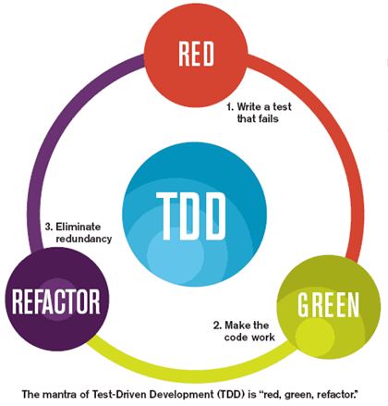
How does XP remove the need for extensive testing?
Notes:
Image from http://blog.typemock.com/2012/04/what-is-test-driven-development.html.

Slide 9
What are the limits?
*The Planning Game
Small Releases
System Metaphor
*Simple Design
*Continuous Testing
Refactoring
Pair Programming
Collective Code Ownership
*Continuous Integration
40-Hour Work Week
*On-Site Customer
Coding Standards
* Are all of these inherently harder?
→

Slide 10
The difficulties of “the customer”
Custom development situation…
(one customer for this particular version)
Product development situation…
(use customer multiplier – Myhrvold’s law)
Notes:
Myrvold’s law – a takeoff on Moore’s law, but for software. Basically, if it costs $ 100 million to make the next version of Microsoft Office, but there are 100 million customers, then it only cost $ 1 per customer.

Slide 11
Question for your groups – What about different stakeholders?
What if you have:
Client – pays for it
Users – do day-to-day use
Service people – fix it
Their managers
Customers of the buying organization / general public
How do you ensure they are all represented?

Slide 12
Adding more programmers to an XP project
How many before relationships have to be more formal?
Can they be remote?

Slide 13
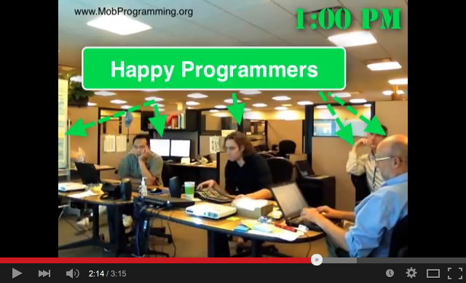
The even more extreme XP
“Mob programming”
See the silent movie on YouTube:https://www.youtube.com/watch?v=p_pvslS4gEI
Basics – see http://mobprogramming.org

Slide 14
XP - How much role fuzziness?
Where does XP stand on the grounds of:
Defining clear responsibilities and holding people accountable for those?
Having a clear message from leadership to followers?
Self-organizing teams?

Slide 15
Management theory tangent – Self-organizing teams
What’s it mean? We asked last week…
In physics, “self-organization” means organization arises out of local interactions.
An initially disordered system.
This is Empiricism in action!
In management, “organization” means who-does-what.
All of agile claims to have this.
Including Scrum.
See discussion athttp://www.mountaingoatsoftware.com/presentations/leading-a-self-organizing-team
Leadership is distributed and changing.
Control is subtle – “Light touch and adaptive.”
Notes:
See for example http://homepages.mcs.vuw.ac.nz/~elvis/twikipub/Main/RashinaHoda/OSOT.pdf

Slide 16
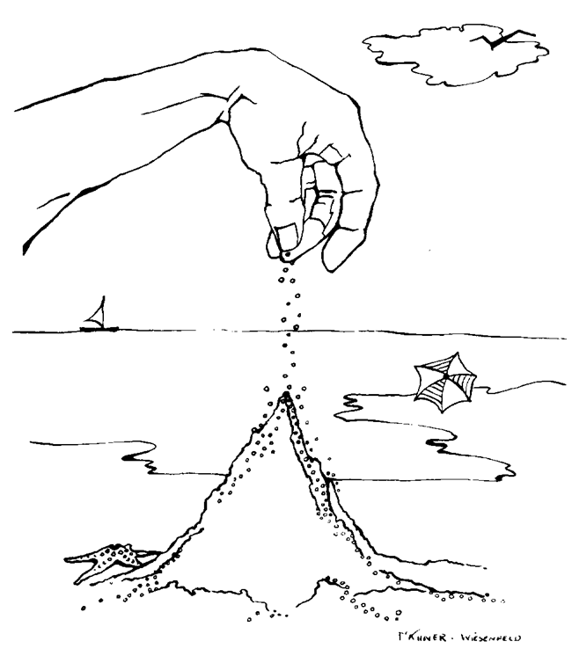
In physics…
Notes:
Image from http://csmres.jmu.edu/geollab/complexevolutionarysystems/SOC.htm

Slide 17
How this relates to XP
Typically teams need to transition to being “self-organizing.”
XP teams especially need a Mentor at first.
Doing it on a daily basis – a big change.
Mentor does these things:
Removing misconceptions
Planning the transition to XP
Clearing up insecurities, gaining confidence
Taking away “finger pointing,” negativity
Helping create first cycles of successes

Slide 18
Other “roles” with Agile
Like Mentor, these surround the self-organizing team.
The customer role isn’t exactly as fluid as the team roles.
Likely need a Coordinator to manage customer relationship.
Helps customer manage list of requirements.
May also need a Translator
The old role of Business Analyst
A Champion gains upper-management support for use of agile processes.
A Promoter does similar work with customers.
A Terminator removes people from the team.
This is a controversial role!
Notes:
See http://homepages.mcs.vuw.ac.nz/~elvis/twikipub/Main/RashinaHoda/OSOT.pdf

Slide 19
Your questions from the reading quiz
My pick
Your choice

