Slide 1


Other Views of Design and Integration – as part of PM
Notes:
Image from http://www.curver.com/usa/design-innovation

Slide 2
This week – Our last week!
This week’s (Week 10) topics – “Ethics and Trends”
Advanced topics & new trends
Google and Valve – Slides Part 3
Applying design to reduce technical debt – Slides Part 1 (this set)
Planning for continuous integration and automation – Slides Part 1 (this set)
Ethical decision making – Slides Part 2
The usual questions, this time on maintenance and metrics in your world.
No new questions, from this week’s material!
Third exam is out on the web site, due Monday, May 25 (hard deadline).
Additional questions?
Need everything else done by Monday, May 25!
I’ll be in Europe next week.
Will make best effort to check email.

Slide 3
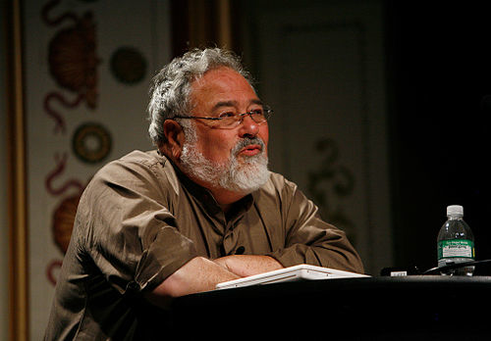
What’s a metaphor?
Ward Cunningham cites George Lakoff’s book, Metaphors We Live By:
Lakoff argues that the assumptions we make in normal discourse are heavily influenced by metaphors embedded in our language.
For example, “arguments are war,” because we talk about arguing like:
He won the argument.
Your claims are indefensible.
He shot down all my arguments.
His criticisms were right on target.
If you use that strategy, he'll wipe you out.
If we used different ways of talking, we’d think about it differently.
Cunningham borrowed this idea to invent “Technical Debt” as a framework to think about progressive, agile software development.
George Lakoff
Notes:
George Lakoff’s picture and the example metaphors are from his Wikipedia page, http://en.wikipedia.org/wiki/George_Lakoff

Slide 4
Another Lakoff metaphor…
“Time is money”:
You're wasting my time.
This gadget will save you hours. I don't have the time to give you.
How do you spend your time these days? That flat tire cost me an hour.
I've invested a lot of time in him/her.
I don't have enough time to spare for that.You're running out of time.
You need to budget your time.
Put aside aside some time for ping pong.
Is that worth your while?
Do you have much time left?
He's living on borrowed time.
You don't use your time profitably.
I lost a lot of time when I got sick.
Thank you for your time.
On projects, is this metaphor entirely accurate?
Notes:
From http://www.jera.com/techinfo/xpfaq.html

Slide 5
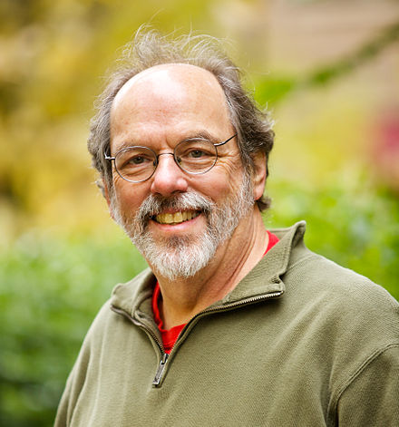
Technical Debt
An intentional metaphor!
It’s “shortcuts” –
All the stuff you don’t do now,
Intentionally or unintentionally,
Which will add time and cost
to future development
Because of being deferred.
Like having to redesign or refactor later on.
Like not putting “test first” in place at the start.
Like not taking time to share design knowledge.
It’s not the cost of delayed features, per se.
It’s not the cost of doing “bad code,” because Cunningham doesn’t approve of that under any circumstances!
Seconded by Bob Martin – See https://sites.google.com/site/unclebobconsultingllc/a-mess-is-not-a-technical-debt
Ward Cunningham
Notes:
Ward Cunningham’s picture from his Wikipedia page, http://en.wikipedia.org/wiki/Ward_Cunningham.
What’s “bad code”? See http://www.exmsft.com/~hanss/badcode.htm

Slide 6
The exact situation
The scenario Ward Cunningham describes in the video:
When we started, we didn’t know that much about the domain.
As we delivered iterations, we discovered some of our design decisions were wrong.
This was the technical debt.
Things they had to do later required redesign.
If we couldn’t fix them right away, we paid interest on this technical debt.

Slide 7

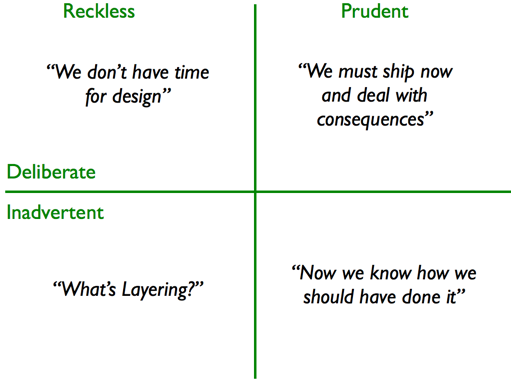
Martin Fowler’s Quadrants
Martin
Fowler
Irresponsible?
Technical
Debt
Incompetent
Notes:
From http://martinfowler.com/bliki/TechnicalDebtQuadrant.html

Slide 8
Technical Debt – A Useful Metaphor
What causes technical debt?
What is the interest on technical debt? (hint: it’s not refactoring itself – that’s something that reduces technical debt)
Why do you want to take on technical debt?
Why do some groups refuse to take on technical debt?
Notes:
Ward Cunningham’s picture from his Wikipedia page, http://en.wikipedia.org/wiki/Ward_Cunningham.

Slide 9
YAGNI and technical debt
Typical scenario:
Sprint 1
Sprint 5
Sprint 8
Martin Fowler’s Quadrants?
Deliberate
…And Prudent
“Allow for touch pads? You aren’t going to need it!”
“Uh oh, we ARE going to need it! Let’s work around it for now…”
“Time to refactor – we’ve gotta fix it!”
Wrong - Incur the technical debt
Pay interest on the technical debt
Pay back the technical debt

Slide 10
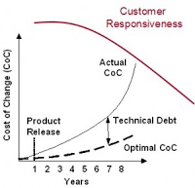
Technical Debt and Cost of Change
Unlike Cunningham, Highsmith sees technical debt as increasing over time.
Highsmith is talking about long-lived products.
The product becomes more “fragile” or “brittle” over time, even using agile methods.
Why?
This means your responsiveness to customers!
Recall thee CoC curve is what XP claims to flatten..
Highsmith’s Figure 9-7, p 216
Notes:
Highsmith’s Figure 9-7 is from http://www.bobtuse.com/2011_03_01_archive.html, which is a contrary view of the Highsmith’s CoC concept.

Slide 11
Design approach makes a difference!
Main causes of technical debt in a project with a lot of up-front design:
You think you can get clear requirements from the client without showing them a progressive product.
The complexity inevitably implies embedded errors.
Delayed exposure to users hides these errors.
Main causes of technical debt in project with simple design:
Your thinking isn’t mature when you start.
Need to refine everything as you learn more.
Could be way off, too.
Pay “interest” on what was wrong.
Avoid this with Highsmith’s approach – do an overall design before first sprint.

Slide 12
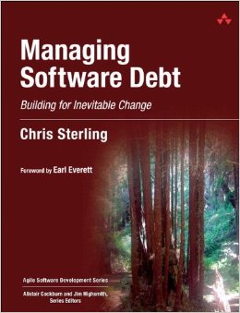

A great resource on technical debt
Very interesting discussions, like:
“Patterns of technical debt:
Schedule pressure
Duplication
Get it “right” the first time
Notes:
Chris’s picture from https://twitter.com/csterwa.
Book cover from http://www.amazon.com/Managing-Software-Debt-Inevitable-Development/dp/0321948610.

Slide 13
What causes schedule pressure?
Scope creep
Third-party estimates
Change in team leadership – architect makes initial estimate
Change in team makeup
Artifact of the estimation process – it’s a guess, not a commitment
Late integration
Notes:
Chris Sterling, cntd – p 19

Slide 14

What causes duplication of code?
Lack of experience on the part of team members
Copy-and-past programming
Conforming to existing software’s poor design
Pressure to deliver
Notes:
Chris Sterling, cntd – p 20
Diane Arbus’s twins photograph from http://en.wikipedia.org/wiki/Identical_Twins,_Roselle,_New_Jersey,_1967.

Slide 15

How to avoid duplication
Pair programming
Copy and paste “Spidey-sense” – resist the urge
Continually evolving software design
Notes:
Chris Sterling, cntd – pp 20-21
Spiderman image from http://marvel.wikia.com/Peter_Parker_(Earth-96283)

Slide 16
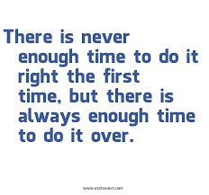
Get it “right” the first time?
Opposite of duplication – create a lot of powerful design up-front.
Costs associated with fixing – keep growing
Notes:
Chris Sterling, cntd – pp 21-22
Motto from unreachable website!

Slide 17
Why it doesn’t get fixed…
Changing directions to get rid of technical debt feels like a distraction, a waste of time.
Just putting in “TODO’s” doesn’t help!
Hint: Maintain only one list of work!
Hint: Throw exceptions, so the code is left broken.
Hint: Add Technical debt to the product backlog.
Notes:
Chris Sterling, cntd – pp 25-26

Slide 18
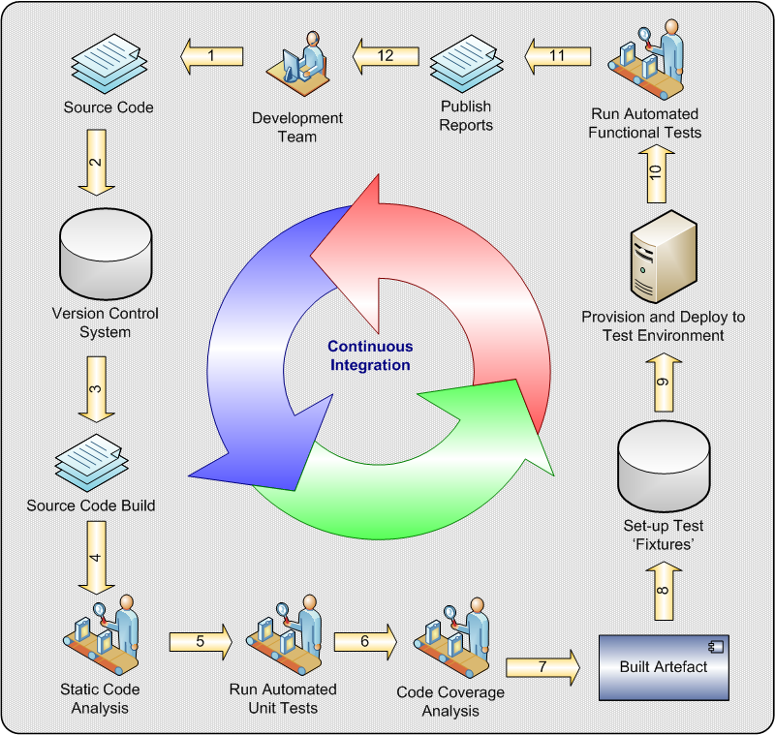
Continuous Integration
What is the corresponding old-school practice for continuous integration?
Why is testing (ideally automated testing) so important in continuous integration?
When does continuous integration fail?
Notes:
Image from http://cse360fall14.wikispaces.asu.edu/Continuous+Integration

Slide 19
Build repeatability
Crucial for continuous integration
Requires that multiple people know how to build, and
You can avoid subtle bugs
Can you “build any version” as you come out with new ones?
E.g., existing features customers are using
How to patch these?
They used an old version of the operating system

Slide 20
Related to continuous integration
Continuous delivery
Harder
Typical desired scenario
Code – build – test today (or continuously)
Deliver tonight
Gives you a continuous flow of features to your customers
Works a lot better with SOA’s
Notes:
SOA = Service-Oriented Architecture. I.e., you have the system for every customer, running on your servers, not theirs. Your product is a service, to them.

Slide 21
Opportunistic Refactoring
What do you refactor your code to do?
Rule 1: Enable whatever you know best comes next!
Rule 2: Make your code easy to use:
Reduce duplication
Be more explanatory (note: agile equivalent of documentation here)
Improve the “smell”
Improve the design is of course the goal, but this can be a tricky business
We have a full look at refactoring in a course called CSSE 575…

