Slide 1
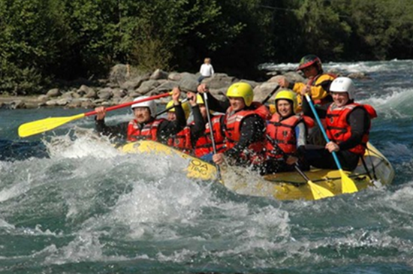
The Agile/Non-Agile Divide --
A first taste!
Right – The debate in one picture: Do these rafters need to be able to maneuver fast based on what they see immediately ahead? Or, do they need a correct plan of the river and a design for how to accomplish each stage?
CSSE 579
Week 1
Slide set 3
Notes:
Image from http://epam-systems.blogspot.com/2012/05/introduction-to-agile-epam-systems.html./

Slide 2
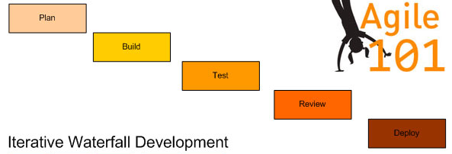
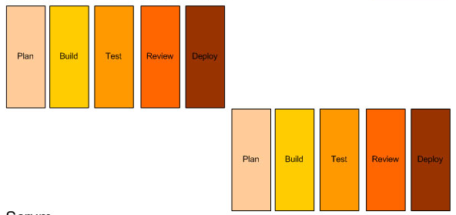
The Basics: From Traditional to Agile PM
Waterfall model
Iterative model
Notes:
It is all in how you slice it…

Slide 3
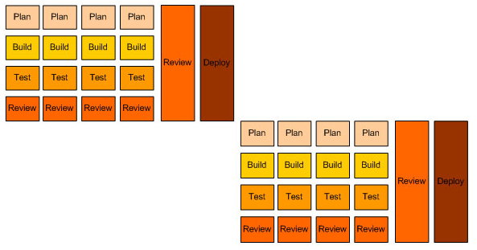
Traditional to Agile PM (continued)
Iterative model
Agile methodology (Scrum)

Slide 4
Who would you like to manage you?
A collaborator who spends a lot of time getting your input, and blends that at the time with what the customer wants to do? Or,
A technical / managerial leader who knows what to tell you to do next, based on a plan?
What are you used to?

Slide 5



A personal version of the story thus far
1975
1995
1999
Mainframe vendor IBM, building basic software for the world.
Large software projects for the US military.
Small teams who need to get custom software out fast for one client.
How would the nature of the work relate to the advice?

Slide 6
“Old School” is not…
Non-iterative
Requirements never change
Process is always good
Focus on the differences described in the Agile manifesto
Individuals and interactions over processes and tools
Working software over comprehensive documentation
Customer collaboration over contract negotiation
Responding to change over following a plan
Is the customer collaboration essential to Agile?

Slide 7
Visibility
What is Philips saying?
Is he right?
How does it relate to:
Individuals and interactions over processes and tools
Working software over comprehensive documentation
Customer collaboration over contract negotiation
What if the project lasts 20 years, like Adobe Acrobat?

Slide 8
What is CM?
Software Configuration Management, but let me say slightly more than just that:
  It’s managing all the artifacts that add value to the project (for you or for the customer).
  That especially includes managing the code.
  It also includes managing other artifacts key to success of the product, like design, tests, requirements.
Why is configuration management easier with Agile development?

Slide 9
Configuration Management
Relates to: Responding to change, over following a plan.
Also relates to: Doing development like OO software is supposed to be designed:
  Work on one set of related things at a time.
  Things that “mean something” to you and to the customer.
Is this an advantage, even if you have to maintain other documents besides the code?

Slide 10
Phillips’ CM Scheme
“Configuration Control Boards” (CCB’s) agree on “baselines” at each project stage.
Everyone works off those artifacts as “what we should be doing.”
Perfecting and preserving the documents has high value.
The other meaning of CCB is “Change Control Board.” How would that differ?

Slide 11
What do the agile and old school methods agree on?
We need to deliver a product with value for the customer(s).
  In a competitive situation, more value, sooner.
That delivery is (usually) part of a larger marketing strategy.
  To keep a stable group of customers happy, and
  To attract new customers in some market niche.

Slide 12
12 Agile Principles
Our highest priority is to satisfy the customer
through early and continuous delivery
of valuable software.
Welcome changing requirements, even late in development. Agile processes harness change for the customer's competitive advantage.
Deliver working software frequently, from a
couple of weeks to a couple of months, with a preference to the shorter timescale.
Business people and developers must work
together daily throughout the project.
Build projects around motivated individuals.
Give them the environment and support they need, and trust them to get the job done.
At regular intervals, the team reflects on how to become more effective, then tunes and adjusts its behavior accordingly.
The most efficient and effective method of
conveying information to and within a development team is face-to-face conversation.
Working software is the primary measure of progress.
Agile processes promote sustainable development. The sponsors, developers, and users should be able to maintain a constant pace indefinitely.
Continuous attention to technical excellence
and good design enhances agility.
Simplicity--the art of maximizing the amount
of work not done--is essential.
The best architectures, requirements, and designs emerge from self-organizing teams.
What does “self-organizing” mean?

Slide 13
Where each is stronger – my list
Agile:
Building off close collaboration with one customer.
Getting a product with significant value out faster.
Building with a small team working closely together.
Iterative delivery by a single organization who come to have the knowledge in their heads.
What’s important can only be discovered incrementally.
What’s a “perfect example” of an Agile-friendly project?
Old school:
Building a general product to address a wide customer base.
Building off standards and consistent design principles.
Managing a large project with lots of interdependent pieces.
Product releases over a long period of time, by rotating staff who rely on documentation.
Goals and rules well known at the start.
What’s a “perfect example” of an Old-school-friendly project?
Do it when the cost of rework is low. Dealing with things “ad hoc” mostly works. We call it “refactoring.”
Do it when the cost of rework is high. Big surprises would be awful. We’d be starting over.

Slide 14
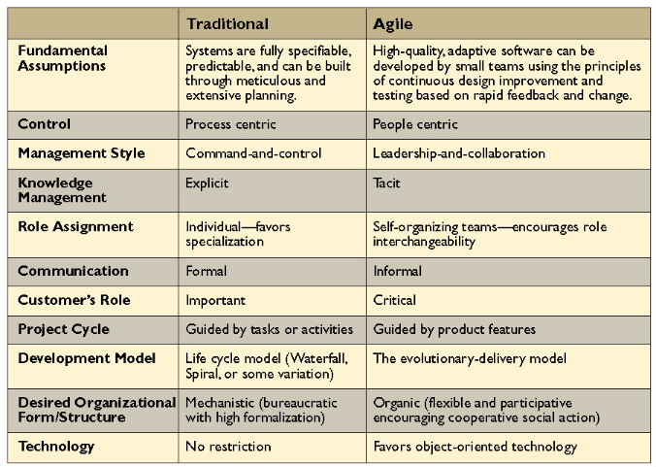
One summary of differences
Notes:
From a 2005 Communications of the ACM article, http://cacm.acm.org/magazines/2005/5/6219-challenges-of-migrating-to-agile-methodologies/abstract.

Slide 15
What I want you to take away
Agile and non-agile approaches have some of the same goals and techniques
And they also have some really key disconnects:
  The extent to which design and documentation is prized over face to face communication OR code
  The amount of control/review that’s deemed important in the process
Scaling and difficulty is a big question here: How far can an ad hoc process take you?

Slide 16

And… This isn’t just about
Agile vs Old School
Every software organization you will ever work in thinks their entire software process is “right,” or “right for what we do.”
At Lucent, we did a large study, discovering that, for us, creating a detailed design before coding didn’t improve the quality of the product.
  So, after decades, we finally stopped doing that step.
  It saved a lot of time on each project.
Even after the study, was there resistance to that change?
Notes:
Cat from http://www.indiandownunder.com.au/2011/08/superstitions/.

Slide 17
Homework and Reading Reminders
Think about a term project / presentation – See course web site!
Let’s vote on Week 3! →
Four readings for next week –
  See Moodle for the readings and their quizzes
Goal will be to compare theories and actual practices!
Please add to the “last questions” on each quiz – what would be most valuable for you to talk about!
The following set of slides here is an intro…
This is a “Week 1” thing, to put this info in a slide deck!
Normally – See the schedule on the course web site.

Slide 18
Our learning outcomes
Re-repeated
Key principles of agile project management
Agile software life cycle processes
Agile software project estimation
Software risk planning and management
Agile software project planning
Managing software projects to a plan
Forming and managing project teams
Progress, Program/Portfolio Management
Adv. Topics: Earned Value, Critical Chain
This week &
Next week
What for
Week 3?

