Slide 1
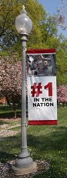


CSSE 579
Software Project Management
Course Introduction
Week 1
Slide set 1
Above – At my home office in Terre Haute, sporting religious symbolism and in front of posters iconizing former projects.
Steve Chenoweth
Office: Moench Room F220
Phone: (812) 877-8974
Cell: (937) 657-3885
Email: chenowet@rose-hulman.edu

Slide 2
Agenda – based on a good guess at today’s schedule!
1:30pm – Introduction to each other
A first try at teamwork
Need for Agile Software Projects & their Management
Course Learning Objectives
Guidelines, Expectations, and Schedule
3:00 – 3:15pm ish – Break
Overview of Management Disciplines
Software Project Failures & 2nd teamwork activity
Anatomy of a Software Project
“Old school” vs “Agile” – an Intro → Next week
You pick Week 3 course outcomes!
5:00pm – Done
This 1st slide set
2nd slide set
3rd slide set

Slide 3
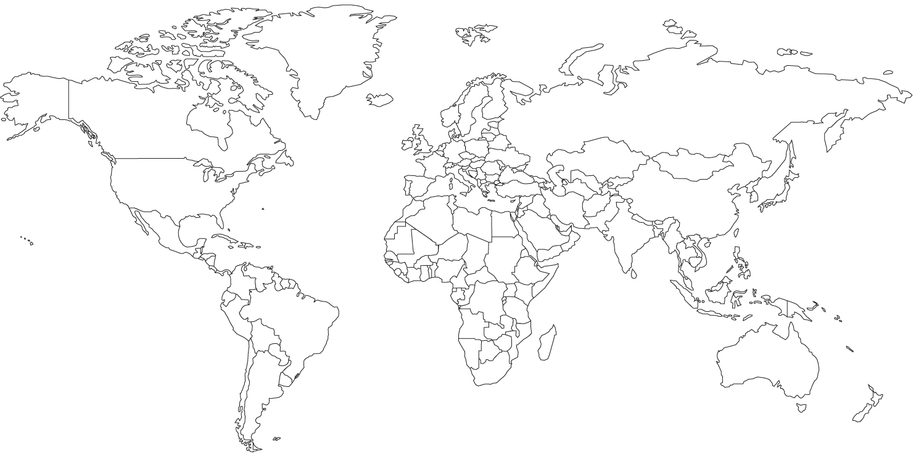
Let’s get to know each other… the 1 minute summary!
Lived where?
Interests?
Jobs held?
Coolest Software System Project you can mention (in generality)?
★
★
Notes:
(3 min)Christian man, Ruths husband, Ariel & Nico’s dad, Computer Geek who enjoys building and fixing things, martial arts, riding bikes, and talking with friends
Lived all over – I went to high school in Maine -> Texas -> England -> Washington DC -> Blackburg, VA -> Terre Haute
Traveled to Ireland, Vancouver, Pittsburgh, Washington DC, VA, and Ohio this summer…
UoMD, worked… Johns Hopkins, worked… GMU
I’ve had a great 1st career as a field engineer, scientific & engineering programmer, senior software engineer, senior member of technical staff, lead scientist, senior program director, research director, VP of Performance Engineering, and now 2nd career as a Rose-Hulman teacher
- Went to a start-up called the Software Productivity Consortium…

Slide 4
An opening exercise…
New Jersey folks
  One team
Indianapolis folks
  One team of five
  One team of four plus the caller(s), Matt & Jon
First we’ll see a short problem to do
Then you can “organize” and solve it
We’ll report back on:
  Your team’s solution, and
  How the team did it

Slide 5

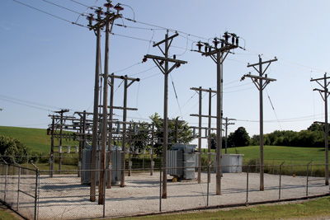
Here’s the problem!
How to keep grizzly bears from attacking remote power stations in Canada!
  The bears are annoyed by the hum.
  A too frequent result – No bear or power.
Cost should be under $ 100 per station.
Notes:
Power station image from http://www.elp.com/articles/2013/09/usda-to-fund-electric-power-grid-upgrades-in-seven-states.html.
Bear image from http://animalfactguide.com/wp-content/uploads/2013/01/grizzlybear-2.jpg

Slide 6
How to organize…
Each team decide on your own!
  Except for one thing…
  Each team needs to appoint an “observer.”
  They will take notes, and report back on the process used by their team.
  Someone else – report on the solution ideas.
In 15 minutes we’ll hear the first solution ideas from each team.
  And the observers will report what they saw.
Then we’ll do a short follow-up.
  Similar read-outs.
GO!

Slide 7
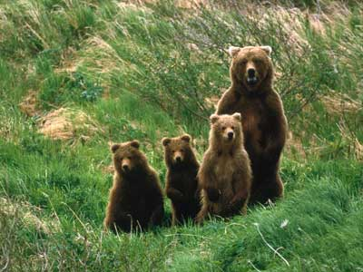
So, how did it feel to be on a new team?
Just now…
Trying to “be the stakeholder” and all that…
Notes:
Bears from http://adventure.howstuffworks.com/bear-attack3.htm

Slide 8
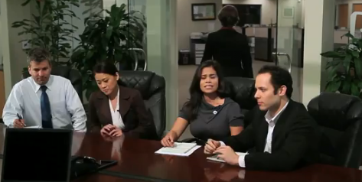
And, how does it feel to be a new project manager?
“Moments ago, I was a valued technical contributor…”
Notes:
(9 min) Project managers – yes, the folks in the nice clothes, the schedule hanging out of their pocket… that’s not me, right?
Does this mean you should shun the topic of project management? NO!
You’ve been developing software in your class projects and even in internships… these are small, contained, and often contrived.
What happens when you confront a large project – how would you handle it?
What about a time constrained project?...

Slide 9

What is a project?
Think for 15 seconds…
Let’s discuss it
Notes:
(12 min) An open loop of activities or tasks?
No… a sequence of unique, complex, and connected activities having one goal or purpose and that must be completed by a specific time, within budget, and according to specification.

Slide 10
Most of the world does routine work
You serve people the same food off the menu every day.
  Does the “soup of the day” count as a project?
Some work is a combination of routine and project
  Say, farming.
But most of the “projects” are routine, too.
  Say, planting the crops, or adding onto the barn.
Software projects, in contrast, are largely “new work.”
  We only do them because they don’t already exist.

Slide 11
What is a Project, anyway?
A project is a sequence of unique, complex, and connected activities having one goal or purpose and that must be completed by a specific time, within budget, and according to specification.
Activity C
Activity E
Activity A
Activity D
Activity B
Notes:
(14 min)

Slide 12

What is Management, now that we’re asking questions?
Management – The activities undertaken by 1 or more persons to plan and control activities of a group, to achieve an objective.
Notes:
(15 min) Plan and control others to achieve an objective…

Slide 13

Semi-Formal Definition
Project Management – “… a system of procedures, practices, technologies, and know-how that provide the planning, organizing, staffing, directing, and controlling necessary to successfully manage an engineering project.” [Thayer 1987]

Slide 14
Another Popular Project Management Definition
Project management is a method and set of techniques based on accepted principles of management used for planning, estimating, and controlling work activities to reach a desired result on time, within budget and according to specification. (PMBOK)

Slide 15

What makes software projects different?
It’s New Work!
Intangible Product
Highly Integrated Components
Complex
Distributed
Uncertain
… Risky!
Notes:
(22 min) Lots of change and uncertainty…
If it wasn’t suppose to change, it would be in the hardware!

Slide 16

What else makes software projects different?
More recent understandings –
Customers discover things they want changed, only after delivery
Can be built and tested continuously
Needs to be!
In combined products, it’s the layer where we put everything that can’t
be done elsewhere.
Notes:
(22 min) Lots of change and uncertainty…
If it wasn’t suppose to change, it would be in the hardware!

Slide 17
Our learning outcomes
Key principles of agile project management
Agile software life cycle processes
Agile software project estimation
Software risk planning and management
Agile software project planning
Managing software projects to a plan
Forming and managing project teams
Progress, Program/Portfolio Management
Adv. Topics: Earned Value, Critical Chain

Slide 18
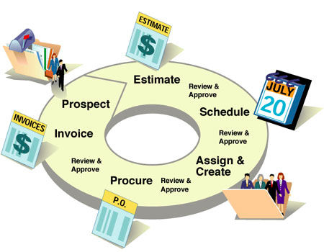
Learning Outcomes: Key principles of agile project management
Examine and analyze fundamental elements of Agile Software Project Management.
Compare with
“old school”
in many ways.
Practice it –
Leadership
Notes:
…Elements of project management that lead to solutions…

Slide 19

Learning Outcomes: Agile software life cycle processes
Investigate and employ contemporary software life cycle processes, activities, and work products.
Compare with the
Systems Engineering
V-model, etc.
Notes:
(24 min)
- Simple things do not need any rigor to get right
- but large complex things need rigor and process to be repeatable/predicable and controllable.

Slide 20

Learning Outcomes: Agile software project estimation
Estimate software project effort, cost, and schedule for an intermediate size project.
What’s the real deal
with counting
stories and points?
Notes:
(25 min)Sextant to gauge position, direction, and rate of change…

Slide 21


Learning Outcomes: Risks
Identify, analyze, and manage software project risks.
Do we need to worry about these separately with an agile process?
How are technical and project risks both important!
Notes:
If you are flying blind, you are going to be running into risks…

Slide 22

Learning Outcomes: Schedule
Typically, a key part of the contract that’s governed by a larger entity.
Create and maintain a software project schedule.
How to sell the idea that it should change over time!
What’s this even mean with “agile”?
Notes:
(26 min)

Slide 23

Learning Outcomes: Agile Planning
How to create a plan for an intermediate size software project, and manage to the plan as project evolves.
How to work with surrogate customers, like your own systems engineers!

Slide 24

Learning Outcomes: Teams
Formulate and manage software project teams.
It looks different when you are the project manager!
We’ll go after this
outcome regularly…
Like, when to lead,
when to follow.
Notes:
(27 min)

Slide 25
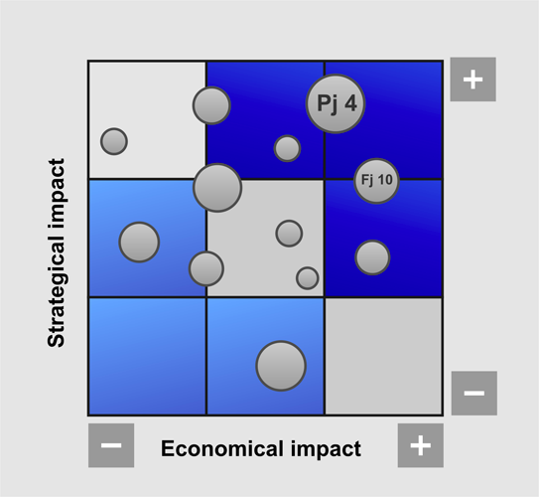
Learning Outcomes: Progress
Be able to deal with burn-down / burn-up deftly.
Explain program and portfolio
concepts as they
pertain to managing
aggregates of
software projects
and assets.
Notes:
(28 min)

Slide 26
Some specific topics / skills to learn!
Within the above framework of outcomes…
Understand program management concepts and strategic goals.
Create and maintain software plans and schedules.
Select a software life cycle model and methodology to include traditional and agile concepts.
Develop software cost estimates and proposals.
More →

Slide 27
Some specific topics / skills to learn!
Build, develop, and maintain a software team, including:
  Acquire the software staff.
  Build a team communication plan and "run" rules.
  Assign responsibilities for all functional / team areas.
  Arrange for training for the software team.
  Negotiate involvement of all project groups in the software activities.
  Plan for staff transitions.
More →

Slide 28
Some specific topics / skills to learn!
Identify software risk and develop risk management plans.
Special topics to consider:
  Software maintenance versus development.
  Earned value management.
  Configuration management.
  Planning for continuous integration and automation.
  Project measurements.
  Ethical decision making.
  New trends.

Slide 29
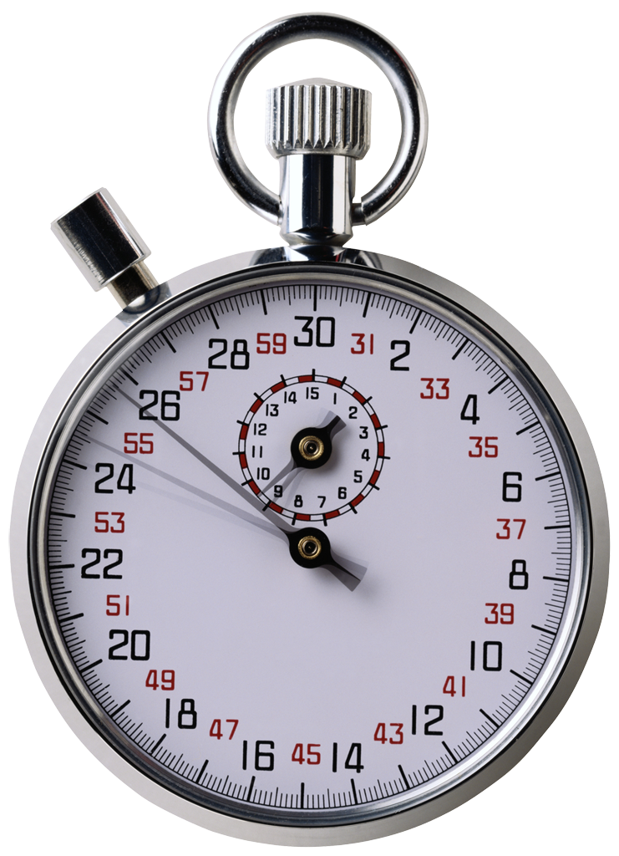
What are some differences between traditional and agile projects?
Think for, oh, 32 seconds…
Let’s discuss it.
Tell someone “close” to you.
This will be a serious focus of the course, so we’ll study both!
Starting with…
Notes:
People get injured or worst
Money loss
Time loss

Slide 30
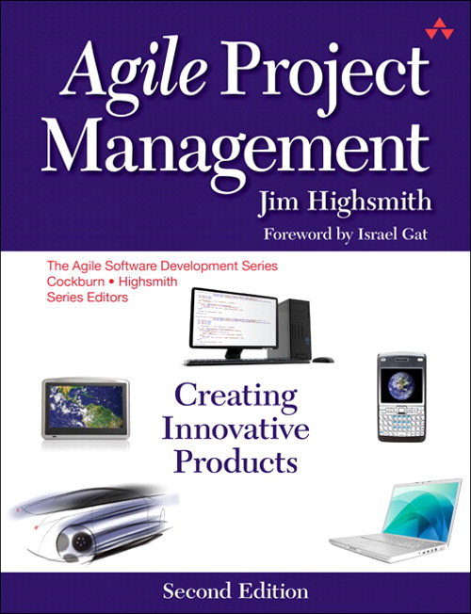

Course Textbook and Readings
Provided Textbooks
  Agile Project Management: Creating Innovative
  Products, by James A. Highsmith
  2009, 2nd edition.
  The Software Project Manager’s Handbook:
  Principles That Work, by Dwayne Phillips
  2004, 2nd edition
Readings will also be assigned
from relevant papers
  Pivotal papers
  Case studies
“Agile”
“Old school”
Notes:
Traditional covered by my material and papers
Agile covered by this book…

Slide 31
Course Mechanics
Find most material:
moodle.rose-hulman.edu
  Grades, Reading quizzes, and Drop boxes will be on Moodle
Schedule, Assignments and Slides will be on the course web site:
https://www.rose-hulman.edu/class/csse/csse579/

Slide 32
Guidelines and Expectations
Demanding Course ALERT:
Average of 8 hours or more / week outside of class
Read the assigned material before class & do the related quizzes
  Quizzes cover reading assignments
Check email for more info
Be mindful of the Rose CSSE Honesty Policy
Electronic Distraction Policy
Notes:
I respect that you have a lot to do, but I would be remise as a teach if I didn’t encourage you to read the book too.
Electronic Distraction Policy: Strongly encourage you to turn off IM and email and only use laptop for things directly related to class. If you choose to use non-class-related software during class, then you must sit in the back row. Doing so will prevent your classmates from being distracted by what is on your screen.

Slide 33
Grading and Evaluation
40% Theory
  Examination (25%)
  Quizzes / Participation / Discussion (15 %)
60% Practicum
  Homework (25%)
  Final Project / Milestones (35%)
Grade Scale
The Rose point scale will apply: A = 90 – 100, B+ = 85-90, B = 80 – 85, C+ = 75 – 80, C = 70 – 75, D+ = 65 – 70, D = 60 – 65, F = below 60. But, as a graduate class, a grade of B and above is considered passing.
Statute of Limitations
Any questions (or concerns) about the evaluation of an assignment must be raised within two weeks of the posting of score information.
Notes:
Familiar for those of you who were in CSSE 374.

Slide 34

Late Work
Legitimate reasons for late work,
  This is a class for working professionals, so everyone can have work or home things that conflict with getting class work turned in.
  Please let me know before due date.
I do need to turn grades in on time, at mid-term and at the end of the course!
Deadlines
  Deadlines temperamental beasts,
  … you hug one too close and it’s liable bite you!
  Since this is a course on managing to make deadlines,
  … it would be a little awkward for me to be sloppy about this!
Notes:
We encourage you to stay ahead of the wave…

Slide 35
Tentative Schedule – See the schedule on course website
https://www.rose-hulman.edu/class/csse/csse579/CSSE579Schedule2014-15.html
Typical week –
  Class discussion
  Learn topics from the perspective of:
    “Agile” and
    “Old school”
  Have something to work on in addition to reading for the next week:
    Homework, or
    Project, or
    Take-home exam

Slide 36
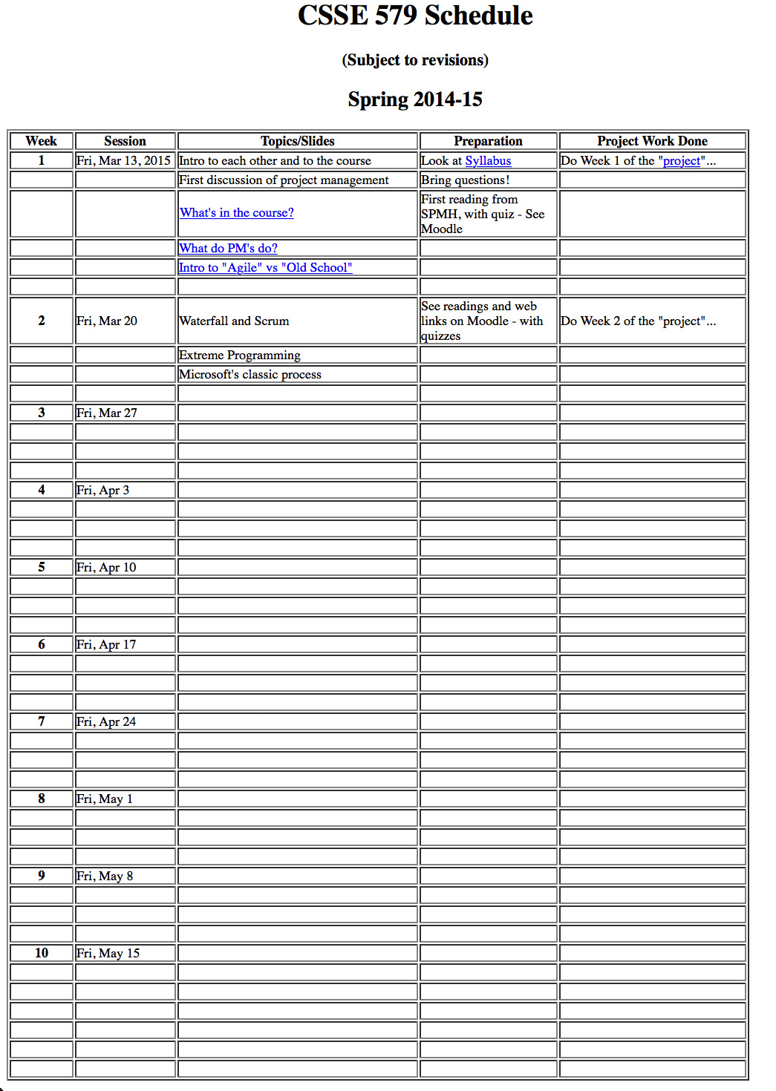
And… why does the course schedule look like this?
Let’s do the course Agile!
The way you are faced with…
Fixed resources and end point.
But – You get to be the client!
And – You recommend the next “user stories” to develop…
So →

Slide 37
Our learning outcomes
Slide 18, repeated
Key principles of agile project management
Agile software life cycle processes
Agile software project estimation
Software risk planning and management
Agile software project planning
Managing software projects to a plan
Forming and managing project teams
Progress, Program/Portfolio Management
Adv. Topics: Earned Value, Critical Chain
This week &
Next week
What for
Week 3?
We’ll get back to this – just before 5 PM!

Slide 38



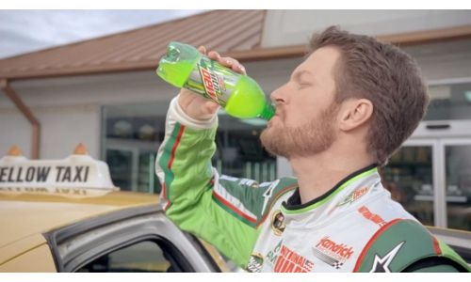
Break – 15 minutes
Notes:
Top image from web site http://www.lovethispic.com/tag/coffee+quotes
Cell phone caller from http://blog.calldirek.com/do-you-use-your-cell-phone-plan-for-international-long-distance/
Picture of Dale Earnhardt, Jr., from http://drink-brands.com/drinks/soft-drink/dale-earnhardt-jr-gives-up-number-88-for-diet-mountain-dew/
Office worker in field from http://teamgantt.com/blog/2014/02/05/why-you-need-a-break-and-how-to-take-one/

