Slide 1

“Agile yet extensible”…
CSSE 577
Software Architecture
What’s in our course?

Slide 2

Course theme – Agile with Design
Using XP, Scrum and
other agile processes, in design –
  Agile values & practices
  The agile opportunity with patterns & styles
  Organizational impacts
How does attention to both sides enable lasting system quality attributes?
Notes:
Book cover from http://www.amazon.com/Software-Architecture-Practice-Edition-Engineering/dp/0321815734

Slide 3
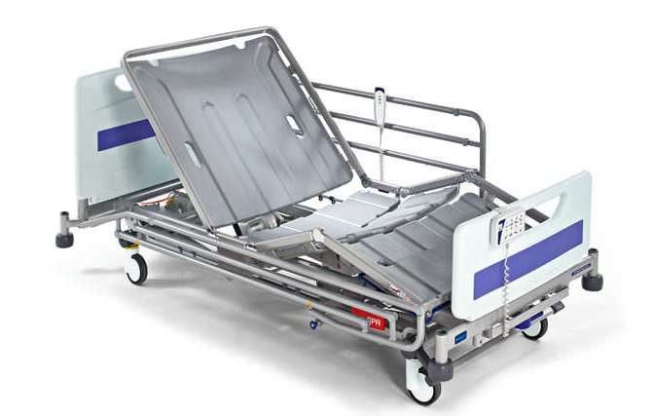
Course theme - Extensible
Create new products
  You can’t blindly start “sprinting”!
  You can’t assume it looks like the last thing you did
Build onto old products
  How to see design issues
  coming
  How to make them
  strategically more flexible
Above - The infinitely
customizable hospital bed in action.
Notes:
Hospital bed image from http://www.medicalexpo.com/medical-manufacturer/trendelenburg-hospital-bed-10229.html.

Slide 4
Typical architecting situations
“What do we have to do, to add predictive analytics into this SOA-based system?”
“Can we make this system customer-extensible, so that they can still do standard upgrades and we support them?”
“How do we avoid rewriting this app for future mobile devices?”
“Can we model this other kind of customer?”

Slide 5
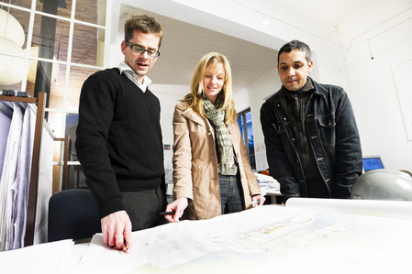
What you do to cause this… The social side
Close relationship with stakeholders
  Listen, and sell it to the client
Close relationship with developers
  Know what they are
  capable of doing
  Show technical leadership
Above – Building trades architect Patrick L Pinnell explains to the clients how his design solves their problem.
Notes:
Image from http://www.patrickpinnellaia.com

Slide 6
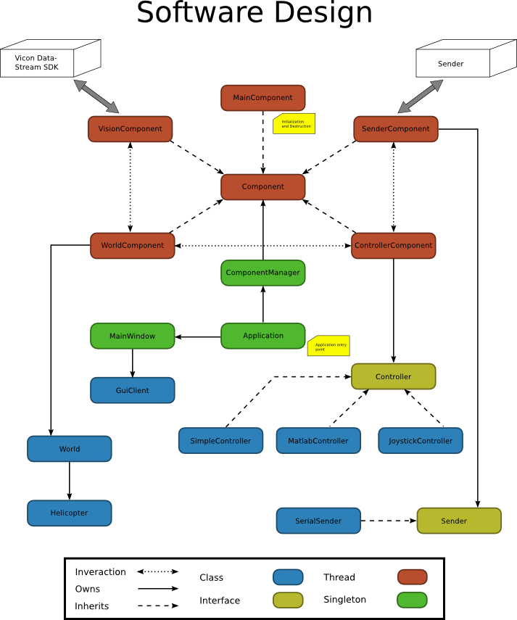
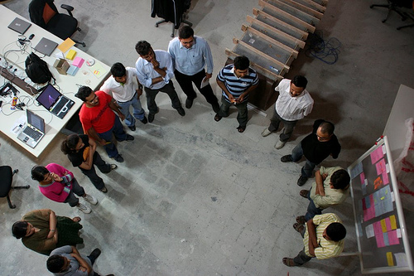
What you do to cause this… The technical side
Match a great top-down and bottom-up design
  Create frameworks and explain them
Understand the technologies
  Notice early, if the
  results are right or not
“Is this working?”
Notes:
Software design figure from http://www.n.ethz.ch/~amstutjo/coaga/SoftwareDesign.html.
Image of stand-up meeting from http://martinfowler.com/articles/itsNotJustStandingUp.html. http://www.n.ethz.ch/~amstutjo/coaga/attachment/wiki/SoftwareDesign/software-design.png

Slide 7
Course outcomes
Fundamental elements of Agile Software Architecture
Role of the architect – connecting customers and development
Patterns for different kinds of systems
Architecture as the answer to making products profitable
Architectural requirements and QA
Design risks and managing change collaboratively
Achieving quality attributes – lots of them!
Agile project management and architecture across organizations
Managing the design as a project evolves
Your role in leading software project teams

Slide 8
Course style
Learn about something in one class session
→ Try it in your environment
Come back and describe how that went
Get advice from instructor and from the other working professionals in the class

Slide 9

Typical course flavors
Flavor of the decade – Get it off the customer premises
Quinquennial flavor – Use AWS to do it
  Side order of CloudFront
Biennial flavor – Try Hadoop
Annual flavor – Everything’s
now about ConOps
Notes:
Image from http://halfoffblackhills.nimbledeals.com/deal/rapid-city/coldstone-creamery

Slide 10

A typical course focus
How is design and architecture the next step in your software career?
Closer to the decisions - A chance to make the
technical things happen
that you see coming.
A chance to multiply what you yourself can do.
Here you are now –
close to the code!
Notes:
Images from http://www.agilemodeling.com/essays/costOfChange.htm
Play the slide show to see the first image, then the second.

Slide 11
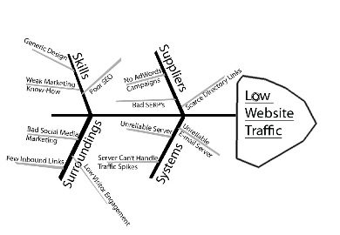
Another focus
Better products by handling risks to the design:
Processes that remove these risks, like:
  Architecture and design
  reviews
  The right shared artifacts
  Stand-up meetings
  Retrospectives
  Shared ownership
  Customer involvement
Notes:
Image from http://www.geekpreneur.com/improving-problem-solving-and-focus-with-fish-bone-diagrams

Slide 12

One more
Agile meets design - teams over tasks:
It’s all about leadership
  Which is earned, bottom-up
  Technical knowledge, and
  Social savvy
Self-organizing teams
  The right people
  Accountability
  Self-discipline
  Collaboration
Notes:
Self-organizing in action, from http://en.wikipedia.org/wiki/Self-organization

Slide 13
thank you
Learn more:
www.rose-hulman.edu/msse

Slide 14
Contact Us
Dr. Steve Chenoweth
Associate Professor of Computer Science and Software Engineering and Acting Director of the Master of Science in Software Engineering Program
Office: 812.877.8974
Email: Chenowet@rose-hulman.edu
Mr. Jared Goulding
Associate Director of Graduate and International Admissions
Office: 812.877.8589
Cell: 812. 208.5035
Email: Goulding@rose-hulman.edu
The Office of Graduate Studies
Office: 812.877.8403
Fax: 812.877.8061
Email: GraduateStudies@rose-hulman.edu

