Slide 1
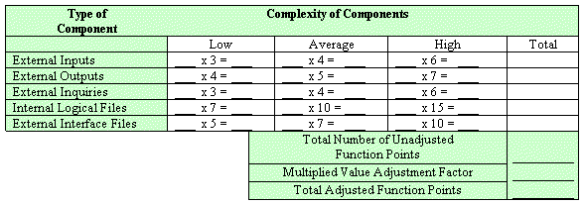
Using Function Points
It’s easy! Kind of:
Steve Chenoweth, RHIT
Notes:
Image from http://www.softwaremetrics.com/fpafund.htm.

Slide 2
Remember function points?
Another way to consider “opportunities for error” (OPEs).
Uses a weighted total of 5 major components:
Number of external inputs x 4
Number of external outputs x 5
Number of internal files x 10
Number of external interface files x 7
Number of external inquiries x 4
These are the “average weighted factors”…
Notes:
Kan pp 93+

Slide 3
We skipped over the rest of the steps!
There are low and high weighting factors for these, depending on an expert’s “complexity assessment,” like:
External input: low complexity, 3; high complexity, 6
External output: low complexity, 4; high complexity, 7
Based on standards, like, for the latter,
If the number of data element types is 20 or more and the number of file types referenced is 2 or more, then complexity is high.
If the number of data element types is 5 or fewer and the number of file types referenced is 2 or 3, then complexity is low.

Slide 4
So,
FCs (Function Counts) are the sum of all these.
Then, there’s a scale from 0 – 5 “to assess the impact of 14 general system characteristics in terms of their likely effect on the application.” These characteristics are:
Data communications
Distributed functions
Performance
Heavily used configuration
Transaction rate
Online data entry
End-user-efficiency
Online update
Complex processing
Reusability
Installation ease
Operational ease
Multiple sites
Facilitation of change

Slide 5
Getting there, at last:
$VAF=0.65+0.01 \sum_{i=1}^{14}{ci}$
Where c_{i} is the score for the general system characteristic i.
And… (wait for it)
FP = FC x VAF,
Where FP are the function points.

Slide 6
Issues
Mainly, having multiplied terms like this leaves a lot of room for slight differences in judgment to be multiplied, too.
The sensitivity suggests some formal training and experience help make the results reliable.
Using LOC had a head start on FP’s.
Meaning isn’t based on a deep theory.
Many variations in how it’s used.
Takes a lot of work to get FP’s, vs LOC.
Notes:
LOC = Lines of Code

Slide 7
On the other hand,
FP’s appear to be a slightly better measure than LOC.
They can be used on documents, before you code, to guess defect rates.
There’s not enough theory and empirical evidence (yet) to back up any process improvement methods in the definitive ways we would like.

Slide 8
Key questions about improvement
What does it cost to improve software processes?
How long does it take to see tangible improvements, if processes do improve?
What kind of value results from process improvements?
Fewer failures
Higher productivity and quality?
Shorter schedules?
Higher user satisfaction?
Fewer lawsuits for breach of contract?
Notes:
Kan, pp 453-4

Slide 9
Kan recommends an improvement sequence
Stage 0: Software process assessment, baseline and benchmark.
Stage 1: Focus on management techniques.
Stage 2: Focus on software processes and methodologies.
Stage 3: Focus on new tools and approaches.
Stage 4: Focus on infrastructure and specialization.
Stage 5: Focus on reusability.
Stage 6: Focus on industry leadership.
Notes:
Kan p 454

Slide 10
Stage 0: Baseline
Doesn’t improve anything
Sets you up for being able to measure improvements.
Do a formal process assessment.
Establish a quantitative baseline of current productivity and quality levels.
Here’s where you start counting FP’s.
Perhaps done to measure against similar companies in the same industry.
Outside consulting companies – readily available.
Including Kan’s – SPR.

Slide 11
Stage 1: Focus on Management
Bring the managers up to speed on:
Planning
Sizing
Cost estimating
Milestone tracking
Quality and productivity measurement
Risk analysis
Value analysis
They have to calculate ROI later.
They also have to collect data to demonstrate progress.

Slide 12
Stage 2: Software processes and methodologies
Do before buying tools!
They support processes, rather than the other way around.
New processes can be deployed:
Joint application development →
UML
Inspections
Change management
Notes:
Kan p 457

Slide 13
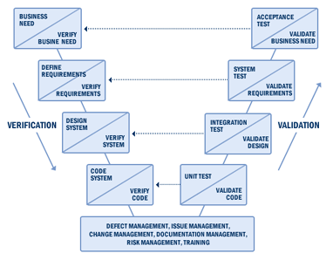
What’s JAD?
See http://www.umsl.edu/~sauterv/analysis/488_f01_papers/rottman.htm.
Like a customer focus group, but for design.
Stakeholders reach a consensus.
Like a predecessor to the XP idea of keeping a customer in the loop as you develop.
Goes with the “V & V Vee”

Slide 14
Stage 3: New tools and approaches
Pick your weapons!
Configuration management
Complexity analysis tools
Test case monitors
Analysis and design tools
New development environments
Also, time to “convert” to things people have been avoiding, like OO frameworks.
Need to spend on training!
The half-hearted will revert.

Slide 15
Stage 4: Infrastructure and specialization
Specialized teams for handling critical activities
Specialists outperform generalists
Testing
Maintenance
Integration
Configuration control
Technical writing
QA
Better organizational structures

Slide 16
Stage 5: Reusability
Has the best return on investment.
Surprised?
Effective reuse is difficult.
Includes reuse of errors!
Reusable components can be other than code:
Requirements
Designs and specs
User documents
Test plans, test cases and scripts

Slide 17
Step 6: Industry leadership at last
Goal: Outperform competitors in development and maintenance.
Typical signs of success:
Effective project management tool suites
Effective software development tool suites
Effective quality assurance and testing tool suites
Effective software processes and methods
Effective organizational structures
Effective technical teams with substantial specialization … and

Slide 18
Step 6, cntd
More signs:
High morale among the software staff
High user satisfaction levels
High regard by top corporate management
High regard by industry analysts
High regard by competitive organizations

Slide 19
Process improvement economics
= ½ person-month
“Per capita” = “per seat” for tools and training.
Notes:
Kan p 459

Slide 20
More economics
= 5 years
Here we see the slowness of cultural changes, even under almost ideal conditions.
Notes:
Kan p 460

Slide 21
And some more
Translation to $ or time?
Notes:
Kan p 461

Slide 22
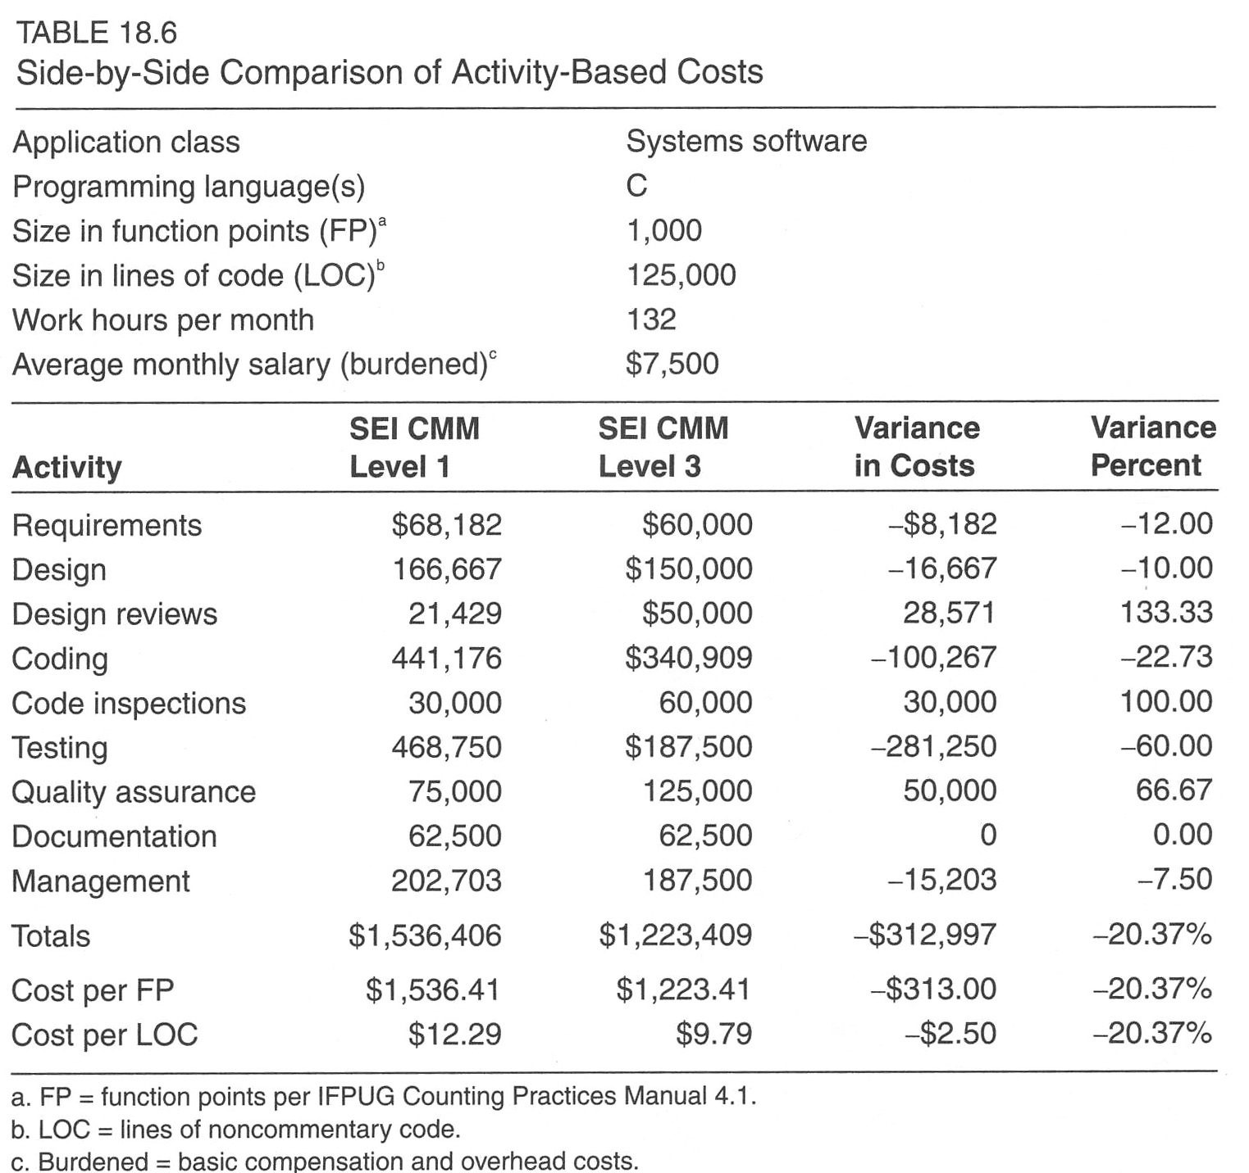
Measuring process improvement
Have to look at specific activities of projects.
Notes:
Kan p 465

Slide 23
Overall differences
This is the SEI selling story for their SCAMPI assessment process.
Notes:
Kan p 466

