Slide 1
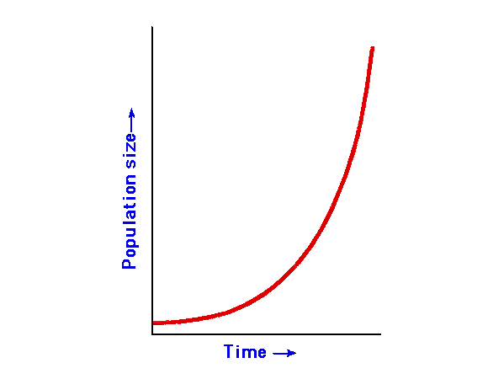
Exponential Distribution and Reliability Growth Models
Right: Wait – I always thought “exponential growth” was like this!
Kan Ch 8
Steve Chenoweth, RHIT

Slide 2
Reliability growth models
Exponential … and more
Rayleigh tries to model the whole lifecycle.
These models, in contrast, are for formal testing phases.
Worth doing because “Defect arrival or failure patterns during such testing are good indicators of the product’s reliability when it is used by customers.”
During formal testing, the software gets more stable, and “reliability grows.”
Notes:
Kan p 207

Slide 3
What do we mean by “reliability”?
More general than often used for large systems, where –
Reliability = MTBF, and
A “failure” is like a system crash.
Instead, here “reliability” = absence of all kinds of measurable faults, including:
Little things not working, and
Features not meeting specs.

Slide 4
What is our “Exponential model”?
Notes:
Kan p 208

Slide 5
And, it works…
Lots of places where this model is known to predict failures over time.
Can estimate defect arrival rates or time between failures.
Kan used for AS/400 studies.
Easy to set up.
A good place to start in modeling testing.
Notes:
Kan pp 208-9

Slide 6
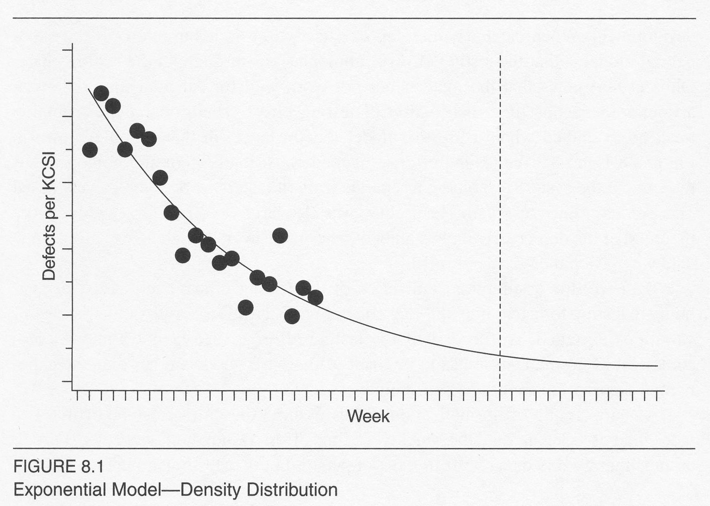
Kan’s AS/400 results
Notes:
Pp 209-210

Slide 7
More complex models
Try to fix problems with exponential model.
Generally more complex to set up.
May be harder to get their additional data.
Notes:
Kan Sec 8.2, pp 211+

Slide 8
Jelinski-Moranda model
A time between failures model
Assumes –
N software faults at start of testing.
Failures occur purely at random.
All faults contribute equally to cause a failure.
Fix time is negligible.
Fix for each failure is perfect.
Thus, software product’s failure rate improves by the same amount at each fix.

Slide 9
Jelinski-Moranda model, cntd
So, the “hazard function”
The instantaneous failure rate function
At time t_{i}, which is between failures (i-1) and I, is
Z(t_{i}) = φ[N – (i – 1)] , where
N = number of defects at beginning of testing, and
φ is a proportionality constant (not a function).
As each fault is removed, the hazard function decreases in value, and the time between failures increases.
Notes:
Kan pp 212-213

Slide 10
Even messier models
Each of these tries to get rid of some possibly untenable assumption in the previous models.
E.g., in the Goel-Okumoto Imperfect Debugging Model,
Defect fixes are allowed to be imperfect.
Z(t_{i}) = [N – p(i – 1)]λ , where
N = the number of faults at the start of testing,
P = probability of imperfect debugging, and
λ = the failure rate per fault.
Notes:
Kan pp 213-215

Slide 11
The Delayed S and Inflection S Models
Allow for separate defect detection and defect isolation processes.
The S-shaped curve that results allows for the delay between first failure observation and the time of reporting.
The S-curve results from this delay in reliability growth.
The inflection model also allows for detection dependence – the more we find, the more undetectable failures become detectable.
Notes:
Kan pp 215-216

Slide 12
A comparison of predictions
Notes:
Kan p 217

Slide 13
Criteria for Model Evaluation
Predictive validity
Capability
Quality of assumptions
Applicability
Simplicity
Bold = Kan’s preferences.
Notes:
Kan pp 218-219

Slide 14
How to model reliability
Examine the data.
Select the model or several models.
Estimate the parameters for the model.
Obtain the fitted model, by substituting the parameters.
Perform a goodness-of-fit test and assess reasonableness of the model.
Make reliability predictions based on the fitted model.
Notes:
Kan p 220

Slide 15
Step 1 - Examine the data
Notes:
Kan p 221

Slide 16
Steps 2, 3, & 4
2. Picked Exponential Model.
Had used Delayed S and Inflection S Models before, but,
In this data, Kan didn’t notice an increase-then-decrease pattern typical of those models!
3. Used two SAS processes to get constants K and λ. (See slide 4.)
4. Plugged those into the exponential model.

Slide 17
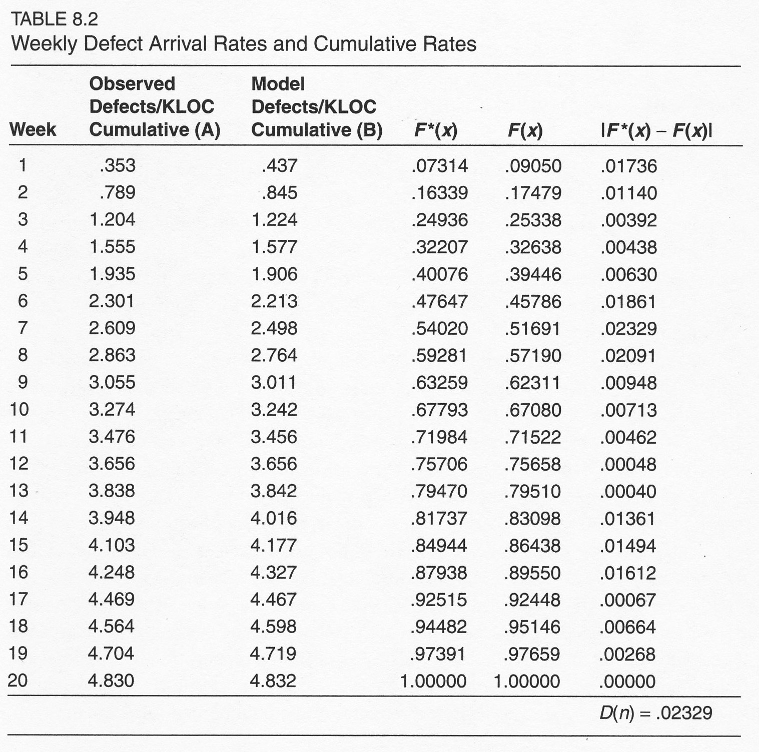
Step 5
Used Kolmogorov-Smirnov goodness-of-fit test, to validate the model:
Notes:
Kan pp 222-223

Slide 18
Step 6
Kan used this model during 4 years worth of testing!
“The projection from this model was very close tto the estimate from the Rayleigh model and to the actual field defect data.”
Notes:
Kan p 224

Slide 19
Test Compression Factor
These tests work best when:
Project is large,
Defect arrival rates tend not to fluctuate much,
The system is not safety-critical (!), and
Environment-specific factors are taken into account.
But, even being this cautious doesn’t mean you can extend the model into customer use (e.g., maintenance)!
Notes:
Kan p 224

Slide 20
What’s different about maintenance?
During testing, the sole purpose is defect detection and removal.
Test cases are maximized for defect detection.
Defect arrivals – usually much higher.
Customer, in contrast, takes time to find defects!
Defect arrivals may be much more spread out.
The difference between these = the “compression factor.”
Notes:
Kan p 224

Slide 21
Real-life comparisons
Notes:
Kan p 225

Slide 22
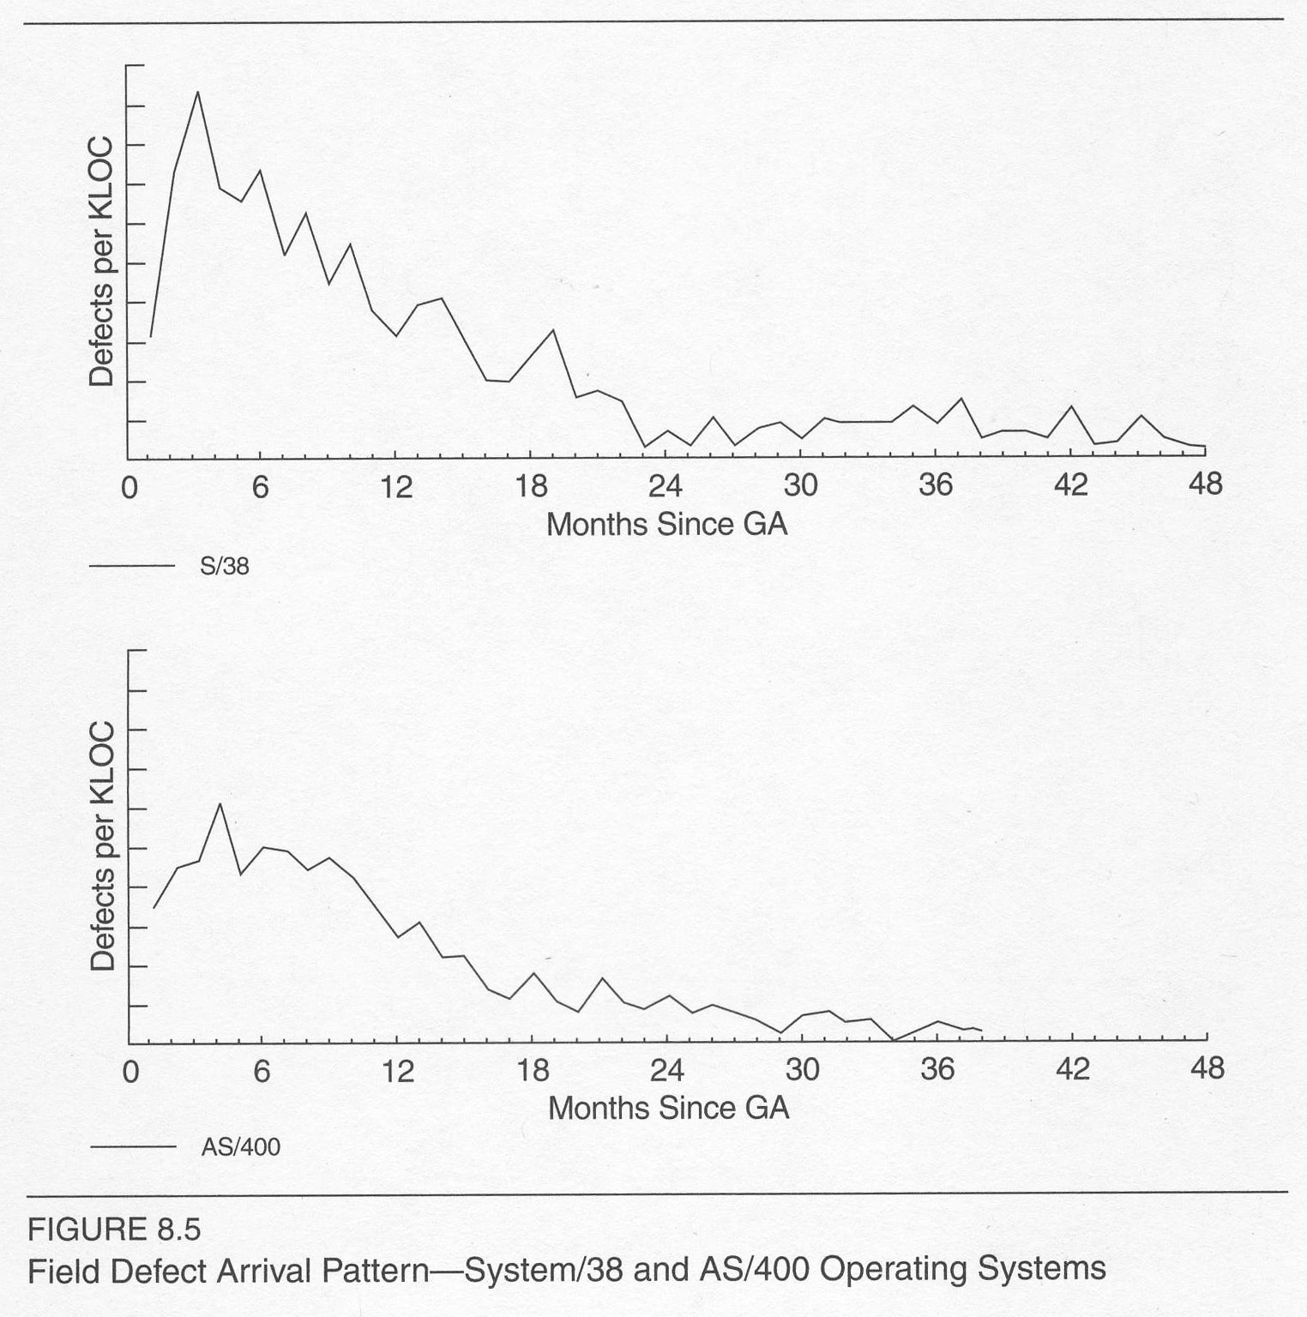
Estimating Total Defects
Use reliability models and,
Historical patterns for projecting into field use.
Notes:
P 226

Slide 23
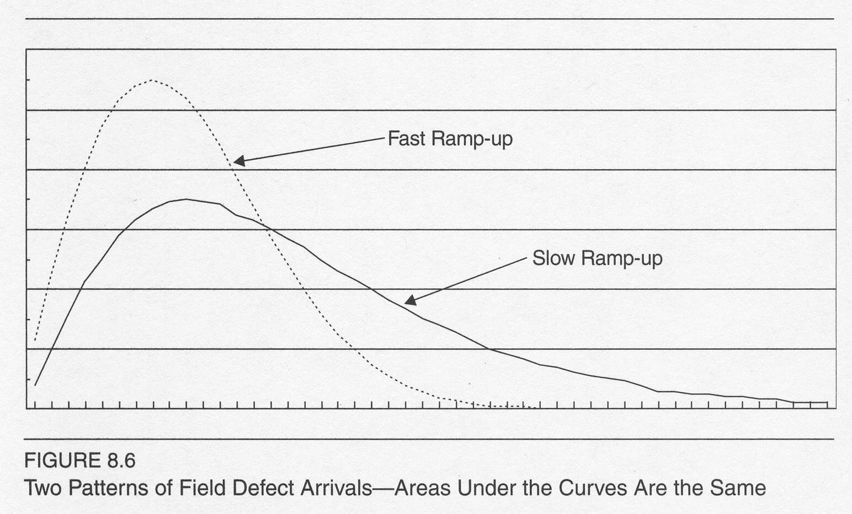
Fast vs Slow Ramp-up
Large systems and O/S’s – slow (3 years)
Typical apps – fast (2 years)
Notes:
Kan p 227

Slide 24
Conclusion on ramp-ups
Use your own historical data to estimate for new products.
Kan recommends a nonparametric method
Like 3-point moving average
To smooth the data.

Slide 25
Recommendations for small projects
For Ch 7 - Rayleigh can work, but requires people with the modeling expertise.
From Ch 6 – Use a test effectiveness metric, validate with prior projects. Then,
For Ch 8 – Gather data, etc., as described on p 220.
Pick a simple metric (in terms of both data needed and complexity to validate).
Interval estimating is easier.
Cross-validate results across projects, if comparable.
Know your assumptions!

