Slide 1
Measurement Theory
Ch 3 in Kan
Steve Chenoweth, RHIT
Notes:
Welcome to Math Land! We’ll be figuring things, for real, and looking at how that applies to our work.
Above image – How do you know if an observed test result is “close,” or not? Answer: Try to bound the possible error, in the way you measure it. From http://blog.questionmark.com/item-analysis-analytics-part-1-what-is-classical-test-theory.

Slide 2
What quality is about
You have to measure quality some way, to “know” if you have it!
If customer “happiness” can’t be anticipated by something you can measure, then you’re just guessing about uncertainties.
Engineering is all about the “controlling” of processes – how you do things.
In this case, how you achieve quality.

Slide 3
Quality vs Qualities
Quality is usually taken to be some degree of goodness, like how much a feature is there, how well it works, how fast it runs, etc.
Qualities are usually seen as these dimensions that you can measure or judge.
Almost inevitably, the more you can control the qualities you want to measure, the more reliably or accurately you can measure them.
Like “experiments.” So,

Slide 4
We want to run QA like science!
To begin with, you need to understand how to measure things carefully.
Thus, Kan’s Ch 3.
E.g., we try to do sequences of:
Observing things we can measure, then
Generalizing from those measurements,
Based on some careful method.
So, we gather data to test propositions about our products.

Slide 5
What stands in the way of science?
We don’t know how to control a lot of variables in real production processes like software.
We don’t do the same thing each time.
Just because measuring “errors per KLOC” worked well last time, doesn’t mean it will next time.
Thus, in software, we rarely rely on single measurements to decide things like, “Ship it.”

Slide 6
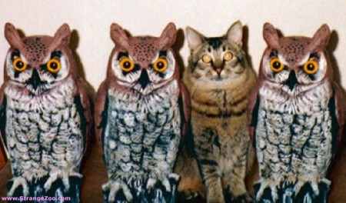
When is best chance for measurement?
Doing things like what you already know what to do!
The whole development process, if you just did several products a lot like this one!
It’s worth, at the start, deciding
What’s the same, vs
What’s different.
Notes:
Image from http://blog.cloudpassage.com/2013/04/16/one-of-these-things-is-not-like-the-others/.

Slide 7
We do apply common sense
But, we also test that!
E.g., “The higher the percentage of the designs and code that are inspected, the lower the defect rate at the later phase of formal machine testing.”
If you have guts, you can actually test if this is true or not!

Slide 8
You have to be careful using believed but untested common sense!
Notes:
From Daniel Kanneman’s Thinking Fast and Slow, 2013. Image from https://docs.google.com/file/d/0ByXsRacEHnd5aTkyb2Z5eDMwT00/edit.

Slide 9
We do hypothesis testing…
Notes:
From Kan, p 58.

Slide 10
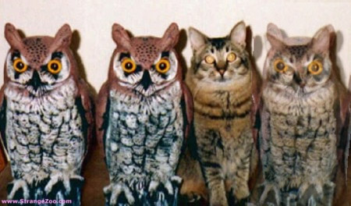
Kan’s levels of measurement
Nominal scale – classify things!
How about that new guy on the right?

Slide 11
Ordinal scale
Roughly, something like 1,2,3,4,5,6,7,…
Mathematical properties, such as:
If A > B and B > C, then A > C.

Slide 12
Interval and Ratio scales
Interval:
Product A’s defect rate is 5 KLOC,
Product B’s defect rate is 3.5 KLOC.
Then Product A’s defect rate is 1.5 KLOC greater than Product B’s defect rate.
Ratio:
We can also say that Product A’s defect rate is 1.43 x Prodct B’s defect rate.

Slide 13
Higher level vs lower level
Higher level measurements scales possess the properties of lower level ones.
Can’t do the reverse – If we have:
Excellent
Good
Average
Worse than average
Poor
How much better is Good than Poor? Who knows?

Slide 14
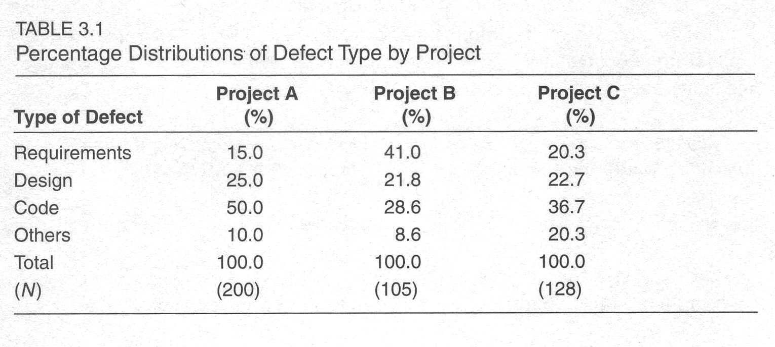
Games to play with the numbers
Ratio
Proportion
Percentage
Notes:
Table from Kan, p 64.

Slide 15
Percentage, cntd
Notes:
Kan, p 65

Slide 16
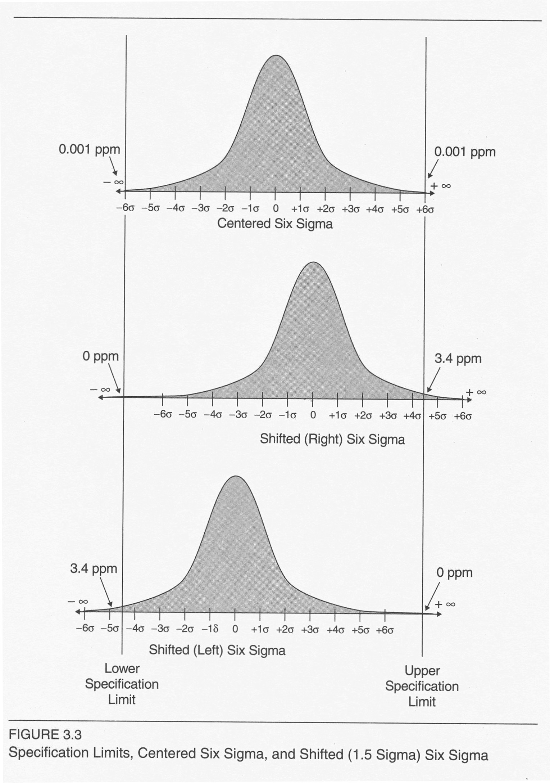
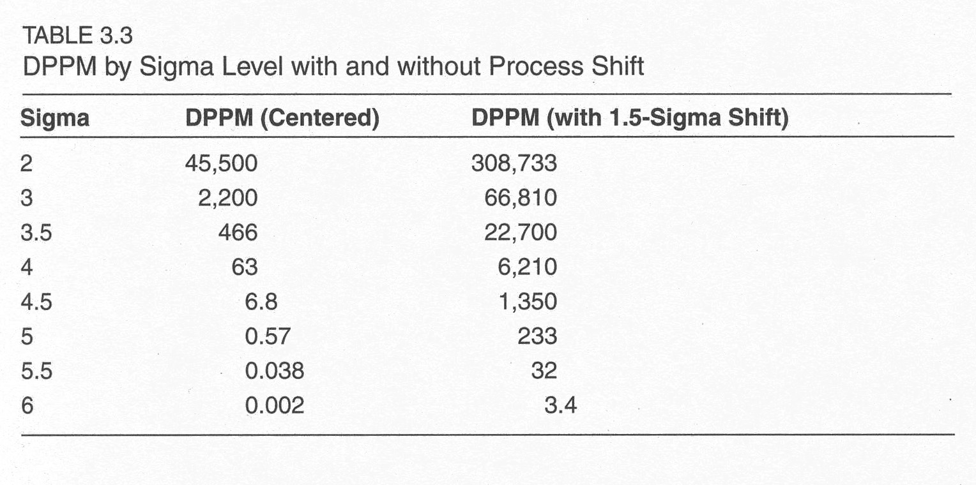
More games
Rate
Six Sigma
Notes:
Figure from Kan, pp 68-9

Slide 17
Reliability and Validity
Not the same thing
E.g., IQ tests – What do they really measure?
They all prove that they are “reliable” –
If you take it again, you’re likely to get close to the same score.
And they are “validated” against each other –
If you take a different test, you’re likely to get close to the same score.
So?

Slide 18
Validity =
“Does it measure what we intend it to measure?”
E.g., Do IQ tests predict how well students will do in school?
Angela Lee Duckworth, of U Penn, says a better key to success, even in school, is “grit”.
Other people cite motivation, “competence,” “multiple intelligences,” and other factors.
IQ tests predict best how well people do taking similar tests.
Notes:
See for example, https://www.ted.com/talks/angela_lee_duckworth_the_key_to_success_grit.
Last 3 vocabulary words on a famous IQ test: parterre, syzygy, and homunculus.
“For scientists, engineers, and medical doctors…the correlations between ability measures and occupational success are only around 0.2, accounting for only 4% of the variance (Baird, 1985). “ From http://www.danielgoleman.info/the-trouble-with-iq/.

Slide 19
How about for us?
What measures accurately if a product will be a success?
Or, even “not crash”?

Slide 20
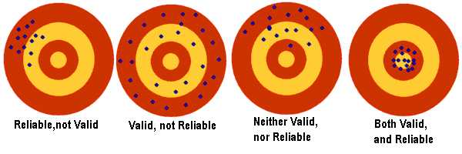
Reliability vs validity pictured
Measurement errors –
Systematic
Random
Notes:
Image from http://www.documentingexcellence.com/stat_tool/reliabilityvalidity.htm.

Slide 21
Reliability and Validity give confidence!
Reliability helps us know if our process is sound.
Correlation is used to judge validity.
Really hard to conclude “causality.”
If my alarm clock goes off at 7 AM every morning,
And yours goes off at 7:01 AM every morning,
Did my alarm clock make yours go off?

