Slide 1
Kan’s Intro and Overview Models
Ch1 & 2 in his book
Steve Chenoweth, CSSE

Slide 2
Quality – Popular views
You tell me – Is this a “quality house”?
Qualities are felt by us to be “qualitative” – matters of opinion.
Notes:
From http://www.archidir.com/house-design/museum-quality-house-design-in-holly-oak-drive-los-angeles/. According to Architecture Directory, it is a “Museum-quality house design in Holly Oak Drive Los Angeles.”

Slide 3
Quality – Professional view
We can’t be vague about “quality” even if it is a set of attributes which lead to a sweeping decision by a stakeholder.
The two classic ingredients in quality:
Conformance to requirements, and
Fitness for use.
The customer thinks they are “buying quality.”
It’s more than just features functioning as they should –
Also “how well?”

Slide 4
Quality – the stakeholder’s view
Users will see it from the perspective of their usage.
Clients will try to add it all up into one judgment
Because they have to write one check for it.
Things outside your control influence their decision, like how well the demo went.
“Let me try it!” A very dangerous request!
Notes:
Image from http://www.inc.com/welcome.html?destination=http://www.inc.com/geoffrey-james/give-a-great-product-demo-5-rules.html.

Slide 5
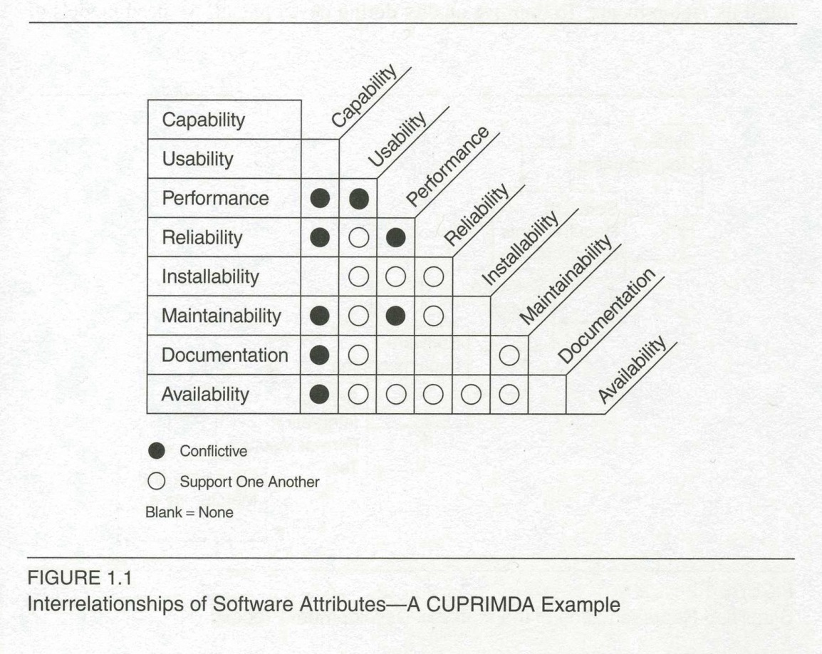
Software quality
And many of those “high level” qualities don’t exactly work together!
Notoriously, the faster it runs, the less reliable (or available) it is. Performance and
Usability also are contrary:
E.g., an expert can operate a system faster,
But usually using some cryptic techniques.

Slide 6
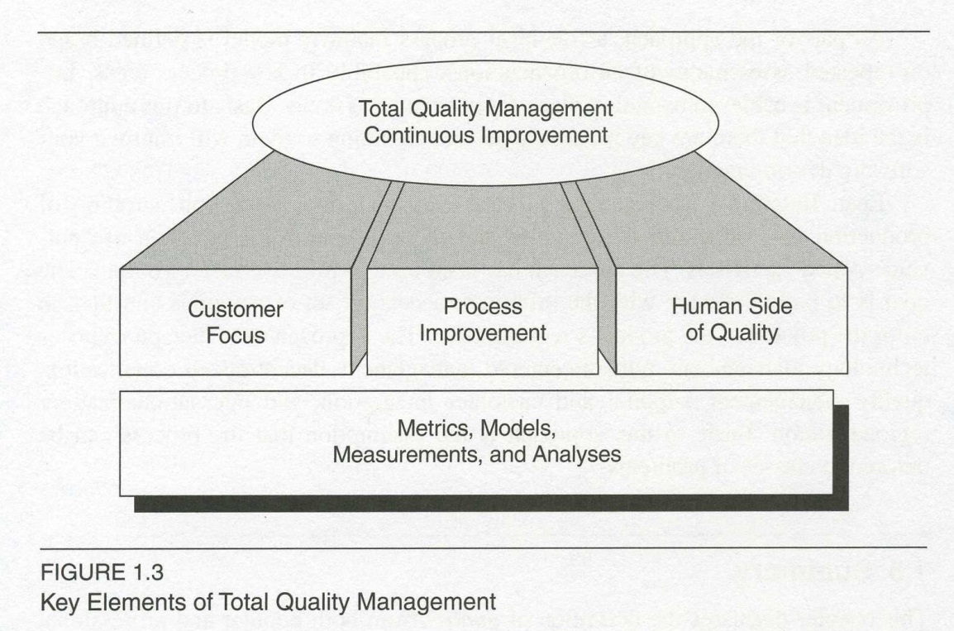
Total quality management (TQM)
The Japanese style of management of quality (1980’s)
Many current quality approaches are based on it:
Malcolm Baldridge
ISO 9000
Six Sigma
Includes the multiple aspects shown here:

Slide 7
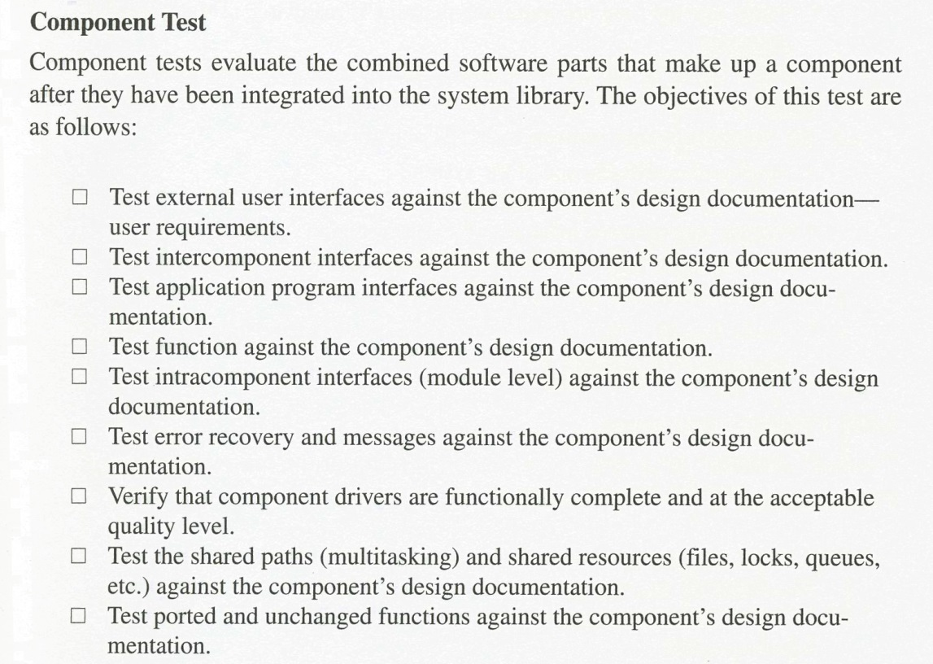
The Waterfall?
How can this be a quality approach?
It’s “divide and conquer,” sequentially.
Gives clear ways to measure progress
Against clear objectives.
Provides natural milestones at the end of each stage.
At right – Here’s an example:
It’s a disciplined approach!

Slide 8
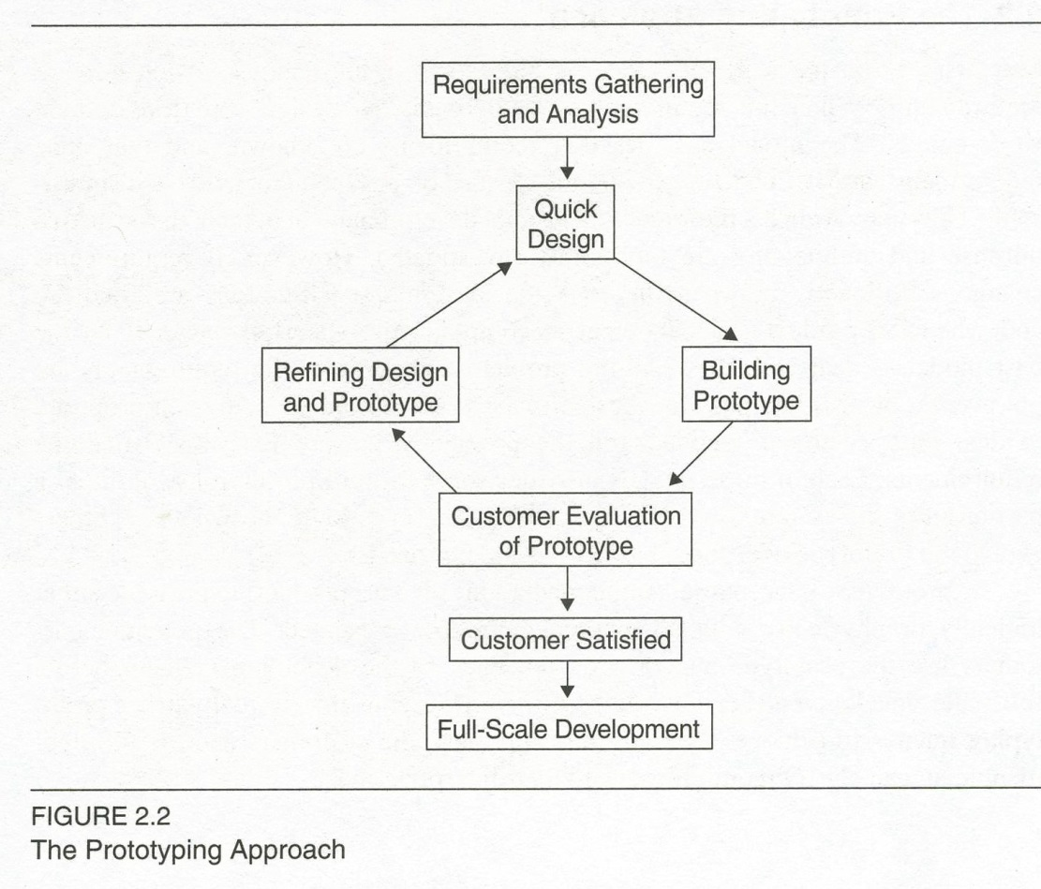
Prototyping approach
Kind of the opposite of the waterfall:
“We don’t trust that they know what they want,” or perhaps
“…that we can build it,” so
We do a quick design
To show them, or
To prove something to ourselves.
The prototype is either
Throwaway, or
It evolves.
Which is better?

Slide 9
Boehm’s spiral
It’s so famous, I’m not going to draw it.
It’s “risk reduction” in stages.
Uses a series of prototypes.
Requires repeated stakeholder interactions.
You really only have one delivery, at the end.
Especially good for integrating diverse components.
Famous issue:
Doesn’t fit well with complex, contractual developments.

Slide 10
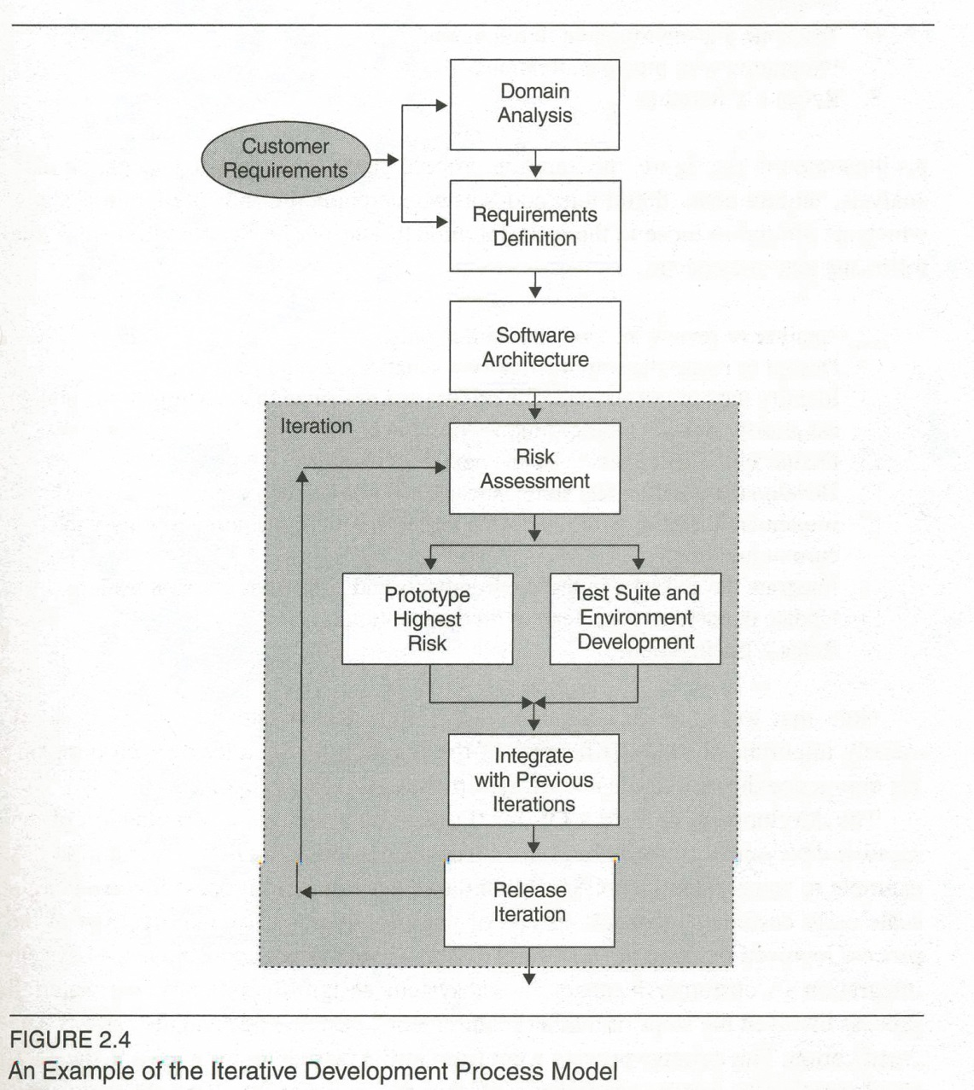
Iterative model
You really deliver it in stages.
The customer uses each successive one.
A strategic quality step is right here:
I used to run these assessments, at NCR and at AT&T.
The position shown is perfect!
→

Slide 11
OO process
Our OO analysis and design methods really differ from the rest of engineering:
Spend time just modeling what happens in the domain.
Emphasis on making systems that are easy to evolve,
In addition to whatever properties they give their stakeholders.
The structure of the software resembles objects in the domain.
Classes are added for maintenance as needed:
E.g., an “adapter” to make interaction easy with some changing, outside entity.
A big win – having code expressive enough that less documentation is needed to maintain it.

Slide 12
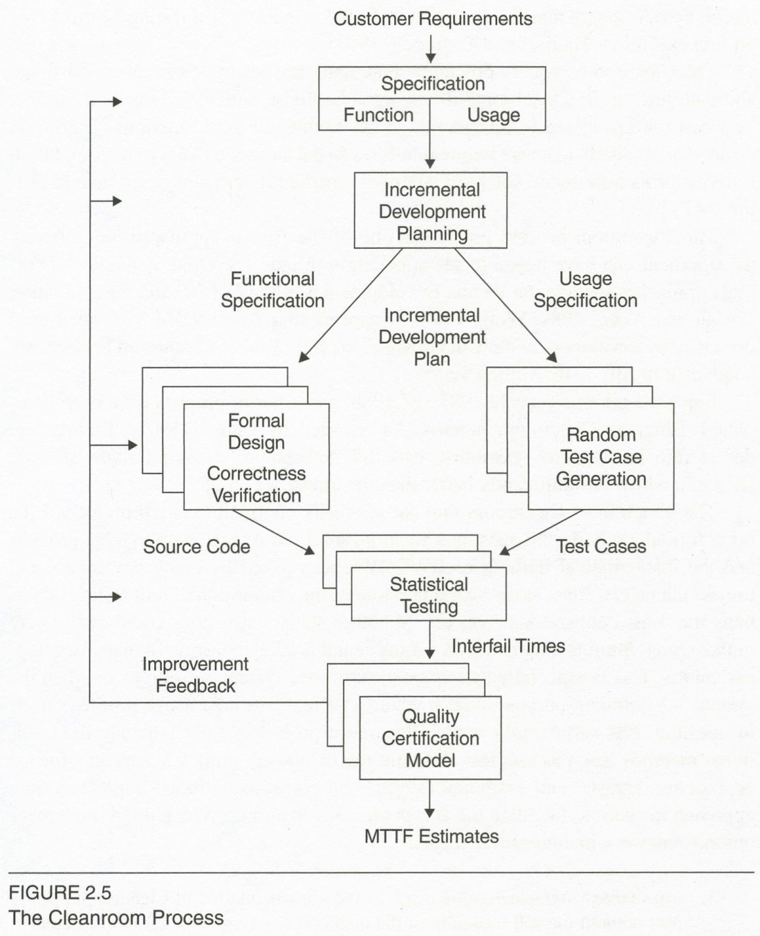
Cleanroom
Idea is to get it right as a spec or model.
The building of the real thing is then perfunctory.
Theoretically, you don’t have to test it!
Formal methods, etc.
You anticipate customer use.

Slide 13
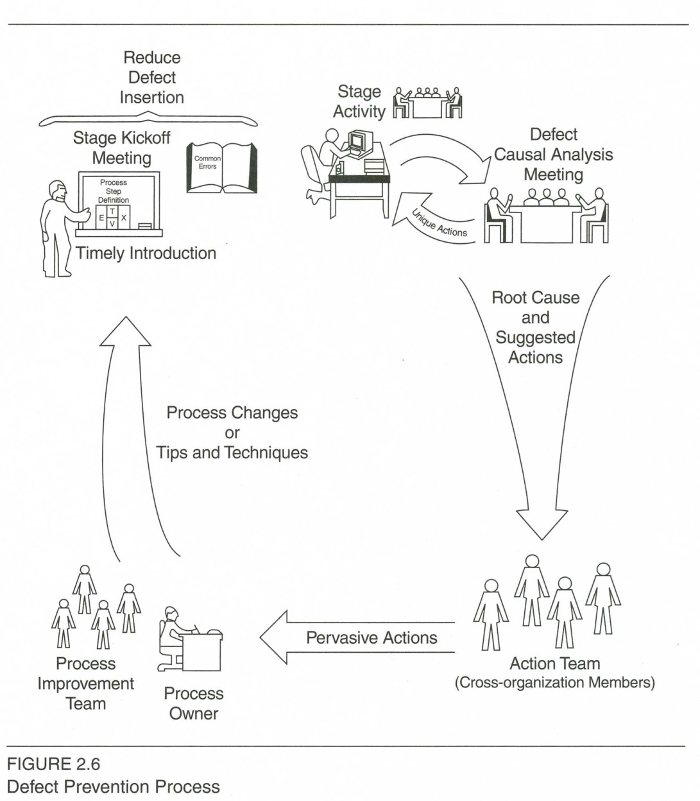
Defect prevention process
This is a process process:
How to continually improve the development itself.
(If not the split infinitives.)
Requires searching for causality.
That decides what to fix!
Teams work together.
Have meetings at start of each development effort:
“What are we going to change?”

Slide 14
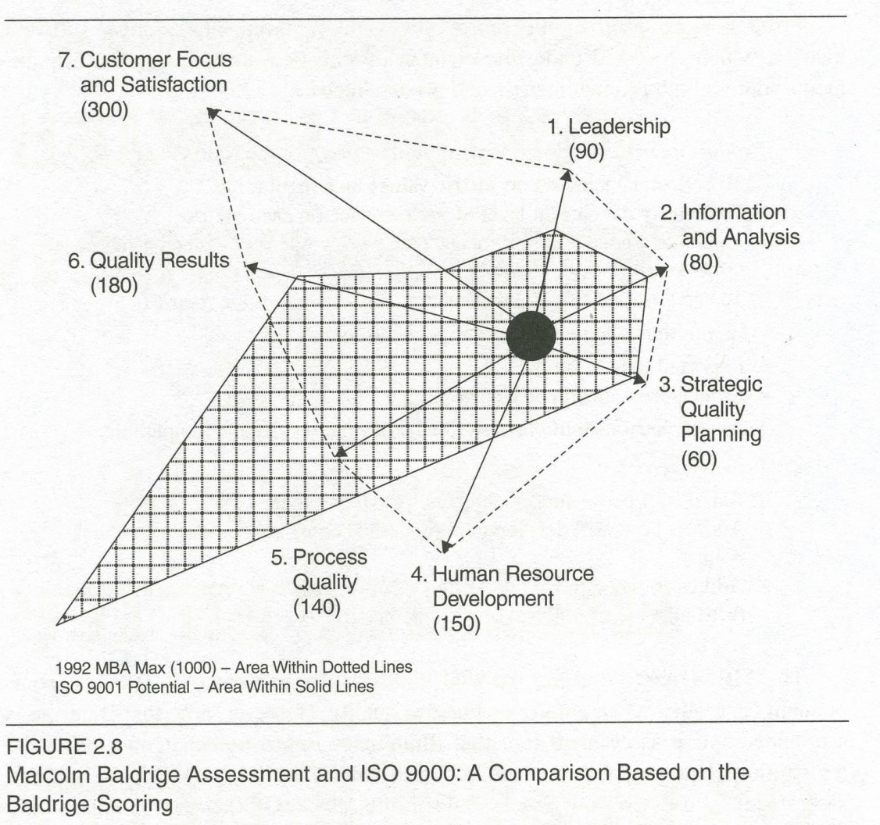
Quality standards
We’ll look at many!
SEI’s “Capability Maturity Models”
Jones’s SPR Model
Baldridge
ISO 9000
They don’t all agree on what’s important:

