Slide 1
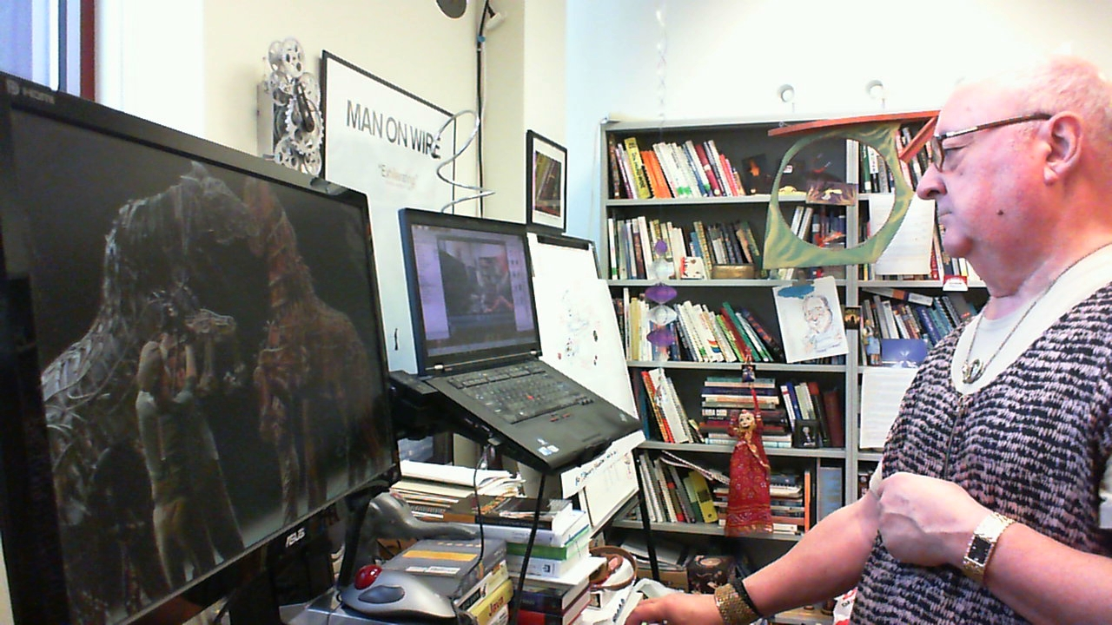

CSSE 576 Software Quality Assurance:
Introduction
Steve Chenoweth
Office: Moench Room F220
Phone: (812) 877-8974 Cell (937) 657-3885
Email: chenowet@rose-hulman.edu
Notes:
In the image I demonstrate aspects of quality – The watch is my late father-in-law’s Bulova, which still keeps perfect time about 30 years after he bought it. My screen background is from the stage play “Warhorse,” about World War I, and in which the mechanical horses are hauled around by visible humans, yet it still successfully conveys the sensation of horses moving. The desk device my laptop and monitor are on allows for standing or sitting and transitions almost effortlessly between those modes.

Slide 2
Agenda
5:00pm – Introductions
Syllabus and schedule
Epic Software Quality Failures
What is Software Quality and why Assure it?
Learning outcomes
6:45pm ish – Break
Intro to Quality Assurance Concepts
Software Development Process Models
8:30pm ish – Done!

Slide 3

Let’s get to know each other…
Lived where?
Interests?
Schools?
Jobs held?
What’s the thing I like to
do the most in the Spring?
Notes:
Image from http://www.brockpest.com/blog/2012/03/spring-family-activities/.

Slide 4
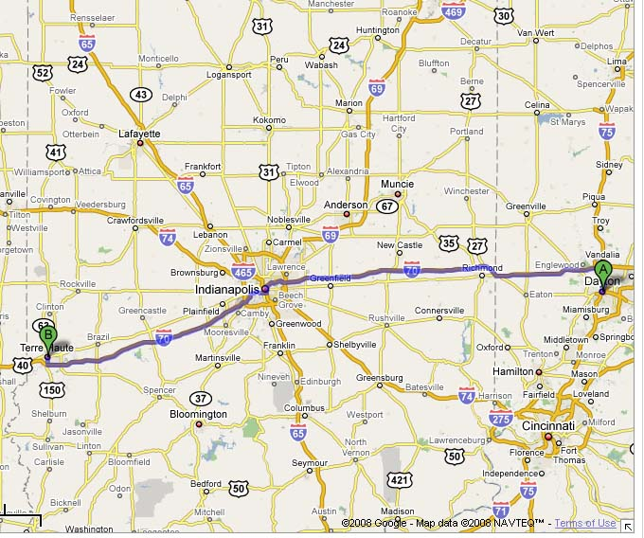
Where I live and work - 3 places!
Grad Class
Weekends
Undergrad Classes

Slide 5
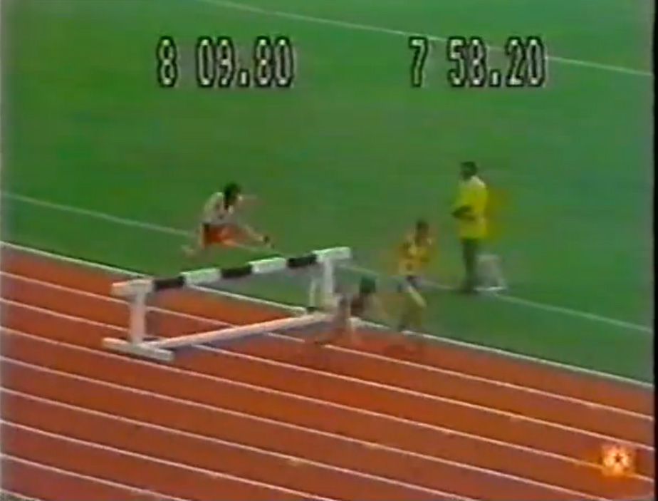
Epic Software Failures
European Space Agency’s Ariane 5 Explosion
Hospital Radiation Incident
London Ambulance
Service
NASA Mars Lander
AT&T Switch Failure –
$Billion bug
2013 Affordable Care
Act enrollment
Right – Epic failure in action: Frank Baumgartl falls on the last obstacle while leading the Steeplchase at the 1976 Olympics. Anders Garderud passes him to win in world record time.
→

Slide 6
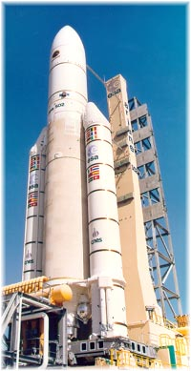
European Space Agency
Ariane 5 Failure
Ariane 4 SRI (Inertial Reference Systems)
software reused on new Ariane 5
Operand Error exception due to
overflow in converting 64bit FP to
16bit INT
Launcher disintegrated after 39 sec
because of high aerodynamic loads
Cause: Unknown Bug introduced with Reuse
→
Notes:
What was the technical cause of the Ariane 5 explosion and the management cause?
Ariane 4 accelerated much slower, used different trajectory
On Board Computer interpreted SRI diagnostic pattern as flight data and commanded nozzle deflection
SRIs measuring the attitude and movements of the launcher.
Horizontal attitude sensor caused overflow.

Slide 7
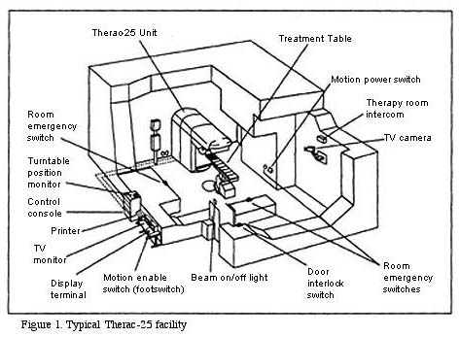
Medical Radiation Incident
Machine provide graphical user interface
Hospital workers selected options via fields
  Tab-key & Shift-Tab combination used to move between fields
Some hospital workers used up & down arrows to move between rows of fields
  Moved cursor, but internally,
  didn’t change fields
Result: Data entered in wrong
fields some patients over-
radiated and did not survive
Cause: Usability Defect
Notes:
Image from http://computingcases.org/case_materials/therac/analysis/SocioTechnical_Analysis.html

Slide 8
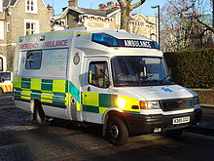
London Ambulance Service
Computer Aided Dispatch System to automate human-intensive processes of manual dispatch
  Call Taking (assumed to be better)
    Receive calls, record incident details, pinpoint location
System went live on 26th October 1992
  Taken offline next day and reverted to semi-manual dispatching on 28th October 1992
Increased incident errors =>increased number of exceptions =>increased incorrect information
Result: 20–30 people speculated to have died as a result of ambulances arriving too late
Cause: Insufficient Load Testing
Notes:
Computer Aided Dispatch System to automate human-intensive processes of manual dispatch
Call Taking (assumed to be better) - Receive calls, record incident details, pinpoint location
System went live on 26th October 1992
Taken offline next day and reverted to semi-manual dispatching on 28th October 1992
Increased incident errors =>increased number of exceptions =>increased incorrect information
Multiple ambulances sent to same location
Closest ambulance not chosen for dispatch

Slide 9
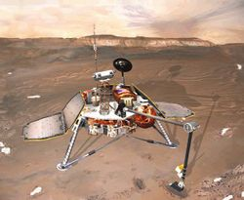
Mars Polar Lander
Last telemetry from Mars Polar Lander December 3, 1999
  No further signals have received – cause is unknown
Most likely cause of the failure was a software error that mistakenly identified the vibration caused by the deployment of the lander's legs as being caused by the vehicle touching down on the Martian surface, resulting in the vehicle's descent engines being cut off whilst it was still 40 meters above the surface, rather than on touchdown as planned.
  Another possible reason for failure was inadequate preheating of catalysis beds for the pulsing rocket thrusters
Result: Lost Mars mission.

Slide 10
AT&T Switch Failure (Jan 15, 1990)
In pseudocode, the program read as follows:
1 while (ring receive buffer not empty and side buffer not empty) DO
2 Initialize pointer to first message in side buffer or ring receive buffer
3 get copy of buffer
4 switch (message)
5 case (incoming_message):
6 if (sending switch is out of service) DO
7 if (ring write buffer is empty) DO
8 send "in service" to status map
9 else
10 break END IF
11 process incoming message, set up pointers to optional parameters
12 break
END SWITCH
13 do optional parameter work
Notes:
When the destination switch received the second of the two closely timed messages while it was still busy with the first (buffer not empty, line 7), the program should have dropped out of the if clause (line 7), processed the incoming message, and set up the pointers to the database (line 11). Instead, because of the break statement in the else clause (line 10), the program dropped out of the case statement entirely and began doing optional parameter work which overwrote the data (line 13). Error correction software detected the overwrite and shut the switch down while it could reset. Because every switch contained the same software, the resets cascaded down the network, incapacitating the system.
From http://users.csc.calpoly.edu/~jdalbey/SWE/Papers/att_collapse.html.

Slide 11

Affordable Care Act
Disastrously slow early sign-up performance
Errors in validity of documents created
Notes:
Image from Nov 30, 2013 article at http://www.npr.org/2013/11/30/247898470/glitches-in-digital-insurance-forms-threaten-aca-rollout, which cited the next problem after capacity as being the quality of the data transmitted from the government site to insurers, via the “834” information form.

Slide 12

So, … what is quality and what do you do to assure it?
Think for 15 seconds…
Let’s discuss!
Opposite of quality?
Notes:
A characteristic that indicates value and a lack of defects.
Poster is from 1986 movie “The Money Pit,” http://en.wikipedia.org/wiki/The_Money_Pit.

Slide 13
IEEE Definition of "Software Quality"
The degree to which a system, component, or process meets specified requirements.
The degree to which a system, component, or process meets customer or user needs or expectations.

Slide 14
IEEE Definition of
"Software Quality Assurance"
A planned and systematic pattern of all actions necessary to provide adequate confidence that an item or product conforms to established technical requirements.
A set of activities designed to evaluate the process by which the products are developed or manufactured. Contrast with quality control.

Slide 15
Assurance in Verification & Validation
Verification:
An iterative process aimed at determining whether each step in the development cycle fulfills the requirements levied on it by the previous phase.
Is internally complete, consistent, and sufficiently correct to support the next phase.
“Are we building the product right?”
Validation:
The process of executing the software to exercise the hardware and comparing the results to the requirements specifications.
“Did we build the right product?”
V&V
Activities
Formal
Reviews
Inspections
Audits
Testing
Verify Test
Application
and Results
Adherence
to Standards
→

Slide 16
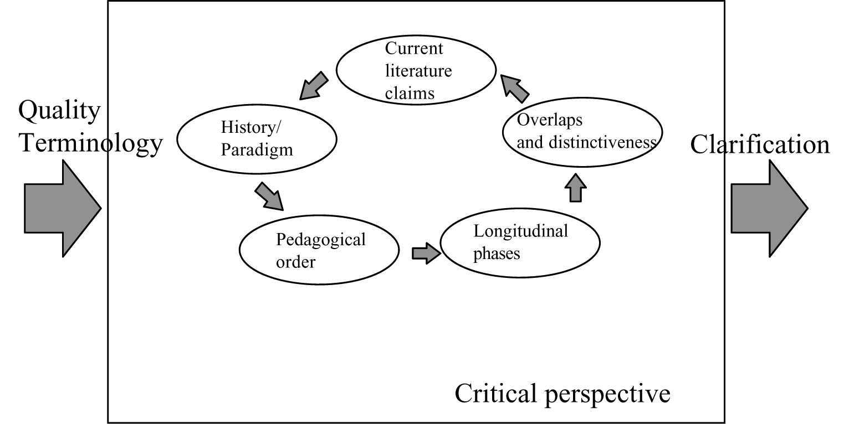
Learning Outcomes: Vocabulary!
Talk the language of your peers, the software quality engineers.
How do you
know if you
have a
“quality
plan” for
quality?
Notes:
Image of a quality plan for quality terminology, from http://www.emeraldinsight.com/journals.htm?articleid=841956&show=html

Slide 17
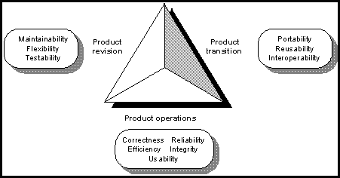
Learning Outcomes: Models
Apply the many sorts of quality models and when to use which ones.
Quality management models
Complexity metrics and models
Process improvement
Above – The McCall model from 1977

Slide 18
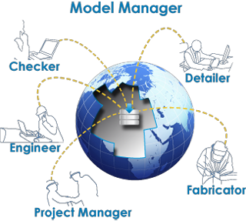
Learning Outcomes: Process
Manage quality processes effectively.
Inspections and reviews
CMM, Six Sigma, Lean, etc.

Slide 19
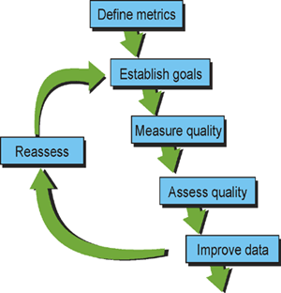
Learning Outcomes: Metrics
Use and choose metrics to keep in assessing product and process quality.
Measurement discipline
Product and process metrics
Metrics programs

Slide 20
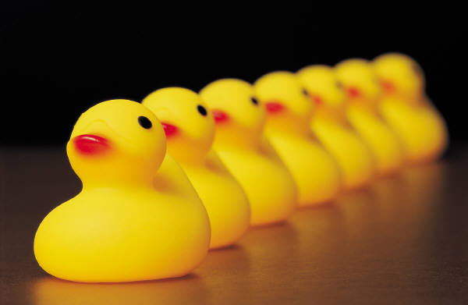
Learning Outcomes: Testing
Set up and measure more complex systems type tests.
Performance Testing
Availability Testing
Localization Testing
Usability Testing
Security Testing

Slide 21
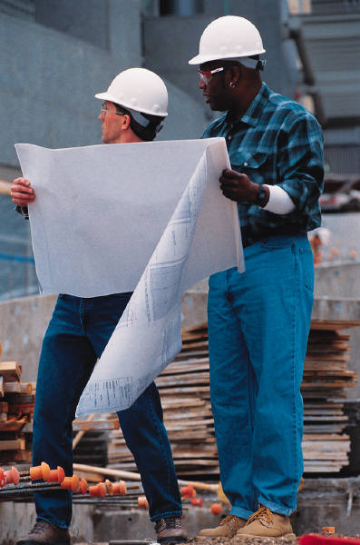
Learning Outcomes: Acceptance
Effectively verify customer satisfaction.
On-site and beta testing
Customer surveys
Analyzing data

Slide 22
Learning Outcomes: Assessments
Conduct project-level assessments, software inspections and peer reviews.
Preparation
Running them
Evaluation
Above - The right stuff? One process for use of metrics.
Notes:
Image from http://www.signal.army.mil/OLD/ocos/ac/Edition,%20Fall/Fall%2001/JSCmtrc.htm.

Slide 23
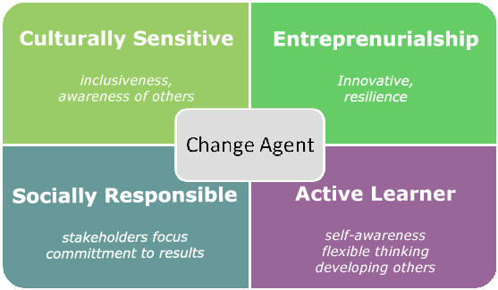
Learning Outcomes: Making Change
Be able to recommend effective process improvement strategies.
Measuring maturity
Measuring capability
Staged vs continuous
Notes:
What it really takes to make changes? Image from http://plpnetwork.com/2010/04/08/educator-as-change-agent/.

Slide 24

Course Textbook and Readings
Required Textbook
  Metrics and Models in Software Quality Engineering, by Stephen H. Kan, Addison-Wesley, 2003, 2nd edition,
  ISBN-10 0-201-72915-6.
Readings will be assigned
from relevant papers
  Case studies
  Additional topics – e.g., software performance engineering
Notes:
Picture of the book’s author, from http://www.msse.umn.edu/directory/Stephen-Kan-PhD.

Slide 25
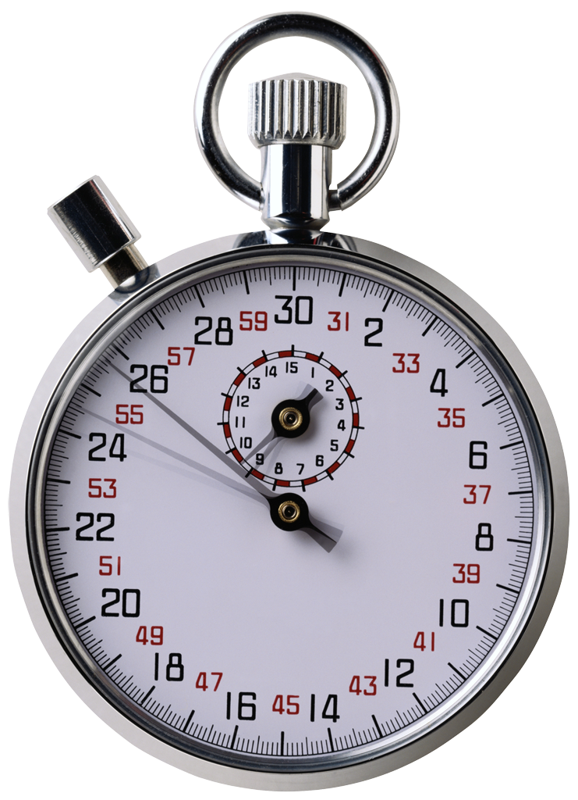
What is the difference between an error and a failure?
Think for 30 seconds…
Let’s discuss!

Slide 26
More Definitions
Software Error – an error that can be attributed to a defect in software.
  A bug that can cause a failure or incorrect output.
  Defect – incorrect software or specification
Software Failure – a abnormal or unexpected behavior in software that result in an undesirable situation.

Slide 27
Causes of Software Errors
Faulty requirements definition
Client-developer communication failures
Deliberate deviations from software requirements
Logical design errors
Coding errors
Non-compliance with specifications
Shortcomings of the testing process
Procedure errors
Documentation errors

Slide 28
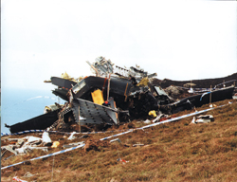
Software Related Failures
Programming errors
  Errors such as incorrect storage size can be catastrophic
Passive failures
  Software, node, and link failures can cut-off sub-systems
Active failures
  Faulty software can interfere
  with other sub-systems
Byzantine failures
  Malicious agents can actively interfere with system operation
Chinook Helicopter Accident:
Cause → software error
→
Notes:
What are examples of Byzantine failures in software? [Rogue BOTs can try to block network and deny service, Trojan Horses, viruses]
Programming: Arianne 5 failure was due to overflow in a 16 bit integer variable!
Passive: failure due to not protecting from failure - Satellite controller failures can cause a belly-up
Active: failure of software that causes other failures - Car controller or sensor errors can cause car collisions
Byzantine: Rogue BOTs can try to block network and deny service
Found “Cook and Tapper” grossly negligent in1994 crashing Chinook Helicopter in Scotland, killing all 29 on board

Slide 29
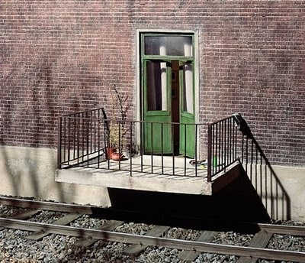
Defects Injected Early, but
Discovered Late
Address wrong needs
Specify incorrect behavior
Technically flawed Design
and Implementation
Test plans miss
functionality
The later these problems are found, the more likely they are to cause the project to fail
Our perspective, as developers!
→
Notes:
Projects can address the wrong needs
Requirements can specify incorrect behavior
Design, architecture and code can be technically flawed
Test plans can miss functionality
The later these problems are found, the more likely they are to cause the project to fail

Slide 30
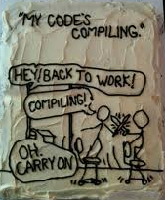
Poor Programming Habits and
No Accountability for Work
Poor control of source code
and other artifacts
Write-Only Code
Poor test cases
The team does not have a good sense of the overall health of the project
Our boss’s perspective?
→
Notes:
Programmers don’t have good control of their source code
Code written by one person is often difficult for another person to understand
Programmers don’t test their code, which makes diagnosing and fixing bugs more expensive
The team does not have a good sense of the overall health of the project.

Slide 31

Managers trying to test quality into the software
Assumes testers will catch all of the defects
When testers miss defects, everyone blames them for not being perfect
Always blame the last guy who touched it!
→
Notes:
Everyone assumes that the testers will catch all of the defects that were injected throughout the project.
When testers look for defects, managers tell them they are wasting time.
When testers find defects, programmers are antagonized because they feel that they are being personally criticized.
When testers miss defects, everyone blames them for not being perfect.

Slide 32
What does software quality have to do with productivity?
Think 15 seconds
Let’s discuss!
Your managers will like this question!
→
Notes:
Rework – 40% of typical process
Extra work for business line staff with workarounds
Delayed delivery

Slide 33
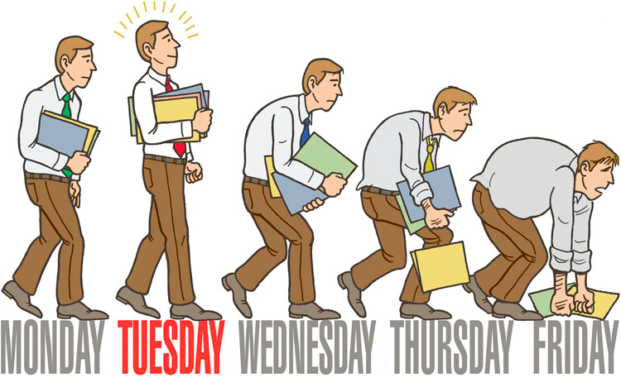
It’s Tuesday… are we productive yet?

Slide 34

Thirty-eight Years of Progress
2014
Engineering Design (Inter/Multidisciplinary, Optimize…)
& Human Centered Design (Usability, Customer…)
Computing = Pervasive
Systems = Distributed; Large = ~10M SLOC
Change Focus = Architecture
Trade-Offs = Effectiveness (Product-Line, Change…)
1976
Structured Design (Data flow, modules, …)
Computing = Centralized
Systems = Standalone; Large = ~100K SLOC
Change focus = Source Code
Trade-offs = Efficiency (Memory, processing time…)
Software Programmers
(Database, Algorithm...)
Software Disciplines (Database, HCI, Web...)
Computer Disciplines (Network, Embedded, Sensors...)
Application Domain Disciplines (Business Mgt., Aerospace...)
We have better Software and Productivity…
but, we are not keeping pace with demand!
→
Notes:
Interesting problem cited early where models are all wrong, but some are useful.
Also, models answer questions (sometimes we do not not the right way to answer the questions and stress things too far).
I think that model-based approaches are largely useful.
This reminds me of the chicken and egg problem -- which came first? The solution is…

Slide 35
Provocative Statements on Software Engineering
Software Engineering’s time has come and gone.
(see notes, below) Tom DeMarco
Software engineering isn’t engineering.
  Peter Denning
Many advancements now measurable - we have come a long way, but there is still much to do Barry Boehm
Social problems complicate technical ones -- adoption of new tools hampered by business and management objectives Bob Glass
→
Notes:
In an essay in IEEE Software, 2009. See http://www.computer.org/portal/web/computingnow/0709/whatsnew/software-r.

Slide 36
Hardware View of Productivity Gap
Moore’s Law
100M
1000M
10M
100M
Development
Productivity
Gap
1M
10M
Gates/Month in Application
Logic Gates/Device
1M
100K
10K
100K
1K
10K
Notes:
Is the productivity problem in computing strictly a software issue? Why, or why not? [no, hardware growth is also outstripping our ability to use it]

Slide 37

Software System Landscape
Littered with lots of new stuff
  Self-Aware/Healing Systems, Web Apps, Service-Oriented Architectures, Ubiquitous Computing…
It’s Big and Connected
  Lots of Components Distributed across Net
It’s Complex
  The number and intricacy of
  the interactions
Can’t fit it all in the engineer’s head!
→
Notes:
Complexity makes change hard…
Models simplify understanding…

Slide 38
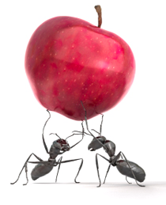
Productivity
Typically expressed as a ratio of
Outputs / Inputs
  E.g., Function Points / Staff Month
  Assumes units of output & input are
  known, consistent, & unambiguous
  Assumes they are continuous and linear
Also a function of quality
Business productivity viewed as Utility/Cost
→
Notes:
What is the general equation for productivity and what is an example of a software productivity measure? [ratio of output/input, FP/staff month]
Function points / fortnight
What about disruptive technologies that improve productivity – robots in manufacturing

Slide 39

Software Productivity’s Greatest Increases
Abstraction Higher
Level Models
(Languages)
Reuse (levels)
Software Process (types/maturity)
Automation - (cobbler’s children)
→
Notes:
What are the four greatest levers used to address software productivity? [Abstraction, reuse, process, and automation]
Higher Level Models (Languages)
5th/4th/3rd Generation Languages … micro-code
Reuse
Reuse of Applications (Product-Lines…)
Reuse of Concepts (Application Generators…)
Reuse of Design (Portable designs, Design patterns, …)
Reuse of Programs (Quasi-portable constructs, …)
Software Development Process
Capability Maturity
Reduction of Rework
Quality Improvement
Automation - (cobbler’s children)
Typically a function of advancements in the other areas…
Point solutions prevailed early on, but overcome later…

Slide 40
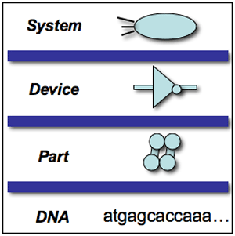
Language Abstraction
General Purpose Languages
Micro Code – bit by bit
Assembly Code – register by register
Early Procedural Languages (e.g., Fortran)
  Decision by decision,
  Computation by computation
Object-Oriented Languages
  Object by object, class by class, …
Domain Specific Languages ?
Architecture Description Languages ?
→
Notes:
In the past, what has been the most effective means of improving productivity in software? [Raising the abstraction level via programming language]

Slide 41
Software Reuse Effectiveness
Application
Generators
Product
Lines
Domain
Reuse
Configurable
Applications
Design
Patterns
Services
Reuse Leverage
COTS
Integration
Design
Reuse
Component-Base
Development
Code
Reuse
Program
Libraries
Effort to Reuse
Notes:
This is linear but, as experience is gained, this becomes geometric with generation technologies…

Slide 42
Process Maturity Levels
Maturity
Level
Defined
Process metrics focus
High predictability
Process => Success
Medium Risk
Input
Output
3
Repeatable
Project metrics focus
Low variability/Medium predictability
PM => Success
Medium-High Risk
2
Input
Process
Output
Process
?
Ad hoc
High variability/Low predictability
Heroes => Success
High Risk
Input
1
→

Slide 43
More Traction at Upper levels...
Maturity
Level
Direction
Optimized (Incorporated)
Value metrics
High predictability
Agility => Success
Low Risk
Output
Input
5
Performance
Resource
Managed
Product and Process metrics
High predictability
Managed Process
=> Success
Low-Medium Risk
Output
Input
4
→

Slide 44

Some Factors Affecting Productivity
Abstraction level of Language/Reasoning
Application Domain Experience
Common understanding of
problem/solution
Quality
Process
Project
Technology support
Development environment
Notes:
How do quality factors effect software productivity? [rework and lost time in repairs]

Slide 45
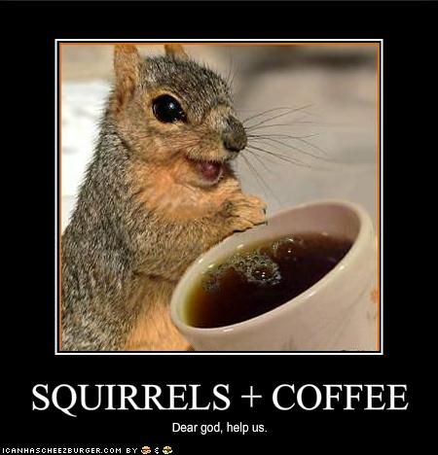
Productivity Enhancement
Notes:
From http://cheezburger.com/1695181568. What is the intended meaning of this poster?

Slide 46
Software Engineering is about
Scale and Quality
People have done projects for a long time and all of them deal with quality issues
  e.g., Buildings, Boats, Planes
  Computers, Communication systems, Software…
Their experience has been recorded in process models that have quality assurance
Quality assurance, control, management are cross-life cycle activities that govern the quality production of purposeful products
→

Slide 47
Quality → Cross-Life-Cycle Activity
SQA is one of the Cross-Life-Cycle Activities used to gate or control the life cycle for better flow and throughput
  Software Quality Assurance
    e.g., Testing, formal technical reviews, inspections, audits, …
  Software configuration management
  Software project management
  …
Control
Manage
Assure
More about life cycles in the next slide set!
→

Slide 48
Standard 12207 Development Process
Process Implementation Activity
DPP, SDSD
Software
Qual Test
Software
Integra- tion
Software Code
& Test
SCR, T/VRR
Software Installation
Software Item 1:
Software Detailed Design
SIP,T/VPr
Software Arch.
Design
Software Reqts.
Analysis
EOCR, SCR,T/VPr, T/VRR
SRD, UDD
System
Qual
Test
T/VRR
SCR
SAD, SIDD, DBDD, T/VP
Software
Qual Test
System Integra-tion
SRD, UDD
Software
Integra- tion
SARAD
Software Code
& Test
Sys Arch
Design
Software Item 2:
Software Detailed Design
T/VPr
T/VRR
Software Arch.
Design
System Reqts Analysis
Software Reqts.
Analysis
Software Acceptance Support
SRS
T/VRR
SCR
Hardware items
Supporting Processes: Documentation, CM, QA, Verification, Validation, Joint Review, Audit, Problem resolution
SCMP, SCMR, SCIR, SQAP, SQAR, SVRR, PR/PRR
Organizational Processes: Management, Infrastructure, Improvement, Training
→
Notes:
SQA is often part of a larger quality picture that incorporates the system…

Slide 49
Iterative Models
Analyze
Design
Get
Feedback
Build
Test
Drive
AKA “Build a little, test a little” or “Learn as you go”
Quality iteratively applied…
Notes:
When used in the process must be careful to balance the improvement on risks with overhead of cycles…

Slide 50
Incremental Models
Analysis
Design
Coding
Test
Build 1 or IOC
(Initial Operating Capability)
Analysis
Design
Coding
Test
Build 2
Analysis
Design
Coding
Test
Build 3
Analysis
Design
Coding
Test
Build 4
Time
What happens when a bug is found in the first increment?
Notes:
Can be based on architecture & priority

Slide 51
Process Improvement mostly Quality
Software Engineering Institute Capability Maturity Model
ISO 9001/3
Six Sigma
Lean Development
Total Quality Management
BootStrap
SPICE
Malcolm Baldridge
ServQual,
Quality Function Deployment…
Notes:
We will talk more to these later in the term…

Slide 52
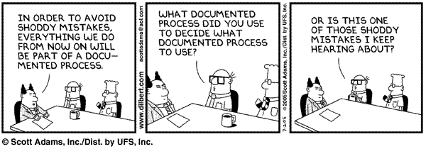
Healthy dose of Skepticism…

Slide 53
This course extends RHIT’s CSSE 376
- From our undergrad program
These are the lab topics from the spring 2013 version of that!
Software Craftsmanship
GIT Basics
Unit Testing
Test Driven Development
Code Coverage
Mocking
Integration Testing
Performance Testing
Localization
Metrics
Test Plans
Behavior Driven Development
Notes:
The intent is to have a fit, for people who take both!

