Slide 1
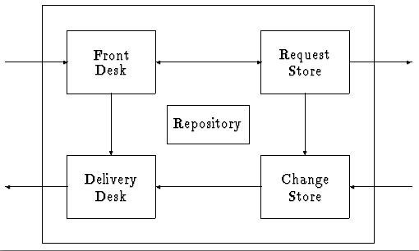
Software Maintenance and Evolution CSSE 575: Session 9, Part 3 Statistical Modeling
Steve Chenoweth
Office Phone: (812) 877-8974
Cell: (937) 657-3885 Email: chenowet@rose-hulman.edu
Above – Modeling evolution requires setting up processes that can lead to taking meaningful measurements.
Notes:
Some material for this discussion taken from Software Maintenance: Effective Practices for Geographically Distributed Environments, by Gopalaswamy Ramesh and Ramesh Bhattiprolu.

Slide 2
Statistical Modeling
Having meaningful numbers about the evolution and maintainability of a system
Leads into Measurable Maintainability (week 10 topic)
Starting point – can we measure the pieces of the horseshoe model?
Next step – can we explain / relate these results to the process used?
Then – can we change that process and investigate differences?

Slide 3
What to model / measure?
Typically – bugs reported, time taken to fix a bug, etc.
Need to analyze these holistically, with people who know what’s going on.
Also need to know goals of each process.
E.g., knowing time to fix different bugs leads to setting-up service contracts.
Need to take both kinds:
In-process metrics
End-goal metrics

Slide 4
Typical scenario
Time taken for each of these internal processes forms the in-process metrics: These should be controlled by an organisation to achieve the end-goal metrics.
Corrective Maintenance
Problem Reporting
Problem Resolution
Fix Distribution
Difference between these two frames is an end-goal metric, which is customer-mandated and externally dictated
Notes:
From Ramesh and Bhattiprolu, p. 154.

Slide 5
Terminology
Measurement = the raw data
Metrics & statistics = derived calculations
Modeling = underlying analysis of what influences what
Looking at these tends to cycle:
E.g., Data on defects → calculated “defect density” → comparison with expectations or history → looking at more specific data to find causes

Slide 6
Based on a model…
Every development team needs metrics goals:
Short term
Long term
And a roadmap for how to get there.
Can’t just be “try harder.”
Falls in line with the Deming plan:
Plan → Do → Check → Act

Slide 7
Deming applied to swre evolution - 1
Plan =
Anticipate workload
Stipulate end goals, service contracts
Staff appropriately
Design the processes for problem resolution

Slide 8
Deming applied to swre evolution - 2
Do =
Provide training
Carry-out reporting, resolution and fix distribution activities
Collect appropriate metrics

Slide 9
Deming applied to swre evolution - 3
Check =
Periodically check end-goal and in-process metrics
If you have a project manager whose main job this is, “periodically” can mean “daily”

Slide 10
Deming applied to swre evolution - 4
Act =
Modify processes
Replan
Keys – like managing other processes:
What is your goal and where do you want to go?
What is your current position
Knowing where you are and where you want to go, what steps should you take?

Slide 11
Typical metrics strategy
Decide what you want to measure and how to measure it.
See next slide →
Set targets and track them.
Likely includes both qualitative and quantitative
Targets should be “SMART”
Understand variability, work towards minimising variability.
Consistency = predictability
Well-known stats should have upper and lower bounds
Variabilities need to be studied for root causes
Act on data and strive for continuous improvement.
Consider the human angle.
Hard to measure people’s “progress” like a machine’s.
Notes:
SMART = Specific, Measurable, Aggressive yet achievable, Results-oriented, and Time-bound.

Slide 12
What to measure
Is this measurement relevant to the project?
E.g., Maybe portability isn’t relevant to the first release…
Is it easy to measure?
Ideal is “no extra effort” to measure.
E.g., can it come automatically from the repository?
Is it one of the most valuable things to measure?
Can we quantify the costs / benefits of measuring it?
Is it controllable?
Can you afford NOT to measure it?

Slide 13
Common measurements - 1
Mean time between failures = average time between arrival of bugs.
Can be calculated from defect repository.
Mean time to repair = Avg time to fix a bug; indicates responsiveness to bugs and effectiveness in fixing problems that are not reported.
Can be calculated from defect repository.

Slide 14
Common measurements - 2
Number of problems responded to by “first level support” = The effectiveness of that level, implies number of interruptions to development team.
Can be calculated from Customer Support Repository
Classification of defects by severity = The nature of incoming problems. Measures the demand on support and maintenance resources.
Can be calculated from Defect Repository.

Slide 15
Common measurements - 3
Classification of defects by product component = Problem-prone parts of a product, and hence points to areas of the product that need to be looked into more carefully.
Can be calculated from the Defect Repository

Slide 16
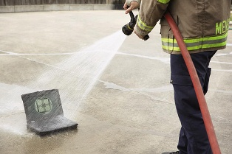
Best practices in metrics
Automate the process via repositories.
Integrate metrics into operational decision-making, not just as a collection mechanism.
Overdosing on metrics – not good!
Decide what to measure first.
Use for performance appraisal.
Oh, wait – Don’t do that.
Make it a closed loop.
Data fire hose in action

Slide 17
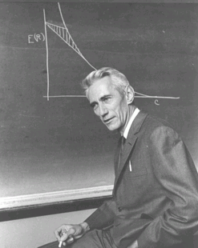
Article on Measuring Evolution
Tom Arbuckle, “Measuring Software – and its Evolution – Using Information Content,” 2009.
Idea – to examine evolution, need to measure related artifacts over time.
Thesis – relative Kolmogorov complexity is the correct fundamental measurement.
“Algorithmic entropy”
Measures number of bits of information in an object.
Above - And here he is, the father of information theory – Claude Shannon.

Slide 18
Article, cntd
“Information size is highly correlated with counting size”.
Given that many SE metrics count features representative of software artefacts - lines, methods, calls - we claim that this result provides some evidence both for our argument but also for those who may claim that existing metrics are good enough.
In the rest of the paper, they try to find good ways to measure the Kolmogorov complexity in software programs! (E.g., section 3.1.)

Slide 19
Assignment and Milestone Reminders
Related topics to Journal about (save for week 9 if we discuss earlier!):
What metrics you use in maintenance
Are these done automatically?
How would metrics have rated your refactoring activity?
How do you know what the metrics “mean”?
What’s the most recent thing you changed in your process, based on analyzing the statistics from maintenance?

