Slide 1
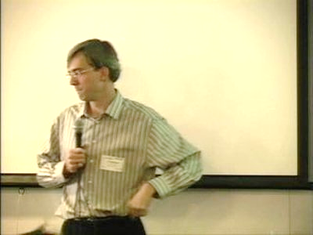
Software Maintenance and Evolution CSSE 575: Session 8, Part 3 Predicting Bugs
Steve Chenoweth
Office Phone: (812) 877-8974
Cell: (937) 657-3885 Email: chenowet@rose-hulman.edu
Above – A good video on research into predicting bugs, by James Whitehead of UC Santa Cruz. At https://www.youtube.com/watch?v=IYmbMtOL9Sc.

Slide 2
Basic question
I only have so much time for code reviews, testing, other QA-related costs:
What do I spend the time on
Related to studies of software reliability
Traditional answer is to spend time on the code that “has to work” like
Code used to recover from a crash
Start-up and shut down code
The small percentage of code that runs all the time
Notes:
Some of this material is from Zimmerman, et al, “Predicting bugs from history.” In Mens & Demeyer (Eds), Software Evolution. Springer, 2010.

Slide 3
Developers can’t remember everything
So, they need help from actual facts about successes and failures
Like the bug database
Helps to visualize this
But past doesn’t predict future:
Software evolves, with refactorings to fix bug-prone areas
New features may be in different areas

Slide 4
What makes a module defect-prone?
Software needs to be fixed because it doesn’t satisfy some requirement.
There’s an error, somewhere from writing down the requirement to product usage.
An error in source code is considered a “defect”
It may cause a detectable fault, and needs to be fixed
We look for certain “invariants” in a module’s history:
Complexity
Problem domain
Evolution
Process
→ See next slides

Slide 5
Complexity
We can assume that likelihood of mistakes in some artifact increases with:
The number of details
The extent of how these details interact with each other
Many ways to measure this…
Do complexity metrics correlate with defect density?

Slide 6
Complexity, cntd

Slide 7
Complexity, cntd
The authors studied 5 Microsoft projects.
Found significant correlations between complexity metrics and post-release defects.
But – across projects, different complexity metrics correlated significantly.
None of the metrics qualified as a universal predictor.
Tried making combination predictors, as well!

Slide 8
Problem domain
Question – How does problem domain impact defect likelihood?
Authors looked at Eclipse.
Domains were:
User interfaces
Compiler internals
These are complex in different ways!

Slide 9
Problem domain, cntd
86%
15%
Chance of having a defect needing to be fixed,
in the first 6 months after release

Slide 10
Problem domain, cntd
The authors also considered families of dependencies as a “problem domain”
Studied these in Microsoft Windows Server 2003
Families were:
Imports
Exports
RPC
Registry access
They found these to be suitable predictors of defect levels in modules

Slide 11
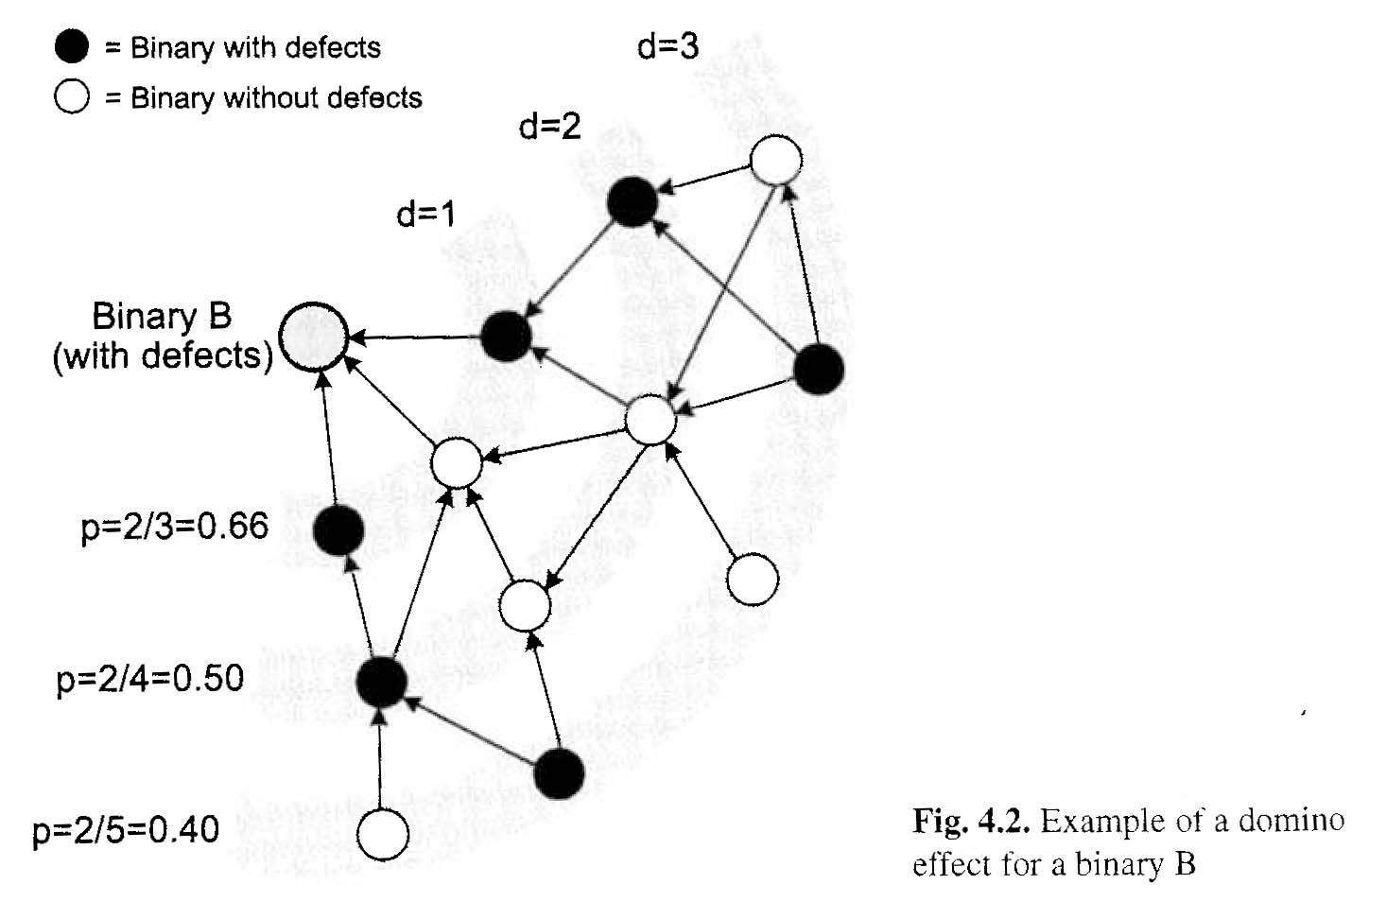
Problem domain, cntd
They also found a “domino effect” in these dependencies:
A defect in one component can increase the likelihood of defects in dependent components.

Slide 12
Problem domain, cntd

Slide 13
Evolution
Question: Does code churn correlate with defects?
Churn = amount of code change in a unit over time
Authors analyzed churn leading to MS Windows Server 2003 SP1
Included about 40 million lines of code in 2000 binaries!
Extracted churn info from version control system

Slide 14
Evolution, cntd
They found –
The more a component changed, the more likely it was to have defects
Code churn measures can be used to predict defect-prone components

Slide 15
Process
Every defect that escapes into the field → a failure of quality assurance.
A good software process can compensate many of the risks in everything else.
Thus, the quality of the development process should also be considered when it comes to predicting defects.
This remains to be studied!
E.g., do higher-level CMM organizations really produce better software of equal complexity?

Slide 16
The “management factor”
“Any predictor will eventually turn out to be wrong.”
This is because, if a predictor predicts a higher number of defects, then
That component will be checked more carefully
Which will reduce defect density!
Thus, defect predictors are self-defeating prophecies…
Above – Nostradamus takes a dim view of our prediction methods. From http://j.l.navarro.tripod.com/jlnavarro/id11.html.

Slide 17
Other bug prediction approaches
Most people assume that new bugs will occur where old bugs occurred, given similarities in new tasks:
Consider “temporal and spatial locality”
Consider “developer locality”
Use machine learning techniques
See Jim Whitehead talk
One might ask, “What would it be like if we used formal methods and ‘clean room’ to avoid most bugs in the first place?

Slide 18
The paper you read
“Bug-fix time prediction models: Can we do better?” By Pamela Bhattacharya and Julian Neamtiu. MSR ‘11.
Takes a different approach – predicting the work involved, versus just the bug occurrence.
They found existing models had bugs!
Need more independent variables.
No correlation with bug-opener’s reputation.

Slide 19
Paper, cntd
Bug fix time is important to predict, because:
It helps predict software quality
It helps coordinate effort in analyzing bugs
The prior models used machine learning algorithms
Experiments on both open source & commercial
Report attributes like bug severity, number of developers involved, number of comments and attachments, and developer reputation
The authors’ new findings leave open questions!

Slide 20
Assignment and milestone
See the assignment info under projects.
Left – Where did the word “milestone” come from, anyway? Is this graphic answer way too obvious to be right? From http://www.wigdahl.net/quern/2009/09/14/milestone/.

