Slide 1
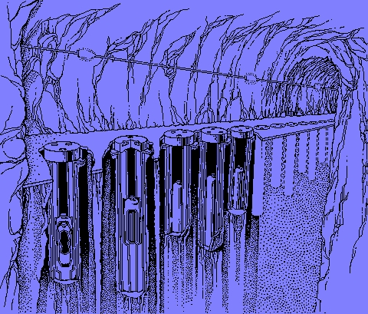
Software Maintenance and Evolution CSSE 575: Session 8, Part 2 Analyzing Software Repositories
Steve Chenoweth
Office Phone: (812) 877-8974
Cell: (937) 657-3885 Email: chenowet@rose-hulman.eduz
Above – We think we have problems! Here’s a picture from an article on how to store high-level nuclear waste. From http://earthsci.org/education/teacher/basicgeol/nuclear/nuclear.html.

Slide 2
In the prior slide set…
We discussed issues of duplicate code from several perspectives – like
Planning to avoid writing it, via a product line approach, and
Analyzing how big a problem it is in existing systems as they evolve over time
Which is an example of analyzing repositories
Analyzing a source code repository, in particular

Slide 3
There are several repositories…
That we can analyze in a typical long-term development project, like:
Versioning system (for the source code)
Defect tracking systems
Archived communication between project people
We should be able to mine this information!
Could improve maintenance practices
Could improve design or reuse
Could validate other ideas we have about what’s going on, or whether some process change worked
So, how would that mining go?
Notes:
Some of this material is from, “Analyzing software repositories to understand software evolution,” by Marco D’Ambros, et al. In T. Mens and S. Demeyer (eds), Software Evolution. Springer, 2008.

Slide 4
Looking for causes & effects…
Like,
What kinds of clones cause problems?
Which we just looked at
What caused the most serious bugs?
How do developers network the most efficiently?
Where are hotspots in the current architecture?
Can we predict defects or defect rates?
What will be the likely impacts of a certain change?
Are particular evolution models justified?

Slide 5
This is “evolution analysis”
Start with modeling the data
Versioning system (source, documentation, etc.)
Defects
Team interactions
All but the source code need to be linked to the actual software (in the model)
E.g., Do you know what each team member did?

Slide 6
Next…
Actual data retrieval and processing
E.g., parsing source code data
Linking artifacts
Often tough – if the development support system doesn’t have built-in pointers
Like what bug reports go with what code

Slide 7
Finally…
Data analysis
Use the model and
The retrieved data
To see what conclusions are discovered / supported

Slide 8
A study
D’Ambros, et al built a “release history database” (RHDB) of models and data.
Had source code in CVS and Subversion.
Authors and time-stamped commits
Lines added, branches, etc.
Also had Bugzilla with bug reports having:
Id’s, status, product, component, operating system, platform
The people – bug reporter, assigned to, QA people, people interested in being notified

Slide 9
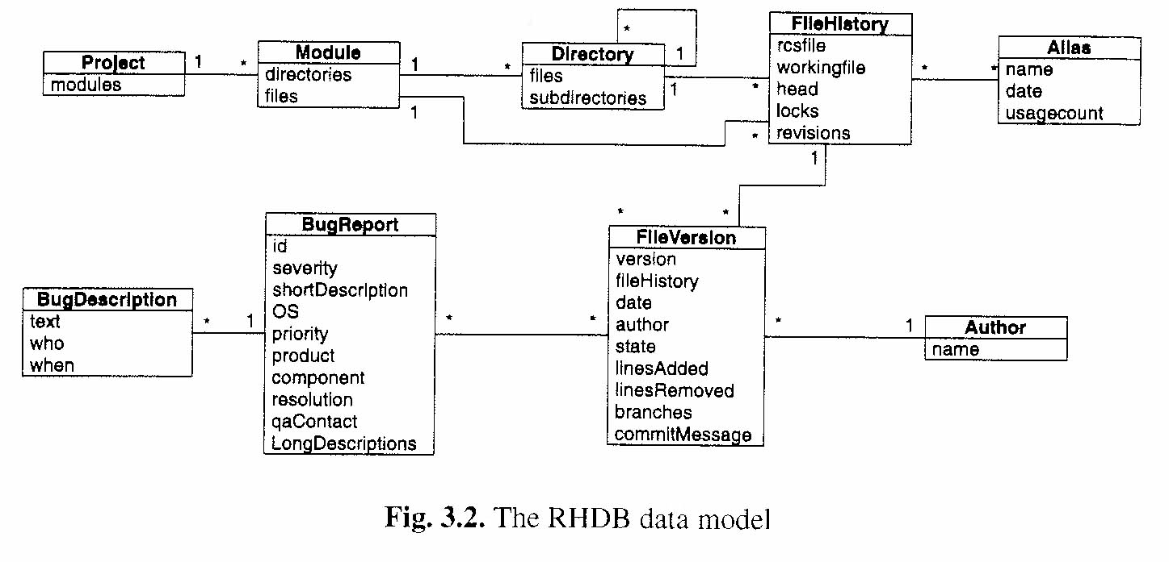
Their model
A file version = CVS commit with date, author, state, etc.
Can be associated with 1 or more bug reports. (Actually many to many with these.)
File history = the actual file and sequence of versions, one per commit. Filename, aliases used for tagging releases.
Directory = sub-directories and file histories.

Slide 10
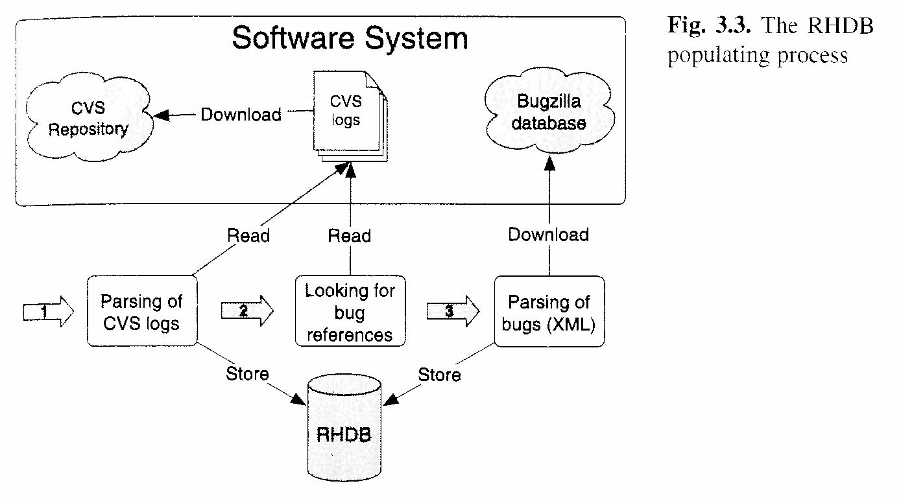
They populated their database
Loaded data from real application systems’ CVS and Bugzilla DB’s.
A research project
Loaded in batch mode
The RHDB’s contribution was linking the two sources of info.
Success at this required that correct data be entered at the time the work was done.
Like “commit comments” referring to bug ID’s.
Needed to handle aliases because people have multiple email addresses.

Slide 11
Other people’s models - similar
Notes:
The Hipikat model is from a studies by Cubranic, et al. Google for “cubranic hipikat” – the ACM ref comes up first.

Slide 12
Analyzing Developer Effort
Who contributed how much, on a particular set of code?
D’Ambros, et al, used “Fractal Values” to represent relative work, following the “Gestalt principle.”

Slide 13
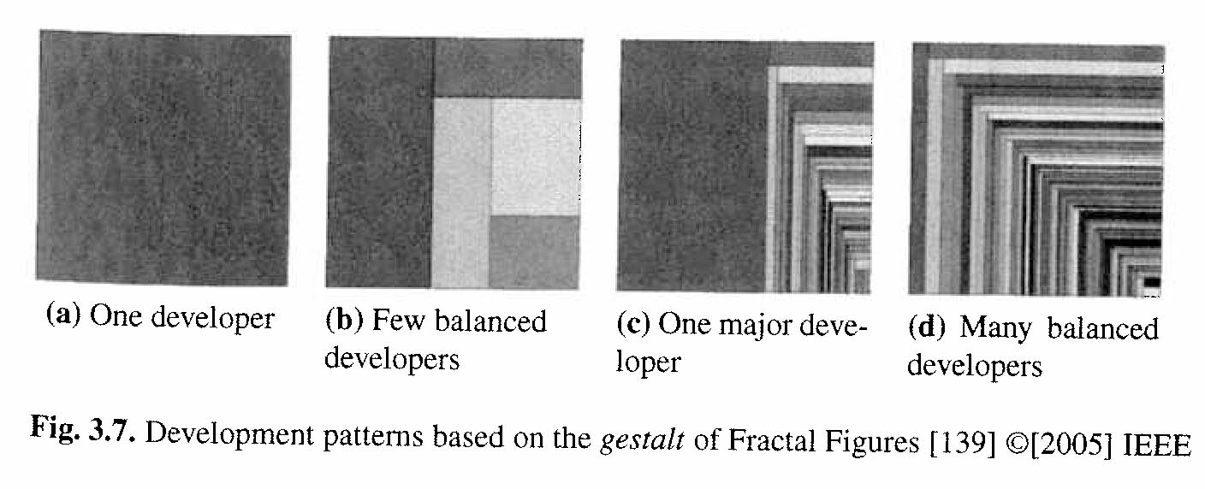
Goal was…
They wanted to decide if the work had been:
One developer
A few balanced developers
One major developer
Many balanced developers

Slide 14
What they found (Mozilla):
→ Most of the directories which introduced bugs had “many balanced developer” patterns!
Notes:
The “Webshell” hierarchy of source code directories for Mozilla included all four patterns of contribution.

Slide 15
Change coupling
D’Ambros et al studied the implicit dependencies between software artifacts
Based on their changing together
In SVN, for example, they were submitted as a part of “change sets”
They created an “evolution radar” interactive visualization for these couplings
Showed components with strongest couplings
Could drill down to individual files
Looking for “architectural decay”

Slide 16
Change coupling, cntd

Slide 17
ArgoUML visualizations
The authors took different snapshots every 6 months.
Needed to avoid “polluting” the picture with commits from the past.
Size of the dots = number of lines changed
“Explorer” module was most closely coupled to “Diagram.”
They found one file which had long-lasting dependencies with others – a problem.

Slide 18
Trend analysis & hot-spot detection
D’Ambros wanted an “ArchView” of a system’s components
What modules are:
Exceptionally large
Complex
Have strong dependencies on others
Or strong increases in any of these over time

Slide 19
Typical results - Mozilla
Notes:
Authors picked the three circled for further study as “hot spots” – because of either current size or growth.

Slide 20
Conclusions
Mining software repositories – a current research topic
Potential for benefits in where to spend time & effort maintaining big systems
Ideas on how to visualize the problems – still evolving
Still a challenge in interpreting what to do once problems are detected!

Slide 21
The paper you read
Kagdi, et al: “Towards a taxonomy of approaches for mining of source code repositories.” MSR ‘05.
A survey paper
Issue is “how to derive and express changes from source code repositories in a more source-code “aware” manner.
Considered three dimensions:
Entity type and granularity
How changes are expressed and defined
Type of MSR question they’re looking to answer
They also defined MSR terminology

Slide 22
Paper - Using data mining
There’s a problem in converting and interpreting information from the source code repository! E.g.,
Knowing how many lines are changed in a commit
Are changes to add a feature or fix a bug?
Can use some techniques from general data mining
Deriving entities like (filename, type, identifier) associated with a change, and putting into a database
Decide what rules to apply to these, to get results

Slide 23
Paper – Using heuristics
Heuristics-related goals of MSR:
Predict what will happen based on history
When a given entity is changed, what else must change?
Decide what assumptions can be made in doing an analysis
Changes are symmetric – the order of modification of entities is unimportant
Automate the analysis
Like finding dependencies in a given language

Slide 24
Paper – Using “differencing”
Time is an important factor in an analysis
Need to consider differences between versions
Each version needs to be represented semantically (depending on the goal), then
Have a way to make the desired comparisons
E.g., study of Apache bug-fix patches over time

Slide 25
Paper – “Differencing” questions
We’d like to ask “meta-differencing” things like:
Are new methods added to an existing class?
Are there changes to pre-processor directives?
Was the condition in an if-statement modified?

Slide 26
Some of the tools are getting better
E.g., this paper described having to infer how changes are made together, in CVS.
In SVN, you can assume this from “change sets”

