Slide 1
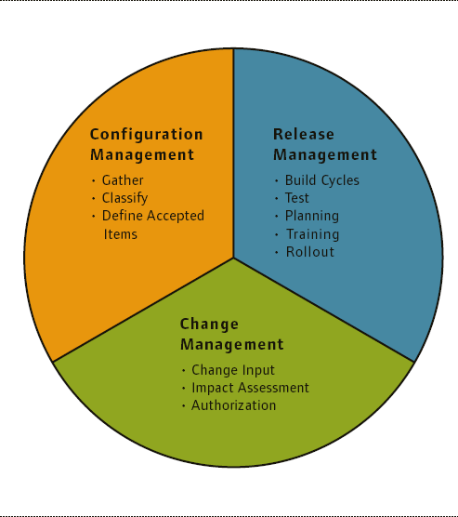
Software Maintenance and Evolution CSSE 575: Session 7, Part 2 Evolution of Versions and Configuration Management
Below – The partnership is depicted, among Configuration Management and its sister tasks – Change Management and Release Management. From http://withfriendship.com/user/cyborg/configuration-management.php.
Steve Chenoweth
Office Phone: (812) 877-8974
Cell: (937) 657-3885 Email: chenowet@rose-hulman.eduz
Notes:
In the traditional view, “Configuration Management” =
Configuration identification
Change control
Status accounting
Configuration audit

Slide 2
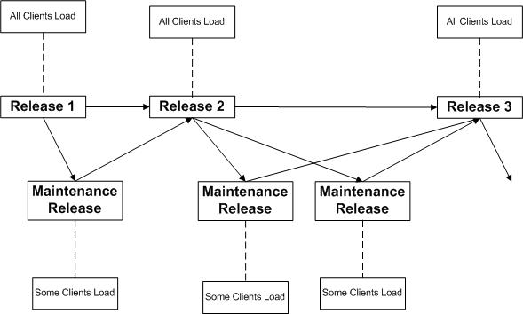
The goal of this discussion…
Talk about Configuration Management as the source of the problem in making evolution work well.
Then, in the next set, we’ll discuss a possible solution.
Above – The essence of the problem. After a while, configuration management is a huge deal.! From http://www.davidconsultinggroup.com/blogs/harris/?p=350.

Slide 3
Configuration Management
What is it?
It’s a big area. Most large projects have a “configuration manager,” who is responsible for having the right versions of everything go out the door, among other things.
Ever been one of these?
It also has to do with managing standards and documents used in a project. Like, “Where are the current documents supposed to be?”
Also relates to the “change control” system, and to “release management.”
Notes:
Pictured is Anil Erdura, a system center configuration manager. From http://microsoftfeed.com/2010/meet-anil-erduran-system-center-configuration-manager-mvp-from-turkey/.

Slide 4
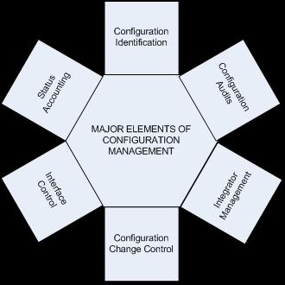
In every project…
You need to do a Configuration Management Plan, which will include:
File management
Bug & feature request processing
Software releases
Coding requirements
Security concerns
Notes:
Pictured – a wider scope of configuration management planning. From http://www.fhwa.dot.gov/cadiv/segb/files/i680/i680config.htm.

Slide 5
What’s the scope of CM again?
Other authors make CM be the whole thing shown on slide 1.
To Aiello & Sachs, for example CM includes all of:
Source code management
Build engineering
Environmental configuration (see notes)
Change control
Release engineering
Deployment
And, in some organizations, the Configuration Manager may be in charge of all these!
Notes:
Bob Aiello and Leslie Sachs, Configuration Management: Best Practices. Addison-Wesley, 2010. ISBN 0-321-68586-5.
Environmental configuration is the identifying, modifying and managing of the interface dependencies required for the system to progress from development to QA to production. This refers to “runtime dependencies” that impact how the code will behave when running in a particular environment.
Disagreements on all this include such silly disagreements as, “What SCM stands for – Software Configuration Management, or Source Code Control?”

Slide 6
And what are CM the goals again?
Traditionally:
1. All the code going out (deployed):
To production, or to QA, depending
Must be easily identifiable
That’s a “configuration audit”.
Means you can easily confirm the exact versions with absolute certainty.
and
Notes:
From Aiello & Sachs

Slide 7
Goals, cntd
2. You can retrieve the exact version
Of all source code
And other configuration items
That was used to create that release
Without “heroic” efforts
and

Slide 8
Goals, cntd
3. You can create a workspace (sandbox)
To make a small “bugfix”
Without any chance of the code regressing
Due to the wrong version of a header file
Or other dependency.

Slide 9
The other goals…
Kind of serve these 3.
These are the things you do all day,
The things that matter the most, per se.
And, if you don’t have these 3 under control,
Being good at the others don’t compensate.

Slide 10
A configuration manager’s day…
Release 3.9 is supposed to go out in two weeks – what goes in it?
Fix 27.4.3 isn’t ready yet, but a key customer was supposed to get it. Can they wait?
Feature 149.3 is ready, but needs feature 143.7 in order to work. Is that ready?
There’s a meeting of the “change control board” in an hour, and the data from China hasn’t come in yet.

Slide 11
A large number of situations happen!
Configuration management in industry is messy!
Let’s look at typical situations that arise:
Explosions of similar component versions in the repository.
Different customers are running different combinations of the software.
Special features added to a maintenance upgrade of an “old” version of the software put it ahead of the “new” versions of the software.
Special features added for two key customers are conflicting, and so can never become general features of the product.
Notes:
Material taken in part from Effective Software Maintenance and Evolution: A Reuse-based approach, by Stanislaw Jarzabek. Auerbach Publications, ISBN 0-8493-3592-2.

Slide 12
Overall,
The more successful a software system,
The longer its lifetime
The wider its range of customers
It will have a large number of system releases
And component versions to go with those
All of which differ in user-impacting ways
With complicated dependencies among them
And impacts back up to the architecture level

Slide 13
CS departments haven’t addressed this
It’s a hard problem
Could be impossible to make it go away!
Why would theoreticians have it on top-of-mind, anyway?
It’s not a “clean” situation that one particular, mathematically based solution would pop out for.
Maybe it doesn’t happen in their software?
Uh oh.
Notes:
Homer Simpson from http://mooreslore.corante.com/archives/2005/04/27/blog_item_placement_flux.php.

Slide 14
In a way,
The culprit is the variant features demanded by different customers!
So, we need an evolution support environment that allows us to deal with these systematically. Like:
Representing them in some common way, and
Positioning them in some network relative to other features
Goal – some of the work of deciding impacts and feature interactions becomes more obvious.

Slide 15
How do you do that?
Fig 12.4
Fig 12.5
“Optional”
Fig 12.3
Fig 12.10
Fig 12.6
A “Feature
Diagram”
“Or”
“Alts”
Notes:
These figures are all from Jarzabek’s Ch 12.
His “Facility Reservation System” is a sample software system that reserves conference rooms, etc.

Slide 16
Drilling down in this figure…
Notes:
These requirements need to be expressed more atomically than they usually are!

Slide 17
Drilling down, cntd

Slide 18
Drilling down, cntd
Notes:
These are features that cross boundaries in the larger picture.

Slide 19
Drilling down, cntd
Notes:
These features also cross boundaries.

Slide 20
Drilling down, cntd
Notes:
Fig 12.11 also crosses boundaries.

Slide 21
How to express such things…
Notes:
These show some general kinds of feature interactions.

Slide 22
Converting to UML, and beyond
We can use component and connector views, and architectural layers, to represent the design with these interactions and dependencies.
So, the issue for Change Management, Configuration Management and Release Management, is how to trace these relationships through to the pieces of the finished product!

Slide 23
The “Mixed strategy approach”
Such terminologies are the basis for attempts to preserve the knowledge of past changes in a form that enables effective reuse.
More about this idea in the next set of slides!

Slide 24
Key Configuration Mgmt Decisions
Starting point:
Which version of a component to start with as the base for an extension, and
Which others to take other things from, updating this base.
Getting matching pieces:
Like, if you use MVC, what view and controller go with the model you want?
The “abundance of riches” problem – many choices that have similar-looking features.
Predicting the impacts and ripples of each choice.

Slide 25
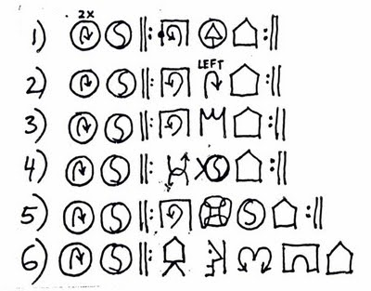
Key Decisions, cntd
Equally critical – what has to be removed from a given component to employ it in the next set of changes:
Unwanted features
Old ways of implementing these
“Mystery code”
Above – “Mystery code” from http://gurneyjourney.blogspot.com/2009/10/mystery-pictographs.html.

Slide 26
Worst problems
Explosion of variant versions of components.
Feature dependencies.
The difficulty of propagating new features in variant forms to selected releases.
The accumulated knowledge from a system’s evolution is murky.
Failure to exploit commonalities across a family of releases is more evolution effort than was necessary!

Slide 27
Traditional remedies
Componentization – divide and conquer
Follows a top-down systems approach to design
But actually at the heart of bottom-up
Componentization above the “middleware” layer remains problematic
We need something better than “concrete components”
Separation of concerns – OO information hiding, etc.
Abstraction – interfaces, abstract classes, hierarchies, parameterization

Slide 28
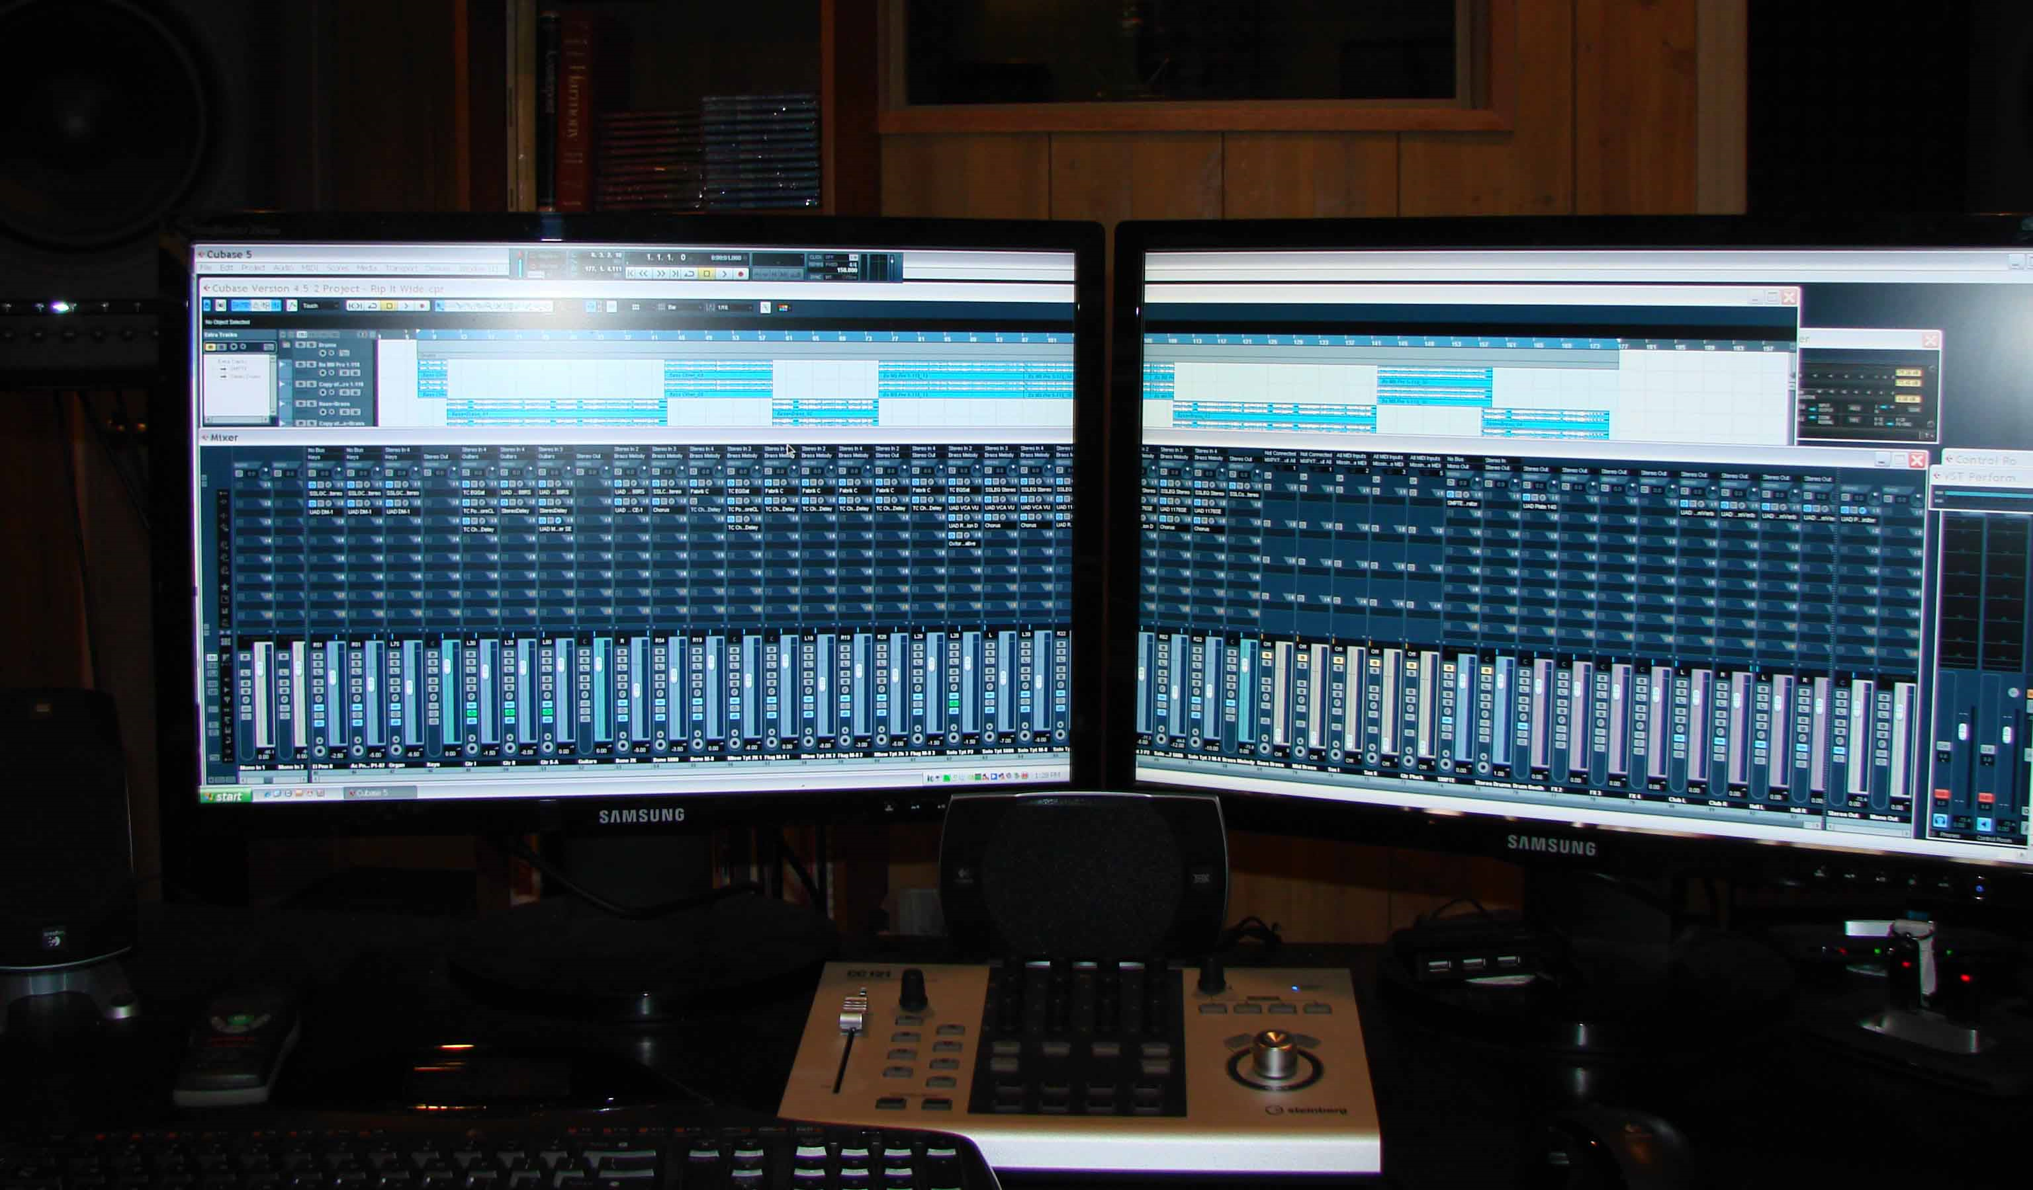
Essential complexity
The problems themselves are hard
The solutions via software are complex
The mappings from one to the other are tricky
Left – Wizard Electric Music’s system for tracking and mixing music. From http://www.wizardelectricmusic.com/tracking.html.

Slide 29
The traditional remedies…
Have been around long enough, we know they don’t solve every problem.
Abstraction, for example, tends to work best in a well-known, closely defined domain
Change mechanisms aren’t “powerful enough to make changes visible and tractable.”
Ones like we described remain “second class citizens” in modeling notations, development methodologies, and IDE’s.
Parameters, generics and macros all have limits on applicability to reduce inherent complexity.
Notes:
From Jarzabek, p. 115.

Slide 30
The article you read
“Kode Vicious” – Forest fire: Keeping your source trees in order
An example of a configuration management complexity problem
Everyone has a maze of their own “checkouts” that are organized for their use only
In reality, some of this knowledge ends up being shared
E.g., “useful scripts”
KV’s suggestions –
Label everything clearly!
Don’t mix personal developer trees and release trees!
And don’t confuse these two!

Slide 31
And
There are surely lots of other aspects of CM that also do matter.
Where quality processes make a big difference.
For example:
Most organizations manage more than one “line” of code development at the same time.
Most have some automated testing integrated in with their CM system in some way, and this is a big part of their development productivity.

Slide 32
A good example of a CM best-practice
“Baselining” –
You don’t just check in and check out your code, using the source code management tool as a virtual library.
That’s necessary but not sufficient.
Your repository needs to be a “time machine”
Which can take you back to a stable version.
That’s a “baseline.”
Need these for each release, especially.
Notes:
This helps sort out which are the “known good versions” of a feature or class.

Slide 33
A second best-practice
A “CMDB” –
How to keep track of environment variables:
Have an up-to-date configuration management database (CMDB) for testing and for release.
Need different ones for different kinds of testing, like:
Large-scale integration testing like
Feature verification testing, or
Regression testing, vs
“System testing” like
Performance testing, or
Endurance testing
And need configurations for key and “typical” customers
Notes:
This is like the reverse of the CMDB’s like Tivoli that are used in IT for controlling distribution of software to servers, etc. This CMDB is for configuring at the product end, before sending to customers.

Slide 34
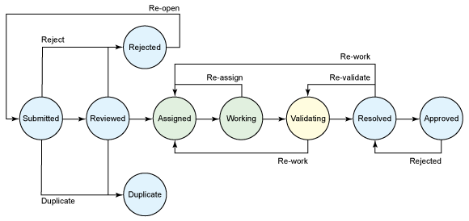
A third best-practice
A “Change control process” –
It’s a workflow that makes the features and fixes move through the configuration management system.
Automation has to know about all the variables of your real process, like how things get approved (like via a change-control board).
Here’s the workflow in Clearquest (part of the IBM Rational tool suite):
Notes:
Figure from http://www.ibm.com/developerworks/rational/library/10/collaborativealminteroperability/index.html.
Another typical tool for managing this workflow – “Sablime” from Alcatel-Lucent. See http://www.bell-labs.com/project/sablime/.

Slide 35
And
Many of the other aspects of CM also relate to the complexity of the long-lived code base.
E.g.,
Merging branches back into the trunk
Doing changes by “change sets”
Having a consistent, immutable ID or branding system
Regression testing to prove that old bugs didn’t fly back in the door
Notes:
Bug spotted at http://www.flickr.com/photos/harmony19490/362411276/.

