Slide 1
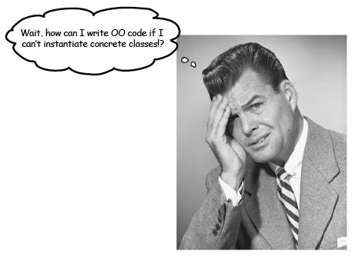
Software Maintenance and Evolution CSSE 575: Session 6, Part 4 Breaking Dependencies
Below – From an article on “breaking the last dependency” at http://today.java.net/pub/a/today/2005/04/14/dependency.html.
Steve Chenoweth
Office Phone: (812) 877-8974
Cell: (937) 657-3885 Email: chenowet@rose-hulman.eduz

Slide 2
We saw that almost all software changes…
Software Changes and Entropy Results
Ripple-Effects of Software Changes
Changes on Changes
Hydra-Effect…
Feathers’ book – how to make those changes easy to accomplish
Main trick – Get it into a test-first harness.
Doing that often requires breaking the same dependencies that make the code easy to extend.
Reprise - Symbol for Creative Entropy, a company who build iPhone and iPod apps. From http://www.creativeentropy.com/
Notes:
Slide from Impact analysis discussion, last week.
Also repeated in slide set 6-2, which you just saw.

Slide 3
Ch 25 – Breaking Dependencies
A whole lot of tricks for avoiding testing difficulties
Pick a class you want to work with, but can’t test
Figure out where it should have a “Seam” but doesn’t
Find a way to break that dependency
This presentation’s concept – pick some of those and apply them to making your code more test-friendly
Not always easy to isolate things you want to test. http://howtosurviveschool101.blogspot.com/
Notes:
We now know that a “Seam” is a place where we can change code behavior without changing the code – like replacing what happens when the code invokes some outside method.

Slide 4
Ch 25 – Ways to break ‘em
Adapt parameter
Break out method object
Definition completion
Encapsulate global references
Express static method
Extract and override –
Call
Factory method
Getter
Extract –
Implementer
Interface
Introduce –
Instance delegator
Static setter
Link substitution
Parameterize –
Constructor
Method
Primitive parameter
Pull up feature
Push down dependency
Replace –
Function with function pointer
Global reference with getter
Subclass and override method
Supersede instance variable
Template redefinition
Text redefinition
Notes:
Some of these are refactoring ideas we saw also in Fowler’s book, applied to the specific issue of test-first.

Slide 5
What’s “Extract Interface”?
To build test code to replace a part of a messy call –
Create an interface to that messy call, incrementally add only the parts of the real object that you need
The compiler will tell you what’s missing
Make a fake object that implements these corresponding parts, for testing
Notes:
See pp 362+

Slide 6
Some of these should look familiar
Subclass and override method, for example
We already discussed, in earlier examples
You invent a “testing subclass” and invoke it instead of the real class, to get rid of some dependency
Many of the other Ch 25 methods are variations on this
Notes:
p 401 in Feathers

Slide 7
A variation on this one…
Push down dependency – can be used when you’d have to define too many interfaces and substitute in too many places, to subclass and override
Idea is –
Make the original class abstract, where these dependency problems occur
Subclass it in one way for testing
Subclass it in another to instantiate those problem dependencies for production
Notes:
p 392

Slide 8
Common strategy in Ch 25
Build a test harness that includes all these overrides and other ways to simulate things where you need “Seams”
Make it clear when you use the test harness or are making it “production.” Perhaps –
The test harness is for a whole system, like in integration testing, or
The test harness is just for unit testing this class

Slide 9
Additional Ch 25 tips
Be careful creating code that enables testing:
Since the code is not yet testable (till you are done), these changes themselves aren’t “testable”
Thus,
Use copy and paste, versus typing
Use code reviews (other people catch errors)
Define testing interfaces (compiler catches errors)
Use “mock object libraries” instead of creating your own
See next page for examples!

Slide 10
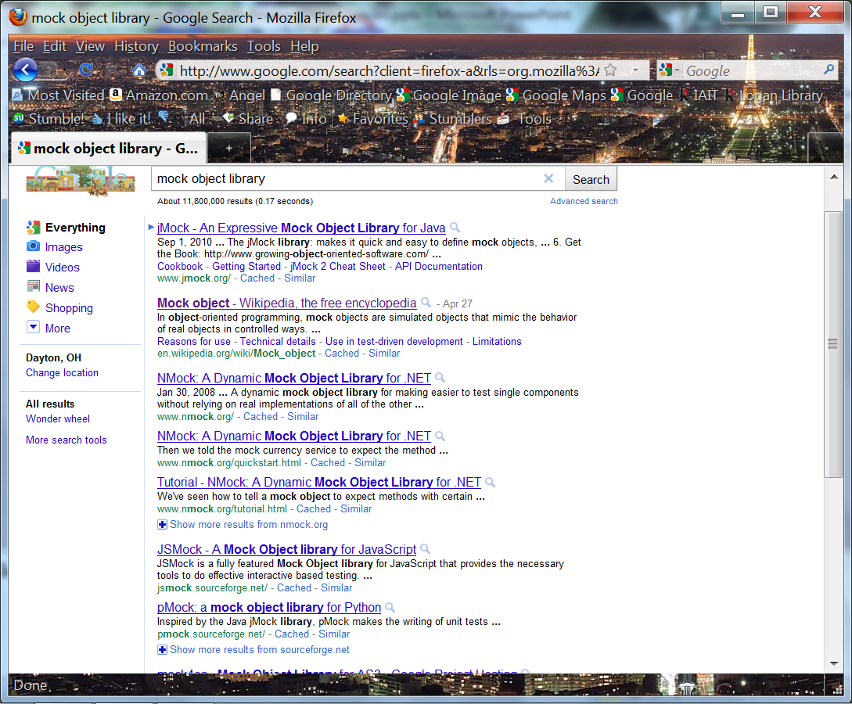

Slide 11
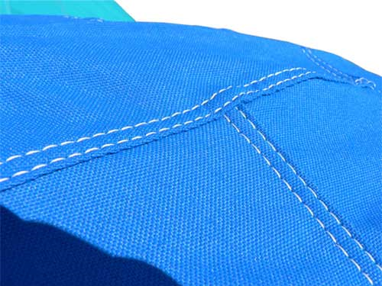
Assignment and Milestone Reminders
Journals and Milestone this week–
See assignments on course web site.
Above – Seams in jeans. From http://67pics.com/view.php?q=Pictures%20Of%20Seams&url=http://www.coversforyou.us/big/overlapped_double_stiched_seams_big.jpg

