Slide 1
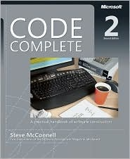

Software Maintenance and Evolution
CSSE 575: Session 4, Part 4
Program Understanding
Steve Chenoweth
Office Phone: (812) 877-8974
Cell: (937) 657-3885
Email: chenowet@rose-hulman.edu
In “Week 6” we’ll also see Feathers’ view of this…
Notes:
Tips from Steve McConnell’s Code Complete, published by Microsoft Press, from Shawn Bohner (an expert on modeling tools), & other sources.

Slide 2
Common Maintenance Situation
Taylor D. Programmer is given the task to make a change to some software that someone else has written
It consists of about 50KLOC, 2000 modules/components, etc. (not a big system!)
Where does Taylor start?
What is Taylor looking for?
Your role in this discussion – “BE” the maintenance programmer!
BE Taylor…

Slide 3

Program Understanding:
Basic Manual Approach
What’s Taylor do?
Read about the program
Read the source code
Run the program
Return to steps
1 or 2 as necessary
(Wash-Rinse-Repeat…)
Notes:
What are the steps in the basic manual process for Understanding a Program?

Slide 4
Perhaps some strategy can help….
Top-down
(Decomposition)
Bottom-up
(Composition)
  “Chunking”
  See next slide
Opportunistic
  Combination of top-down and bottom-up
  How can you avoid it becoming “ad hoc”?
Notes:
What are three general strategies for systematically understanding a program?
What strategy do you use?

Slide 5
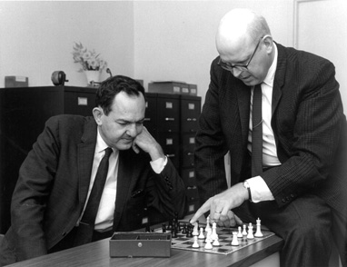
What is “chunking”?
In Artificial Intelligence, it creates “rules that summarize the processing of a subgoal, so that in the future, the costly problem solving in the subgoal can be replaced by direct rule application.”
Somewhat similarly, in psychology, chunking “is a phenomenon whereby individuals group responses when performing a memory task.” This is “based on the items' semantic relatedness or perceptual features.”
The second source warns that, “Representations of these groupings are highly subjective, as they depend critically on the individual's perception of the features of the items and the individual’s semantic network.”
Allen Newell, right, was a promoter of “chunking” in learning systems, Seen here at chess with his long-time CMU collaborator, Herbert Simon. They considered chess a perfect example of where people use “chunking” to discover underlying principles.
Notes:
First quote is from “Chunking in soar: The anatomy of a general learning mechanism,” by John E. Laird, Paul S. Rosenbaum, and Allen Newell, 1985, p 11. http://repository.cmu.edu/cgi/viewcontent.cgi?article=2552&context=compsci
Picture is from http://diva.library.cmu.edu/Newell/biography.html.
Second quotes are from http://en.wikipedia.org/wiki/Chunking_%28psychology%29.

Slide 6
Program Understanding
Also known as Program Comprehension and Software Visualization
Definition:
The process of
acquiring knowledge
about a computer
program
A discipline of understanding computer source code
view(soulPredicates,<byCategory,byHierarchy>).
viewComment(soulPredicates,
['This intentional view contains ALL classes that
implement SOUL predicates (i.e., Prolog-like
predicates that may use Smalltalk code due to
language symbiosis).']).
default(soulPredicates,byCategory).
intention(soulPredicates,byCategory,?class) if
category(?category),
name(?category,?name),
startsWith(?name,['Soul-Logic']),
classInCategory(?class,?category).
include(soulPredicates,byCategory,[Soul.TestClassifications]).
intention(soulPredicates,byHierarchy,?class) if
…
Notes:
Useful for reuse, maintenance, reverse engineering and the like in the context of Software Engineering
What are two other names for program understanding as a technology area?

Slide 7
Program Understanding Factors
Expertise
Representation Form
Implementation Issues
Documentation
Organization and Presentation
Notes:
Expertise – domain knowledge, skill with language/environment, system knowledge…
Representation Form – Structure, Semantics, Language Form/Type (Declarative, Symbolic, Procedural, Functional)
Implementation issues - Naming conventions, Comments, Decomposition Mechanism
Documentation – relation to source code, hypertext links
Organization and Presentation – of the software artifacts, formal/informal

Slide 8
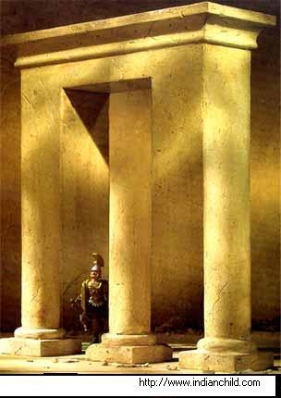
Parts of a Whole Comprehension
Studies on people’s perception indicate that there is a natural tendency to look for ways which can bring the parts into a meaningful whole (Gestalt) : The Aha Moment!
This feeling comes when all the parts can be linked to form a holistic picture.
Meaning lies in the connection.
Above – Gestalt means seeing the big picture, which may have a lot more info than you could get just looking at the individual parts. This one’s taken from website http://paulocoelhoblog.com/2008/11/27/image-of-the-day-gestalt-the-middle-column/.
Notes:
Humans need both “informal” and “formal” knowledge for program understanding
As a human begins to understand a program he/she finds and recognizes informal concepts and starts assigning them to structures in the program
Automatically “discovering (find + recognize) these informal concepts and assigning them to their implementation instances (structures of code) is the concept assignment problem”

Slide 9
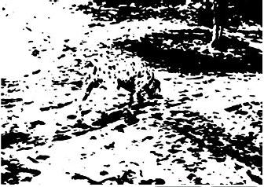
Ok, how about this one?
Notes:
There’s like a Dalmatian in the middle of this! From http://fun-optical-illusions.blogspot.com/.

Slide 10
Concept Assignment Problem
Program understanding →
put in context of
Program knowledge
(structure, syntax,
plans etc.)
Human oriented
world concept
knowledge
Assign concepts
to parts of code
Find concepts
(recognize)
Concept
Assignment
Problem
Notes:
Humans understand in terms of application domains e.g. “reserves an airline seat” ≠ “if(seat = request(flight)) && available(seat) then reserve(seat, customer)”
Humans understand because of “rich context of world knowledge”
Machines lack contextual world knowledge
What does the Concept Assignment problem map?

Slide 11
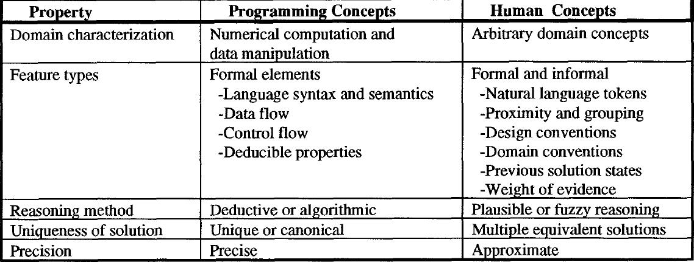
Program and Human Concept Types
Notes:
What is the difference between programming concepts and human concept with respect to uniqueness of solution?

Slide 12
Focusing on 1 Thing - Program Slicing
int main() {
int sum = 0;
int i = 1;
while (i < 11) {
sum = sum + i;
i = i + 1;
}
printf(“%d\n”,sum);
printf(“%d\n”,i);
}
Question – What affects the value of i in the last printf statement?
Program slicing is the computation of the set of program
statements, the program slice, that may affect the values at
some point of interest, referred to as a slicing criterion.
Notes:
In your own words, what is program slicing?

Slide 13
Program Slicing – Backward Slice
int main() {
int sum = 0;
int i = 1;
while (i < 11) {
sum = sum + i;
i = i + 1;
}
printf(“%d\n”,sum);
printf(“%d\n”,i);
}
Backward slice with respect to i in “printf(“%d\n”,i)”
Notes:
A backward slice consists of all program points that affect a given point in the program.

Slide 14
Program Slicing – Forward Slice
int main() {
int sum = 0;
int i = 1;
while (i < 11) {
sum = sum + i;
i = i + 1;
}
printf(“%d\n”,sum);
printf(“%d\n”,i);
}
Question – What is affected by the value change
sum = 0 ?
Forward slice with respect to “sum = 0”
Source: Tom Reps
Notes:
A forward slice consists of all program points that are affected by a given point in the program.

Slide 15
Example:
What Slice impacts the Character Count “chars”?
void line_char_count(FILE *f) {
int lines = 0;
int chars;
BOOL eof_flag = FALSE;
int n;
extern void scan_line(FILE *f, BOOL *bptr, int *iptr);
scan_line(f, &eof_flag, &n);
chars = n;
while(eof_flag == FALSE){
lines = lines + 1;
scan_line(f, &eof_flag, &n);
chars = chars + n;
}
printf(“lines = %d\n”, lines);
printf(“chars = %d\n”, chars);
}
Here’s where we care about it!
Notes:
What impacts the “chars” value printed at the end?

Slide 16
Character-Count Program - Answer
void char_count(FILE *f) {
int lines = 0;
int chars;
BOOL eof_flag = FALSE;
int n;
extern void scan_line(FILE *f, BOOL *bptr, int *iptr);
scan_line(f, &eof_flag, &n);
chars = n;
while(eof_flag == FALSE){
lines = lines + 1;
scan_line(f, &eof_flag, &n);
chars = chars + n;
}
printf(“lines = %d\n”, lines);
printf(“chars = %d\n”, chars);
}
All the red stuff could affect it!
Notes:
Answers to previous slide’s question.

Slide 17
Control Flow Graph
int main() {
int sum = 0;
int i = 1;
while (i < 11) {
sum = sum + i;
i = i + 1;
}
printf(“%d\n”,sum);
printf(“%d\n”,i);
}
Enter
F
sum = 0
i = 1
while(i < 11)
printf(sum)
printf(i)
T
sum = sum + i
i = i + i
Source: Tom Reps
Notes:
Various other ways to do a systematic analysis, akin to “slicing”…
This one – looks like a flow chart.

Slide 18
Flow Dependence Graph
int main() {
int sum = 0;
int i = 1;
while (i < 11) {
sum = sum + i;
i = i + 1;
}
printf(“%d\n”,sum);
printf(“%d\n”,i);
}
Flow dependence
p
q
Value of variable
assigned at p may be
used at q.
Enter
sum = 0
i = 1
while(i < 11)
printf(sum)
printf(i)
sum = sum + i
i = i + i
Source: Tom Reps
Notes:
Statement S2 is dependent on statement S1 iff S1 modifies a resource that S2 reads, and S1 precedes S2 in execution.

Slide 19
Control Dependence Graph
int main() {
int sum = 0;
int i = 1;
while (i < 11) {
sum = sum + i;
i = i + 1;
}
printf(“%d\n”,sum);
printf(“%d\n”,i);
}
Control dependence
p
q
q is reached from p
if condition p is
true (T), not otherwise.
T
p
q
Similar for false (F).
F
Enter
T
T
T
T
T
T
sum = 0
i = 1
while(i < 11)
printf(sum)
printf(i)
T
T
sum = sum + i
i = i + i
Source: Tom Reps
Notes:
Which statements guard the execution of the next statement?

Slide 20
Program Dependence Graph (PDG)
int main() {
int sum = 0;
int i = 1;
while (i < 11) {
sum = sum + i;
i = i + 1;
}
printf(“%d\n”,sum);
printf(“%d\n”,i);
}
Control dependence
Flow dependence
Enter
T
T
T
T
T
T
sum = 0
i = 1
while(i < 11)
printf(sum)
printf(i)
T
T
sum = sum + i
i = i + i
Source: Tom Reps
Notes:
What kind of dependencies are depicted in a Program Dependence Graph (PDG)? It shows both control and flow dependencies.

Slide 21
So, What Are Slices Useful For?
Understanding Programs
Restructuring Programs
Program Specialization and Reuse
Program Differencing
Testing
Notes:
Understanding Programs
Restructuring Programs - Isolation of separate “computational threads”
Program Specialization and Reuse - Slices = specialized programs, Only reuse needed slices
Program Differencing - Compare slices to identify changes (Impact analysis)
Testing
What new test cases would improve coverage?
What regression tests must be rerun after a change?

Slide 22
Program Comprehension Tools
A tool that aids in program understanding through the capture, analysis, and presentation of different perspectives (views) of the software
Basic Process is:
  Extract information by parsing the source code
  Store and handle the information extracted
  Visualize all the retrieved information
Notes:
These tools possess the complications of compilers (completeness, consistency, invariance…)

Slide 23
Interesting Software Views
Machine (ex. Byte Code, Assembly Code)
Program (ex. C code, Java code)
Define/Use Graphs
Data Flow
Control Flow
Call Graph
Function Graph
Module Graph
Architecture components…
Notes:
What software views listed above are you familiar with?
Define/Use Graphs - Functions and data used in runtime

Slide 24
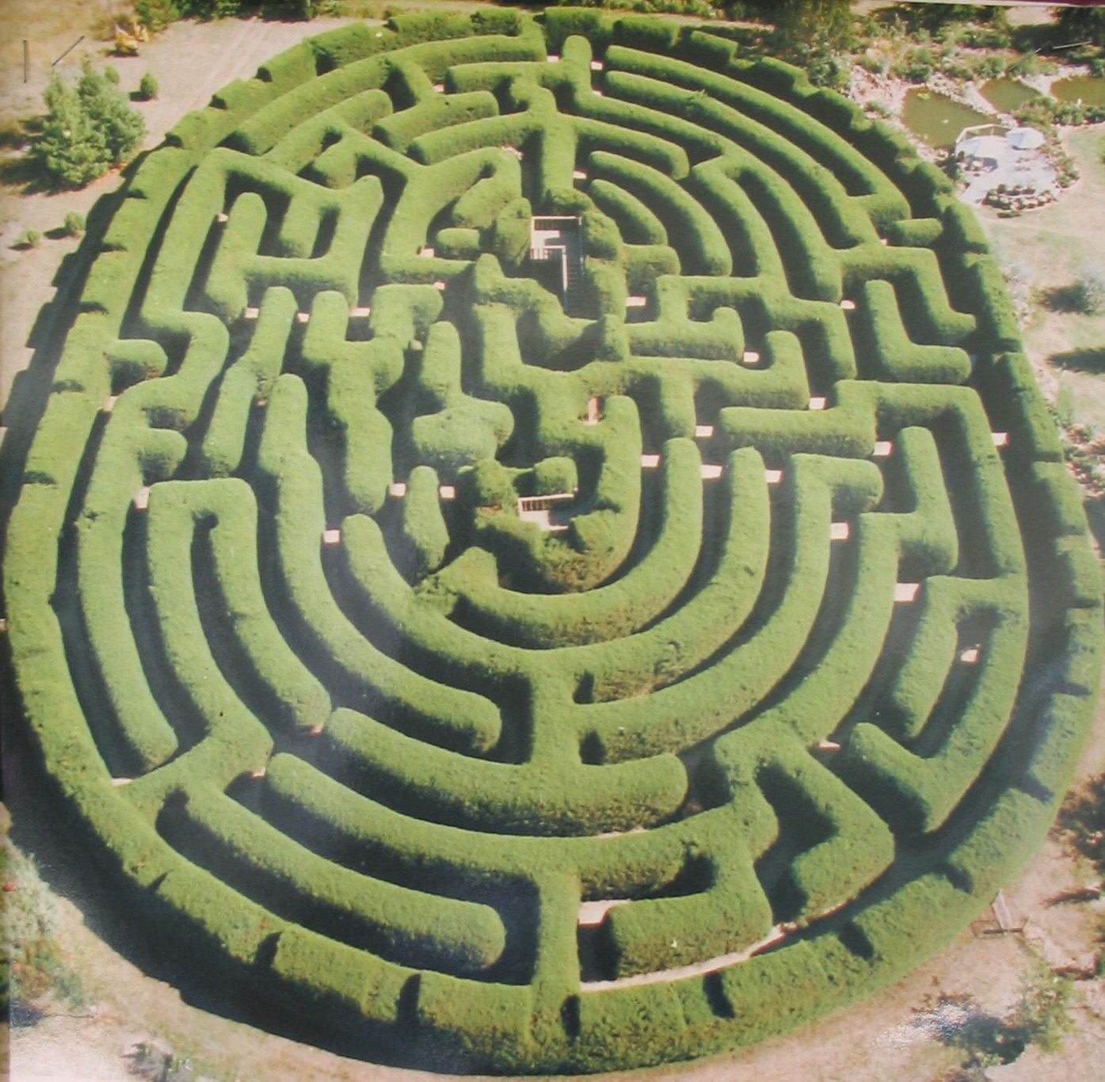
The humans and analysis tools work together
Often, the main reason a maze is a frustrating problem is that you can’t see it from this view!
In software, often the tool gives a view that helps us decide where to look for interesting things.
Notes:
Maze image from http://en.wikipedia.org/wiki/File:Wandiligong_maze.jpg.

Slide 25
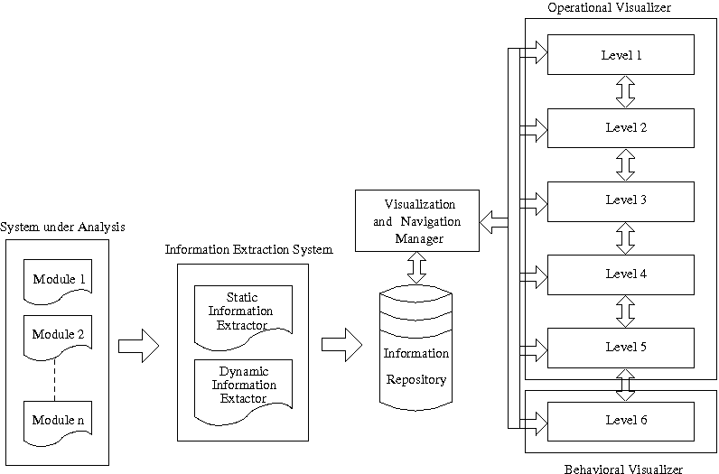
Anatomy of Software Visualization Tool
Notes:
We’ll then look at a few examples…

Slide 26
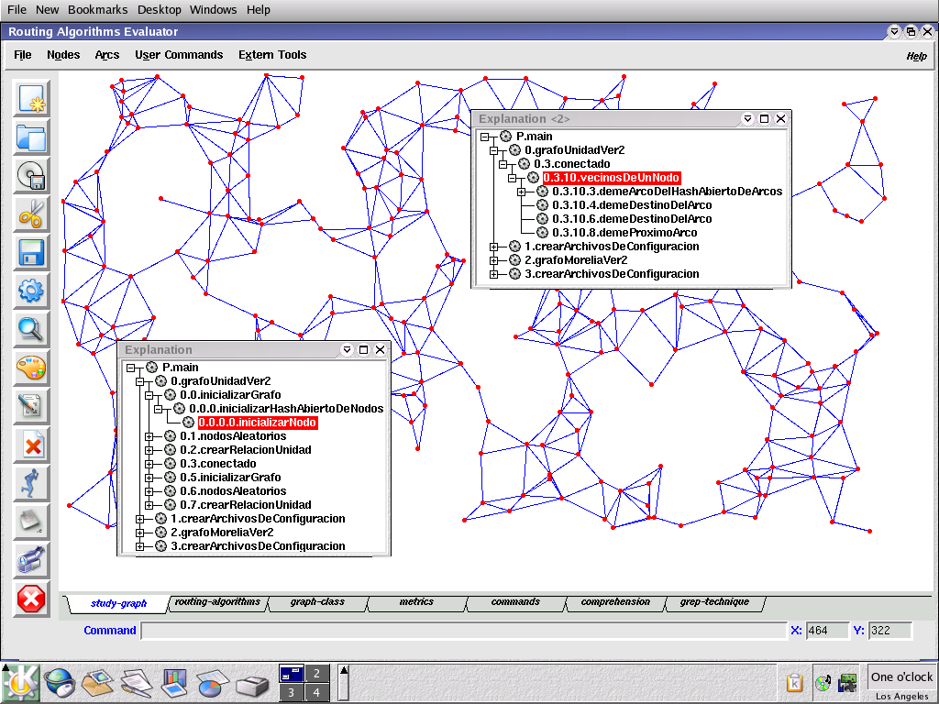
Example:EAR (Un Evaluador de Algoritmos de Ruteo)
Notes:
Shows which modules/classes use which others.
For more about this system, in Spanish, see http://www.google.com/url?sa=t&rct=j&q=&esrc=s&source=web&cd=1&ved=0CC4QFjAA&url=http%3A%2F%2Fwiki.di.uminho.pt%2Ftwiki%2Fpub%2FEducation%2FMICEI%2FMatPedSem%2Fseminario-21-04.ppt&ei=xavOUsz2OtS0sQS9u4DwCw&usg=AFQjCNF_hTCYOkeVgHmgZvENlcRLjQooHA&sig2=wOvBK7HypSO5utGmqSTUAw.

Slide 27
Example: ComVis Tool
Notes:
ComVis is a prototype for exploring domain-based visualization methods. See “ComVis: A Coordinated Multiple Views System for Prototyping New Visualization Technology,”
By Matkovic, et al, Proceedings of the 2008 12th International Conference on Information Visualization.

Slide 28
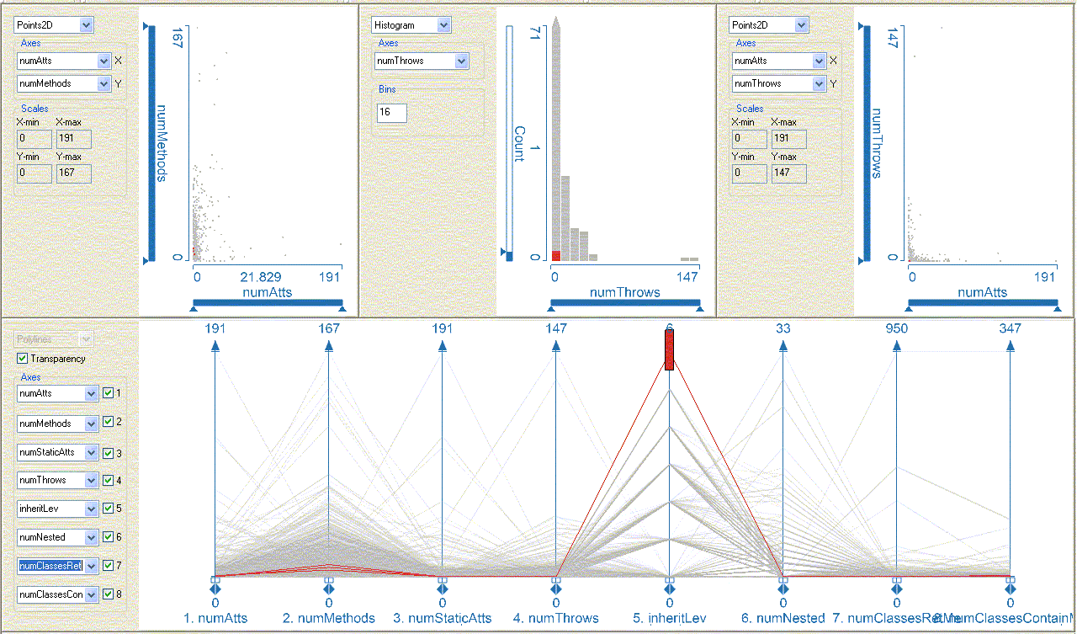
Static View: Aspects of Classes
Compare
# of Methods
vs. # of Attribures
# of Throws
# of Attributes
Brush
Classes that
have highest
Inheritance
Level
Note that they
have low
# of Attributes, etc.
Notes:
Linked Multi-views, composite “brushing.” Brushing is a method of highlighting relevant data in different views, like that highlighted above.

Slide 29
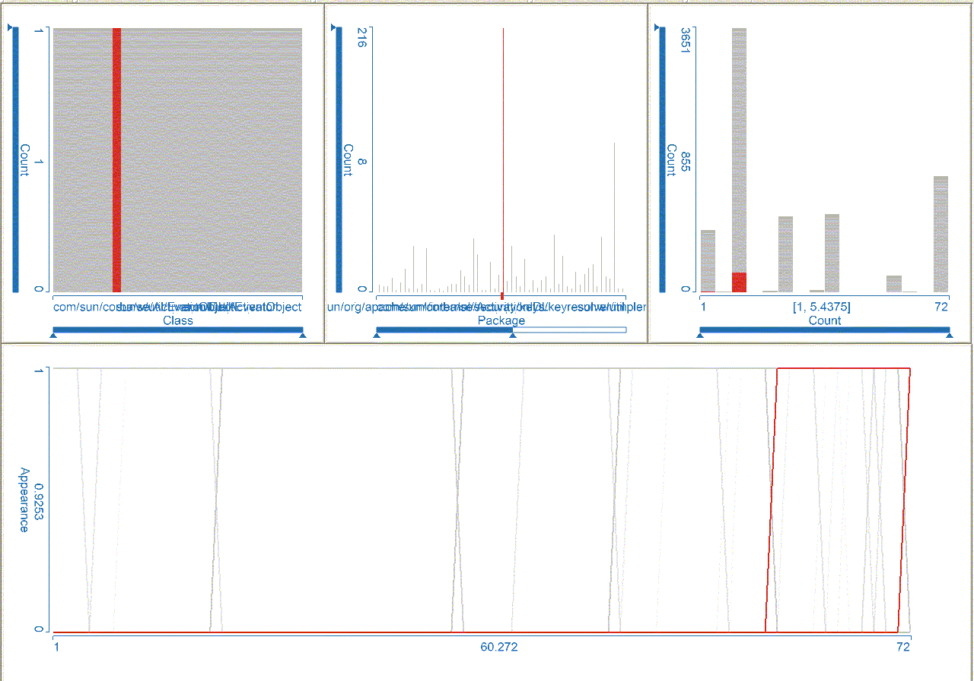
Dynamic View: Time series
Select
package
with
highest
# of
classes
Note
# of
classes
WRT
total in
version
Indicates how
the selected
classes show
up across all
72 versions
Notes:
A “brushing” example:
Overall view of the Java SDK source code history.
Lower view provides a family of 8537 curves, each representing a class over a sequence of 72 versions (from version 1.1.2_012 to 1.6.0).
An individual curve has values 0 or 1 -- present (1) or absent (0) in a given version of the code (time values from1 to 72).
While a simultaneous presentation of 8537 curves in a curve view is not necessarily useful, the ability to brush (select) to provide focus and content makes this view very useful.
TOP right view - histogram of the individual packages with the highest number of classes in the largest versions…72 versions and 3651 classes in largest version.
For more on “brushing and linking,” see http://en.wikipedia.org/wiki/Brushing_and_linking.

Slide 30
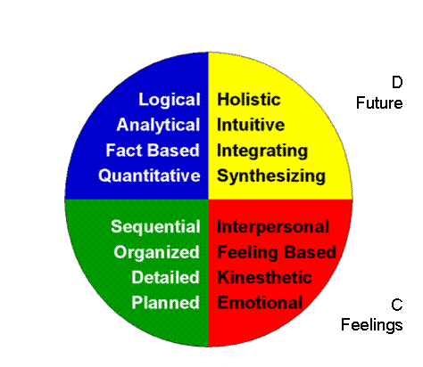
One more angle on understanding…
Different developers will understand programs in inherently different ways!
Example analysis – the
Ned Herrmann Model →
  People’s preferences in
  thinking during problem
  solving – tend toward A,
  B, C, or D.
  This model’s had actual
  research backing it…
  Including studies of
  engineering students!
A
Facts
B
Form
Notes:
Image from http://www.12manage.com/methods_herrmann_whole_brain.html.
See for example the Lumsdaines’ study of engineering students, at http://www.innovationtoday.biz/pubs/Thinking_Preferences_of_Engineering_Students.pdf.
Most CS profs are in the upper left-hand quadrant in this model, preferring logical, analytical thinking. However, that does not mean that all engineers are that way!

Slide 31
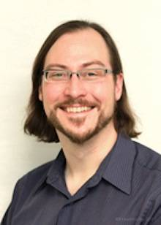
Article – Automate program understanding?
Jan Schumacher, et al, “Building Empirical Support for Automated Code Smell Detection,” 2010.
Like built into Eclipse, only more sophisticated
Identify “smelly” components
  “god” class code smells
Researchers found:
  Study required some other way to decide if a
  class really was a “god” class
  Even experts disagree on these
    Even used similar process for checking
  Metrics beat humans
  Automation would save time
  Combination of automated and human
  verification - best
Author Forrest Shull
at University of Maryland
Notes:
Image from http://www.cs.umd.edu/people/fshull.

Slide 32
Assignment and Milestone Reminders
Exam 1 is out there on the course web site – due , Tues, July 12, 11:55 PM !!!
  See next slide for topics to expect
Journal / milestone topics to consider - for “Week 5”:
  Journal – Make actual changes to your code, and record how these went, making observations about the process you use, and the changes themselves.
    See the Milestone topic list, below, for things to consider as you make these changes!
  “Milestone 4” – Try to summarize any of the following topics, from this week, that are appropriate to the work you just did:
    How do you mix maintenance and major development on your system?
    How are your “best practices”?
    How do you carve-up who does development and who does maintenance?
    What’s the transition like, between these?
    Cntd →
    How well do you document the processes you use?
    What formal / informal standards should your system meet?
    How do you estimate time for a kind of change?
    What development / maintenance risks are there?
    How Maintainable is your system?
    How much will it cost your client to maintain it over time, and why (you don’t need to supply real numbers, but can talk in generality)?
    Add discussion about how user documentation / help could be added / enhanced
    How do use cases or user stories evolve through your design to testing?
    How are the strengths and weaknesses of your Test Plan and Deployment Plan?
    For today, add “how you’d make your project code
    more understandable to a maintenance programmer”
    What would a “guide to reading our code” look like?
    Where is the most complexity in your algorithms?
    What tools, if any, do you use to aid in program understanding?

Slide 33
“Review” for Take-home Exam 1:
Topics we’ve covered through today
From Fowler’s book:
Bad code smells
Refactoring principles
Composing methods
Moving features
Organizing data
Simplifying conditionals
Making method calls simpler
Dealing with generalization
Big refactorings
From other sources:
Course intro
Software change
Stepping back to view maintenance and evolution
The software maintenance process
Software documentation
Program understanding
Notes:
We may zip through these if there’s time.

Slide 34
Review: Course Intro
Most software is a problem of change
  It’s continually engineered, not manufactured
  It doesn’t wear out, but deteriorates with change
By testing systematically yourself, some approaches to maintenance and evolution, on your own projects, you learn a lot about how this works.

Slide 35
Review: Software change
Software systems are getting bigger, more ambitious
Change is activities that alter software
Everything changes, including requirements, … testing and delivery methods
Maintenance is a high % of overall costs
Change in teams and processes take a toll

Slide 36

Review: Bad Code Smells
Duplicated Code
Long Method
Large Class
Long Parameter List
Divergent Change
Shotgun Surgery
Feature Envy
Data Clumps
Primitive Obsession
Switch Statements
Lazy Class
Parallel Inheritance Hierarchies
Speculative Generality
Temporary Field
Message Chains
Middle Man
Inappropriate Intimacy
Incomplete Library Class
Data Class
Refused Bequest
Alternative Classes w/ varied interfaces
Comments

Slide 37
Review: Refactoring Principles
Definition of refactoring
How it works with “test first”
Why you should refactor / not
How it fits with agile methods
“Extreme normal form”
How to explain taking time to refactor
Guidelines
Issues with refactoring – where it’s difficult
Shu Ha Ri, and how well you’re expected to know these principles

Slide 38
Review: Composing Methods
Some Bad Code Smells
  Long method
  Duplicated code
  Comments to explain hard-to-understand code
Extract Method
Inline Method
Inline Temp
Replace Temp with Query
Introduce Explaining Variables
Split Temporary Variable
Remove Assignments to Parameters
Replace Method with Method Object
Substitute Algorithm

Slide 39
Review: Moving Features Between Objects
Some Bad Code Smells
  Data class
  Feature envy
  Large class
Move Method
Move Field
Extract Class
Inline Class
Hide Delegate
Remove Middle Man
Introduce Foreign Method
Introduce Local Extension

Slide 40
Review: Organizing Data
Some Bad Code Smells
  Explaining comments
  Public fields
Self Encapsulate Field
Replace Data Value with Object
Change Value to Reference
Change Reference to Value
Change Unidirectional Association to Bidirectional
Change Bidirectional Association to Unidirectional
Replace Magic Number with Symbolic Constant
Encapsulate Field
Replace Array with Object
Replace Record with Data Class
Duplicate Observed Data
Replace Type Code with Class
Replace Type Code with Subclasses
Encapsulate Collection
Replace Type Code with State/Strategy
Replace Subclass with Fields

Slide 41
Review: Simplifying Conditionals
Conditional logic can get tricky and
refactorings can be used to simplify it
Some Bad Code Smells
  Long Method
  Switch Statements
  Temporary Field
Decompose Conditional
Consolidate Conditional Expression
Consolidate Duplicate Conditional Fragments
Remove Control Flag
Replace Nested Conditional with Guard Clauses
Replace Conditional with Polymorphism
Introduce Null Object
Introduce Assertion
Notes:
Why are Simplifying Conditionals refactorings often needed? [[ Conditional logic is prone to getting complex and tricky to understand, which in turn makes us prone to errors]]

Slide 42
Review: Making Method Calls Simpler
Some Bad Code Smells
  Alternative Classes with Different Interfaces, Data Clumps, Long Parameter List, Primitive Obsession, Speculative Generality, Switch Statements
Rename Method
Add Parameter
Remove Parameter
Separate Query from Modifier
Parameterize Method
Replace Parameter with Explicit Methods
Preserve Whole Object
Replace Parameter with Method
Introduce Parameter Object
Remove Setting Method
Hide Method
Replace Constructor with Factory Method
Encapsulate Downcast
Replace Error Code with Exception
Replace Exception with Test

Slide 43
Review: Dealing with Generalization
Generalization → Inheritance
Some Bad Code Smells
  Duplicate Code, Inappropriate Intimacy, Large Class, Lazy Class, Middle Man, Refused Bequest, Speculative Generality
Pull Up Field
Pull Up Method
Pull Up Constructor Body
Push Down Method
Push Down Field
Extract Subclass
Extract Superclass
Extract Interface
Collapse Hierarchy
Form Template Method
Replace Inheritance with Delegation
Replace Delegation with Inheritance
Notes:
Generalization produces its own batch of refactorings, mostly dealing with moving methods around a hierarchy of inheritance.
Dealing with Generalization suggests what element of Object-Oriented development is addressed? [[Inheritance.]]

Slide 44
Review: Big refactorings
Include:
  Tease apart inheritance
  Convert procedural design to objects
  Separate domain from presentation
  Extract hierarchy
Require a systematic approach, usually by a team

Slide 45
Review: Software maintenance as a part of evolution
Maintenance is a subset of evolution
  What has to be changed now
  Especially, between releases in the evolution
  A practitioner’s view of evolution
  Needs to have a systematic process
  Documentation is a pain, but key to doing it well
    Need to experiment on time and costs and good ways to do it
    Goal is high maintainability
Notes:
Article you read showed that user satisfaction and profitability also rely on other things, such as changes to the environment, beyond the control of the maintenance team.

Slide 46
The software maintenance process
Key issues we discussed:
The financials and planning of a maintenance activity
Ingredients of the maintenance process
  E.g., role of release management
Maintenance process standards
Maintainability
  Modifiability is a strategic part of this
Notes:
The article you read on maintenance said:
Everyone thinks they know what “maintainability” is,
And something about how to achieve it
Like having a good design to begin with
And doing refactoring
But in contrast to attributes such as performance and correctness, there is no common understanding of:
What maintainability actually is, how it can be achieved, measured, or assessed.
In fact, every software organization has its own definition of maintainability.
The authors defined a quality model that –
Associates maintenance activities with system properties, including
The capabilities of the organization.
They found that keys to maintainability were –
Measurements as well as
Manual inspections.

Slide 47
Review: Software Documentation
Key issues we discussed:
Project documents:
  In design – Use of use cases
  In testing – Test plans
  Deployment plan – Describes setup and suggests intended use
User documentation:
  Who’s the audience and what kinds do they need?
  Usability guidelines
Notes:
Article you read showed that there were widespread preferences and aversions for software documentation tools. Everyone wants automated documentation tools!

Slide 48
Review: Program Understanding
(That’s this slide set!)
Manual approaches that people use
Factors in being able to do this
Program understanding as –
  Gestalt problem solving
  Concept assignment
Ways to do program slicing
Graphs to help understand code
What program visualization tools do
Notes:
Article you read found that automated ways of detecting “bad smells” worked better than using experts to detect these.

