Slide 1
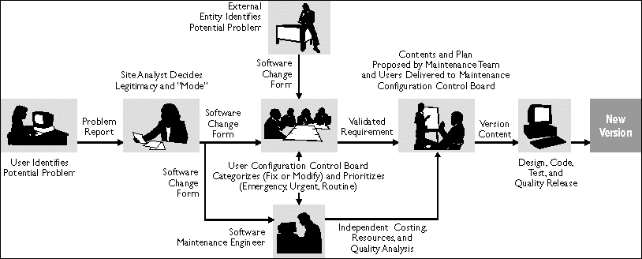
Software Maintenance and Evolution CSSE 575: Session 4, Part 2 Software Maintenance Process
Above – Hill AFB’s maintenance process, from http://staff.unak.is/andy/MScMaintenance0809/Lectures/Measurements%20to%20Manage%20Software%20Maintenance%20-%20July%2097.htm
Steve Chenoweth
Office Phone: (812) 877-8974
Cell: (937) 657-3885 Email: chenowet@rose-hulman.edu

Slide 2
Maintenance topics on these slides
The financials and planning of a maintenance activity
Ingredients of the maintenance process
E.g., role of release management
Maintenance process standards
Maintainability

Slide 3
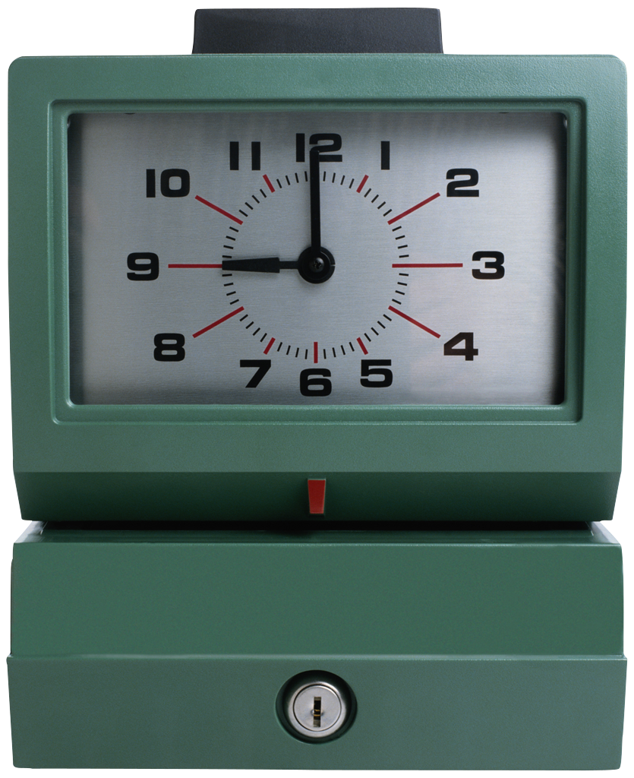
Discretionary and Non-Discretionary $
Since Development and Maintenance can be somewhat ambiguous situations, money often determines the label
The boundary becomes:
Estimated cost (>$5000)
Estimated effort (> 20 hours of effort)

Slide 4
Development versus Maintenance Risk
Development Risks
Technology - sometimes bleeding edge
Personnel - sometimes high turnover
Budget - risk entrepreneurial investments
Business - business case based on future customers
Maintenance Risks
Technology - sometimes technology obsolete
Personnel - sometimes dated skills
Budget - risk averse cost containment
Business - business case based on existing customers
Notes:
What is the business case based on for Software Maintenance? [[ existing customers ]]

Slide 5
Key Software Maintenance Factors
Software Product
User Requirements (i.e., Change Request and Specification)
Organizational Environment
Operational Environment
Maintenance Personnel
Maintenance Process

Slide 6
Software Product
Application domain
Documentation quality
Code flexibility
Code complexity/structure
Product quality
Notes:
Application Domains Mature (early 80% solution → Covering range of situations)
Code Flexibility - No clear standards for code changes (vs the rest of engineering)
Product quality – like entropy
What are the key issues with the software product with respect to maintenance?

Slide 7
User Requirements
Requests for additional features
Correction of defects (bugs)
Other support (e.g. training, help desk)
Notes:
Requests for additional features
Usually wait for next release
Specials for key customers or submarkets
Correction of defects (bugs)
Fix now vs. Wait for next release
Other support (e.g. training, help desk)
Should developers take a turn at the help desk?
Where do user requirements play the most direct role in software maintenance? [[specification in change requests]]

Slide 8
Organizational Environment
Change in Policies
Medical – FDA 13485 Medical Device Regulation
Competition
Informal standards – like:
What your client is used to!
What the developers are used to!
Internal Management Changes
Mergers and Acquisitions
Notes:
Policies - Banking, Insurance, Finance…
Competition - announces their product on iPad
Internal Management Changes - Your group is merged with another group, under their old management

Slide 9
Operational Environment
Hardware
Communications
Operating Systems
Systems Software
Third Party Software
Notes:
Nasty scenario – One of the components you use forces you to do an expensive upgrade
Nastier – That upgrade won’t work with other components you have to use
Damocles' sword conflicts …
What elements of the operational environment can be effected by interoperability changes? [[HW, Comms, OS’s, Systems SW, and 3rd party SW]]

Slide 10
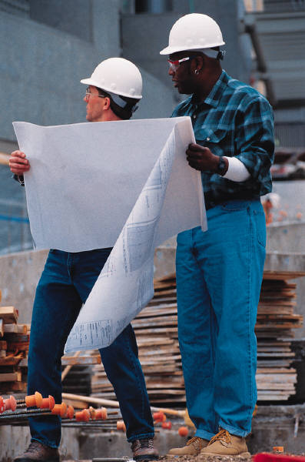
Maintenance Personnel
Staff Turnover
Application Domain Expertise
Working Practices
Notes:
Staff Turnover – A killer of maintenance capability → Which often means, key people can never leave!
Application Domain Expertise - A critical intellectual property
Working Practices – “attitude”
A long-term focus is required of the people
What are three factors to consider when addressing software maintenance personnel issues?

Slide 11
Ingredients of a Maintenance Process (1 of 2)
Process requests before working on them:
Capture maintenance requests
Deal with Emergency Fixes/Priority CRs
Investigate change requests
Verify bugs from DRs/PRs
Understand the impacts (1st Impact Analysis)
Estimate the Effort / Cost
Prioritize requests
Competing against other requests!
Assigning to maintenance release and team
Scheduling the maintenance release
Notes:
Capture maintenance requests (Change Requests, Discrepancy / Problem Reports, etc.)
1) New versions coming out in Maintenance Releases at regular intervals
2) Ongoing Technical/Maintenance Support
1) Between or instead of releases, 2) Emergency Fixes, 3) Priority Change Requests
Question: Before you prioritize the change requests, you must do a preliminary impact analysis to _________________ the effort and cost of the change. [[estimate]]

Slide 12
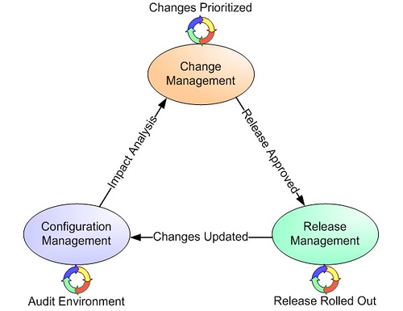
Ingredients of a Maintenance Process (2 of 2)
Conduct detailed Impact Analysis
Update estimates
Plan the change strategies
Update Requirements (as needed)
More on this – Thursday…
Design the Changes
Plan the implementation
Update Design (Architecture, Logical, Physical)
Implement and Integrate the Changes
Test Changes with Various Configurations
Deciding to send it out
Special, or in a specific sub-release
Deploy the Release
Above – A process overview, which shows how processes interrelate here (and often their associated organizations). From http://blogs.technet.com/b/randyy/archive/2005/10/25/413064.aspx
Notes:
Why conduct a detailed impact analysis if you already did one for estimating the costs for the change request? [[the first one was completed quickly to provide a preliminary estimate of effort and cost. This second IA maps out the information to plan, navigate, and execute the change]]

Slide 13
What is Release Management?
The key role in managing what goes out next
A team or person who makes those decisions
Consider what customers want ASAP
Consider what’s tested & ready to include
Take out “extras” you don’t want
A cool software management job for technical people

Slide 14
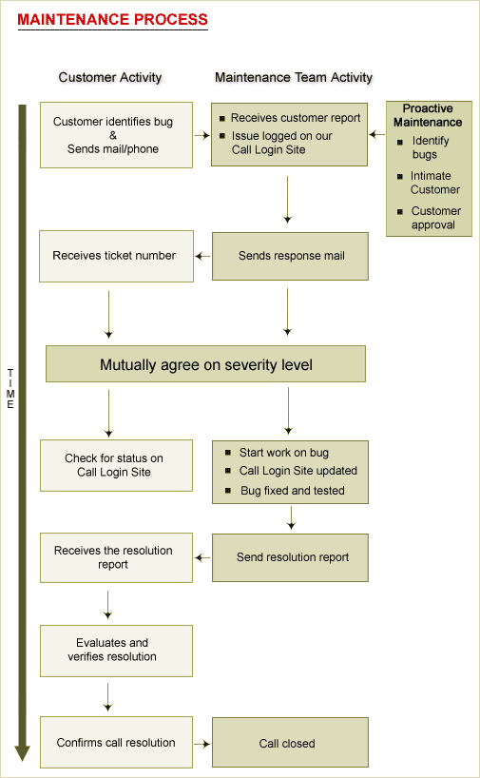
Example Maintenance Process
“Pre-fixing”
Help Desk
Technical Support
Maintenance Personnel
Customers instead of Users!
http://www.indiawebdevelopers.com/CustomerSupport/maintenance_process.asp
Notes:
Note the amount of “pre-fixing” and other communication activity!
Help Desk
Technical Support
Maintenance Personnel
Customers instead of Users!

Slide 15
Maintenance in the System Life Cycle
ISO/IEC 15288
System Life Cycle Processes
ENTERPRISE ENVIRONMENT MANAGEMENT
INVESTMENT MANAGEMENT
SYSTEM LIFE CYCLE MANAGEMENT
RESOURCE MANAGEMENT
ENTERPRISE(5)
QUALITY MANAGEMENT
SYSTEM LIFE CYCLE
ACQUISITION
AGREEMENT (2)
(25)
SUPPLY
PROJECT (7)
PROJECT PLANNING
PROJECT ASSESSMENT
PROJECT CONTROL
DECISION MAKING
RISK MANAGEMENT
CONFIGURATION MANAGEMENT
INFORMATION MANAGEMENT
TECHNICAL (11)
STAKEHOLDER REQUIREMENTS DEFINITION
TRANSITION
REQUIREMENTS ANALYSIS
VALIDATION
ARCHITECTURAL DESIGN
OPERATION
IMPLEMENTATION
MAINTENANCE
INTEGRATION
DISPOSAL
VERIFICATION

Slide 16
Maintenance in the Software Life Cycle
IEEE/EIA 12207
Software Life Cycle Processes
ACQUISITION
SUPPLY
DEVELOPMENT
OPERATION
MAINTENANCE
SOFTWARE LIFE CYCLE
PRIMARY (5)
(17+1)
SUPPORTING (8)
DOCUMENTATION
CONFIGURATION MANAGEMENT
QUALITY ASSURANCE
VERIFICATION
VALIDATION
JOINT REVIEW
AUDIT
PROBLEM RESOLUTION
ORGANIZATIONAL (4)
MANAGEMENT
INFRASTRUCTURE
IMPROVEMENT
TRAINING
TAILORING
Notes:
With the IEEE/EIA 12207 Software Life Cycle, what other processes are on the same leg Maintenance? [[Primary → Acquisition, … Operation]]

Slide 17
12207’s Maintenance Process A Primary Life Cycle Process - 12207.0 § 5.5 (ISO/IEC 14764)
Defines the basic activities of the maintainer: managing modifications to the software product to keep it current and in operational fitness.
Activity Tasks
1 Process Implementation Document maintenance activities, problem tracking procedures, & Manage modifications to the system.
2 Problem and modification Analyze problem reports. Replicate or verify analysis problems. Develop modifications. Document problems, analysis, fixes. Get modifications approved.
3 Modification implementation Document where changes are needed. Implement modifications and test.
4 Maintenance review/ Review integrity of modified system. Get approval for acceptance modifications.
5 Migration Ensure products meet standard. Develop and use Migration Plan. Notify users of migration. Conduct parallel operations if needed. Notify all concerned, archive all records. Perform post-op review of changes. Keep data from old environment.
6 Software retirement Document plans for retirement. Notify all users of plans and activities. Conduct parallel operations. Notify all concerned, archive all records. Keep data from retired product per contract.

Slide 18
Maintenance Process Standards
ISO/IEC 14764
Process Implementation
Problem and modification analysis
Modification implementation
Maintenance review/acceptance
Migration
Software retirement
IEEE STD 1219
Problem identification
Analysis
Design
Implementation
System test
Acceptance test
Delivery

Slide 19
Maintainability
Means
Management
Operational environment of the target systems
Target system software, maturity, documentation
For the developer, especially means “modifiability of code”:
Localizing changes
All the refactoring ideas!
Preventing ripple effects
Ditto
Deferring binding time
Like runtime registration, configurations, parameterization, component replacement, scripting

Slide 20
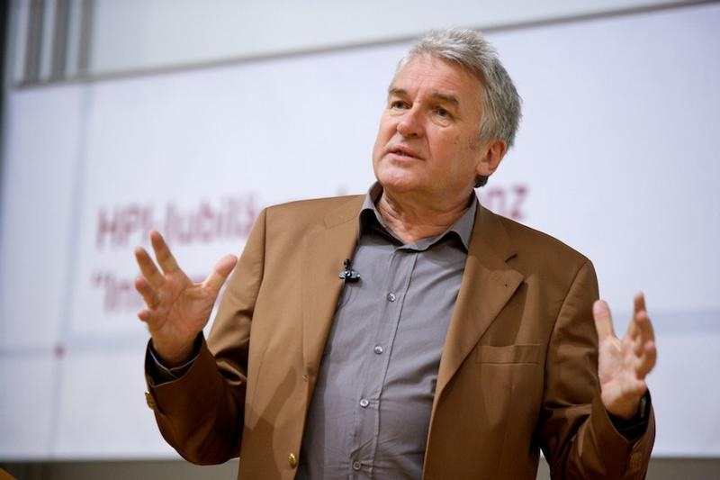
“Demystifying Maintainability” Article by Manfred Broy, et al
Everyone thinks they know what “maintainability” is,
And something about how to achieve it
Like having a good design to begin with
And doing refactoring
But in contrast to attributes such as performance and correctness, there is no common understanding of:
What maintainability actually is, how it can be achieved, measured, or assessed.
In fact, every software organization has its own definition of maintainability.
The authors defined a quality model that –
Associates maintenance activities with system properties, including
The capabilities of the organization.
They found that keys to maintainability were –
Measurements as well as
Manual inspections.
They applied this to large scale commercial software projects.
Having a good definition of maintainability caused –
A slowdown of decay and
A significantly increased awareness for long-term quality aspects.
Notes:
Image of Manfred Broy from https://idw-online.de/de/image104585.

Slide 21
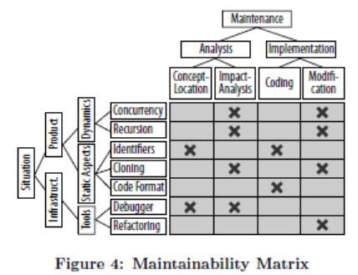
“Demystifying Maintainability” Article
Associating maintenance activities with system properties…

