Slide 1
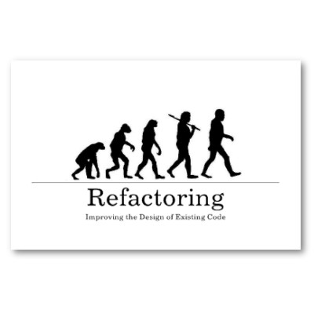
Software Maintenance and Evolution CSSE 575: Session 3, Part 4 Big Refactorings
Steve Chenoweth
Office Phone: (812) 877-8974
Cell: (937) 657-3885 Email: chenowet@rose-hulman.edu
Above – a poster for refactoring, from http://www.zazzle.com/refactoring_poster-228118789330102998.
Notes:
Our last topic on refactoring…

Slide 2
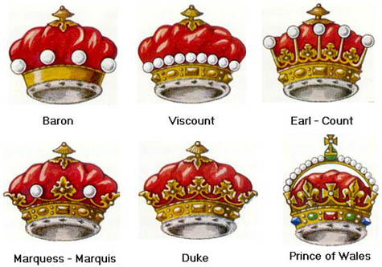
These are higher level…
These likely take a team, in order to do them systematically.
Include:
Tease apart inheritance
Convert procedural design to objects
Separate domain from presentation
Extract hierarchy
Right – Hierarchy in action – the hat you wear in England depends on your position. From http://pirate.shu.edu/~wisterro/cdi/coronets_and_hierarchy.htm.

Slide 3
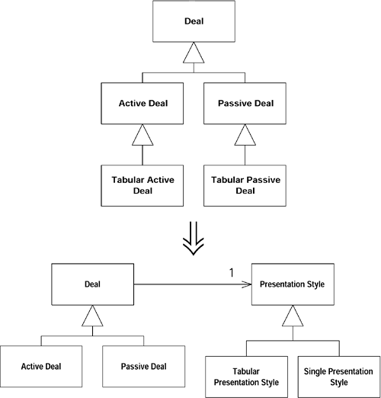
Tease apart inheritance
If you have two parallel sub-hierarchies, they probably contain duplicated code
Need to extract what really doesn’t belong, leaving the common parts in a single hierarchy.

Slide 4
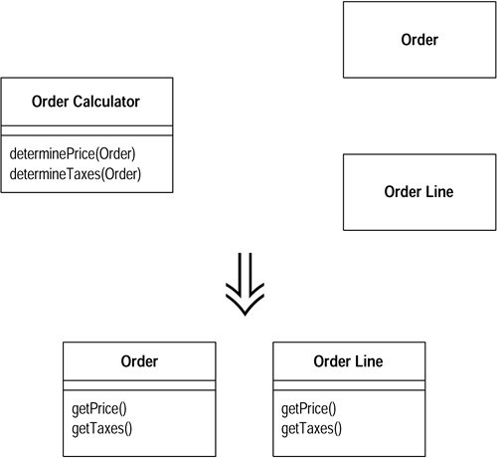
Convert procedural design to objects
Turn the data records into objects
Break up the behavior
Move the behavior into the objects

Slide 5
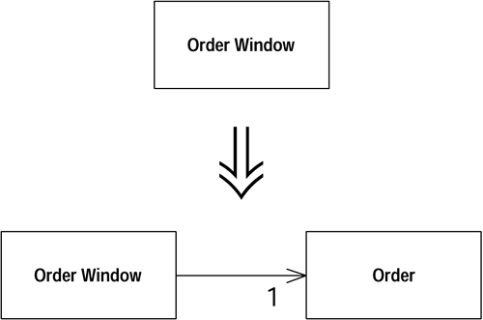
Separate domain from presentation
This is like Model-View-Controller.
Not so easy to do, in a system where that strategy was not taken from the start.

Slide 6
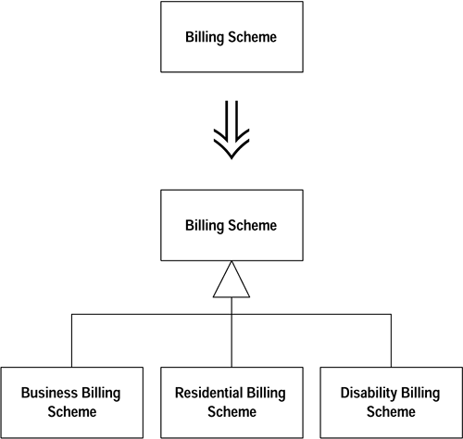
Extract hierarchy
Have a class doing too much work
Partly through many conditional statements
Create a hierarchy of classes in which each subclass represents a special case

Slide 7
Consideration of levels
The Infosys pdf I hoped you could read (!) suggested that refactoring applies to many different levels.
Used to be at http://www.infosys.com/engineering-services/white-papers/Documents/refactoring.pdf
Included:
Structural
Code clean-up
Code standards
User interface

Slide 8
The new, alternative article
Since the Infosys one didn’t work, I suggested “How to do large scale refactoring,” a task you may be faced with!
It suggests 3 approaches:
Big bang, for the truly desperate
Divide and conquer, for the more reasonable
Strangling, for those with time on their hands
And the link from this one to Martin Fowler’s explanation is pretty cool.
Notes:
It’s at https://www.infoq.com/news/2010/08/large-scale-refactoring.
And Fowler’s article is at http://martinfowler.com/bliki/StranglerApplication.html.

Slide 9
Consideration of purpose
In your own journals, some of you suggested refactoring may be for reasons other than code simplification:
Achieving some Quality Attribute goal, like –
Performance
Security
Getting rid of some other kind of smell, like –
The new people never understand this part.
This part is always being changed.

Slide 10
What’s built-in?
Check out the list of “Refactoring commands” for C# /Visual Studio 2013 !
From http://msdn.microsoft.com/en-us/library/719exd8s.aspx.
Included:
Extract Method Refactoring (C#)
Rename Refactoring (C#)
Encapsulate Field Refactoring (C#)
Extract Interface Refactoring (C#)
Remove Parameters Refactoring (C#)
Reorder Parameters Refactoring (C#)

Slide 11
Where we have Been so far…
Refactoring
Bad Code Smells
Composing Methods
Moving Features between Objects
Organizing Data
Simplifying Conditional Expressions
Making Method Calls Simpler
Dealing with Generalization
Big Refactorings
These principles will serve you in constructing and evolving software systems

Slide 12
Perfect Midterm Questions
Here’s a sample of some code. What refactoring would you use on it, and why.
What are the conditions in the lifecycle that favor spending more time refactoring?
Find two pairs of refactoring rules which appear to be opposite advice. Explain what nuances of a situation would favor each.

Slide 13
Moving up from “Shu” to “Ha”
In the refactoring article you read for today, at http://rethinktheworld.blogspot.com/2011/09/rotten-code.html, were you convinced that the problem of refactoring was not easily decomposable into just doing obvious steps?

Slide 14
And from Ha to Aha
Last week we talked about Lambdas (maybe)
How about as a way to refactor?
See http://devleader.ca/2013/11/14/lambdas-example-refactoring-code/
Concept – Private handling methods can get “handed out” as well as “handed in”
A perfect way of feeding specifics to frameworks?

