Slide 1
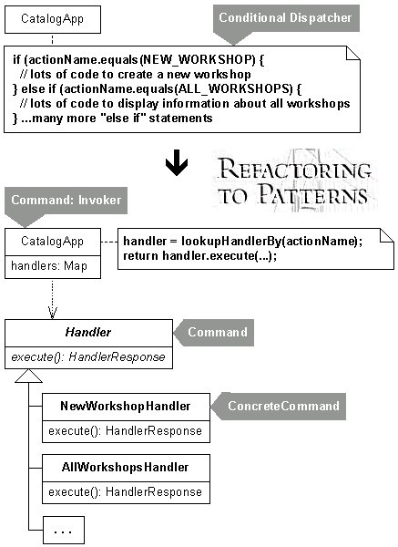
Software Maintenance and Evolution CSSE 575: Session 3, Part 1 Simplifying Conditionals
Steve Chenoweth
Office Phone: (812) 877-8974
Cell: (937) 657-3885 Email: chenowet@rose-hulman.edu
One way to refactor conditionals, from http://www.industriallogic.com/xp/refactoring/conditionDispatcherWithCommand.html

Slide 2
Recall: Basic Rule of Refactoring
Refactor the “low hanging fruit”
Gets you the most value for the least investment
Consider it Algebra for Software code
Pretty low to the ground is – Simplifying Conditionals!
Notes:
In other words, don’t spend much time on it
There are ways to improve any design incrementally
What is meant by Algebra for Software? [[identifying factors and using them to simplify code]]

Slide 3
Simplifying Conditionals
Conditional logic can get tricky and refactorings can be used to simplify it
Some Bad Code Smells
Long Method
Switch Statements
Temporary Field
Decompose Conditional
Consolidate Conditional Expression
Consolidate Duplicate Conditional Fragments
Remove Control Flag
Replace Nested Conditional with Guard Clauses
Replace Conditional with Polymorphism
Introduce Null Object
Introduce Assertion
We’ll discuss the ones in red!
Notes:
Why are Simplifying Conditionals refactorings often needed? [[ Conditional logic is prone to getting complex and tricky to understand, which in turn makes us prone to errors]]

Slide 4
Decompose Conditional
Situation: You have a complicated conditional (if-then-else) statement
Solution: Extract methods from the condition, and then the “then”, and “else” parts
if (date.before (SUMMER_START) || date.after(SUMMER_END))
charge = quantity * _winterRate + _winterServiceCharge;
else charge = quantity * _summerRate;
if (notSummer(date))
charge = winterCharge(quantity);
else charge = summerCharge (quantity);
Decompose Conditional
Notes:
Breaks a conditional into pieces
Separates the switching logic from the details of what happens
What is the problem that “Decompose Conditional” solves?

Slide 5
Decompose Conditional: Motivation
The code (both the condition checks and the actions) tells us what happens, but can easily obscure why it happens
Want our intention made clearer
Decompose it and replace chunks of code with a method calls named after the intention
Receive further benefit by doing this for the conditional part and each of the alternatives
This way you highlight the condition and make it clear what you are branching on
Also highlights the reason for the branching
Decompose Conditional
Notes:
Why do we decompose a conditional?

Slide 6
Consolidate Conditional Expression
Situation: You have a sequence of conditional tests with the same result
Solution: Combine them into a single conditional expression and extract it
double disabilityAmount() {
if (_seniority < 2) return 0;
if (_monthsDisabled > 12) return 0;
if (_isPartTime) return 0;
// compute the disability amount
double disabilityAmount() {
if (isNotEligibleForDisability()) return 0;
// compute the disability amount
Consolidate Conditional Expression
Notes:
What is the solution that “Consolidate Conditional Expression” provides?

Slide 7
Consolidate Duplicate Conditional Fragments
Situation: The same fragment of code is in all branches of a conditional expression
Solution: Move it outside of the expression
if (isSpecialDeal()) {
total = price * 0.95;
send();
}
else {
total = price * 0.98;
send();
}
if (isSpecialDeal())
total = price * 0.95;
else
total = price * 0.98;
send();
Consolidate Duplicate Conditional Fragments
Notes:
Used to remove any duplication within the conditional code

Slide 8
Remove Control Flag
Situation: You have a variable that is acting as a control flag for a series of boolean expressions
Solution: Use a break or return instead
…
done = false;
while not done {
// do something …
if (complete)
done = true;
// next step of loop …
…
while … {
// do something …
if (complete)
return;
// next step of loop …
Remove Control Flag
Notes:
Used to remove any duplication within the conditional code
What is the problem that “Remove Control Flag” solves?

Slide 9
Discussion: Refactor checkSecurity
boolean checkSecurity(String[] people) {
boolean found = false;
for (int i = 0; i < people.length; i++) {
if (! found) {
switch (people[i].inTerroristLists()) {
case Real_IRA: {
sendAlert(Real_IRA, people[i].name);
found = true;
}
case Ulster_Volunteer_Force: {
sendAlert(UVF, people[i].name);
found = true;
}
}
}
return found;
}
The Playmobil Security Checkpoint, from http://www.crunchgear.com/2010/12/02/bad-worst-toys-christma/
Remove Control Flag
Notes:
What is your solution to Refactoring checkSecurity?

Slide 10
Find Control Flags & Replace with returns
boolean checkSecurity(String[] people) {
for (int i = 0; i < people.length; i++) {
switch (people[i].inTerroristLists()) {
case Real_IRA: {
sendAlert(Real_IRA, people[i].name);
return TRUE;
}
case Ulster_Volunteer_Force: {
sendAlert(UVF, people[i].name);
return TRUE;
}
}
}
return FALSE;
}
Remove Control Flag
Notes:
Assume this is a progressive company that allows promotion of managers to engineers.
Thus the type code is mutable, and I can’t use subclassing. My first step, as ever, is to self-encapsulate the type code:

Slide 11
Replace Conditional with Polymorphism
class Real_IRA...
void inTerroristLists(string name) {
sendAlert(Real_IRA, name)
return TRUE;
}
class UVF...
void inTerroristLists(string name) {
sendAlert(UVF, name)
return TRUE; }
…
class TerroristType...
abstract void inTerroristLists(string name);
Declare superclass method abstract
Replace Conditional with Polymorphism
Notes:
Remove the type code definitions from the employee and replace them with references to the employee type

