Slide 1
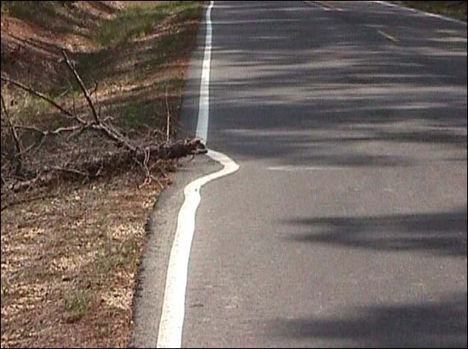
Software Maintenance and Evolution CSSE 575: Session 10, Part 2 Maintenance Management
Steve Chenoweth
Office Phone: (812) 877-8974
Cell: (937) 657-3885 Email: chenowet@rose-hulman.edu
A serious issue in development vs. maintenance is getting the developers to put features into the system which will aid the maintainers later on – especially when these are separate organizations. Above is one version of “Not my job” applied to highway line painting, as seen on the web. From http://www.kollynews.com/facts/193.
Notes:
Some of this material taken from Software Maintenance Management: Evaluation and Continuous Improvement, by Alain April and Alain Abran.

Slide 2
What is management?
Classic def of the functions of managing a group –
Planning (including organizing / staffing)
Leading (“execution” - directing, delegating, coaching, motivating)
Controlling (monitoring, getting and assessing results, cycles back to planning)
This is kinda crude – for example, we have to consider Before, During, and After in planning.
Let’s look at these steps for maintenance…
Before
During
After

Slide 3
Maybe step 1 – getting control?
Planning – for “Before”
If you’re a maintenance manager…
You get handed projects by development managers.
A lot of the maintenance work / grief is based on what was done before you had control of the project.
Like the quality of the development process, and
The quality of the product design
How soon can you “influence” the maintainability?
Maybe at the original project design time?
Are maintenance costs considered in development decisions?
Measurement is a big part of “getting control”
Can you know if you’ve met objectives?
See the prior set of slides!

Slide 4
Maybe do this one as step 2! – When are we done?
Planning – for “After”
It’s not too soon to plan for retirement!
Need an “exit strategy” for any product –
Sell the product to someone else
Tell the bad news to the last remaining customer?
Where do the people go who are working on it?
What new skills will they need for the next product the maintain?
Notes:
Image from http://www.thedigeratilife.com/blog/investing-for-retirement-how-to-retire/.

Slide 5
Then step 3 – What to do in the middle?
Planning – for “During”
Planning
“How” will we provide maintenance (continued from last slide set)?
Internal service-level agreements
Maintenance service contracts
Outsourcing contracts
Need measurement to do estimation
Most people use their own history as a guide
Supplemented by people’s recollections!
Best to have all this written down…
Alternatives to standardized estimates like COCOMO

Slide 6
Internal service-level agreements
Control -
The maintenance organization serves the development organizations (or the product development group they are a part of)
It needs to have its level of service defined, measured, and rewarded
This is like agreements with outside customers
Tends to promote “best practices”
Promote customer satisfaction
Based on results rather than effort
Quality level achievements
Requires consensus among the internal organizations

Slide 7
SLA’s, cntd
Control -
Issues –
The maintenance organizations providing the services will, of course, run into technical hurdles.
The “customers” are interested in the total service, while the maintainers each only one some part of that.
E.g., managing and prioritizing requests, versus delivering the finished maintenance work.
So, how are rewards and penalties handed out?
Necessary involvement by others, such as the original development organization.

Slide 8
Maintenance service contracts
Control -
Here, the idea is that you contract with others to do the maintenance work.
A service contract, vs a license contract
Important for the development organization to make these a package deal if possible!
Need to make the processes clear – like how are problems reported?
How are renewals to be negotiated?
Are additional charges clearly defined?
Is there a need for escrow services?

Slide 9
Outsourcing contracts
Control -
May move maintenance to a third party for many years.
Justifications:
Decreasing costs
Access to the expertise of outsourcer’s personnel
Move from fixed-cost structure to variable-cost
Collect revenue from the sale of an asset
Transfer technical details / problems to outsourcer

Slide 10
Outsourcing, cntd
Control -
Outsourcing contracts tend to have particular features, like:
Warranties for work done, following correction of a problem.
Additional services free of charge if not fixed.
Outsourcer asks the client to determine the priority of maintenance work items.
Outsourcer keeps a list ad history of problems submitted, using help desk software.
The service agreement is the main focus.
Long duration of this.
Notes:
From April and Abran, pp. 34-5.

Slide 11
Pigoski’s “list”
Leading -
Major problems in software maintenance – worst first:
Changing priorities
Inadequate testing methods
Performance measurement difficulties
System documentation incomplete or nonexistent
Adapting to the rapidly changing business environment
Large backlog
Contribution measurement difficulties
Low morale due to lack of recognition and respect
Lack of maintenance personnel, particularly experienced maintainers
Lack of maintenance methodology, standards, procedures and tools
Program code is complex and unstructured
Integration of overlapping and incompatible systems or subsystems
Maintainers lack proper training
Strategic plans
Understanding and responding to business needs
Lack of managerial understanding and support
Antiquated systems and technology
Lack of support for reengineering
High turnover causing loss of expertise

Slide 12
Example of tackling one problem
Leading -
Lack of experienced people:
Put them at a help desk first
Then do maintenance for a while
Then let them go to development
Provide training
Reduce turnover
Improve morale, etc.
Novel staffing solutions
Like people from the user community as testers

Slide 13
Ok, just one more problem…
Leading -
The large maintenance backlog:
Outsource parts of the work
Like testing
Hire temporary people for peaks
Rely on CCB to prioritize
Change the word “backlog” to “customer orders”
Are they paying for this work?
Analyze the processes being used
Notes:
CCB = Change control board.

Slide 14
And an opportunity…
Leading -
How much should a manager encourage developers to spend time refactoring?
A research article on refactoring results:
An Empirical Investigation into the Role of API-Level Refactorings during Software Evolution, by Kim & Cai, ICSE’11:
Studied 3 large open source projects. Found:
An increase in the number of bug fixes after API-level refactorings.
The time taken to fix bugs is shorter after API-level refactorings than before.
A large number of refactoring revisions include bug fixes at the same time or are related to later bug fix revisions.
API-level refactorings occur more frequently before than after major software releases.
They did see mistakes from frequent “floss refactoring.”
Suggested tools supporting refactoring could help eliminate those.
Notes:
Floss refactoring = interweaved with normal development, done preemptively, like when you are about to add a feature, to maintain “healthy” software. This contrasts with refactoring done as a separate activity, like removing duplications just because they are there. This kind, in contrast, was called “root-canal refactoring” in an article by Emerson Murphy-Hill and Andrew P. Black.

Slide 15
The article you read…
Dynamics of Software Maintenance, by Bhatt & Misra, 2004.
Describes strategies for outsourcing. How to know good candidates for this?
Outsourcers face a lot of the same problems as integral maintenance organizations:
How to judge system size, complexity, reliability, maintainability etc.
Good documentation is often missing.
This makes the task of estimating maintenance efforts for any such system difficult for the organization owning the systems as well as for a software services vendor bidding to outsource maintenance of the system.
This is further compounded by human and management factors related to maintenance activities such as management focus, client attitude, engineers’ attitude, the need for multi-location support teams etc.

Slide 16
Article, cntd
These factors make the problem of objectively estimating software maintenance effort almost intractable.
Software maintenance is of equal if not more fundamental importance to the software industry
It has not received the attention it deserves, especially in the context of estimation models.
They developed a holistic approach towards a study of the factors affecting the effort involved in maintenance of existing software systems.
Described how one could build a systems dynamics model to predict the effort involved to maintain a software system, based on qualitative and qualitative inputs.

Slide 17
Article, cntd
With outsourcing of maintenance, this work is now competitive:
Shifting from time-and-materials to fixed price
But, estimation models aren’t good, due to
Incorrect implementation
Improper usage
Data collection is tedious, and subject to human interpretation.
So, predicting maintenance effort is still risky.

Slide 18
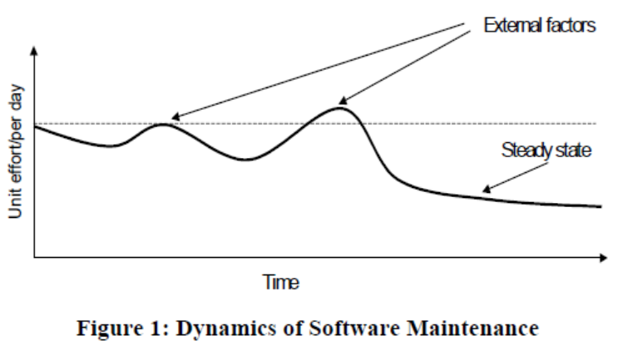
Article, cntd
The article is mostly about doing up-front planning.
The effort needed also varies over time:

Slide 19
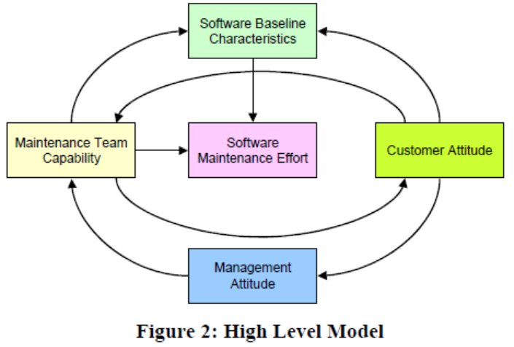
Article, cntd
Their model of influences on cost / effort:

Slide 20
Article, cntd
Software Baseline Characteristics –
Size (like lines of code, forms, database tables)
Program complexity
Estimates of maintainability (mean time to change, maturity, or “spoilage”)
Maintenance history
Documentation

Slide 21
Article, cntd
Maintenance Team Capability –
Technical expertise
Domain expertise
Application knowledge
Programmer attitude
Team capability

Slide 22
Article, cntd
Customer Attitude –
Business / IT alignment (in IT maintenance)
Team stability
Involvement
Scope creep

Slide 23
Article, cntd
Management Attitude –
Assignment priority
Investment motivation
Target definition
Developer involvement

Slide 24
Assignment and Milestone Reminders
Related topics to Journal about –
Hey wait – you already did the last one!
But…
Uh oh – Exam 2 –
Will be out on the course web site under Project Work
Due Saturday, Aug 20, 11:55 PM
Review for the exam?
Please look at the slides and articles
And Feathers, of course

