Slide 1
Software Maintenance and Evolution CSSE 575: Session 10, Part 1 Measurable Maintainability
Steve Chenoweth
Office Phone: (812) 877-8974
Cell: (937) 657-3885 Email: chenowet@rose-hulman.edu
Above – The “end run” around maintainability is “reliability” – reduce the need for maintenance in the first place! From http://planetgreen.discovery.com/tech-transport/eco-car-buying-tips.html.
Notes:
Some material for this discussion taken from Ch 16-17 of Practical software Maintenance: Best Practices for Managing Your Software Investment, by Thomas M. Pigoski, and from Software Maintenance Management: Evaluation and Continuous Improvement, by Alain April and Alain Abran.

Slide 2
Maintainability – one more time!
Where we’ve seen this topic before – Or is it the whole course?
Weeks 1 & 2 - refactoring
Week 4 – discussed keys to maintainability:
Management (to be amplified in our next slide set!)
Operational environment of the target systems
Documentation, target system software, maturity
Modifiability of the code
Localizing changes
Preventing ripple effects
Deferring binding time
Article on “Demystifying maintainability” –
There’s no common understanding of what “maintainability” is
Keys are measurements (this slide set) and manual inspections
Program understanding is also key to maintainability
Week 6 – Feathers – tips on making it easier to test and change OO code
Week 7 – the article on Preventive Maintenance
Week 9 – statistical modeling – a major goal was measure the “pieces of the horseshoe model” to improve maintainability (and lead to tonight’s discussion)
Recommended “things to measure”
Discussed how to automate, to get statistics

Slide 3
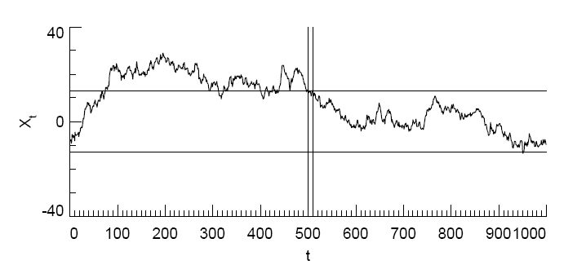
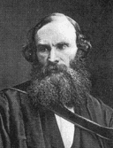
Getting back to Deming…and Kelvin!
Measuring things is fundamental to any “process control” –
“A process is stable if its future performance is predictable within statistically established limits.” – W Edwards Deming
Or, we can’t manage the darn thing if we can’t measure what’s going on!
“…when you cannot measure it, when you cannot express it in numbers, your knowledge is of a meagre and unsatisfactory kind.” – Lord Kelvin
Notes:
First quote is from Deming, W.E., Out of the Crisis. MIT Press, 1986.
Second quote from http://zapatopi.net/kelvin/quotes/.
Process variance control image is from http://climateaudit.org/2005/09/05/spurious-variance-of-autocorrelated-processes/.

Slide 4
What to measure – It depends!
 | Correction | Enhancement
Proactive | Preventive | Perfective
Reactive | Corrective | Adaptive
Recall we have different kinds of maintenance…
Some of these tend to be larger scale.
Some tend to be more urgent.
Notes:
Thus, you’d measure things in different ways for some of these…

Slide 5
When to start measuring - Early
Initiating measurement during pre-delivery
Gives assessment of product quality
Shows product readiness for maintenance
Can use check lists
Just like for first customer delivery
Should have support tools & metrics built-in
Lots of things to “size up” from this point on…
Notes:
As in, you need to organize how maintenance will be measured, during initial development.

Slide 6
Some things to measure - 1
Application (before maintenance)
Functional size
Lines of code
Environmental characteristics
What the lab has to have for maintenance & testing
Application (after)
Functional size
Lines of code
Environmental characteristics
Need
Deltas!

Slide 7
Some things to measure - 2
Effort –
Person-days planned
Other costs
Tools
Administrative services
Right – the lighthouse is a well-known symbol for managerial accounting, as portrayed on this well-known textbook about it.
Notes:
For managerial accounting, the smart thing is to allocate as much as possible in direct costs, vs overhead, so you can measure those costs.
Goal of all this measurement is to know what’s in control or not, and how to do process improvement, in detail.

Slide 8
Some things to measure - 3
Maintenance requests
Number
Category
Completed requests
Number
Category
Functional size
Lines of code
Person-days
Above – Manny Lehman, of Lehman’s Laws. One of my favorites is “self regulation” - that the project size and random facts about the project drive the processes adopted by management.
Notes:
Statistics ought to play a valuable role here, given the large number of CR’s (change requests) that most systems get.

Slide 9
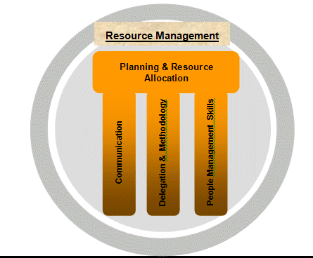
Resources to measure
Employees
Tools
Budgets
Maintenance environment
Above – How to manage resources, from Project Management Made Easy, by Aditya Chinni, PMP.
Notes:
Image from http://aditya369.com/article010.aspx.

Slide 10
Processes to measure
Predelivery and transition
Operational support
Corrections
Evolutions
Change monitoring
Regression testing
Events management
Configuration management
Notes:
Choose the ones that count!

Slide 11
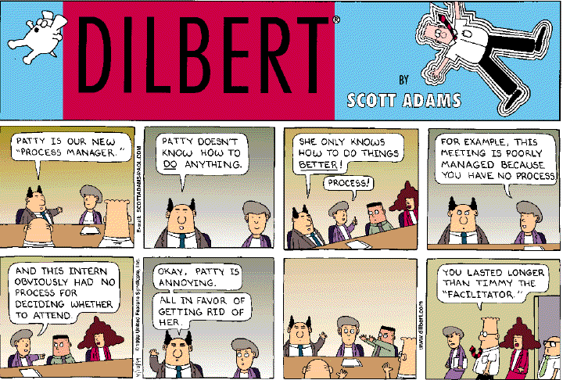
Or,
Notes:
From http://madhu.110mb.com/Comics/Dilbert/.

Slide 12
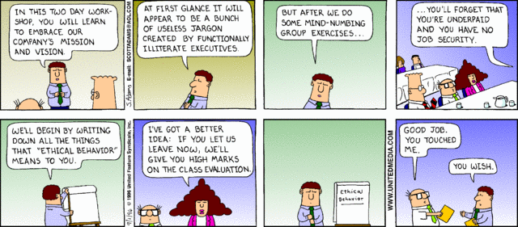
Sidebar – What was with Timmy?
(I used to do this for a living.)
Notes:
From http://dilbert.com/strips/comic/1996-09-01/.

Slide 13
Maintenance products to measure
Technical documentation
User documentation
Source code
Object code
Reference databases
Impact analysis
Notes:
Pick the ones that answer questions you care about – see next slides…

Slide 14
Good measurement questions - 1
How should we plan for staffing maintenance of a software product family?
When is a product stable?
Is mean time between failures for a software product really a meaningful measure of software quality?
In which development phase should tool and training investments be made?
How does documentation improve supportability?

Slide 15
Good measurement questions - 2
How many defects can be expected in a project of a given size?
What relationships exist between defects found prior to release and those found after elease?
What, if any, is the relationship between the size of a product and the average time to fix a defect?
What is the average time to fix a defect?
How much testing is necessary to ensure a fix is correct?
What percentage of defects is introduced during maintenance? During enhancements?
Notes:
From April and Abran, pp. 26-27.

Slide 16
Studies of measurement processes
Dutta et al (1998) –
75% of individuals surveyed said they documented the number of failures, analyzed causes, and identified the origin of failures in production software.
Average change time – Application software with the shortest is considered to have better maintainability.
Hitachi –
Suggests using ratio of number of failures to the cost of initial development, to → better maintainability
Abran et al –
Measure software maintenance portfolios grouped by software maintenance category (see slide 4)

Slide 17
Measuring product quality
Seen as key to understanding maintainability
Most people use something like Bass’s Quality Attributes –
Availability
Modifiability
Performance
Security
Testability
Usability
Notes:
See Bass, Clements and Kazman, Software Architecture in Practice, 2nd Ed. (One of the books for CSSE 574 and 577).

Slide 18
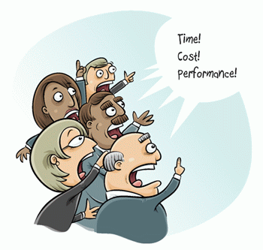
Different perspectives - 1
External point of view:
Maintainability attempts to measure the effort required to:
Diagnose
Analyze and
Apply a change
Internal point of view:
Maintainability is related to attributes of the software that influence the effort required to modify it.
This measure is not direct.
There’s no single measure for maintainability as seen this way
Have to measure many subcharacteristics
So, maintenance managers would like a single number for maintainability, but this is hard to come by!
It’s not just, say, source code complexity
Notes:
Noisy customers from http://assignmenthelpexperts.blogspot.com/2011_04_01_archive.html.

Slide 19
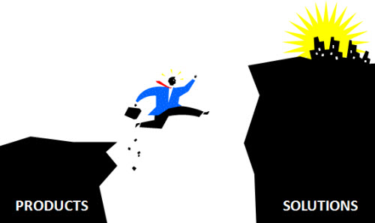
Different perspectives - 2
The “service perspective”:
Maintenance is much more like a service than the initial development is.
Similar to computer operations.
Thus we can look at:
Internal service-level agreements
Maintenance service contracts
Outsourcing contracts
Thus we can measure maintainability as a part of delivering the maintenance service.
More on these in the next slides…
Above – You’re helping this guy in mid-air!
Notes:
Image from http://www.pluggd.in/product-or-solution-selling-the-last-mile-challenge-297/.

Slide 20
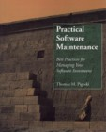
Pigoski’s “list”
Chief causes of unmaintainable software:
Poor software design
Poorly coded software
Software designed for outdated hardware
Lack of common data definitions
Use of multiple languages in one program
Growing software inventory
Excessive resource requirements
Inadequate documentation
Inadequate user interface
Lack of highly skilled staff
Notes:
Pigoski wrote like the first authoritative book on software maintenance. Practical Software Maintenance: Best Practices for Managing Your Software Investment by Thomas M. Pigoski (1996, Paperback)

Slide 21
The first article you read on this
A Systematic Review of Software Maintainability Prediction and Metrics, by Mehwish Riaz, Emilia Mendes, and Ewan Tempero (2009)
The article surveyed previous studies of maintainability
Found “little evidence on the effectiveness of software maintainability prediction techniques and models.”

Slide 22
First article, cntd
Maintainability is a “quality attribute”
We’d like to attribute it to the software being maintained.
Separate somehow from the process used to maintain it.
They’re clearly interlocked concepts
We ought to study –
Ways of predicting maintainability, and
Metrics used to assess it

Slide 23
First article, cntd
In their “systematic review” of the literature, the authors asked key questions about each study, like –
What forecasting methods did they use?
What results did they obtain?
Were there ways to cross-validate results?
How was maintainability measured?

Slide 24
First article, cntd
In comparing the studies, authors of this survey had to deal with such differences as:
The aspects of modifiability they measured - analyzability, changeability, stability, testability, or compliance
The mix of maintenance types being done - corrective, preventive, enhancive, or adaptive
They found that these didn’t matter a lot:
“The most commonly used technique observed for software maintainability prediction was algorithmic, and
“Maintainability prediction techniques seemed to be equally applied to any sub-characteristic of maintainability, or any type of maintenance.”
Most of the predictors came from source code analysis

Slide 25
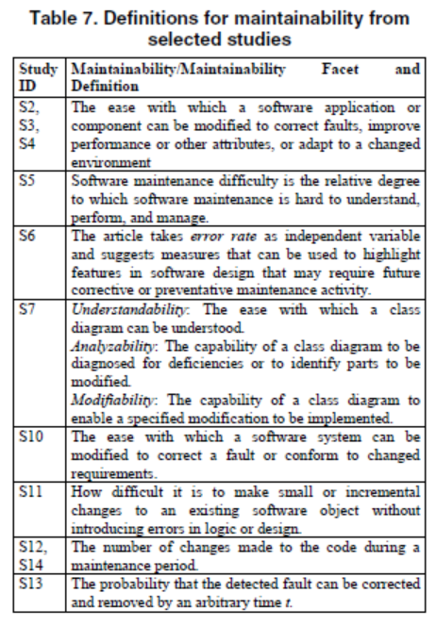
First article, cntd
A definition of an immature field – is when nobody can agree on the definition of the immature field!
Example – what the various studies defined to mean “maintainability”…

Slide 26
Second article
The QualOSS Open Source Assessment Model: Measuring the Performance of Open Source Communities, by Martín Soto and Marcus Ciolkowski (2009)
Open source software (OSS) acquisition requires an assessment of whether its quality is sufficient for the intended purpose, and
Whether the chances of being maintained and supported in the future, as well as of
Keeping certain quality standards over time, are sufficiently high.
They proposed an approach to measuring OSS projects,
The tool was developed in the EU project QualOSS.
Their approach takes into account product quality as well as process maturity and sustainability of the underlying OSS community.

Slide 27
Second article, cntd
It’s a well-known fact that free software isn’t really “free” –
Wrong decisions can have bad consequences
Often need to support and maintain it yourself
Goal of the study – how to help with procurement decisions. Looked at –
Robustness and
Evolvability

Slide 28
Second article, cntd
Deciding maintainability for open source project may be easier, because –
We can inspect the source code!
But, the community behind the code isn’t necessarily so easy to predict…
What level is an open source development community, on CMMI-DEV?
Few studies of the communities themselves

Slide 29
Second article, cntd
As with the first study you read, the authors tried to separate the attributes of the product itself from the attributes of the process being used.
In this case, interested in the second of those.
So, they looked at the community’s interactions in doing development, like:
Mailing lists
Discussion forums
Repositories and bug tracking systems

Slide 30
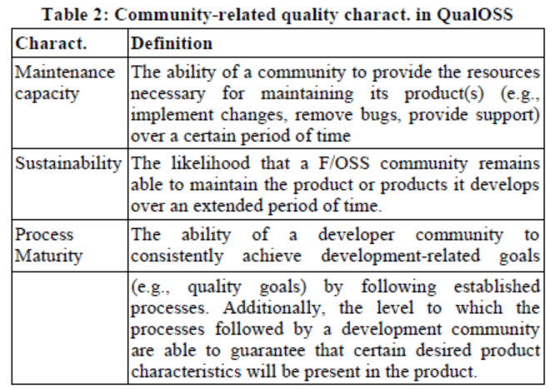
Second article, cntd
Their QualOSS included these community attributes:

Slide 31
Second article, cntd
Community “sustainability” was an issue. Like,
What about products coming out of a company, when the company cuts funding for it?
What role did “heterogeneity” play?
The authors found –
Most of the development was not ad hoc or chaotic.
Good practices were followed, like requirements and configuration management.
Their article defined a model they hoped would be used for assessing additional open source products.

