Slide 1
MongoDB: Ch 16-23 Admin
CSSE 533
Week 4, Spring, 2015

Slide 2
Overview
This week – Ch 16 – 23
Admin
Internals – See MongoDB lecture at https://www.youtube.com/watch?v=bLTNAsrWzOI.
Sharding admin
Ch 16 – Sharding administration
Application admin
Ch 17 – Seeing what your application is doing
Ch 18 – Data administration
Ch 19 – Durability
Server admin
Ch 20 – Starting and stopping MongoDB
Ch 21 – Monitoring MongoDB
Ch 22 – Making backups
Ch 23 – Deploying MongoDB
Notes:
Image from http://backreaction.blogspot.com/2007_09_01_archive.html

Slide 3
Internals
See MongoDB lecture at https://www.youtube.com/watch?v=bLTNAsrWzOI.
His slides are at http://2013.nosql-matters.org/bcn/wp-content/uploads/2013/12/storage-talk-mongodb.pdf.
Some highlights →
More info available at the MongoDB site. E.g., http://docs.mongodb.org/manual/search/?query=architecture.
See also Appendix B – p 389
Notes:
Image from http://backreaction.blogspot.com/2007_09_01_archive.html

Slide 4
Lots of tips from Mr MongoDB, like:
When to expect things to get swapped in and out of RAM, leading to “Why you should never have two databases on the same machine.”

Slide 5
Or,
How data can be lost!

Slide 6
Or,
How data can get fragmented:

Slide 7
Ch 16 – Sharding administration
Sharded clusters are difficult to administer!
Typical tasks:
Inspecting the state – what’s doing what
How to add, remove, and change members
Administering data movement
If we did the “one minute setup” then we could:
Get a summary with sh.status – p 275
See config information from the config database – p 277
Look at sharded collections, chunks, and changelog – pp 278-9
Tracking network connections & limiting the number of connections – pp 283-4
Not all that helpful!
Server admin – pp 285+
Jumbo chunks – p 292 – unsplittable and unmovable!
Notes:
Image from http://backreaction.blogspot.com/2007_09_01_archive.html

Slide 8
Ch 17 – Seeing what your application is doing
How to find slow operations and kill them
Getting and interpreting statistics
Using command-line tools
Seeing current operations – db.currentOp – p 299
Can filter to find slow operations
App servers running “old and buggy versions”?
A few operations are supposed to run long! – p 302
System profiler can be used similarly – p 302
Disk space provisioning – p 305
mongotop and mongostat – p 307
Notes:
Image from http://backreaction.blogspot.com/2007_09_01_archive.html

Slide 9
Ch 18 – Data administration
Non-daily tasks for an admin, like:
Setting up authentication and user accounts – p 311
How it works – p 314
Creating indexes on a running system – p 315
Unix “Out-of-memory” killer can kill a MongoDB index creation – p 317
“Preheating” a new server to allow it to come online quickly – p 317
Use Unix dd to load a db into RAM before starting mongod. – p 317
Defragmenting data files – p 320
Can use the “compact” command – very resource-intensive. P 320
Preallocating new data files manually – p 322
Notes:
Image from http://backreaction.blogspot.com/2007_09_01_archive.html

Slide 10
Ch 19 – Durability
Meaning: The guarantee that an operation that is committed will survive permanently.
How MongoDB does it – p 323:
Journal contains disk location and bytes changed.
Data files are flushed to disk every 60 seconds.
After a crash, MongoDB replays journal files on startup.
To test this, run kill -9 (!)
MongoDB writes to the journal every 100 ms, committing writes in batches.
How to configure your app and server – pp 324-5
The implications of not journaling! – p 325
What MongoDB does not guarantee – p 327
Notes:
Image from http://backreaction.blogspot.com/2007_09_01_archive.html

Slide 11
Ch 20 – Starting and stopping MongoDB
Commonly used options – p 333
Starting up and shutting down MongoDB – pp 333-7
Security-related options – p 337
MongoDB should only be reachable on internal network addresses.
Shutting down back doors, etc.
Logging considerations – p 338
Can direct to places other than stdout.
Notes:
Image from http://backreaction.blogspot.com/2007_09_01_archive.html

Slide 12
Ch 21 – Monitoring MongoDB
Alert you if something goes wrong / be able to go get the info to analyze.
How to track MongoDB’s memory usage – p 341
Like all DB’s, MongoDB is a memory hog.
MongoDB Management Service (MMS) graphs – p 343 →
How to track application performance metrics
Memory usage – p 342
Page faults – p 343
And many more!
How to diagnose replication issues p 353
Notes:
Image from http://backreaction.blogspot.com/2007_09_01_archive.html

Slide 13
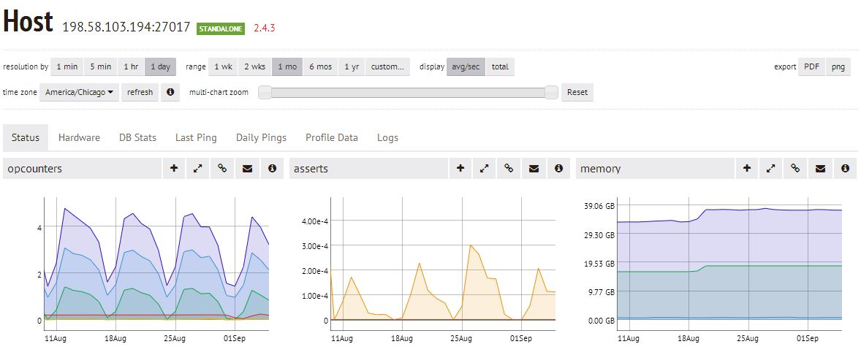
MMS graphs
Show the different levels of memory usage by MongoDB:
Notes:
MMS example from http://blog.mongodb.org/post/61759094055/visualizing-performance-issues-with-mms

Slide 14
Ch 22 – Making backups
Single-server backups – p 357
db.fsynchLock to keep a restorable version while copying. – p 358
Special considerations for replica sets – p 361
Take backups from a secondary.
Restoring looks messy!
Special considerations for sharded clusters – p 362
You can’t get a “snapshot” of the entire cluster at one time.
But, maybe you’ll never have to restore it all at once?
Incremental backups – p 363
Notes:
Image from http://backreaction.blogspot.com/2007_09_01_archive.html

Slide 15
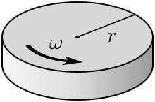
Ch 23 – Deploying MongoDB
Hardware & architecture –
Optimize for data safety and fast access.
For example, can plan to put parts of the DB on RAM, SSD, and spinning disk.
Advantages of SSD – p 366
RAID configurations – p 369
Buy memory vs CPU speed – p 370
Use 64-bit Linux – p 370
Filesystem – ext4 or XFS – p 371
Virtualization issues – p 372
Configuring system settings – p 374
Network configuring – p 382
System housekeeping – p 383
See also Installing MongoDB – Appendix A, p 385
The classic disk:
R for reason?
W for worry?
Notes:
Disk diagram from http://commons.wikimedia.org/wiki/File:Spinning-disk.svg.

