Slide 1
MongoDB: Ch 9-15 Replication and Sharding
CSSE 533
Week 3, Spring, 2015
Side order of Hadoop

Slide 2
When to use what, on a giant DB!
Hadoop – If you want to do queries across the whole thing, or a lot of it. And something like MapReduce would work:
E.g., “Who are the best 1000 Chevy owners in the United States to pitch this expensive Chevy Volt ad campaign to?”
Replication – If you care about keeping the data! Or, your DB needs high availability.
Sharding – If either:
You have little queries flying at the DB fast enough that one server couldn’t handle them, or
The thing’s so big it wouldn’t all fit on one server.
Notes:
Chevy Volt image from http://www.chevrolet.com/volt-electric-car.html

Slide 3
Hadoop
See the Data Science Book chapter, on Moodle.
Typical Hadoop problem:
Find the most frequent words in a (giant) list.
Suppose you had 10⁹ words… or more.
What’s the limit on how big is doable?
Computer memory?
Channel speed?
The need to consolidate results on one computer?
When we get to ~1000 machines, some will fail.
Need to start making copies, embed checksums, have a controller machine.
Need a platform that abstracts away fault tolerance.

Slide 4
Write two functions
Mapper – produces a (key, value) ordered pair. Sorts these outputs via a “shuffle,” finding keys that match and piling them up. These piles go to the reducer.
Reducer – Processes the piles, outputting a (key, new value) pair. New value is some aggregate of the old values.
Reducer has 3 primary phases: shuffle, sort and reduce.
Both functions typically include programmatic intervention – e.g., Java.
Hadoop runs these functions on many machines that are local to the stored data you’re using.
All the fault tolerance is automatic.
E.g., In the word counting problem:
Each occurrence of “red” → (“red”, 1).
Mapper gives stacks of (“red”, 1)’s.
Reducer adds these up, giving values like (“red”, 2).
Notes:
For Apache’s version of the word count problem, in Java, – see https://hadoop.apache.org/docs/r1.2.1/mapred_tutorial.html#Example%3A+WordCount+v2.0.

Slide 5
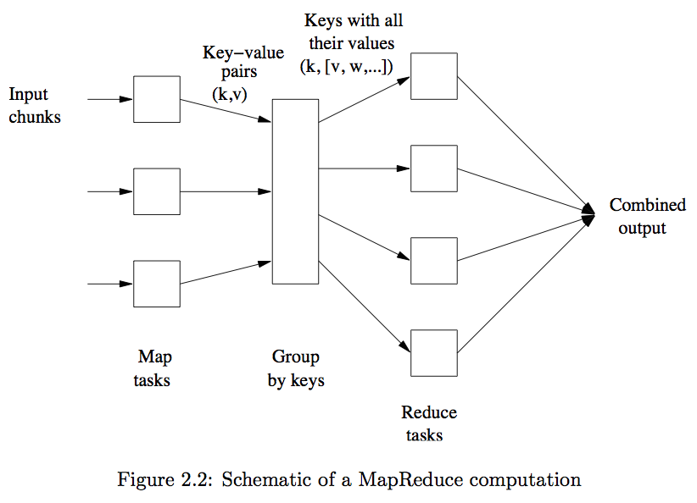
Pictorially…
Notes:
Image from Mining of Massive Datasets, by Jure Leskovec, Anand Rajaraman, and Jeffrey D. Ullman, 2014.

Slide 6
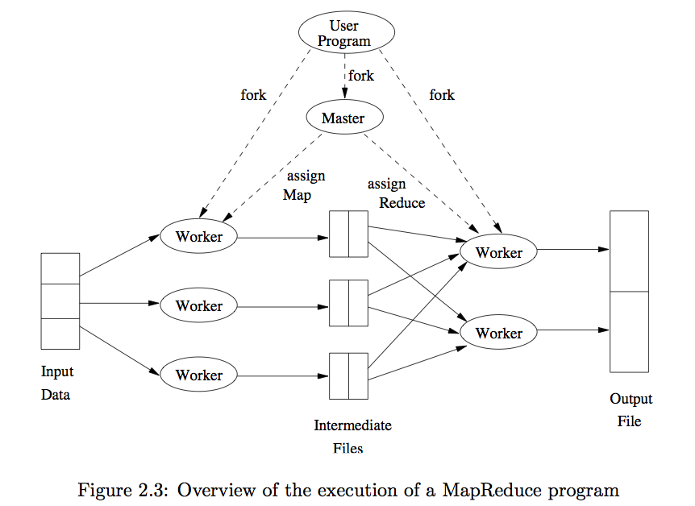
Under the covers…
Notes:
Image from Mining of Massive Datasets, by Jure Leskovec, Anand Rajaraman, and Jeffrey D. Ullman, 2014.

Slide 7
Tricky parts
Converting an algorithm into a series of MapReduce steps can be unintuitive.
Distribution across servers needs to be uniform.
Use hashbucket heaps in the mappers.
Tends to go wrong in the reduce step due to lots of values on one key.
Data preparation and output writing take a long time.
Need a distributed file system.
And MapReduce just to get the data to this file system.
Use of MapReduce is that:
The data can be distributed among many computers and
The algorithm can treat each of those computers separately. (Without interactions between them.)

Slide 8
Another example
Lots of timestamped event data and logs of users’ actions on a website.
For each user, data like:
{user_id, IP_address, zip_code, ad_they_saw, did_they_click}.
Want to count howmany unique users saw ads from each zip code, and how many clicked at least once.
Use {zip_code, user} as the key, and {clicks, impressions} as the value.
Mapper output of these → reducer that emits a table that, per user, per zip code, gives counts of clicks and impressions. New records in that look like:
{user, zip_code, number_clicks, number_impressions}. Then…

Slide 9
Another example, cntd
To get the number of unique users from each zip code, and how may clicked at least once,
Do a second MapReduce job with zip_code as the key, and, for each user emits {1, ifelse(clicks>0)}.
So, two different MapReduce runs, one for each goal.

Slide 10
Hadoop – More info?
See http://hadoop.apache.org/docs/current/hadoop-mapreduce-client/hadoop-mapreduce-client-core/MapReduceTutorial.html.

Slide 11
Back to MongoDB
Today – Ch 9 – 15
Replication and Sharding
Ch 9 – Replication
Ch 10 – Components of a Replica Set
Ch 11 – Connecting to a Replica Set from Your Application
Ch 12 – Administration
Ch 13 – Introduction to Sharding
Ch 14 – Configuring Sharding
Ch 15 – Choosing a Shard Key
Notes:
Image from http://www.bloomberg.com/ss/09/01/0130_career_stagnation/1.htm

Slide 12
This leaves, for next week…
The rest of the MongoDB reading
All about administration
And, talking about what you’ll do with MongoDB in your project
So, this part will be your discussion!
Then on to PostgreSQL

Slide 13
Ch 9 – Replication
Intro
Why would anyone not have a DB backup running?
Replication keeps identical copies running.
A one-minute test setup
Can we try this? P 170
Configuring a replica set – p 174
How to setup for real, across multiple machines.
Replica set gets a name, then you describe what’s in it.
The replicas start out empty – they’ll all clone the first member.
Configuring / changing requires some downtime.
There are “rs Helper Functions” – simplified MongoDB commands.
Must know the underlying networking to set this up.
Changing your replica set configuration
Member configuration options
Like “arbiters” – p 182
Options like not building indexes on secondaries – p 185

Slide 14
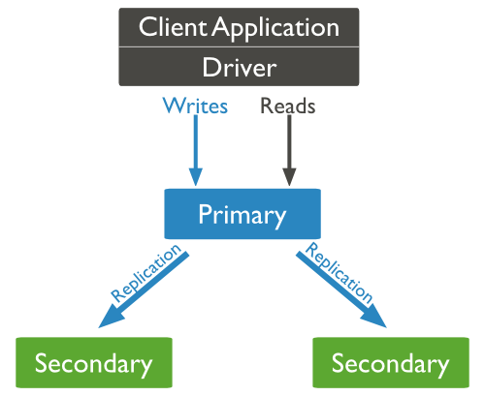
Typical replication setup
Clients normally talk to the Primary.
Usually an odd number works best!
What’s the “majority” here? (See p 178)
Common sense says to put some of these at a different data center! (p 179)
Notes:
Image from http://www.tutorialspoint.com/mongodb/mongodb_replication.htm

Slide 15
Ch 10 – Components of a Replica Set
Synching – p 187
How they all work together.
Main idea – copies of the data on multiple servers.
MongoDB keeps an oplog containing every primary write.
A capped collection on the primary,
Secondaries query this collection to replicate.
Each of them has its own oplog. So they can be used as a synch source.

Slide 16
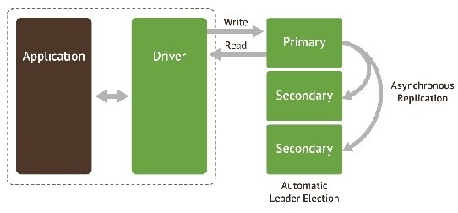
The replication is asynch…
“Eventually up-to-date”
Notes:
http://www.infoq.com/articles/mongodb-deployment-monitoring

Slide 17
Little twists
If a secondary goes down… (p 188)
When it restarts, it will start synching from where it left off in its own oplog. May replay operations already applied – ok.
If it’s been down to long for this to work, it is “stale” and will attempt to make a full copy of the data from another member – initial synching.
Can also restore from backup, manually. (p 190)
Recoveries can slow down operations.
E,g, “working set” in memory gets kicked out.
Need to rebuild indexes.

Slide 18
Ch 10, cntd
Heartbeats – p 191
Every two seconds, from every member to every other member.
Lets primary know if it can reach a majority of the set.
If not, it demotes itself!
Members communicate their state. (pp 191-2)
Elections – p 192
If a member can’t reach a primary, and is eligible to become a primary, it asks to become primary.
Other members go through logic to decide if this is suitable.
Rollbacks – p 193
Typically needed because of network partitions.
Primary gets disconnected after a write, before replication.
Can result in conflicting oplogs. Call the administrator!

Slide 19
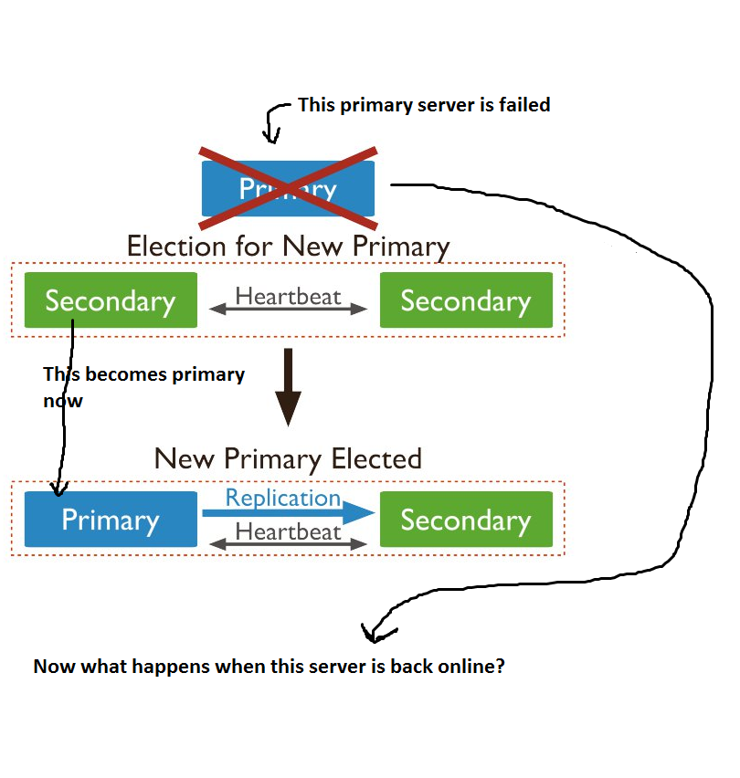
Rollbacks, cntd
Notes:
http://stackoverflow.com/questions/20785404/what-happens-if-a-failed-server-return-back-from-failover

Slide 20
Ch 11 – Connecting to a Replica Set from Your Application
Client-to-replica-set connection behavior – p 199
Client libraries connect to primary, route all traffic there.
Looks like you’re talking to a standalone server.
The hot standbys are programmatically invisible.
When your driver connects, it discovers “seeds” to the secondaries.
When the primary goes down, driver finds the new primary.
May be a detectable lull when you can’t write.
Driver won’t do any reads or writes then.
You can optionally find secondaries to do reads.
You may not know if read succeeded on primary before it went down. →

Slide 21
Ch 11, cntd.
Waiting for replication on writes – p 200
This helps ensure that a write was successful, but takes time.
Use getLastError to check this.
What can go wrong? – p 201
You check that the write was successful on the primary, but it crashes before secondaries replicate the write.
Your app thinks it can access the write – but not!
Custom replication guarantees – p 202
You can do things like “wait for one server per data center to write.”
Sending reads to secondaries – p 205
Generally a bad idea!
You can get inconsistent reads.
But it does let you distribute the load and have low-latency reads.

Slide 22
Ch 12 – Administration (for replication)
The rest of “Administration” is next week!
Starting members in standalone mode – p 209
Restarting - Lets you do many maintenance tasks.
Replica set configuration – p 210
Kept in local.system.replset collection.
Be careful how you change this set!
Can create a replica set using rs.initiate.
Can change set members.
Can make “larger sets” than usually allowed. Why? (p 211)
Monitoring replication – p 214
Look at the logs.
Visualize the replication graph.
Track lag.
Master-slave – p 225
The predecessor to MongoDB’s replication system.

Slide 23
Ch 13 – Introduction to Sharding
Intro – p 231
Splits data across multiple machines – partitioning.
Can store more data / handle more load.
Automatic alternative to having to program this!
MongoDB’s built-in system abstracts the architecture and simplifies the admin.
But, it’s still messy!
Understanding the components of a cluster – p 232
Don’t confuse with replication!
A one-minute test setup – p 232
We should try this!

Slide 24
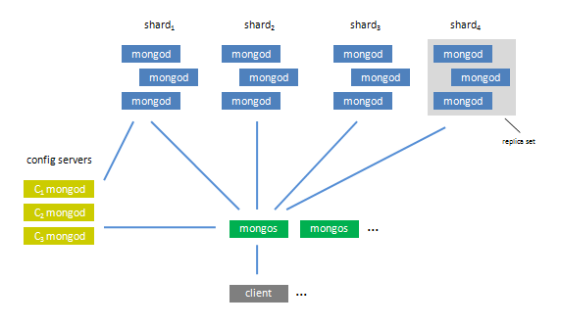
Typically used along with replication
We’ll get to these other pieces.
Notes:
Image from http://facility9.com/2010/08/mongodb-now-with-sharding/

Slide 25
What’s a “primary shard”?
It’s the entire replica set composing a shard.
Vs a single server that can take writes.
Right – Modern “Shard” – a 1009 ft skyscraper in London!
Notes:
Image from http://skyscrapercenter.com/building/the-shard/451.

Slide 26
Ch 13, cntd
The splits are based on a “shared key” – a field or two used to breakup the data.
Like “username”.
Must be indexed. (p 235)
MongoDB divides the data into “chunks” based on this key.
Each chunk is for a range of the keys.
Notes:
Image from http://docs.mongodb.org/manual/core/sharding-shard-key/.

Slide 27
Ch 13, cntd
The chunks are then evenly distributed across “shards.” (The separate servers being used.)
Client-side queries work normally. Routing done by “mongos”.
Can use “explain” to see what really happens. (p 237)
You can still do big operations on sharded datasets. E.g., mongos does sorting with a merge-sort across the shards.

Slide 28
Ch 14 – Configuring Sharding
When to shard – p 241.
Increase available RAM.
Increase available disk space.
Reduce load on a server.
Read or write data with greater throughput than a single mongod can handle.
Monitor to decide when sharding becomes necessary.
Starting the servers – p 242
Need to start up all the processes required.
Need to set up the mongos and the shards.
Need to set up “config servers.” Usually 3! (See p 243.)
These are “the brains of your cluster.” Used by mongos. “Table of contents.”
Set up first. Started first.
Each on a separate machine, geographically distributed.

Slide 29
Ch 14, cntd
The mongos process
Application uses it to connect to.
Needs to know where the config servers are. Precisely! (p 244)
Typically one mongos process per application server.
Can add shards after mongos is running.
Existing shard replica set vs starting from scratch. (p 244)
Clients make requests from mongos, vs contacting the replica sets directly.
Can add more shards as needed.
MongoDB needs to be told how to distribute the data.
Need to tell both the database and the collection to do this – p 245.

Slide 30
Ch 14, cntd
How MongoDB tracks cluster data – p 246
Documents grouped into chunks. Always on 1 shard.
MongoDB keeps a table of chunks mapped to shards. “config.chunks”. (see p 247)
As writes occur, some chunks grow in size, etc.
At a certain size, MongoDB splits a chunk.
Chunks on a server are not really physically grouped on disk.
A “split storm” occurs when mongos repeatedly attempts to split a chunk and can’t (often because a config server is down). (p 250)
The balancer – p 253
Migrates data.
Checks for imbalances between shards.
Each mongos plays the part of “the balancer” occasionally.

Slide 31
Ch 15 – Choosing a Shard Key
Taking stock of your usage – p 257
Once you have more than a few shards, almost impossible to change the shard key!
Need to understand workload, and how your application’s requests will be split-up.
Work-out examples, like shown in the chapter.
Basic considerations – p 258
A 3-shard cluster has lots more flexibility than a 1000-shard cluster.
If many shards, you can’t fire-off queries that can hit all shards.
Thus, almost all queries must include the shard key.
Why are you sharding? To decrease read or write latency?
To decrease write latency, you may need geographically closer or more powerful machines.
To increase read or write throughput? (Capacity.) Need requests evenly distributed for that. (Parallelism.)
To increase system resources? (Like more RAM per GB of data.) If so, keep working set as small as possible.

Slide 32
Ch 15, cntd
Picturing distributions – p 258
Three basic distributions for splitting data.
Ascending shard keys – something like “date” that increases steadily over time.
All the growth will always be at the end, on the max chunk.
Randomly distributed shard keys – like usernames, email addresses, hashes.
Inserts will hit every chunk (and shard) fairly evenly.
But, MongoDB isn’t efficient at randomly accessing data on disk.
Location-based shard keys – like user’s IP, address, or some pseudo-location like “office.”
MongoDB can shard to put data close to users and keep related data together.
Hard to predict what growth patterns will occur!

Slide 33
Ch 15, cntd
Shard key strategies – p 264
To load as fast as possible – hashed shard keys
Good choice for an ascending key used in a lot of write queries
But of course you can never do a targeted range query!
The firehose strategy – p 267
Give more powerful servers more load.
E.g., One of your servers has an SSD.
Force all inserts to go to the SSD.
Allow the balancer to move older chunks to other chards.
Multi-hotspot – p 268
Ideally writes are ascending within a shard, but randomly spread across shards. How to do that!?
Use a compound shard key.
First value is a rough, random value with a low-ish cardinality. Try for one chunk per random value.
Second part of the key is an ascending key.
Notes:
Firehose image from http://www.ucciaconf.org/4257/drinking-from-a-firehose.

Slide 34
Ch 15, cntd
Shard key rules and guidelines – p 271
Pick shard keys like indexes – the concepts are similar.
Shard keys can’t be arrays!
Once inserted, a document’s shard key can’t be modified.
Special types of index can’t be used for shard keys.
Better choose a shard key that will vary!
It performs better on high-cardinality fields.
Controlling data distribution – p 271
There are options beyond automatic distribution!
Like how to keep some low-value data off your best server.

Slide 35
Conclusions?
Still want to use MongoDB for the recruiting-related documents?

