Slide 1
Project Thoughts
CSSE533 – Week 10
Topics for Thurs
Notes:
Imagehttps://www.sdstate.edu/cee/development/project-management-training.cfm

Slide 2
Goal – Skills for a job
Skills being asked for in position descriptions
E.g., Career Builder:
Type in Software Designer, Indianapolis
Get back:
Engineering designer
Assistant designer
Graphic designer and email marketing specialist
Technical documents designer
Architect/architectural (CAD) designer
R&D Mechanical designer
Front-end web designer/developer (Web & catalog)
Electrical designer/engineer
Wall panel designer
UX designer/web designer
Senior planner/landscape architect
Software engineer
Radar design engineer
…
Hits in red

Slide 3
How about other jobs?
Type in Technical support, Indianapolis, get:
Work at home – technical & sales support representative
Technical support engineer
Technical support
Technical support specialist
Technical support manager
Entry level helpdesk – technical support
Technical services specialist
Technical support analyst – 2
Technical analyst
All hits?

Slide 4
What’s the goal?
Hire the right people?
Analyze existing people versus an outside “talent pool”?
Discover how expensive people are with certain skills – compete for them?

Slide 5
Associated areas of likely interest
How the talent pool is changing?
Trends in technologies based on position descriptions on Career Builder?
Technology trends at other companies?
Or in general?

Slide 6
Can Career Builder predict technology trends?
We had a Rose senior project explore that this school year.
They tried job sites like Career Builder. Found:
Monster and Indeed had query limits
And wanted a paid subscription for access – Monster was $ 5000.
Also tried analyzing:
Question sites (like Stack Overflow)
Repository sites (What tools are they using?)
Social media (What’s everyone talking about?)

Slide 7
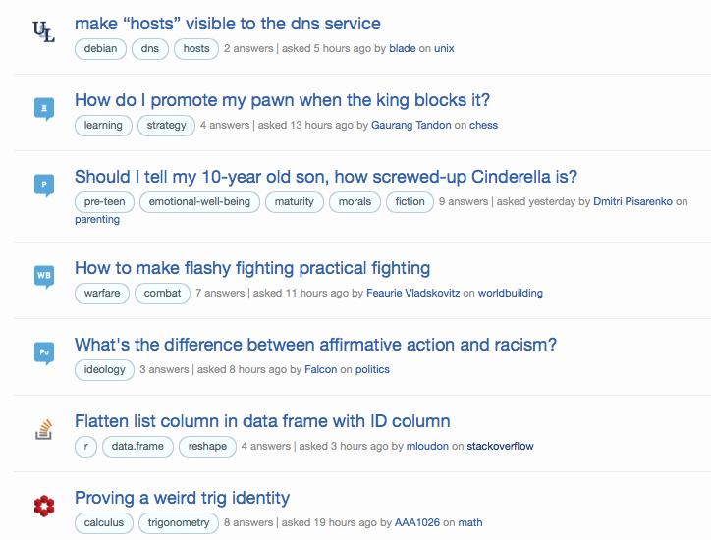
What the senior project liked - StackExchange
Notes:
From http://stackexchange.com

Slide 8
Other issues they ran into
The problem of Monster and Indeed sending you to other people’s web sites, with widely differing formats.
Non-scalable screen-scraping problem.
How to analyze –
Machine learning
Ranking
Etc
How to present results –
Email a trend when you find one?
Show graphical comparisons?
Bar graph comparisons?
Pie chart?

Slide 9
Decisions they had to make
Reliability of sources.
Amount of noise to sort out.
How much of a “leading indicator” a type of site is.
There are well-known considerations
Relative strength of different trends
Oscillation?
Like the stock market?

Slide 10
Just for fun, IDC’s 2015 technology predictions
New technology will take over the market in information and communications technology.
Nearly all growth focused on cloud-based solutions.
Wireless data growth – 13%. Carriers will develop platform and API-based services to attract developers.
Phablets will rise, wearables will underwhelm.
Cloud services – new competitors for AWS.
Big data and analytics – New Big Data supply chains.
The Internet of Things – Causing 3rd Platform growth.
Cloud services = the new data center.
The 3rd platform will become industry specialized.
Security – new ID mechanisms.
3D printing – traction in conventional document printing companies.
Massive growth in China’s ICT market.
Gartner, in contrast, predicted different stuff!
Notes:
From http://sdtimes.com/idcs-top-10-technology-predictions-2015/
Gartner is at http://sdtimes.com/gartners-top-10-strategic-technology-trends-2015/.

