Slide 1
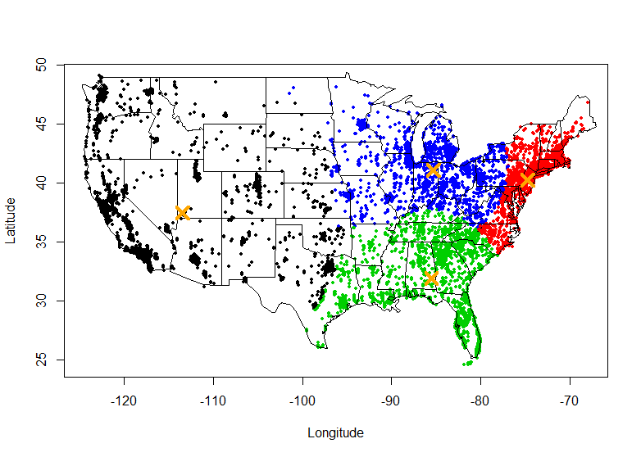
Clustering with k-means Lantz Ch 9
Right – A typical nasty clustering problem – How do you divide the continental US into geographical chunks of equally sized populations?
Wk 5, Part 1
Notes:
Image from http://statistical-research.com/spatial-clustering-with-equal-sizes/

Slide 2
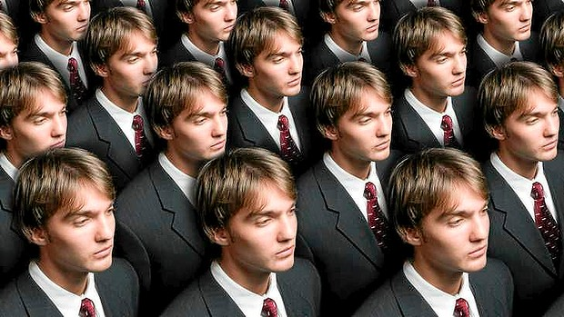
Early warning – stereotypes!
This is supplying data to justify grouping people or things in ways you’re already set on.
Notes:
Image from http://www.smh.com.au/small-business/managing/blogs/work-in-progress/the-end-of-the-line-for-whitecollar-jobs-20130207-2e1uv.html

Slide 3
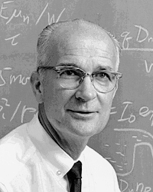
E.g., race and intelligence
E.g., In his later life, Nobel prize winner William Shockley infamously used grouping to show statistically some racial groups had lower average IQ’s.
But he ignored the fact that IQ also had geographical variations, for example.

Slide 4
Generally unsupervised
Clustering usually is exploratory.
Like, what sales are associated with other sales.
There is an end goal.
Like, how can we reorganize product promotions to create more add-on sales.

Slide 5
Often, we want a simpler picture
What are the natural groupings for a large number of features?
We may not even have names for our groups, at the start.
We figure these out as we go.
Thinking of groups and possible actions for them – an interactive thought process.

Slide 6
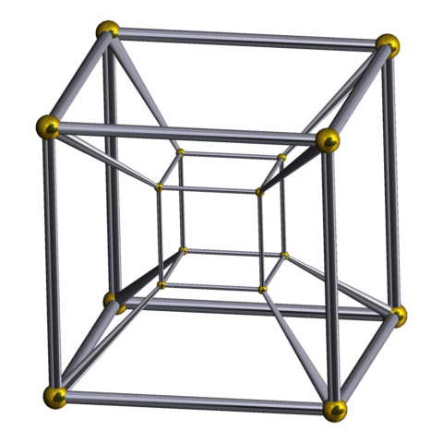
Clustering creates new data
We invent concepts from it.
The groups may, initially, be without names.
Madeleine L’Engle would be horrified.
Plot of “A Wrinkle in Time” was that “dark” things had no names – this needed to be fixed!
Wait, wait – I dub thee a “tesseract”!
Notes:
See http://en.wikipedia.org/wiki/A_Wrinkle_in_Time
Image from http://en.wikipedia.org/wiki/Tesseract

Slide 7
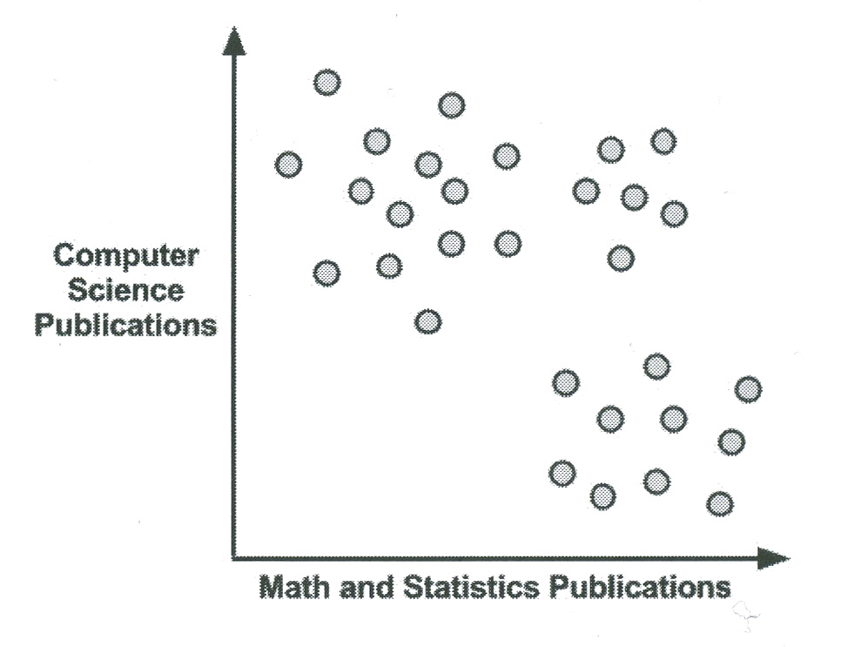
Lantz’s example – setting up networking at a conference
There are math people, and
There are computer science people:
Notes:
Lantz p 269

Slide 8
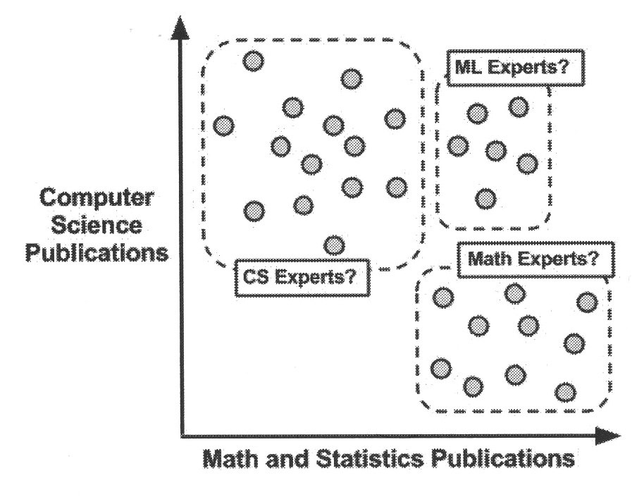
Can machine learning cluster these for us, to help identify groups?
We have to supply the name tags, of course:
Notes:
Lantz p 270

Slide 9
The k-means algorithm
Strengths | Weaknesses
Uses simple principles for identifying clusters which can be explained in non-statistical terms. | It is less sophisticated than more recent clustering algorithms.
It is highly flexible and can be adapted to address nearly all of its shortcomings with simple adjustments. | Because it uses an element of random chance, it is not guaranteed to find the optimal set of clusters.
It is fairly efficient and performs well at dividing the data into useful clusters. | Requires a responsible guess as to how many clusters naturally exist in the data.

Slide 10
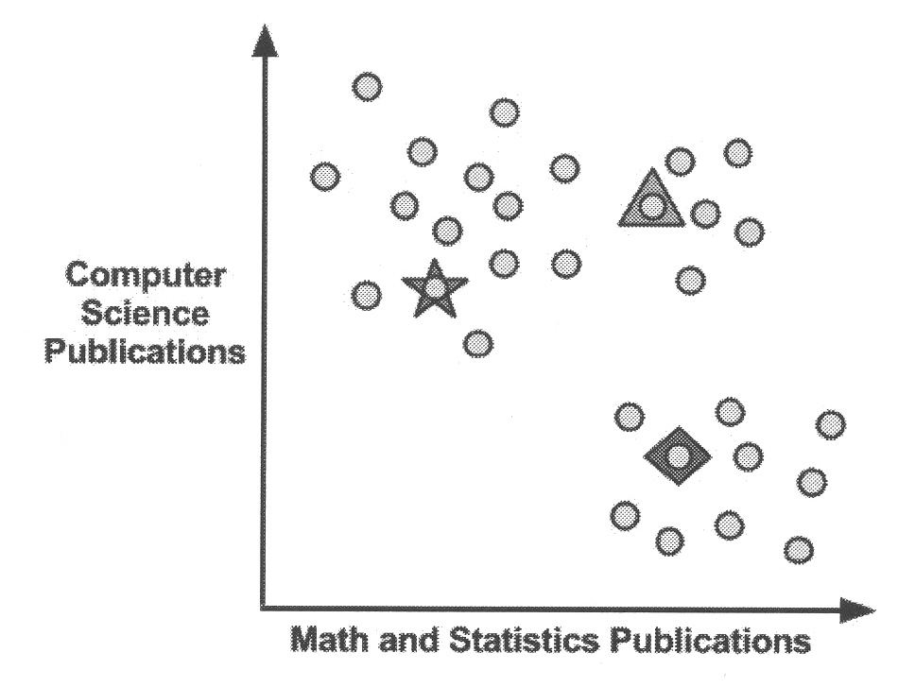
Use distance to identify clusters
Choose initial cluster centers.
How many? User guesses a number.
Then, how far are other points from these?
Notes:
Lantz p 273

Slide 11
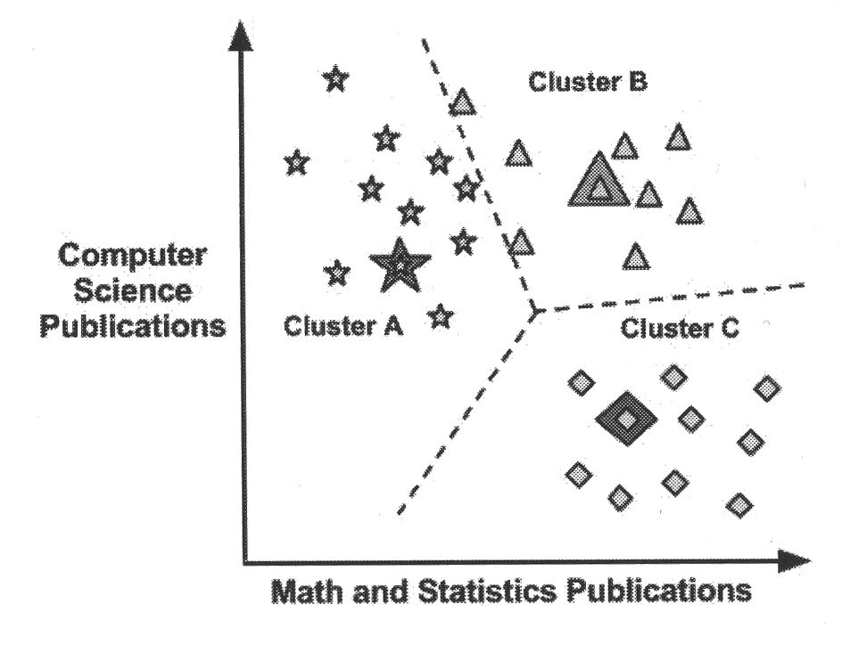
This leads to defining initial boundaries
Use our old friends, the convex polygons, etc.
Slightly simpler, if few categories:
But, how do we know this division is optimal?
We don’t!
Notes:
Lantz p 274

Slide 12
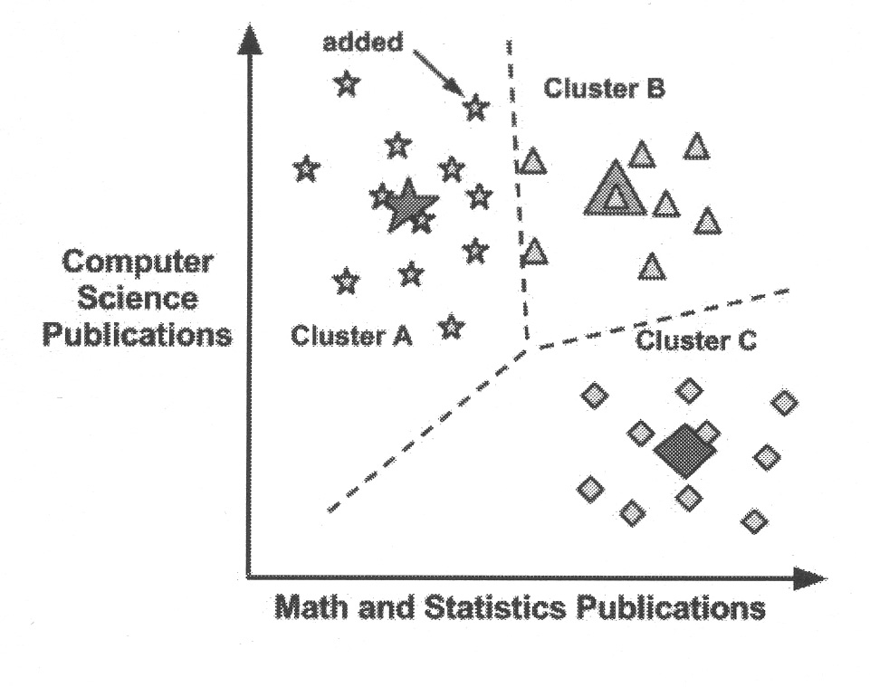
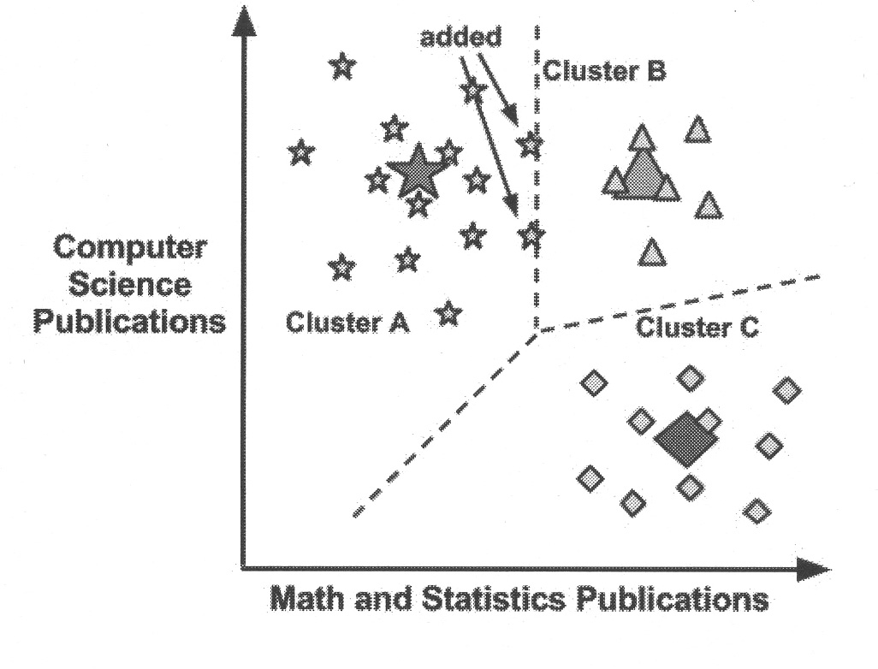
Change the initial cluster centers…
Calculate the “centroid” (central point) of each group.
Then re-decide what other points are closest to each centroid.
Notes:
Lantz p 275

Slide 13
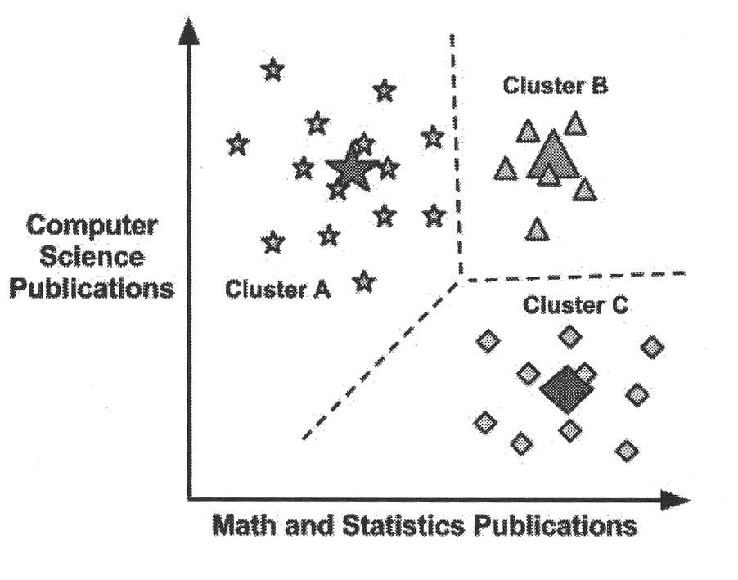
Additional cycles of updates
Changing the centroids, then changing what’s closest to them, can be done several times.
Final result?
Notes:
Lantz p 276

Slide 14
But – How many clusters?
More more clusters → more homogeneity in the features
Which may be based partly on noise!
Look for “knee bend” as a likely point to stop increasing the number.
Notes:
Lantz p 277.

Slide 15
Lantz’s example – Teen market segments
> str(teens)
'data.frame': 30000 obs. of 40 variables:
$ gradyear : int 2006 2006 2006 2006 2006 2006 2006 2006 2006 2006 ...
$ gender : Factor w/ 2 levels "F","M": 2 1 2 1 NA 1 1 2 1 1 ...
$ age : num 19 18.8 18.3 18.9 19 ...
$ friends : int 7 0 69 0 10 142 72 17 52 39 ...
$ basketball : int 0 0 0 0 0 0 0 0 0 0 ...
$ football : int 0 1 1 0 0 0 0 0 0 0 ...
$ soccer : int 0 0 0 0 0 0 0 0 0 0 ...
$ softball : int 0 0 0 0 0 0 0 1 0 0 ...
$ volleyball : int 0 0 0 0 0 0 0 0 0 0 ...
$ swimming : int 0 0 0 0 0 0 0 0 0 0 ...
$ cheerleading: int 0 0 0 0 0 0 0 0 0 0 ...
$ baseball : int 0 0 0 0 0 0 0 0 0 0 ...
$ tennis : int 0 0 0 0 0 0 0 0 0 0 ...
$ sports : int 0 0 0 0 0 0 0 0 0 0 ...
$ cute : int 0 1 0 1 0 0 0 0 0 1 ...
$ sex : int 0 0 0 0 1 1 0 2 0 0 ...
$ sexy : int 0 0 0 0 0 0 0 1 0 0 ...
$ hot : int 0 0 0 0 0 0 0 0 0 1 ...
$ kissed : int 0 0 0 0 5 0 0 0 0 0 ...
$ dance : int 1 0 0 0 1 0 0 0 0 0 ...
$ band : int 0 0 2 0 1 0 1 0 0 0 ...
$ marching : int 0 0 0 0 0 1 1 0 0 0 ...
$ music : int 0 2 1 0 3 2 0 1 0 1 ...
$ rock : int 0 2 0 1 0 0 0 1 0 1 ...
$ god : int 0 1 0 0 1 0 0 0 0 6 ...
$ church : int 0 0 0 0 0 0 0 0 0 0 ...
$ jesus : int 0 0 0 0 0 0 0 0 0 2 ...
$ bible : int 0 0 0 0 0 0 0 0 0 0 ...
$ hair : int 0 6 0 0 1 0 0 0 0 1 ...
$ dress : int 0 4 0 0 0 1 0 0 0 0 ...
$ blonde : int 0 0 0 0 0 0 0 0 0 0 ...
$ mall : int 0 1 0 0 0 0 2 0 0 0 ...
$ shopping : int 0 0 0 0 2 1 0 0 0 1 ...
$ clothes : int 0 0 0 0 0 0 0 0 0 0 ...
$ hollister : int 0 0 0 0 0 0 2 0 0 0 ...
$ abercrombie : int 0 0 0 0 0 0 0 0 0 0 ...
$ die : int 0 0 0 0 0 0 0 0 0 0 ...
$ death : int 0 0 1 0 0 0 0 0 0 0 ...
$ drunk : int 0 0 0 0 1 1 0 0 0 0 ...
$ drugs : int 0 0 0 0 1 0 0 0 0 0 ...

Slide 16
Need to understand / fix “NA’s”
> table(teens$gender, useNA = "ifany”)
F M <NA>
22054 5222 2724
> summary(teens$age)
Min. 1st Qu. Median Mean 3rd Qu. Max. NA's
3.086 16.310 17.290 17.990 18.260 106.900 5086

Slide 17
For marketing we want “interest” clusters for these teens
> interests <- teens[5:40]
> interests_z <- as.data.frame(lapply(interests, scale))
> teen_clusters <- kmeans(interests_z, 5)
> teen_clusters$size
[1] 1061 5008 720 22562 649
Put them on a uniform scale!
One cluster is lots bigger!

Slide 18
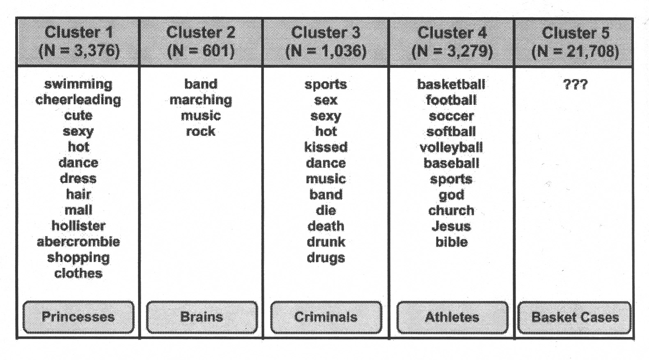
We can characterize these clusters
Look at their centroids.
Where are the strong + and – values?
We then provide the stereotypes!
Notes:
Lantz p 288

Slide 19
Improving on these results?
Go back and look at the data, given our new cluster knowledge:
> teens[1:5, c("cluster", "gender", "age", "friends")]
cluster gender age friends
1 4 M 18.982 7
2 2 F 18.801 0
3 4 M 18.335 69
4 4 F 18.875 0
5 1 <NA> 18.995 10

Slide 20
Aggregate data make sense?
> aggregate(data = teens, friends ~ cluster, mean)
cluster friends
1 1 30.68143
2 2 38.69269
3 3 35.77917
4 4 27.93932
5 5 35.33128

