Slide 1
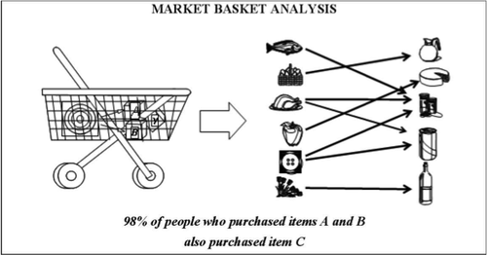
Market Basket Analysis and Association Rules Lantz Ch 8
Left – The goal of computerized market basket analysis is to discover non-intuitive associations, the knowledge of which can improve profits.
Wk 4, Part 2
Notes:
Image from http://www.allanalytics.com/author.asp?section_id=2037

Slide 2
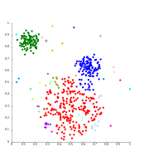
How does it work?
Usually, you need to have some way of identifying the groups you might want to separate?
Like the ID’s of the different products in a market basket analysis.
If we don’t have the concepts to use, the separation problem is much trickier.
What if you don’t have names for these 3 different groups of data?
Notes:
Image from http://en.wikipedia.org/wiki/Cluster_analysis

Slide 3
The grocery store is a good example
Practical to know more about buying patterns.
Easy to picture underlying rationale:
{peanut butter, jelly} → {bread}
Most often, searching for associations that will be used later for some purpose.
A fishing expedition.
Unsupervised learning. (No dependent variable, per se.)
Humans eyeball the results for usefulness.

Slide 4
Typical example
Fraud detection
Where are unusual relationships repeated?
E.g., Store associate X has a lot more cash “voids” than average, and
Supervisor Y approves a high percentage of these.
Voided transactions are a known source of “opportunity crimes” by retail clerks.
Because liquid assets are handed out.

Slide 5
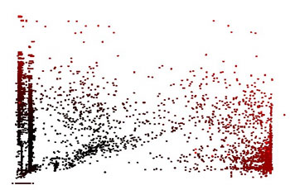
Another example
“Intrusion detection” systems try to help the humans, who are monitoring a system, notice anomalies in the patterns: E.g.,
Pay-per-view movie rentals.
Network security
Ship movements
Analyst’s dilemma – Is this “normal”?
Notes:
Image and examples from http://www.ercim.eu/publication/Ercim_News/enw56/holst.html.

Slide 6
Basic principle – ignore the unimportant
In analyzing network performance, at AT&T, we mostly had to rule-out most of the data that devices might report.
Like, how many errors does a network device have to throw off, in a certain period of time, before we care?
Probably a lot!

Slide 7
The Apriori algorithm
It uses prior beliefs about the properties of common itemsets.
Like the analyst supplies logic and subject-matter experience to what they see.
Subsets (e.g., associations) of data only deserve to be searched if the larger dataset is significant.
[A, B] is only interesting to look at if [A] and [B] are both frequently occurring.

Slide 8
How to use Apriori
Strengths | Weaknesses
Is ideally suited for working with very large amounts of transactional data. | Not very helpful for small datasets.
Results in rules that are easy to understand. | Takes effort to separate the insight from common sense.
Useful for “data mining” and discovering unexpected knowledge in databases. | Easy to draw spurious conclusions from random patterns.
Notes:
P 246

Slide 9
Measuring rule interest
Apriori could come up with a huge number of proposed rules.
Whether or not an itemset or rule is “interesting” is determined by:
Support – How frequently it occurs.
Confidence – Its predictive power or accuracy, like the Confidence that X leads to Y is the Support for X and Y occurring together, vs Support for just X.

Slide 10
What Apriori does
Identify all the itemsets that meet a minimum Support threshold.
In succeeding iterations, it combines itemsets that follow rules (like occurring together) with increasing levels of frequency.
Create rules from these itemsets that meet a minimum Confidence threshold.
At some point, it begins considering candidate rules like [A] → [B], evaluated vs the threshold.

Slide 11
Lantz’s example – Frequently purchased groceries
The lists in grocery.csv are varying length grocery transactions, listing items bought.
Need a sparse matrix to put these items into!
A column in each transaction for every item that might possibly appear.
Lantz’s data has 169 different items.
A large Walmart typically has 1,000,000 items (though not that many different types of items).
A sparse matrix is more memory efficient.

Slide 12
Preparing the data
> library(arules)
…
> groceries <- read.transactions("/Users/chenowet/Documents/Rstuff/groceries.csv", sep = ",")
> summary(groceries)
transactions as itemMatrix in sparse format with
9835 rows (elements/itemsets/transactions) and
169 columns (items) and a density of 0.02609146
most frequent items:
whole milk other vegetables rolls/buns soda yogurt
2513 1903 1809 1715 1372
(Other)
34055
element (itemset/transaction) length distribution:
sizes
1 2 3 4 5 6 7 8 9 10 11 12 13 14 15 16 17
2159 1643 1299 1005 855 645 545 438 350 246 182 117 78 77 55 46 29
18 19 20 21 22 23 24 26 27 28 29 32
14 14 9 11 4 6 1 1 1 1 3 1
Min. 1st Qu. Median Mean 3rd Qu. Max.
1.000 2.000 3.000 4.409 6.000 32.000
includes extended item information - examples:
labels
1 abrasive cleaner
2 artif. sweetener
3 baby cosmetics

Slide 13
Can inspect support for each item
> itemFrequency(groceries[, 1:3])
abrasive cleaner artif. sweetener baby cosmetics
0.0035587189 0.0032536858 0.0006100661
> itemFrequencyPlot(groceries, support = 0.1)
> itemFrequencyPlot(groceries, topN = 20)
> image(groceries[1:5])
> image(sample(groceries,100))
→ See next 3 slides

Slide 14
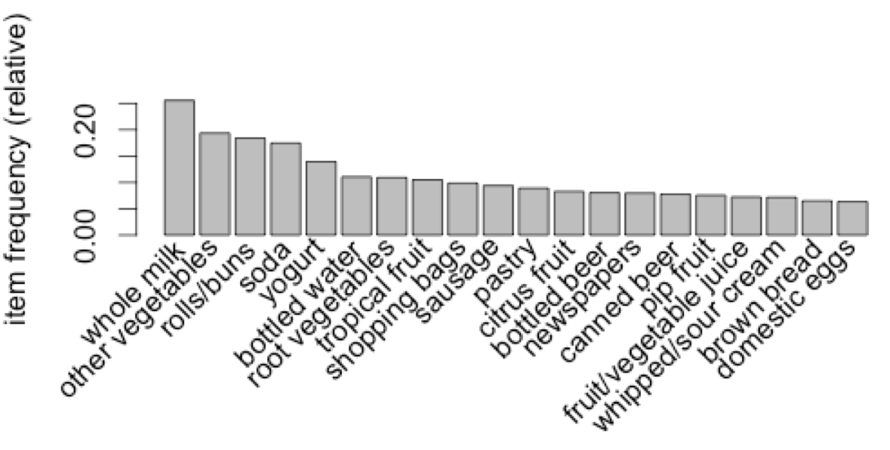

Slide 16
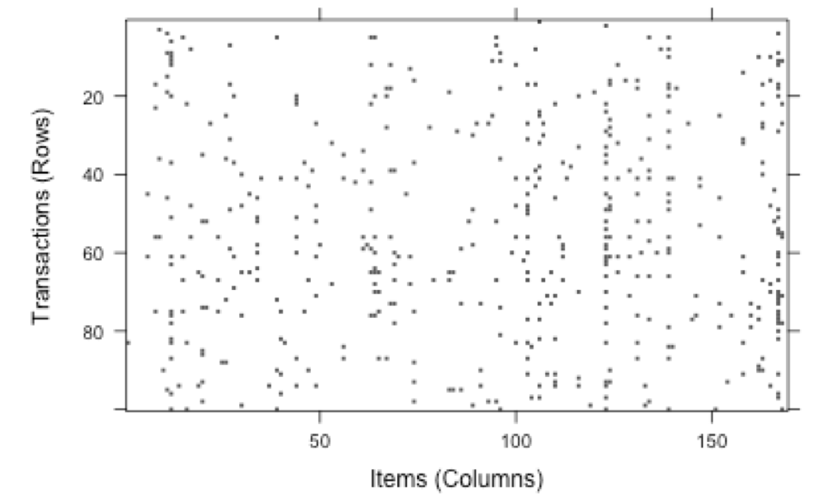

Slide 17
Training a model on the data
> apriori(groceries)
Parameter specification:
confidence minval smax arem aval originalSupport support minlen maxlen
0.8 0.1 1 none FALSE TRUE 0.1 1 10
target ext
rules FALSE
…
set of 0 rules
Using default confidence and support

Slide 18
What’s a reasonable support level?
Lantz argues that you can reason about this. E.g., if a pattern occurs in a grocery transaction twice a day, it may be interesting to us.
The dataset represents 30 days of data.
So, that would be 60 occurrences, out of the 9835 transactions represented.
Or, 0.006 as a trial at the level of support needed.
Notes:
P 259

Slide 19
What’s a reasonable confidence level?
Lantz discusses batteries as an example.
Set this too high, you’ll only get the association with smoke detectors.
Set this too low, you’ll get every chance thing someone buys commonly, like celery.
Goal probably is to know “What to place next to the batteries.”
He guesses, start with 0.25 here, and then lower it if you are getting only obvious results.

Slide 20
Revised training model
> groceryrules <- apriori(groceries, parameter = list(support = 0.006, confidence = 0.25, minlen = 2))
Parameter specification:
confidence minval smax arem aval originalSupport support minlen maxlen
0.25 0.1 1 none FALSE TRUE 0.006 2 10
target ext
rules FALSE
…
set of 463 rules
We got something this time!

Slide 21
More from the apriori call…
rule length distribution (lhs + rhs):sizes
2 3 4
150 297 16
Min. 1st Qu. Median Mean 3rd Qu. Max.
2.000 2.000 3.000 2.711 3.000 4.000
summary of quality measures:
support confidence lift
Min. :0.006101 Min. :0.2500 Min. :0.9932
1st Qu.:0.007117 1st Qu.:0.2971 1st Qu.:1.6229
Median :0.008744 Median :0.3554 Median :1.9332
Mean :0.011539 Mean :0.3786 Mean :2.0351
3rd Qu.:0.012303 3rd Qu.:0.4495 3rd Qu.:2.3565
Max. :0.074835 Max. :0.6600 Max. :3.9565
Like, {peanut butter, jelly} → {bread} is length 3.
Lift(X → Y) = confidence(X → Y) / support(Y)
And, Lift(X → Y) = Lift(Y → X)

Slide 22
And what rules did we get?
Actionable? Trivial? Inexplicable?
> inspect(groceryrules[1:3])
lhs rhs support confidence lift
1 {potted plants} => {whole milk} 0.006914082 0.4000000 1.565460
2 {pasta} => {whole milk} 0.006100661 0.4054054 1.586614
3 {herbs} => {root vegetables} 0.007015760 0.4312500 3.956477

Slide 23
Improving model performance
How about sorting these rules, to make them easier to analyze?
> inspect(sort(groceryrules, by = "lift") [1:5])
lhs rhs support confidence lift
1 {herbs} => {root vegetables} 0.007015760 0.4312500 3.956477
2 {berries} => {whipped/sour cream} 0.009049314 0.2721713 3.796886
3 {other vegetables,
tropical fruit,
whole milk} => {root vegetables} 0.007015760 0.4107143 3.768074
More interesting?

Slide 24
Or,
How about taking subsets of the rules?
> berryrules <- subset(groceryrules, items %in% "berries")
> inspect(berryrules)
lhs rhs support confidence lift
1 {berries} => {whipped/sour cream} 0.009049314 0.2721713 3.796886
2 {berries} => {yogurt} 0.010574479 0.3180428 2.279848
3 {berries} => {other vegetables} 0.010269446 0.3088685 1.596280
4 {berries} => {whole milk} 0.011794611 0.3547401 1.388328

Slide 25
Can save rules for future analysis, etc.
> write(groceryrules, file = "/Users/chenowet/Documents/Rstuff/groceryrules.csv", sep = ",", quote = TRUE, row.names = FALSE)
> groceryrules_df <- as(groceryrules, "data.frame")
> str(groceryrules_df)
'data.frame': 463 obs. of 4 variables:
$ rules : Factor w/ 463 levels "{baking powder} => {other vegetables}",..: 340 302 207 206 208 341 402 21 139 140 ...
$ support : num 0.00691 0.0061 0.00702 0.00773 0.00773 ...
$ confidence: num 0.4 0.405 0.431 0.475 0.475 ...
$ lift : num 1.57 1.59 3.96 2.45 1.86 ...

