Slide 1
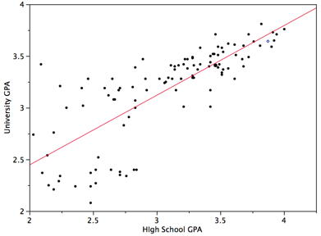
Forecasting numeric data with regression Lantz Ch 6
Regression often is used to predict outcomes or make decisions, based on historical data, assuming that new results would follow the same pattern. (Plus some significant additional assumptions!)
Wk 3, Part 2
Notes:
Image from http://onlinestatbook.com/2/regression/intro.html

Slide 2
Based on a lot of math!
Estimating numeric relationships is important in every field of endeavor.
Can forecast numeric outcomes.
Can quantify the strength of a relationship.
Specifies relationship of a dependent variable to one or more independent variables.
Come up with a formula for the relationship, like:
y = a + bx
Actually, E(Y | x) = α + βx, where E(Y | x) is the expected value of Y given x.
Can be used for hypothesis testing.
Strength of the relationship

Slide 3
But is it even machine learning?
Yes, it’s pure math.
Google say Wikipedia say…
Machine learning is a scientific discipline that explores the construction and study of algorithms that can learn from data. Such algorithms operate by building a model based on inputs and using that to make predictions or decisions, rather than following only explicitly programmed instructions.
Yes, it produces a new formula.
Yes, though the model isn’t rich in new concepts.
w
Yes, this is how we use it.
Yes, this one’s surely true.
Maybe – you’d get the same answer every time.
Notes:
Do slide show to see the bubbles and comments appear in order.
Quote from http://en.wikipedia.org/wiki/Machine_learning.

Slide 4
Actually many kinds of regression
We’ll focus on linear.
There’s also logistic regression.
Models binary categorical outcomes.
Convert true-false to 1 or -1, etc.
We’ll discuss in this chapter.
Poisson regression.
Models integer count data.
Instead of y being linear in x,

Slide 5
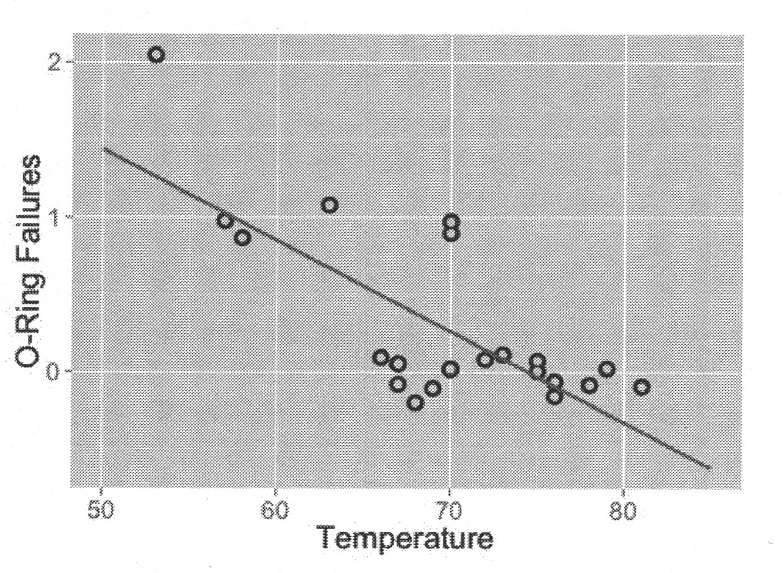
Lantz’s Space Shuttle data
> b <- cov(launch$temperature, launch$distress_ct) / var(launch$temperature)
> b
[1] -0.05746032
> a <- mean(launch$distress_ct) – b * mean(launch$temperature)
> a
[1] 4.301587
So, y = 4.30 – 0.057x
Notes:
Lantz p 164

Slide 6
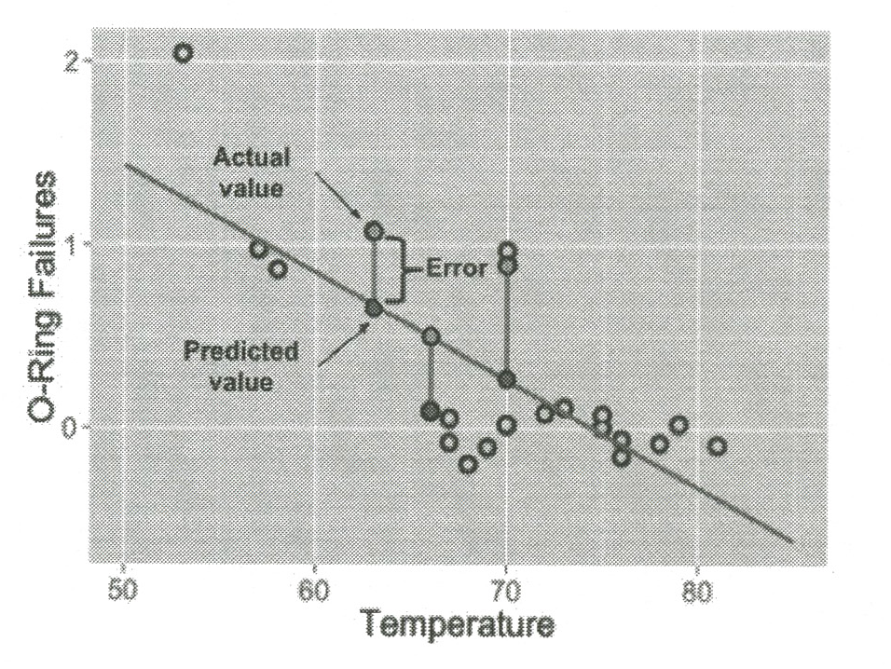
Goal is to minimize error

Slide 7
How strong is the relationship?
This is shown by the “correlation coefficient” which goes from -1 to +1:
-1 = perfectly inverse relationship
0 = no relationship
+1 = perfectly positive relationship
> r <- cov(launch$temperature, launch$distress_ct) / (sd(launch$temperature) * sd(launch$distress_ct))
> r
[1] -0.725671

Slide 8
Strengths | Weaknesses
By far the most common approach for modeling numeric data. | Makes strong assumptions about the data. (E.g., linearity)
Can be adapted to model almost any data. | The model’s form must be specified by the user in advance.
Provides estimates of the strength and size of the relationship among features and the outcome. | Does not do well with missing data.
 | Only works with numeric features, so categorical data requires extra processing.
 | Requires some knowledge of statistics to understand the model.
Notes:
Lantz p 169

Slide 9
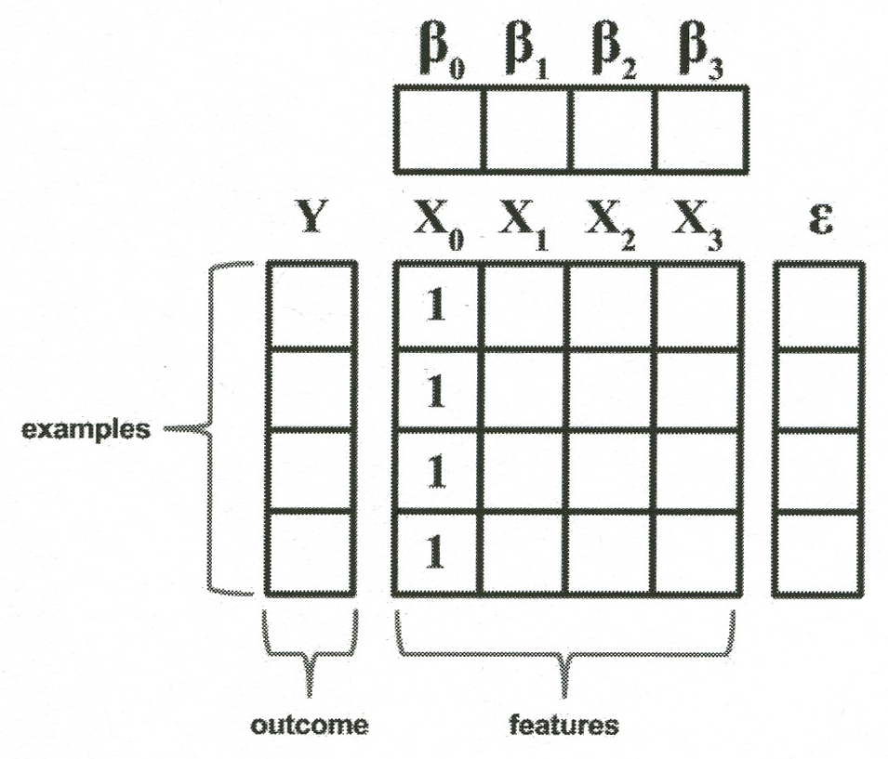
Multiple linear regression
Multiple independent variables.
The model can be expressed as vectors:
Y = Xβ + ε,
Where Y = the dependent variable values.
X = the array of multiple independent values.
β = the array of estimated coefficients for these, including a constant term like “a”.
ε = “error”.

Slide 10
Lantz’s function to return a matrix of betas
> reg <- function(y, x) {
+ x <- as.matrix(x)
+ x <- cbind(Intercept = 1, x)
+ solve(t(x) %*% x) %*% t(x) %*% y
+ }
Where,
Solve() takes the inverse of a matrix
t() is used to transpose a matrix
%*% multiplies two matrices

Slide 11
Applied to the Shuttle data
reg(y = launch$distress_ct, x = launch[3:5])[,1]
Intercept temperature pressure launch_id
3.814247216 -0.055068768 0.003428843 -0.016734090
Notes:
Image from http://en.wikipedia.org/wiki/Space_Shuttle

Slide 12
Lantz’s example – predicting medical expenses
> str(insurance)
'data.frame': 1338 obs. of 7 variables:
$ age : int 19 18 28 33 32 31 46 37 37 60 ...
$ sex : Factor w/ 2 levels "female","male": 1 2 2 2 2 1 1 1 2 1 ...
$ bmi : num 27.9 33.8 33 22.7 28.9 ...
$ children: int 0 1 3 0 0 0 1 3 2 0 ...
$ smoker : Factor w/ 2 levels "no","yes": 2 1 1 1 1 1 1 1 1 1 ...
$ region : Factor w/ 4 levels "northeast","northwest",..: 4 3 3 2 2 3 3 2 1 2 ...
$ charges : num 16885 1726 4449 21984 3867 ...

Slide 13
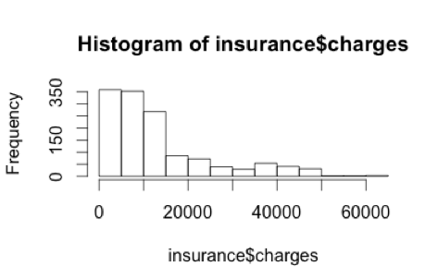
2 - Exploring the data
> table(insurance$region)
northeast northwest southeast southwest
324 325 364 325

Slide 14
Correlation matrix
> cor(insurance[c("age", "bmi", "children","charges")])
age bmi children charges
age 1.0000000 0.1092719 0.04246900 0.29900819
bmi 0.1092719 1.0000000 0.01275890 0.19834097
children 0.0424690 0.0127589 1.00000000 0.06799823
charges 0.2990082 0.1983410 0.06799823 1.00000000

Slide 15
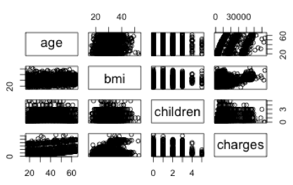
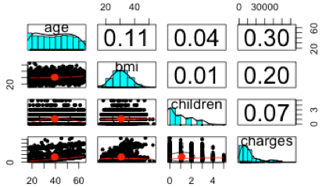
Visualizations
> pairs(insurance[c("age","bmi","children", "charges")])
> pairs.panels(insurance[c("age","bmi","children", "charges")])
Scatterplots:
Enriched scatterplots:
Correlations
Mean values
Same thing transposed.
Distribution for this variable.
Look like clumps.

Slide 16
3 - Training the model
> ins_model <- lm(charges ~ age + children + bmi + sex + smoker + region, data = insurance)
> ins_model
Call:
lm(formula = charges ~ age + children + bmi + sex + smoker +
region, data = insurance)
Coefficients:
(Intercept) age children bmi
-11938.5 256.9 475.5 339.2
sexmale smokeryes regionnorthwest regionsoutheast
-131.3 23848.5 -353.0 -1035.0
regionsouthwest
-960.1
Try everything!

Slide 17
4 - Evaluate the results
> summary(ins_model)
Call:
lm(formula = charges ~ age + children + bmi + sex + smoker +
region, data = insurance)
Residuals:
Min 1Q Median 3Q Max
-11304.9 -2848.1 -982.1 1393.9 29992.8
Coefficients:
Estimate Std. Error t value Pr(>|t|)
(Intercept) -11938.5 987.8 -12.086 < 2e-16 ***
age 256.9 11.9 21.587 < 2e-16 ***
children 475.5 137.8 3.451 0.000577 ***
bmi 339.2 28.6 11.860 < 2e-16 ***
sexmale -131.3 332.9 -0.394 0.693348
smokeryes 23848.5 413.1 57.723 < 2e-16 ***
regionnorthwest -353.0 476.3 -0.741 0.458769
regionsoutheast -1035.0 478.7 -2.162 0.030782 *
regionsouthwest -960.0 477.9 -2.009 0.044765 *
---
Signif. codes: 0 ‘***’ 0.001 ‘**’ 0.01 ‘*’ 0.05 ‘.’ 0.1 ‘ ’ 1
Residual standard error: 6062 on 1329 degrees of freedom
Multiple R-squared: 0.7509, Adjusted R-squared: 0.7494
F-statistic: 500.8 on 8 and 1329 DF, p-value: < 2.2e-16
Majority of values fell between these
Significance of each coefficient
How much of variation is explained by the model

Slide 18
5 - Improve?
Add columns for age² and for bmi > 30, combine the latter with smoking status:
> insurance$age2 = insurance$age^2
> insurance$bmi30 <- ifelse(insurance$bmi >= 30, 1, 0)
> ins_model2 <- lm(charges ~ age + age2 + children + bmi + sex + bmi30*smoker + region, data = insurance)
Logistic regression – create a logical variable!
Then “And” it with another one we’ve been using.

Slide 19
Regression trees
Adapting decision trees (Ch 5) to also handle numeric prediction.
Don’t use linear regression
Make predictions based on average values at a leaf

Slide 20
Model trees
Do build a regression model at each leaf.
More difficult to understand.
Can be more accurate.
Compare regression models at a leaf.

Slide 21
For both kinds… (Regression trees and Model trees)
Strengths | Weaknesses
Combines the strengths of decision trees with the ability to model numeric data. | Not as commonly used as linear regression.
Does automatic feature selection, which allows the approach to be used with a very large number of features. | Requires a large amount of training data.
Does not require the user to specify the model in advance. | Difficult to determine the overall net effect of individual features on the outcome.
May fit some types of data much better than linear regression. | May be more difficult to interpret than a regression model.
Does not require knowledge of statistics to interpret the model.
Notes:
Lantz p 188

Slide 22
Regression trees are built like decision trees
Start at root node.
Divide and conquer based on the feature that will result in the greatest increase in homogeneity after the split.
Measured by entropy, like in Ch 5
Standard splitting criterion is standard deviation reduction (SDR):

Slide 23
Splitting example
P 1989 – the table
> tee <- c(1,1,1,2,2,3,4,5,5,6,6,7,7,7,7)
> at1 <- c(1,1,1,2,2,3,4,5,5)
> at2 <- c(6,6,7,7,7,7)
> bt1 <- c(1,1,1,2,2,3,4)
> bt2 <- c(5,5,6,6,7,7,7,7)
> sdr_a <- sd(tee) - (length(at1) / length(tee) * sd(at1) + length(at2) / length(tee) * sd(at2))
> sdr_b <- sd(tee) - (length(bt1) / length(tee) * sd(bt1) + length(bt2) / length(tee) * sd(bt2))
> sdr_a
[1] 1.202815
> sdr_b
[1] 1.392751
Standard deviation reduced more here, so use split B

Slide 24
Let’s estimate some wine quality, using a regression tree!
> str(wine)
'data.frame': 4898 obs. of 12 variables:
$ fixed.acidity : num 6.7 5.7 5.9 5.3 6.4 7 7.9 6.6 7 6.5 ...
$ volatile.acidity : num 0.62 0.22 0.19 0.47 0.29 0.14 0.12 0.38 0.16 0.37 ...
$ citric.acid : num 0.24 0.2 0.26 0.1 0.21 0.41 0.49 0.28 0.3 0.33 ...
$ residual.sugar : num 1.1 16 7.4 1.3 9.65 0.9 5.2 2.8 2.6 3.9 ...
$ chlorides : num 0.039 0.044 0.034 0.036 0.041 0.037 0.049 0.043 0.043 0.027 ...
$ free.sulfur.dioxide : num 6 41 33 11 36 22 33 17 34 40 ...
$ total.sulfur.dioxide: num 62 113 123 74 119 95 152 67 90 130 ...
$ density : num 0.993 0.999 0.995 0.991 0.993 ...
$ pH : num 3.41 3.22 3.49 3.48 2.99 3.25 3.18 3.21 2.88 3.28 ...
$ sulphates : num 0.32 0.46 0.42 0.54 0.34 0.43 0.47 0.47 0.47 0.39 ...
$ alcohol : num 10.4 8.9 10.1 11.2 10.9 ...
$ quality : int 5 6 6 4 6 6 6 6 6 7 ...

Slide 25
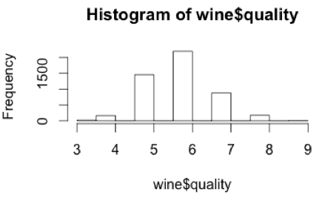
2 - Exploring

Slide 26
Decide how much to use for training
> wine_train <- wine[1:3750,]
> wine_test <- wine[3751:4898,]
> install.packages("rpart")
> library(rpart)
As usual, there’s a package to install.

Slide 27
3 – Training the model (of the regression tree)
> m.rpart <- rpart(quality ~ ., data = wine_train)
> m.rpart
n= 3750
node), split, n, deviance, yval
* denotes terminal node
1) root 3750 2945.53200 5.870933
2) alcohol< 10.85 2372 1418.86100 5.604975
4) volatile.acidity>=0.2275 1611 821.30730 5.432030
8) volatile.acidity>=0.3025 688 278.97670 5.255814 *
9) volatile.acidity< 0.3025 923 505.04230 5.563380 *
5) volatile.acidity< 0.2275 761 447.36400 5.971091 *
3) alcohol>=10.85 1378 1070.08200 6.328737
6) free.sulfur.dioxide< 10.5 84 95.55952 5.369048 *
7) free.sulfur.dioxide>=10.5 1294 892.13600 6.391036
14) alcohol< 11.76667 629 430.11130 6.173291
28) volatile.acidity>=0.465 11 10.72727 4.545455 *
29) volatile.acidity< 0.465 618 389.71680 6.202265 *
15) alcohol>=11.76667 665 403.99400 6.596992 *
* Means leaf node. In this case,
For acidity < 0.2275 and alcohol < 10.85 (see node 2, above), quality is predicted to be 5.97.

Slide 28
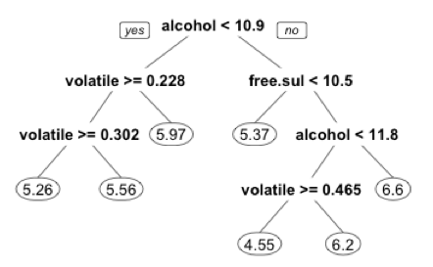
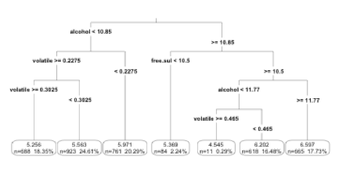
Visualizing the results
Notes:
See pp 196-7

Slide 29
4 – Evaluating performance
> p.rpart <- predict(m.rpart, wine_test)
> summary(p.rpart)
Min. 1st Qu. Median Mean 3rd Qu. Max.
4.545 5.563 5.971 5.893 6.202 6.597
> summary(wine_test$quality)
Min. 1st Qu. Median Mean 3rd Qu. Max.
3.000 5.000 6.000 5.901 6.000 9.000
We’re close on predicting, for middle-of-the-road wines

Slide 30
How far off are we, on average?
Lantz’s “mean absolute error” function:
> MAE <- function(actual, predicted) {
+ mean(abs(actual - predicted))
+ }
> MAE(p.rpart, wine_test$quality)
[1] 0.5872652
> mean(wine_train$quality)
[1] 5.870933
> MAE(5.87, wine_test$quality)
[1] 0.6722474
We’re off by only 0.59 on average, out of 10. Great, huh?
But the average rating was 5.87. If we’d guessed that for all of them, we’d only have been off by 0.67 on average!

Slide 31
5 - Ok, then let’s try a Model tree
Same wine, different training algorithm:
> m.m5p <- M5P(quality ~., data = wine_train)
> m.m5p
M5 pruned model tree:
(using smoothed linear models)
alcohol <= 10.85 :
| volatile.acidity <= 0.238 :
| | fixed.acidity <= 6.85 : LM1 (406/66.024%)
| | fixed.acidity > 6.85 :
| | | free.sulfur.dioxide <= 24.5 : LM2 (113/87.697%)
| | | free.sulfur.dioxide > 24.5 :
| | | | alcohol <= 9.15 :
| | | | | citric.acid <= 0.305 :
| | | | | | residual.sugar <= 14.45 :
| | | | | | | residual.sugar <= 13.8 :
| | | | | | | | chlorides <= 0.053 : LM3 (6/77.537%)
| | | | | | | | chlorides > 0.053 : LM4 (13/0%)
| | | | | | | residual.sugar > 13.8 : LM5 (11/0%)
| | | | | | residual.sugar > 14.45 : LM6 (12/0%)
| | | | | citric.acid > 0.305 :
| | | | | | total.sulfur.dioxide <= 169.5 :
…
Alcohol is still the most important split.
Nodes terminate in a linear model, not in a numeric prediction of quality.

Slide 32
The leaf node linear models:
LM1, for example…
LM num: 1
quality =
0.266 * fixed.acidity
- 2.3082 * volatile.acidity
- 0.012 * citric.acid
+ 0.0421 * residual.sugar
+ 0.1126 * chlorides
+ 0 * free.sulfur.dioxide
- 0.0015 * total.sulfur.dioxide
- 109.8813 * density
+ 0.035 * pH
+ 1.4122 * sulphates
- 0.0046 * alcohol
+ 113.1021
There are 36 of these models, one for each leaf node!

Slide 33
Evaluation of the results – improved?
> summary(p.m5p)
Min. 1st Qu. Median Mean 3rd Qu. Max.
4.389 5.430 5.863 5.874 6.305 7.437
> cor(p.m5p, wine_test$quality)
[1] 0.6272973
> MAE(wine_test$quality, p.m5p)
[1] 0.5463023
Slightly!

Slide 34
Ch 6 Errata – from 12/12 email
p 194, second paragrah : should be install.packages(“rpart”), followed by library(rpart). He put the quotes around the wrong one of these two.
p 196, middle of the page: should be install.pacakges(“rpart.plot”). He left the “.” out of that.
p 199, middle of the page: mean_abserror(5.87, wine_test$quality) should be MAE(5.87, wine_test$quality). He forgot what he called his own function!

