Slide 1
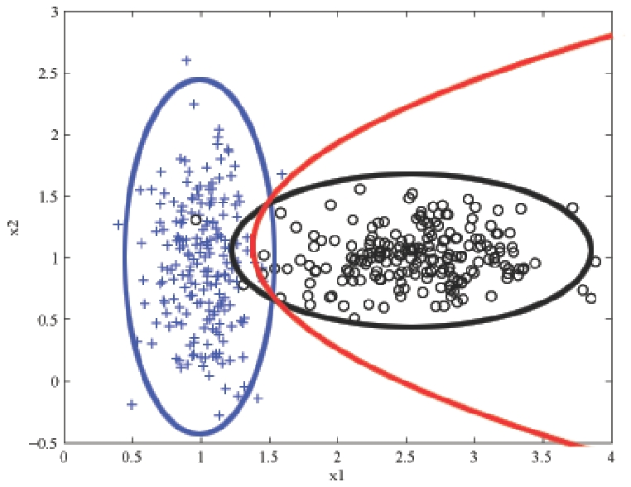
Probabilistic Learing & Naïve Bayes Lantz Ch 4
Once again, it’s about guessing what’s in what group. Here, the red line is a projected boundary separating two groups.
Wk 2, Part 2
Notes:
Image from http://learning.cis.upenn.edu/cis520_fall2009/index.php?n=Lectures.NaiveBayes

Slide 2
Basic idea
There’s a certain probability, P, of an event we are interested in:
Like 0.1 % of the time, our whole duplexed server is crashed.
What does “more information” do to change that?
Like, “What if half of it is down for maintenance?”
We may get a better grip of how to predict when the 0.1 % bad thing happens.
P(crashed | maintenance) = ?

Slide 3
Look at conditional probabilities
Frequency | Maintenance | Non-Maintenance | Total
Crashed | 0.09 (3% of maint) | 0.01 | 0.1
Not crashed | 2.91 (97% of maint) | 96.99 | 99.9
Total | 3 (100% of maint) | 97 | 100
By Bayes formula:
P(maintenance | crashed) * P(crashed)
P(crashed | maintenance) = ------------------------------------------------------
P(maintenance)
0.09 / 0.1
0.1 / 100
3 / 100
= 0.03 (3% vs 0.1%)

Slide 4
Naïve Bayes
What if you have a bunch of independent features, and not just “maintenance vs non-maintenance”?
Naïve Bayes makes the simplifying assumptions that all those independent variables are:
Equally important, and
Independent of each other!
This makes the math a lot simpler.

Slide 5
How that works out…
Strengths | Weaknesses
Simple, fast, and very effective | Relies on an often-faulty assumption of equally important and independent features
Does well with noisy and missing data | Not ideal for datasets with large numbers of numeric features
Requires relatively few examples for training, but also works well with very large numbers of examples | Estimated probabilities are less reliable than the predicted classes
Easy to obtain the estimated probability for prediction

Slide 6
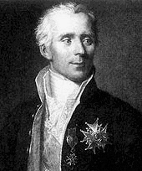
Laplace estimator
Laplace – a great mathematician, and Napoleon’s one time Minister of the Interior!
Zeroes in this multiplied product can cause trouble!
So, we replace them – usually with 1’s.

Slide 7
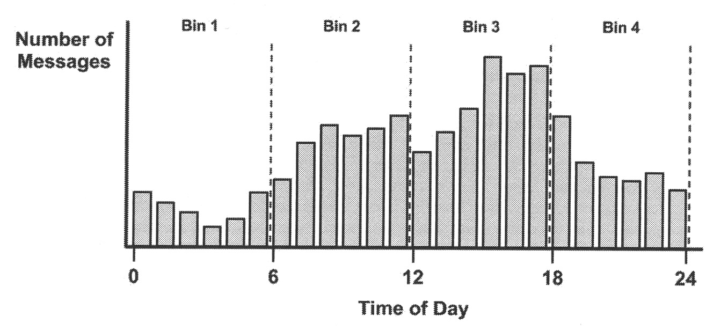
What if we have scaled numbers?
Instead of variables that are True / False?
Like:

Slide 8
Lantz’s mobile phone spam filtering example
Collecting data
Exploring and preparing the data
Processing text data for analysis
Creating training and test datasets
Visualizing text data – word clouds
Preparing indicator features for frequent words
Training a model on the data
Evaluating model performance
Improving model performance

Slide 9
2. Exploring and preparing the data
It’s real text data:
> str(sms_raw)
'data.frame': 5559 obs. of 2 variables:
$ type: chr "ham" "ham" "ham" "spam" ...
$ text: chr "Hope you are having a good week. Just checking in" "K..give back my thanks." "Am also doing in cbe only. But have to pay." "complimentary 4 STAR Ibiza Holiday or £10,000 cash needs your URGENT collection. 09066364349 NOW from Landline not to lose out!"| __truncated__ ...
We convert “type” to a factor, with 4812 instances of “ham” and 747 instances of “spam.”

Slide 10
The Text Mining (tm) Package
…
> library(tm)
Loading required package: NLP
> sms_corpus <- Corpus(VectorSource(sms_raw$text))
> print(vignette("tm"))
Corpus now has raw text for 5,559 text messages
Displays the pdf for how to use “tm”

Slide 11
Text cleanup
In book – can’t use anymore!
> corpus_clean <- tm_map(sms_corpus, tolower)
> corpus_clean <- tm_map(sms_corpus, content_transformer(tolower))
> corpus_clean <- tm_map(corpus_clean, removeNumbers)
> stopwords()
[1] "i" "me" "my" "myself" "we"
[6] "our" "ours" "ourselves" "you" "your"
…
> corpus_clean <- tm_map(corpus_clean, removeWords, stopwords())
> corpus_clean <- tm_map(corpus_clean, removePunctuation)
> corpus_clean <- tm_map(corpus_clean, stripWhitespace)
Use this instead
(from StackOverflow)

Slide 12
Gives better text to process
> inspect(corpus_clean[1:3])
<<VCorpus (documents: 3, metadata (corpus/indexed): 0/0)>>
[[1]]
[1] hope good week just checking
[[2]]
[1] kgive back thanks
[[3]]
[1] also cbe pay

Slide 13
Convert list of examples to a sparse matrix
> sms_dtm <- DocumentTermMatrix(corpus_clean)
Error in UseMethod("meta", x) :
no applicable method for 'meta' applied to an object of class "character"
In addition: Warning message:
In mclapply(unname(content(x)), termFreq, control) :
all scheduled cores encountered errors in user code
>
What you get if you didn’t make the suggested change on lower case conversion!
Notes:
See http://stackoverflow.com/questions/24771165/r-project-no-applicable-method-for-meta-applied-to-an-object-of-class-charact

Slide 14
Create training and test datasets
Confirm that they look like similar distributions:
> prop.table(table(sms_raw_train$type))
ham spam
0.8647158 0.1352842
> prop.table(table(sms_raw_test$type))
ham spam
0.8683453 0.1316547

Slide 15
Visualizing
In this case, with a word cloud:

Slide 16
Create indicator features for frequent words
We discover they’ve taken the “Dictionary” function out of “tm”:
> sms_dict -> Dictionary(findFreqTerms(sms_dtm_train, 5))
Error: could not find function "Dictionary”
Instead, you can just do:
> sms_dict <- findFreqTerms(sms_dtm_train, 5)
Notes:
See http://stackoverflow.com/questions/21790353/dictionary-is-not-supported-anymore-in-tm-package-how-to-emend-code

Slide 17
The conversion function
> convert_counts <- function(x){
+ x <- ifelse(x > 0, 1, 0)
+ x <- factor(x, levels = c(0, 1), labels = c("No", "Yes"))
+ return(x)
> sms_train <- apply(sms_train, MARGIN = 2, convert_counts)
> sms_test <- apply(sms_test, MARGIN = 2, convert_counts)
On my machine, it wanted single quotes!

Slide 18
3. Training a model on the data
> library(e1071)
> sms_classifier <- naiveBayes(sms_train, sms_raw_train$type)
> sms_test_pred <- predict(sms_classifier, sms_test)
This part took about 20 seconds on my machine!

Slide 19
4. Evaluating model performance
| actual
predicted | ham | spam | Row Total |
-------------|-----------|-----------|-----------|
ham | 1202 | 32 | 1234 |
| 0.974 | 0.026 | 0.888 |
| 0.996 | 0.175 | |
-------------|-----------|-----------|-----------|
spam | 5 | 151 | 156 |
| 0.032 | 0.968 | 0.112 |
| 0.004 | 0.825 | |
-------------|-----------|-----------|-----------|
Column Total | 1207 | 183 | 1390 |
| 0.868 | 0.132 | |
-------------|-----------|-----------|-----------|
TN
FP
FN
TP
Notes:
5 Ham messages incorrectly classified as Spam.
32 Spam messages incorrectly classified as Ham.

