Slide 1
Lazy Learning – Nearest Neighbor Lantz Ch 3
Wk 2, Part 1
Notes:
Image from http://www.simafore.com/blog/bid/108912/K-nearest-neighbor-analysis-with-RapidMiner-5-setup-questions

Slide 2
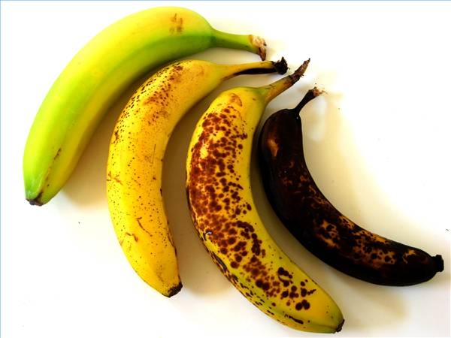
What’s Nearest Neighbor?
A simple way to classify examples.
Assign new examples to the class of the most similar labeled examples.
I say this one’s also brown!
Notes:
Image from http://doubtfulnews.com/2012/07/green-bags-brown-bananas/

Slide 3
The kNN algorithm
Strengths | Weaknesses
Simple and effective | Does not produce a model, which limits the ability to find novel insights in relationships among features
Makes no assumptions about the underlying data distribution | Slow classification phase
Fast training phase | Requires a large amount of memory
 | Nominal features and missing data require additional processing
kNN = “k-Nearest Neighbor”

Slide 4
kNN Training
Begin with examples classified into several categories, labeled by a nominal variable.
Need a training data set and a test dataset.
On the test dataset, kNN will identify k records that are “nearest” in similarity.
You specify k in advance.
Each test example is assigned to the class of the majority of the k nearest neighbors.

Slide 5
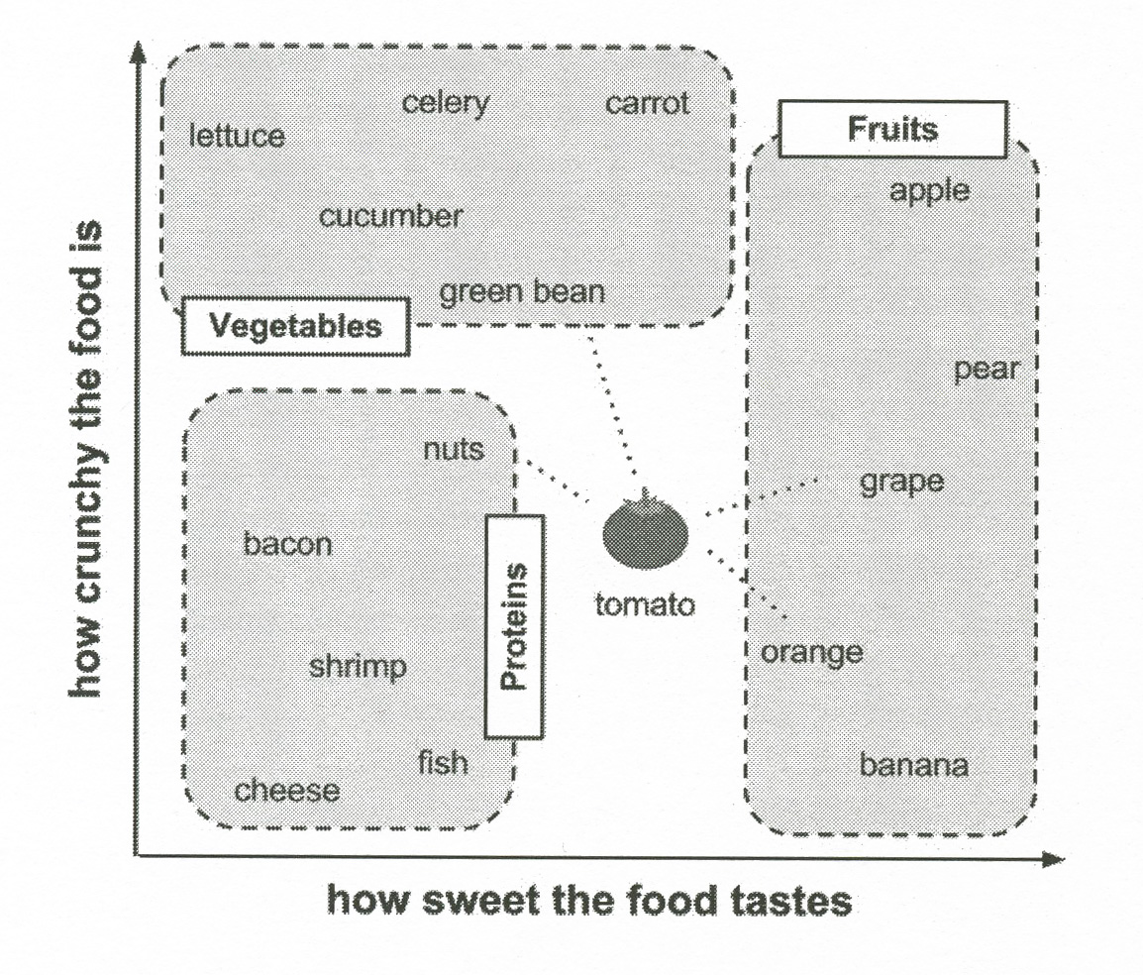
Lantz’s example
Notes:
P 69 in book

Slide 6
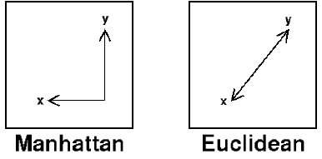
Need to calculate “distance”
Euclidian –
Manhattan – Add absolute values.
Notes:
Images from http://www.improvedoutcomes.com/docs/WebSiteDocs/Clustering/Clustering_Parameters/Euclidean_and_Euclidean_Squared_Distance_Metrics.htm

Slide 7
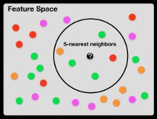
Choosing k
Our first “shot in the dark” guess!
Experience and experimentation improve this.
Larger k values reduce effects of noise.
And bias the “learner,” ignoring small patterns.
Typically k is set between 3 and 10.
Lantz uses the square root of the number of training examples!
Larger training datasets help!
Notes:
Image from http://www.isgtw.org/feature/feature-neighborly-efficiency-scaling-knn-problems-using-gpus

Slide 8
Need to “scale” the data
Usually assume features should contribute equally.
Therefore should be on equivalent scales.
Using mean and standard deviation may be even better!
Notes:
Formula is on p 73

Slide 9
How to scale “nominal” data
Bananas are green -> yellow -> brown -> black.
Could be 1 -> 2 -> 3 -> 4.
But not every nominal variable is easy to convert to some kind of scale.
E.g., What color a car is, versus owner satisfaction.
“Dummy coding” requires some thought.

Slide 10
Why kNN is “lazy”
It doesn’t provide an abstraction as the “learning”.
“generalization” is on a case-by-case basis.
It’s not exactly “learning” anything.
Just uses the training data, verbatim.
So, fast training, but slow predictions.
Both take O(n) time.
It’s like “rote learning.”
It’s “non-parametric”

Slide 11
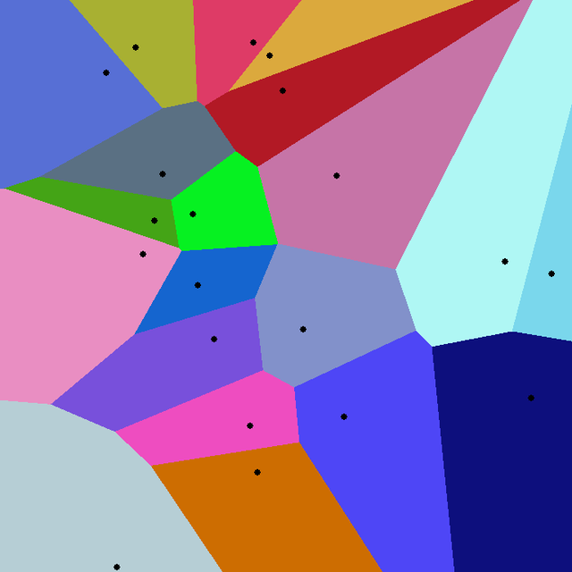
A brief bit more math
Officially, the nearest neighbor algorithm gives us a “Voronoi tesselation.”
The distance algorithm divides the plane into convex regions with “seeds” characterizing those.
Notes:
For more info, see http://en.wikipedia.org/wiki/Voronoi_diagram, from which the image was taken.

Slide 12
High dimensions are a problem
If you have lots of features
The spaces tend to be extremely sparse
Every point is far away from every other point
Thus, the pairwise distances are uninformative.
But, the effective dimensionality may be less
Some of the features may be irrelevant.
Notes:
From Peter Flach, Machine Learning: The Art and Science of Algorithms that Make Sense of Data, p 243.

Slide 13
Lantz’s example – Breast cancer screening
Collect the data
Explore and prepare the data
Transformation – normalize numeric data
Data preparation – creating training and test datasets
Training a model on the data
Evaluating model performance
Improving model performance
Transformation – z-score standardization

Slide 14
Data preparation
Common to divide into training and test data
Lantz used his first 469 examples for training, and the last 100 for testing:
> wbcd_train <- wbcd_n[1:469, ]
> wbcd_test <- wbcd_n[470:569, ], and
> wbcd_train_labels <- wbcd[1:469, 1]
> wbcd_test_labels <- wbcd[470:569, 1]
Where the data examples already were in random order.

Slide 15
Training and testing all at once
The kNN algorithm in the standard “class” package does both:
> wbcd_test_pred <- knn(train = wbcd_train, test = wbcd_test, cl = wbcd_train_labels, k = 21)
The resulting vector, wbcd_test_pred, can then be compared with the real test results, wbcd_test_labels.
Lantz uses the crossTable function from the package gmodels.

Slide 16
And the results are…
| wbcd_test_pred
wbcd_test_labels | Benign | Malignant | Row Total |
-----------------|-----------|-----------|-----------|
Benign | 61 | 0 | 61 |
| 1.000 | 0.000 | 0.610 |
| 0.968 | 0.000 | |
| 0.610 | 0.000 | |
-----------------|-----------|-----------|-----------|
Malignant | 2 | 37 | 39 |
| 0.051 | 0.949 | 0.390 |
| 0.032 | 1.000 | |
| 0.020 | 0.370 | |
-----------------|-----------|-----------|-----------|
Column Total | 63 | 37 | 100 |
| 0.630 | 0.370 | |
-----------------|-----------|-----------|-----------|
TN
FP
FN
TP

