Slide 1
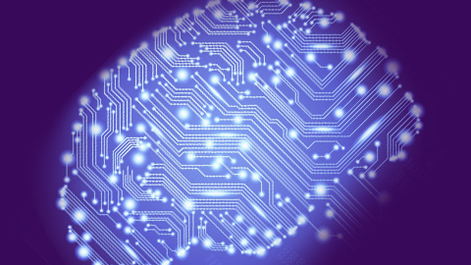
Intro to R and Machine Learning
Wk 1, Part 3
Notes:
Image from http://www.senseta.com/business-intelligence-is-dead-its-time-for-machine-learning/

Slide 2
What is it?
Machine Learning is a young field concerned with developing, analyzing, and applying algorithms for learning from data.
Notes:
Image and def from https://sites.google.com/site/olincollegemachinelearning/.

Slide 3
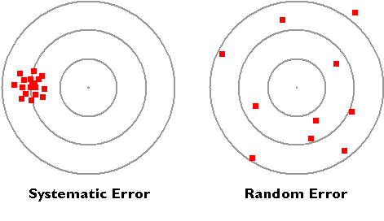
Why is it important?
Advances in Machine Learning have revolutionized a number of huge fields, including: computer vision, data mining, robotics, automated control, and even cognitive science.
Ability to learn from mistakes
“How far off were we this time?”
Dealing with uncertainty
E.g., How to get a good guess from lots of mediocre guesses.
What do we learn from these two situations?
Notes:
From https://sites.google.com/site/olincollegemachinelearning/.

Slide 4
Why is it also curious?
It feels like the essence of AI:
How to make machines learn “on their own.”
Results are an obvious surprise to us.
If they make sense, they added value.
Seems like the core of “data mining”:
Systematic ways to deal with large data.
Probably required for things with sensors.
“Bots” have to learn about their environment.

Slide 5
Why has machine learning taken off?
As Lantz says (Ch 1), we suddenly have:
A huge amount of available data.
Profitable things we could do with it.
Massive parallel processing for cheap.
More advanced AI and statistical techniques that run on this computing power.

Slide 6
Lantz’s list of uses and abuses
Predict outcomes of elections
Identify and filter email spam
Foresee criminal activity
Automate traffic signals for road conditions
Produce financial estimates of storms and natural disasters
Estimate customer churn
Create auto-piloting planes and cars
Identify people who can afford to donate
Target advertising to specific customers

Slide 7
Ethical considerations
One of my undergrads argued that, “If you’re not doing anything wrong, you have nothing to hide.”
I said, “So, you’re showing your girlfriend a web site, and up pops an ad, asking if you want to read more books on problems with relationships?”
Another take on that slogan…
Notes:
Image from http://imgur.com/gallery/BqzRaGv

Slide 8
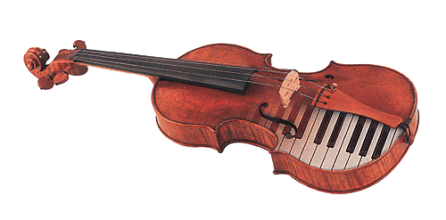
How do we humans learn?
Learning is the act of
acquiring new, or modifying and reinforcing,
existing knowledge, behaviors, skills, values, or preferences and
may involve synthesizing different types of information.
Progress over time tends to follow learning curves.
Question – What do you have to synthesize to make a sound like bowed strings?
Notes:
From http://en.wikipedia.org/wiki/Learning
Image from http://www.soundonsound.com/sos/apr03/articles/synthsecrets48.asp

Slide 9
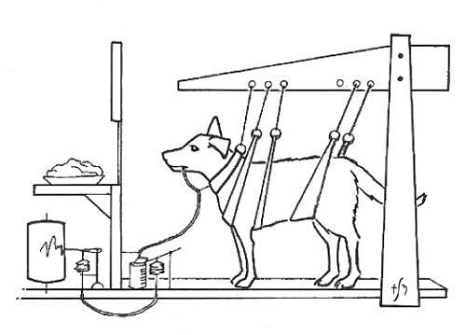
Key ingredients
Having a goal
Motivation
Habituation
Classical conditioning
Sensitization
More complex scenarios, like play
Notes:
Image of Pavlog dog from http://animalbehaviour.net/ClassicalConditioning.htm

Slide 10
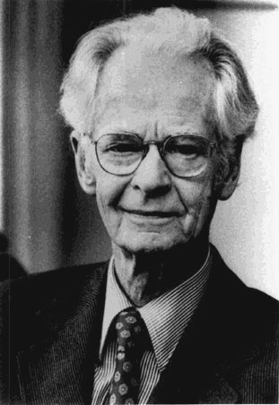
Operant conditioning
While classical conditioning uses antecedents,
Operant conditioning also uses consequents.
E.g., push the correct button, get a treat.
Many variations have impact:
Satiation/deprivation
Immediacy
Contingency
Size
Intermittent reinforcement produces behavior that’s hard to extinguish.
E.g., gambling
Skinner claimed he could use operant conditioning to teach a dog to lick the leg of a chair in 10 minutes. “Any dog, any chair.”
Notes:
B.F. Skinner image from http://www.skeptically.org/skinner/id3.html

Slide 11
Transfer of learning
For humans to do what we now expect machines to do, we must be able to learn “on our own” in novel situations.
Not easy!
“Near transfer” has a similar context.
Need close attention, to make connections.
Usually requires experimentation for “jumps.”
On the way to pre-school, 1985:
Steve: “20 + x = 18. What’s x?”
Katie: “It’s 2, but it would have to be a different kind of 2, that subtracts instead of adds.”
Notes:
Photo from http://www.princeton.edu/fit/people/display_person.xml?netid=kac3&display=All

Slide 12
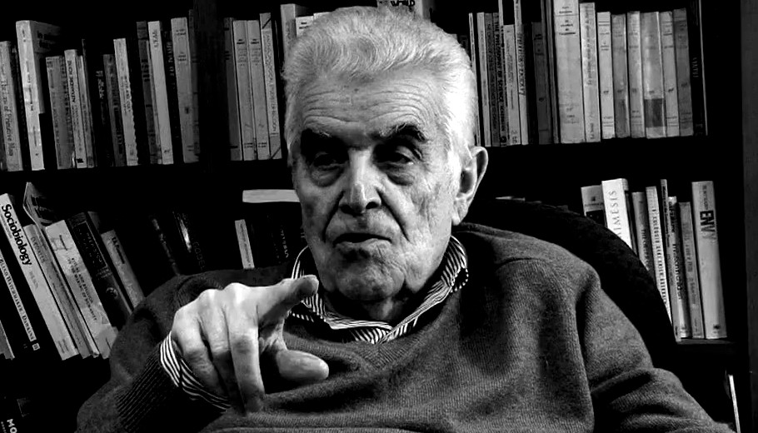
How we learn in school
“From teachers and mentors”
A lot of watching and modeling
Also builds conceptual framework – how we’ll use it
René Girard’s “mimetic desire”
Power from knowledge
Creates rivalry
Causes scapegoating!
Supervised initiation to subjects
Why it’s important to learn
Via play, often with others
Experiments
Testing each other
Practicing – like doing homework
Builds confidence and skill
Prepares for related learning
Notes:
For more on Girard, see http://en.wikipedia.org/wiki/René_Girard.
Image of Girard from http://juicyecumenism.com/2013/05/06/rene-girard-who-is-this-guy-anyway/

Slide 13
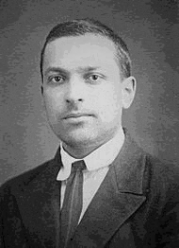
Enter Vygotsky
Learning requires:
Attention
Sensation
Perception
Memory
“Meaning” comes from the social context.
What we learn is guided.
We learn from “the more knowledgeable other.”
The community makes the meaning.
Internalization via language.
“Higher mental processes” are mostly social.
}
The steps in learning are almost the same as the steps in selling!
Notes:
Image from http://en.wikipedia.org/wiki/Lev_Vygotsky

Slide 14
Vygotsky’s sweet spot
Vygotsky believed we build skills incrementally:
Notes:
Figure from http://www.simplypsychology.org/vygotsky.html

Slide 15
As in…
Ok, kids, you know how to differentiate a product, right?
Then let’s show how that leads, almost immediately, to integration by parts!
Notes:
Formulas from http://en.wikipedia.org/wiki/Integration_by_parts

Slide 16
Different kinds of learning
Short term vs long-term memory
Declarative vs procedural knowledge
Declarative: Episodic vs semantic (abstract)
Procedural: May use motor skills as well as mental
Encoding, rehearsal via elaboration, organization
Cue dependency
Explicit vs implicit memory
Anomalies like, “If you take a test before learning something, you learn it better.”
Why recognition beats recall!
Implicit = “nondeclarative”
Notes:
From http://socrates.berkeley.edu/~kihlstrm/GSI_2011.htm

Slide 17
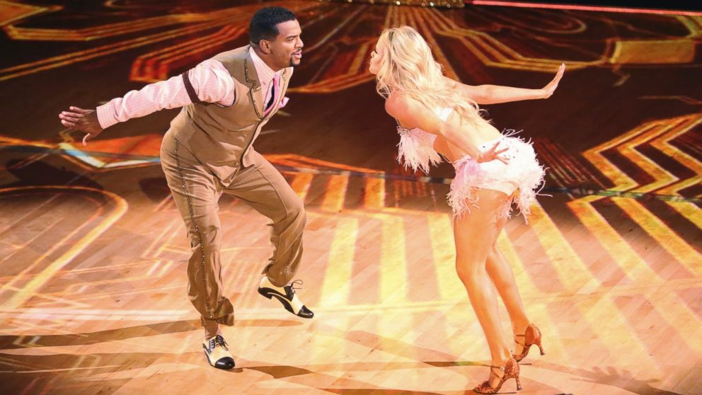
Quick quiz…
What kind of learning is ballroom dancing?
Notes:
Image of Alfonso Ribeiro and Whitney Carson on “Dancing with the Stars,” Sep 15, 2014. From http://abcnews.go.com/Entertainment/dancing-stars-alfonso-ribeiro-carlton-dance-fans/story?id=25999608

Slide 18
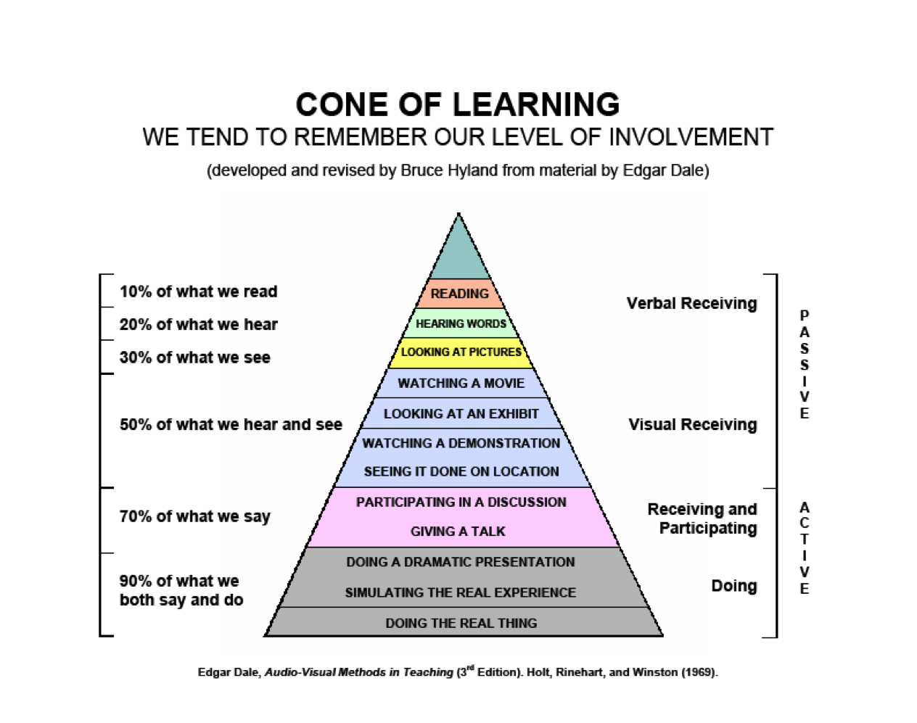
Is it all about involvement?
Maybe…
Notes:
From https://sites.google.com/a/uwlax.edu/exploring-how-students-learn/

Slide 19
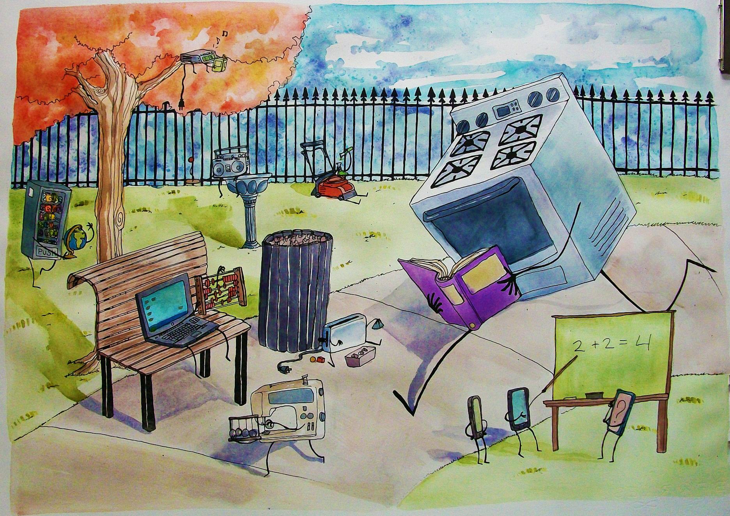
How do machines learn?
Tom M. Mitchell: A machine can take experience and utilize it so that its experience improves in similar situations.
Doesn’t say how that’s accomplished.
Modeled on human learning:
Data input
Like sitting in class
Abstraction
Getting the idea
Generalization
Using it for something
Notes:
Image from http://www.newgrounds.com/art/view/civilized-apocalypse/machine-learning

Slide 20
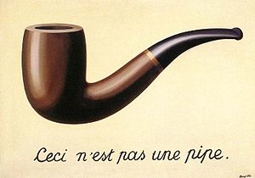
The data translation
This is most of the work, in most machine learning situations.
Involves scrubbing the data
Also, assigning meaning to things.
As we’ll see later in the course, “knowledge representation” is one of the major areas of AI.
Humans aid in setting this up:
Equations
Diagrams like trees and graphs
Logical if/else rules
Groupings (clusters) of data
Notes:
Magritte’s “The Treachery of Images” from http://en.wikipedia.org/wiki/The_Treachery_of_Images

Slide 21
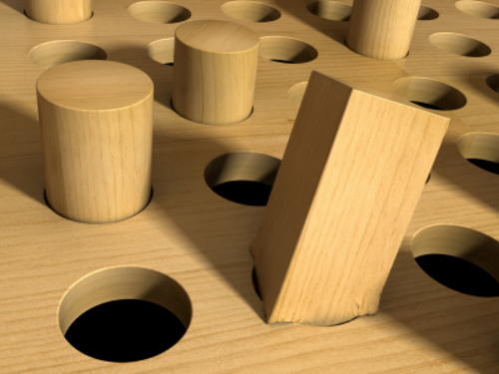
Training
Fitting a dataset to a model.
Abstracts the meaning of the data.
Precedes applying the results.
Called training because the model is imposed on the data by a human teacher.
Notes:
Square peg in round hole from http://foundmediagroup.com/square-pegs-round-holes-dogs-dont-hunt-30000-foot-view/

Slide 22
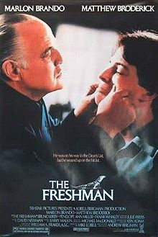
Generalization
Goal – Using the abstracted knowledge for future actions.
Process – Find heuristics for that in the abstracted data.
Always creates some bias.
Matthew Broderick: “Everything we’re doing is illegal!”
Marlon Brando: “Now you’re speaking in generalities.”
Notes:
Image from http://en.wikipedia.org/wiki/The_Freshman_(1990_film)

Slide 23
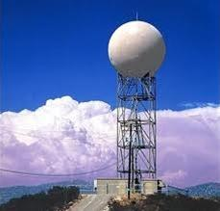
Assessing the results
Sometimes easier than others:
How well can it predict the weather?
There will be unexplained variances.
Requires a new dataset, not used to create the model.
Unless there isn’t going to be any new data!
Sample problem – “Overfitting”:
You’re modeling a lot of the noise in the data.
A Doppler radar tower like the ones by the Indy airport. They can measure velocity data.
Notes:
Image from http://science.wonderhowto.com/how-to/weather-forecast-and-weather-predict-without-technology-0119259/

Slide 24
Steps to apply machine learning
Collecting the data
Exploring and preparing the data
Training a model on the data
Evaluating model performance
Improving model performance
These are more or less the headings for the sections Lantz uses to describe each detailed example.
Notes:
P 17 in the book.

Slide 25
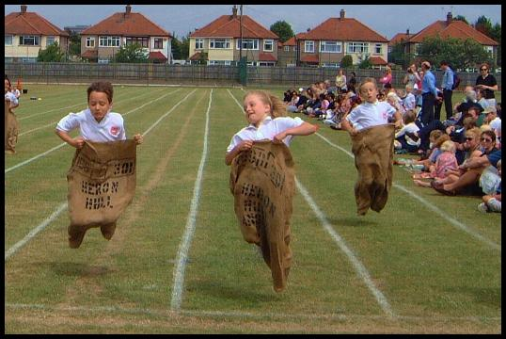
Choosing an algorithm
Lantz warns that you have to learn a lot of these.
Not just one for classifying vs one for numerical.
Everyone’s doing machine learning these days – it’s a competitive sport.
Notes:
Image from http://ehlt.flinders.edu.au/education/DLiT/2002/environs/scott/complern.htm

Slide 26
Characterizing the data
Examples – single instances of training data.
E.g., a single email that’s either spam or not spam.
Features – the characteristics that form the basis for learning.
Numeric
Categorical (or Nominal)
Ordinal – can be made into an ordered list.
Units of observation – like transactions, persons, time points, or measurements.
Notes:
P 18

Slide 27
In supervised learning…
The target feature to be predicted may be:
A categorical feature called “the class”
It’s divided into categories called “levels”
These don’t have to be “ordinal”
Supervised “outcome” can also be:
Numeric data like income, laboratory values, etc.
Like fitting a linear regression model to input data.
Sometimes numeric data is converted to categories:
“Teenagers,” etc.

Slide 28
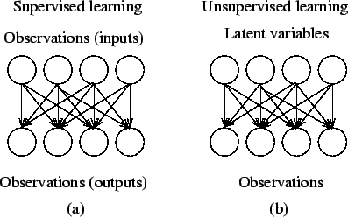
What’s “unsupervised” learning?
Supervised = inferred “causes” and “effects.”
Inputs and outputs, in a causal chain.
The models are “predictive,” in the probabilistic sense.
Unsupervised = everything’s an “effect.”
Everything’s caused by a set of latent variables.
Notes:
Image from http://users.ics.aalto.fi/harri/thesis/valpola_thesis/node34.html

Slide 29
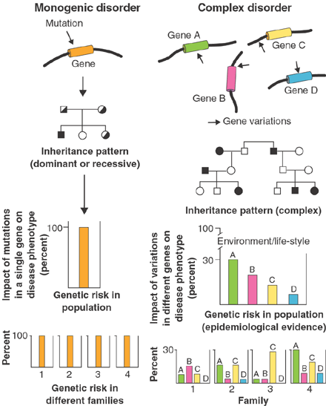
In unsupervised learning…
A descriptive model is used.
Goal is to gain insights from summarizing, categorizing, etc.
E.g., “pattern discovery” like market basket analysis.
Or, fraudulent behavior, multifactorial genetic defects, etc.
Above – What has to be considered in monogenetic versus complex disorders.
Notes:
Image from http://www.si.mahidol.ac.th/simi/genome/disease_postgenomics.htm

Slide 30
Enter R
Started as S, at Bell Labs.
Created by John Chambers.
R is open source.
Growing in popularity.
Used for statistical computing and graphics.
Use for machine learning is a further development.
Uses special packages, usually written in R or Java.

Slide 31
R features
It’s interpreted.
The command line is a central feature.
Everything is a matrix or vector.
E.g.,
> 2+2
[1] 4
Object oriented, but with lots of functions.
Many libraries.
Built-in statistical functions.

Slide 32
Like R as a language?
See the link on Moodle for a guide to learning it.
http://en.wikibooks.org/wiki/R_Programming
E.g., a function with arguments to pass inside it:
plot2 <- function(x,...){
plot(x, type = "l", ...)
}
plot2(runif(100), main = "line plot", col = "red")
We’ll otherwise stay relatively close to Lantz’s examples.

Slide 33
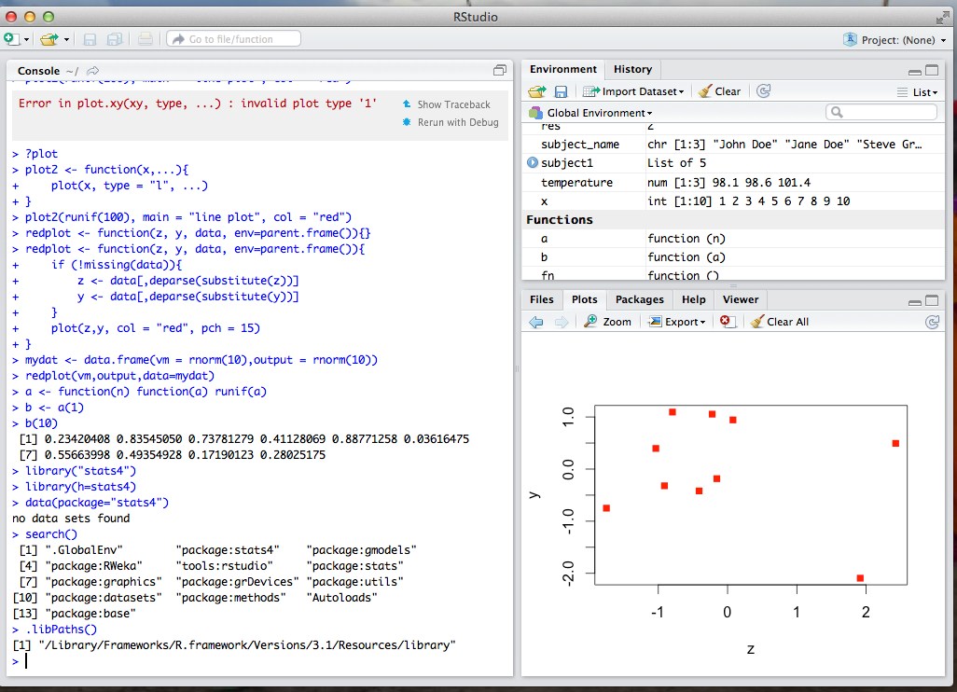
RStudio
A nice development environment for R.
Also open source.
Easy to load packages:
> install.packages("RWeka")
… [includes everything you need, automatically!]
> library(RWeka)

