Slide 1
CSSE 513 – Course intro
With homework and project details
Wk 1 – Part 2
Notes:
Image from http://www.gisfarnborough.com

Slide 2
The usual Approach
Try stuff out, see what works.
There will be homeworks and a paper/project.
Be able to talk about good approaches to using AI.
Two exams
Class discussion

Slide 3
The usual mechanics
Moodle for you to turn in stuff
Also has a few resources
The rest of those are on the course web site

Slide 4
Course Outcomes
From the syllabus:
Use the principal machine learning techniques on practical problems.
Have a working knowledge of the main areas of AI -- search, knowledge representation, constraint satisfaction and planning, etc.
Describe key ways an agent-based approach can be used to solve complex problems.

Slide 5
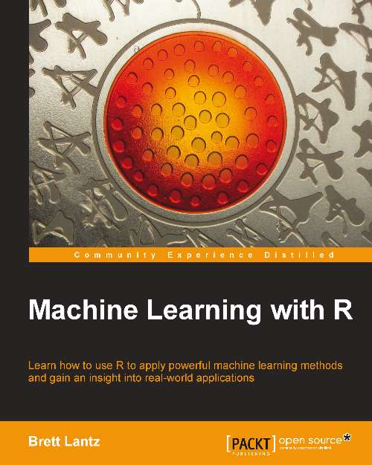
Resources
Your maachine learning book, by Brett Lantz.
Other papers, etc. will be on the website or Moodle.
E.g., on Moodle now are the R-book downloads and a link to the R-programming Wiki Book.

Slide 6
Schedule
Meet 3 weeks in a row
2-week Holiday break
Meet 7 weeks in a row
Last session, Feb 19, may need to be adjusted

Slide 7
Homeworks
Theme:
Choose one of the topics from the coming week.
Find some interesting data to apply it to.
Show that and explain it in the next class, as a part of our discussion.
See Homework, under Assignments

Slide 8
Paper / project
Theme A: Machine Learning Project
Find some data that would be useful for you to learn from / about, with the help of AI algorithms.
Could be real Corporate data, if you can risk showing that in class, etc.
Could be “like” some real data you want to analyze.
E.g., all the examples in the Machine Learning with R book.
Describe what you intend to learn about the data.
Pick 4 machine learning algorithms to try on it.
Two of each kind, numeric or non.
Discuss results and lessons learned, each week, as you go.
Weeks 3, 6, and 9, turn things in, summarizing your exploration.
Week 10 do a retrospective.
See Paper-Project under Assignments

Slide 9
Or, Paper / project
Theme B: An AI Paper
More general. Could be ideas that appeal to you, like:
Explore some machine learning algorithm in more depth.
The business value of some particular AI tool.
Either experimenting, or pure research.
Similar schedule of deliverables over the course.

Slide 10
Exams
Two take-homers.
Will be mostly short discussions of how / why topics we studied could be useful and important.
Could be some R-programming.
E.g., “Describe the advantages and disadvantages of using both Naïve Bayes and a Neural Network to analyze diagnostic reports generated at a software support center.”

Slide 11
Class participation
Discussion of homework and of progress on your project.
Help for other people doing these same things.
Comments on value of topics discussed in class.

Slide 12
Large-scale course outcomes
I’m hoping for any of the following:
You understand how intelligent software works under the covers.
You get what the practical limits are likely to be for any approach.
You are able to use machine learning to reach new conclusions about something you already do.
You can develop a system that has some new, real benefits for your organization.
You could inspire or participate in a new intelligent systems initiative.

