Slide 1
In an assertion-evidence slide, the headline is a sentence, no more than two lines, that states the slide’s assertion
Photograph, drawing, diagram, or graph
supporting the headline assertion
Call-out, if needed:
no more than two lines
Notes:
1
This file presents a template for making Assertion–Evidence (A–E) slides in a technical presentation. The design advocated by this template arises from pages 113-152 of The Craft of Scientific Presentations (Springer, 2003) and from the first Google listing for the search term presentation slides:
http://www.writing.engr.psu.edu/slides.html
To follow this template, make sure that you create the slide within this PowerPoint file. Working with a New Slide (under Insert in older versions or as a button on the Home tab in version 2007) , you should first craft a sentence headline that states an assertion about your topic. In the body of the slide, you should then support that headline assertion visually: photographs, drawings, diagrams, equations, or words arranged visually. Use supporting text only where necessary. Avoid bulleted lists, because bulleted lists do not reveal the connections between details.
This slide shows one orientation for the image and supporting text. Other orientations exist, as shown in the sample slides that follow.

Slide 2
Chinese Remainder Theorem equivalence lets us use systems of congruences to solve problems
Solve the system:
How many solutions?
  Find them.
2
Notes:
Use this slide to create a new slide.

Slide 3
If p is prime and doesn’t divide a, then a^{(p-1)}≡1(mod p)
1
2
3
…
p-1
f(1)=a
f(2)=2a
f(3)=3a
…
f(p-1)=
(p-1)a
S=
p-1 distinct values; just re-ordering of S
This is called Fermat’s Little Theorem
Examples:
  2²=1(mod 3)
  6⁴ =1(mod ???)
  (3²⁰⁰⁰)(mod 19)
3
Notes:
Use this slide to create a new slide.

Slide 4
Euler’s Theorem is like Fermat’s, but for composite moduli
So what’s φ(n)?
4
Notes:
The hypothesis is similar to Fermat, but more general: gcd(a,p) = 1.
We will show that Fermat’s Little Theorem is a special case of Euler’s Theorem.

Slide 5
φ(n) is the number of integers a, such that 1 ≤ a ≤ n and gcd(a,n) = 1.
Ex: φ(10) = 4.
What’s φ(p) for p prime?
What about φ(n), where n =pq (a product of 2 primes)?
5
Notes:
Comments: split this into 2 slides. 1 is Euler. 2 is phi function with a couple examples, pq and

Slide 6
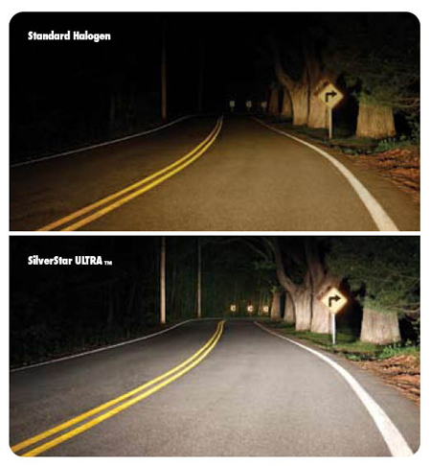

Xenon headlights illuminate signs better than halogen headlights do
Standard Halogen
Halogen Headlight
SilverStar Ultra TM
Xenon
Xenon Headlight
[Sylvania, 2008 ]
Notes:
6
This slide was created by Scott Fishbone, a mechanical engineering student at Penn State. The slide served as a slide from the middle of a presentation in CAS 100A for Engineers in Spring 2008. Notice that the headline serves as a takeaway for this talk.

Slide 7
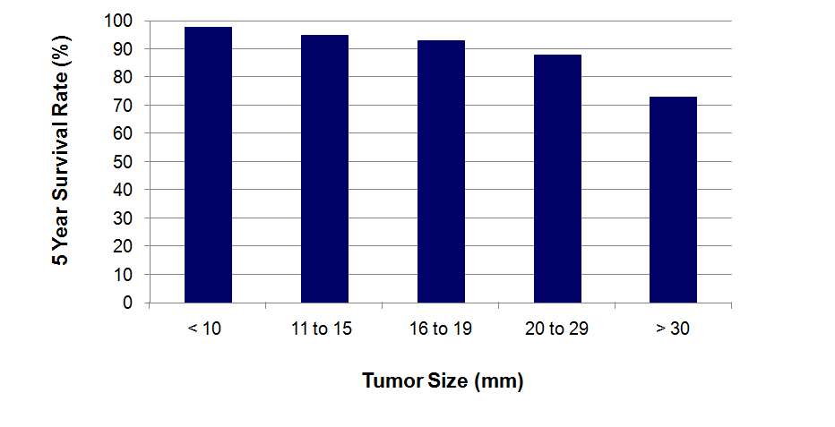
Early detection methods can identify small tumors
and therefore improve survival rates of patients
[Lai et al., 2007]
Notes:
7
This slide was created by Lauren Sawarynski, who earned her B.S. in Bioengineering at Penn State in 2010 and is now in the Physician Assistant Program at Yale Medical School. To appreciate this slide, you should view it in the slideshow mode.
Reference for data:
J.K. Lai, M.A. Martin, R. Meyricke, T. O’neill, and S. Roberts (2007, February). Factors associated with short-term hospital readmission rates for breast cancer patients in Western Australia: an observational study. J Am Coll Surg. 204 (2):193-200.
7

Slide 8
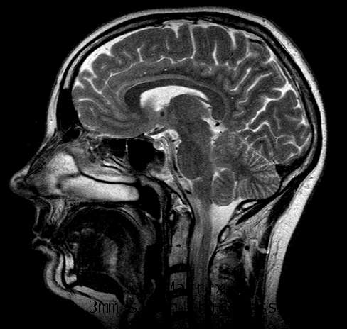
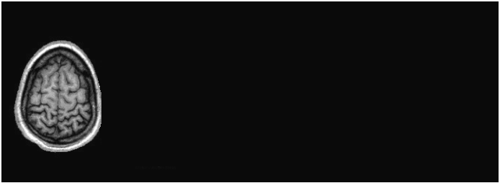
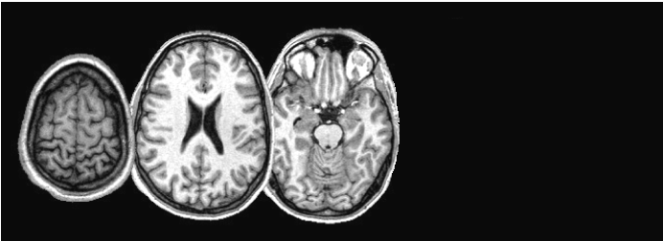
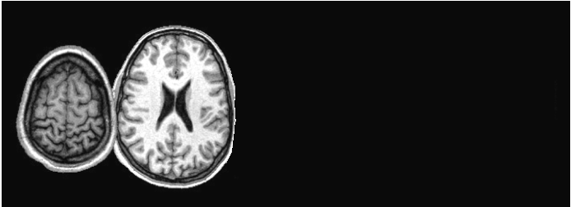
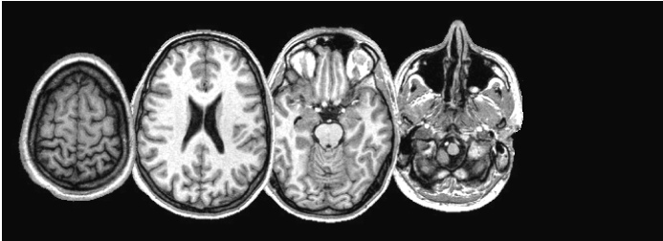
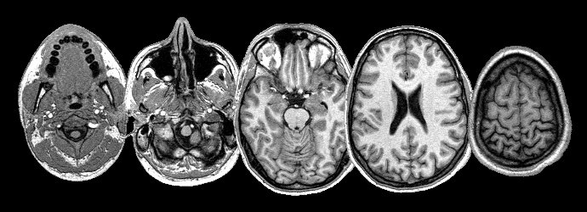
By repeating the MRI process, images from different “slices” can be stacked to create a three-dimensional image
Notes:
This slide was created by Lauren Sawarynski, who earned her B.S. in Bioengineering at Penn State in 2010 and is now in the Physician Assistant Program at Yale Medical School. To appreciate this slide, you should view it in the slideshow mode.

Slide 9
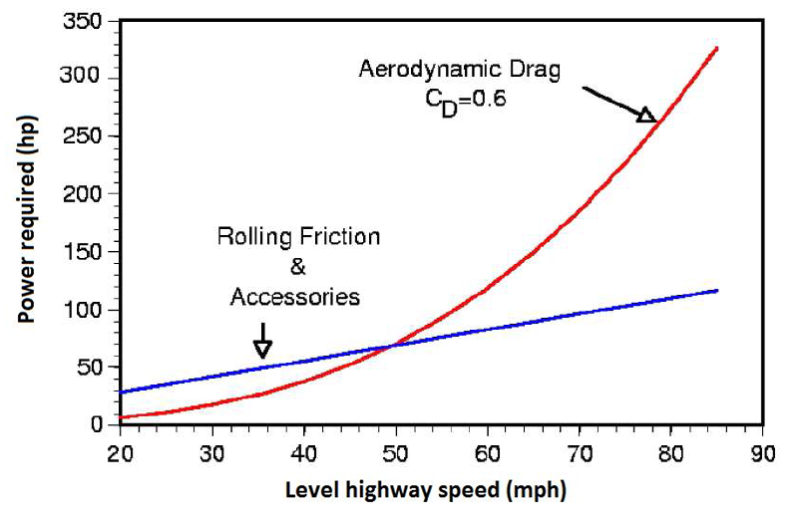
At typical highway speeds, overcoming drag requires about two-thirds of a truck engine’s output
How much power from the engine of a semi-tractor trailer
is needed to overcome aerodynamic drag?
Aerodynamic Drag
C_{D} = 0.6
Rolling Friction
and Accessories
[McCallen, 2004]
Notes:
This slide was created by Casey Howsare, an engineering science student at Penn State. The slide served as a slide from the middle of a presentation in CAS 100A for Engineers in Spring 2010. To appreciate this slide, you should view it in the slideshow mode.
Notice that Casey begins with a question headline because the assertion headline was too complex for the audience to comprehend without first absorbing information from the graph. Notice also that the assertion-evidence structure allows for this type of flexibility when the main point is too complex or too controversial to state when the slide first appears.

