Slide 1
MA/CSSE 474 Theory of Computation
Halting Problem
Decidable and Semidecidable

Slide 2
Does This Program Always Halt?
times3(x: positive integer) =
while x ≠ 1 do:
if x is even then x = x/2.
else x = 3x + 1
max = 100000
maxCount = 0
for i in range(1, max+1):
current = i
count = 0
while current != 1:
count += 1
if current % 2 == 0:
current /= 2
else:
current = 3 * current + 1
print "%7d %7d" % (i, count)
if count > maxCount:
maxCount = count
print "maxCount = ", maxCount
times3(25) …
Lothar Collatz, 1937, conjectured that times3 halts for all positive integers n. Still an open problem. Paul Erdős: "Mathematics is not yet ready for such confusing, troubling, and hard problems."
http://mathworld.wolfram.com/CollatzProblem.html
Notes:
Slide is animated.
times3(25): 25 76 38 19 58 29 88 44 22 11 34 17 52 26 13 40 20 10 5 16 8 4 2 1
It is conjectured that this will halt for all x, but no one has been able to prove it yet.
I wrote a program to count the number of steps before halting for all numbers <= 100,000. The maximum number of steps was 350.
Look at the Word document that contains the output (in SlidesPPT folder). Notice the long string of 48's starting at i = 2987.
In 2008, Oliveira e Silva showed that it always halts for values of x that are ≤ 19 2⁵⁸.

Slide 3
Collatz function example
27, 82, 41, 124, 62, 31, 94, 47, 142, 71, 214, 107, 322, 161, 484, 242, 121, 364, 182, 91, 274, 137, 412, 206, 103, 310, 155, 466, 233, 700, 350, 175, 526, 263, 790, 395, 1186, 593, 1780, 890, 445, 1336, 668, 334, 167, 502, 251, 754, 377, 1132, 566, 283, 850, 425, 1276, 638, 319, 958, 479, 1438, 719, 2158, 1079, 3238, 1619, 4858, 2429, 7288, 3644, 1822, 911, 2734, 1367, 4102, 2051, 6154, 3077, 9232, 4616, 2308, 1154, 577, 1732, 866, 433, 1300, 650, 325, 976, 488, 244, 122, 61, 184, 92, 46, 23, 70, 35, 106, 53, 160, 80, 40, 20, 10, 5, 16, 8, 4, 2, 1
Notes:
Slide is animated.
times3(25): 25 76 38 19 58 29 88 44 22 11 34 17 52 26 13 40 20 10 5 16 8 4 2 1
It is conjectured that this will halt for all x, but no one has been able to prove it yet.
I wrote a program to count the number of steps before halting for all numbers <= 100,000. The maximum number of steps was 350.
Look at the Word document that contains the output (in SlidesPPT folder). Notice the long string of 48's starting at i = 2987.
In 2008, Oliveira e Silva showed that it always halts for values of x that are ≤ 19 2⁵⁸.

Slide 4
The Language H
Theorem: The language:
H = {<M, w> : TM M halts on input string w}
● is semidecidable, but
● is not decidable.
Proof soon! via two lemmas ..
We know that we can decide the halting question for specific simple TMs.
Or can we … ?

Slide 5
H is Semidecidable
Lemma: The language:
H = {<M, w> : TM M halts on input string w}
is semidecidable.
Proof: The TM M'_{H} semidecides H:
M'_{H}(<M, w>) =
1. Run M on w.
2. Accept.
M'_{H} accepts <M, w> if and only if M halts on w.
Thus M'_{H} semidecides H.
Details of step 1:
Write <M,w> on U's first tape.
Run U
U is the Universal Turing Machine
What do we mean by "halts on w"?
Notes:
Basis: Universal Turing machine

Slide 6
H is Not Decidable
Lemma: The language:
H = {<M, w> : TM M halts on input string w}
is not decidable.
Outline of proof:
By contradiction…
Specification of halts function.
Trouble [in (Wabash) River City)]
halts(<Trouble, Trouble>) - what happens?

Slide 7
The Undecidability of the Halting Problem
Lemma: The language:
H = {<M, w> : TM M halts on input string w}
is not decidable.
Proof (by contradiction): Assume that H is decidable.
Then some TM M_{H} would decide it. M_{H} would implement the specification:
halts(<M, w>) =
if <M> is a Turing machine description and M halts on w
then accept.
else reject.

Slide 8
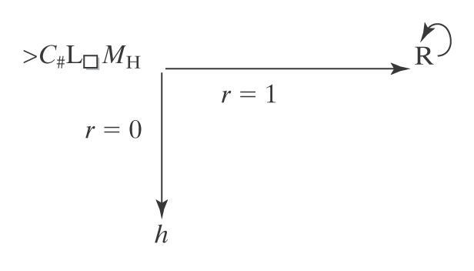
Trouble [in (Wabash) River City)]
Trouble(x: string) =
if halts(<x, x>) then loop forever, else halt.
If there is an M_{H} that computes the function halts, Trouble exists:
Consider halts(<Trouble, Trouble>):
● If M_{H} reports that Trouble(<Trouble>) halts, Trouble loops.
● But if M_{H} reports that Trouble(<Trouble>) does not halt, then
Trouble halts.
C# is the machine from several class sessions ago that makes a copy of the non-blank characters on the tape.
1 means yes 0 means no
Note that it is important to this proof that Trouble be constructible from M_{H}
Notes:
https://www.youtube.com/watch?v=LI_Oe-jtgdI Trouble (from the Music Man)
0:58 is the place in the video to show
Ask: Does MH always halt? MH always halts, because it implements halts.
So here is an example for which MH gives the wrong answer. A contradiction, so a deciding MH does not exist.

Slide 9
Viewing the Halting Problem as Diagonalization
● Lexicographically enumerate Turing machine encodings and input strings.
● Let 1 mean halting, blank mean non halting.
 | i₁ | i₂ | i₃ | … | <Trouble> | …
<machine₁> | 1
machine₂> |  | 1
machine₃> |  |  |  |  | 1
… |  |  |  | 1
<Trouble> |  |  | 1 |  |  | 1
… | 1 | 1 | 1
… |  |  |  | 1
If M_{H} exists and decides membership in H, it must be able to correctly fill in any cell in this table.
What about the shaded square?
Notes:
Since the table enumerates all TMs, some row must be an encoding of Trouble.
If Trouble halts on input <Trouble>, then M_{H} puts a 1 in the cell. But then Trouble loops forever.
If Trouble doesn't halt on input Trouble, then M_{H} leaves the cell blank. So Trouble halts.

Slide 10
Decidable and Semidecidable Languages

Slide 11
If H were in D, then SD would equal D
Recall: H = {<M, w> : TM M halts on input string w}
We know that H∈SD. If H were also in D, then there would exist a TM M_{H} that decides it.
Theorem: If H were in D then every SD language would be in D.
Proof: Let L be any SD language. There exists a TM M_{L} that semidecides it. The following machine M' decides whether w is in L(M_{L}):
M'(w: string) =
1. Run M_{H} on <M_{L}, w>. (M_{H} will always halt)
2. If M_{H} accepts (i.e., M_{L} will halt on input w), then:
2.1. Run M_{L} on w.
2.2. If it accepts, accept.
2.3 Else reject.
3. Else reject.

Slide 12
Every CF Language is in D
Theorem: The set of context-free languages is a proper subset of D.
Proof:
● Every context-free language is decidable, so the context-
free languages are a subset of D.
● There is at least one language, A^{n}B^{n}C^{n}, that is decidable
but not context-free.
So the context-free languages are a proper subset of D.

Slide 13
Decidable and Semidecidable Languages
Almost every obvious language that is in SD is also in D:
● A^{n}B^{n}C^{n} = {a^{n}b^{n}c^{n}, n ≥ 0}
● {wcw, w ∈ {a, b}*}
● {ww, w ∈ {a, b}*}
● {x∗y=z: x,y,z ∈ {0, 1}* and, when x, y, and z are viewed
as binary numbers, xy = z}
But there are languages that are in SD but not in D:
● H = {<M, w> : M halts on input w}

Slide 14
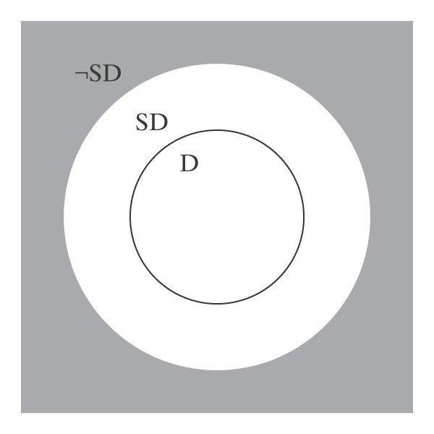
D and SD
D is a subset of SD. In other words, every decidable language is also semidecidable.
There exists at least one language (namely, H) that is in SD-D, the donut in the picture.

Slide 15
Subset Relationships between D and SD
1. There exists at least one SD language that is not in D. Namely H.
2. Every language that is in D is also in SD: If L is in D, then there is a Turing machine M that decides it (by definition of D). M also semidecides L.
3. What about languages that are not in SD? Is the gray area of the figure empty?

Slide 16
There are Languages That Are Not in SD
Theorem: There are languages that are not in SD.
Proof: Assume any nonempty alphabet Σ.
Lemma: There is a countably infinite number of SD languages over Σ.
Lemma: There is an uncountably infinite number of languages over Σ.
So there are more languages than there are languages in SD. Thus there must exist at least one language that is in ¬SD.

Slide 17
Closure of D Under Complement
Theorem: The set D is closed under complement.
Proof: (by construction) If L is in D, then there is a deterministic Turing machine M that decides it.
M:
y n
From M, we construct M′ to decide ¬L:

Slide 18
Closure of D Under Complement
Theorem: The set D is closed under complement.
Proof: (by construction)
M: M':
This works because, by definition, M is:
● deterministic
● complete
Since M' decides ¬L, ¬L is in D.
y
n
n
y

Slide 19
SD is Not Closed Under Complement
Can we use the same technique?
M: M':
y

Slide 20
SD is Not Closed Under Complement
Suppose we had:
M_{L}: M_{¬L}:
Accepts if input is in L. Accepts if input not in L.
Then we could decide L. How?
So every language in SD would also be in D.
But we know that there is at least one language (H) that is in SD but not in D. Contradiction.
Notes:
Run both machines "in parallel" (Dovetail). One of them will eventually halt.

Slide 21
D and SD Languages
Theorem: A language is in D iff both it and its complement are in SD.
Proof:
⇒
● L in D implies L and ¬L are in SD:
● L is in SD because D ⊂ SD.
● D is closed under complement
● So ¬L is also in D and thus in SD.
⇐
● L and ¬L are in SD implies L is in D:
● M₁ semidecides L.
● M₂ semidecides ¬L.
● To decide L:
● Run M₁ and M₂ in parallel (dovetail) on w.
● Exactly one of them will eventually accept.

Slide 22
A Particular Language that is Not in SD
Theorem: The language ¬H =
{<M, w> : TM M does not halt on input string w}
is not in SD.
Proof:
● H is in SD.
● If ¬H were also in SD then H would be in D.
● But H is not in D.
● So ¬H is not in SD.

Slide 23
Enumeration
To enumerate a set means "list its elements, in such a way that for any element, it appears in the list within a finite amount of time."
We say that Turing machine M enumerates the language L iff, for some fixed state p of M:
L = {w : (s, ε) |-_{M}* (p, w)}.
"p" stands for "print" A language is Turing-enumerable iff there is a Turing machine that enumerates it.
Another term that is often used is recursively enumerable.
Notes:
Note that the machine is started with empty input. Whenever it gets to state p, it adds the string that is its tape contents to the list, then keeps running.

Slide 24
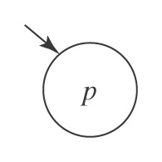
A Printing Subroutine
Let P be a Turing machine that enters state p and then halts:

Slide 25
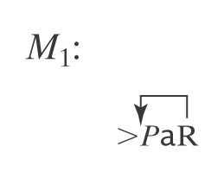
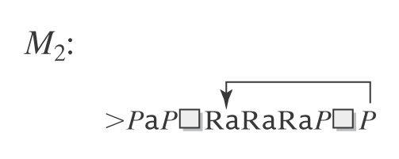
Example of Enumeration
Let L = a*.
Notes:
Second machine : {epsilon, a, aaa, aa, aaaaa, aaaa, …}

Slide 26
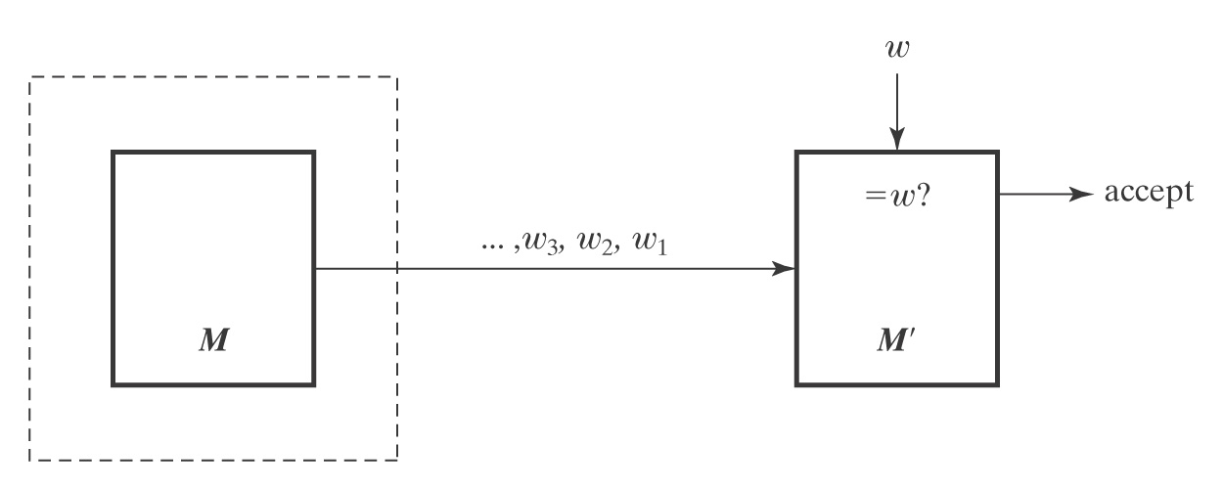
SD and Turing Enumerable
Theorem: A language is SD iff it is Turing-enumerable.
Proof that Turing-enumerable implies SD: Let M be the Turing machine that enumerates L. We convert M to a machine M' that semidecides L:
1. Save input w on another tape.
2. Begin enumerating L. Each time an element of L is
enumerated, compare it to w. If they match, accept.

Slide 27
The Other Way
Proof that SD implies Turing-enumerable:
If L ⊆ Σ* is in SD, then there is a Turing machine M that semidecides L.
A procedure E to enumerate all elements of L:
1. Enumerate all w ∈ Σ* lexicographically.
e.g., ε, a, b, aa, ab, ba, bb, …
2. As each is enumerated, use M to check it.
w₃, w₂, w₁ ∈L? yes w
E
M
M'
Problem?

Slide 28
Dovetailing
We have an infinite number of calculations C1, C2, C3, ..., each of which may or may not halt. We want to enumerate the results of those that halt.
A naive approach would be to run C1, then C2, ...
The problem with this is that C1 may not halt, so we may never get to try C2.
Solution: Run them in this order.
Step 1 of C1
Step 2 of C1
Step 1 of C2
Step 3 of C1
Step 2 of C2
Step 1 of C3
Step 4 of C1
Step 3 of C2
Step 2 of C3
Step 1 of C4
...
Then if Ci halts after j steps, we are guaranteed to eventually get to that step.

Slide 29
The Other Way
Proof that SD implies Turing-enumerable:
If L ⊆ Σ* is in SD, then there is a Turing machine M that semidecides L.
A procedure to enumerate all elements of L:
1. Enumerate all w ∈ Σ* lexicographically.
2. As each string w_{i} is enumerated:
1. Start up a copy of M with w_{i} as its input.
2. Execute one step of each M_{i} initiated so far, excluding those M's that have already halted.
3. Whenever an M_{i} accepts, output w_{i}.

Slide 30
Lexicographic Enumeration
M lexicographically enumerates L iff M enumerates the elements of L in lexicographic order.
A language L is lexicographically Turing-enumerable iff there is a Turing machine that lexicographically enumerates it.
Example: A^{n}B^{n}C^{n} = {a^{n}b^{n}c^{n} : n ≥ 0}
Lexicographic enumeration:
How would a TM do this.
Notes:
Ask how a TM would do this?
A second tape that starts blank.
Repeat:
if n 1's on second tape:
write n a's, then n b's, then n c's.
enter state p
erase first tape and add a 1 to the end of the second tape.

Slide 31
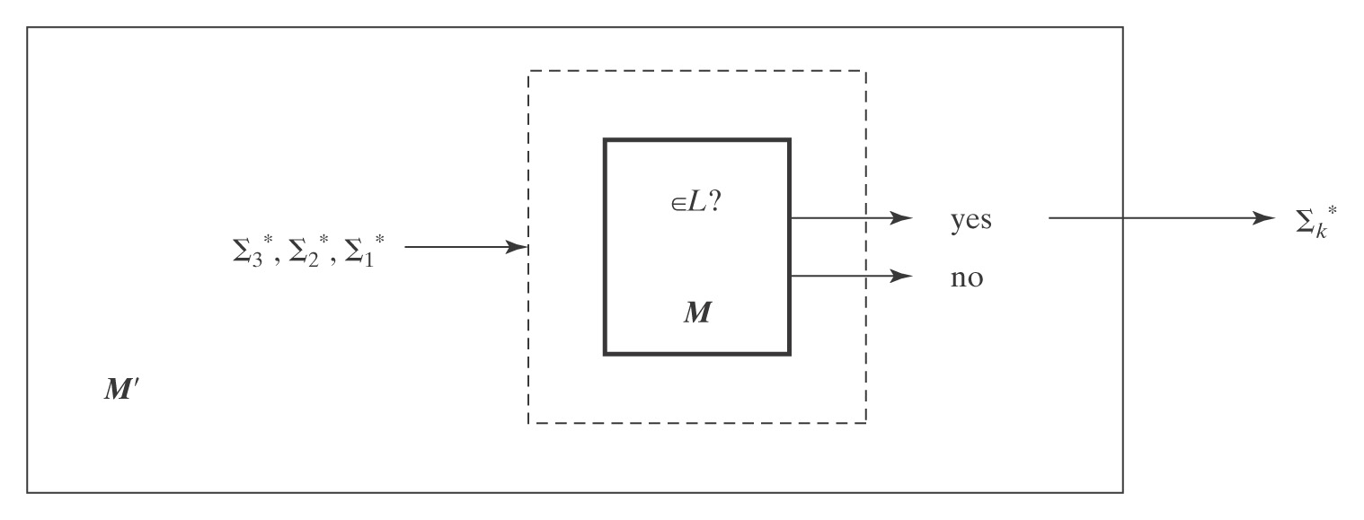
Lexicographically Enumerable = D
Theorem: A language is in D iff it is lexicographically Turing-enumerable.
Proof that D implies lexicographically TE: Let M be a Turing machine that decides L. Then M' lexicographically generates the strings in Σ* and tests each using M. It outputs those that are accepted by M. Thus M' lexicographically enumerates L.

Slide 32
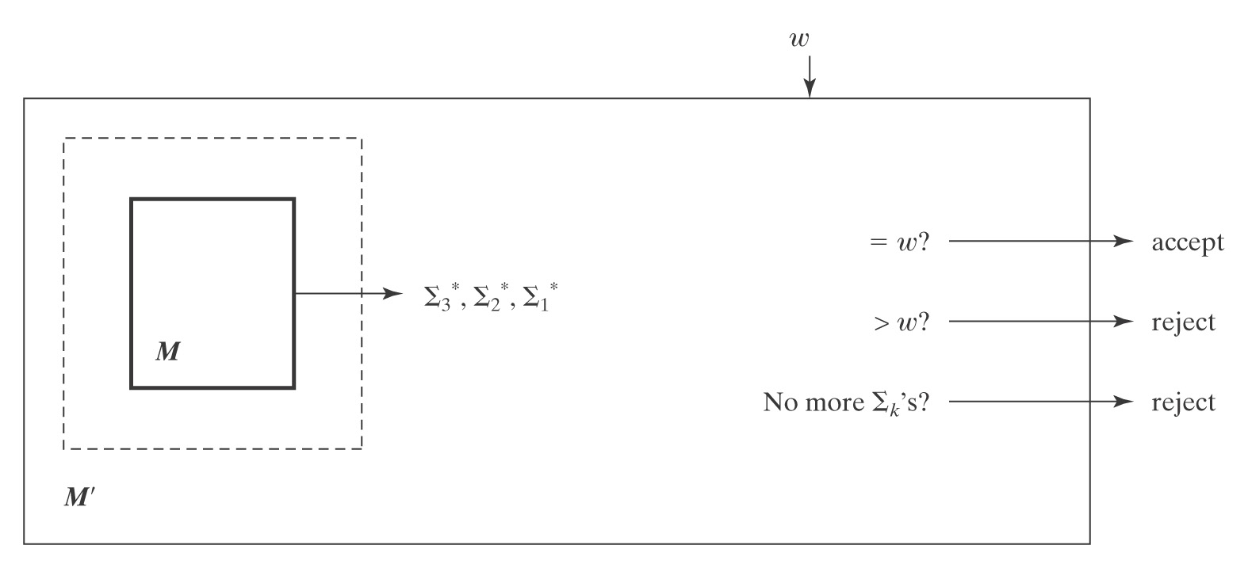
Proof, Continued
Proof that lexicographically Turing Enumerable implies D: Let M be a Turing machine that lexicographically enumerates L. Then, on input w, M' starts up M and waits until:
● M generates w (so M' accepts),
● M generates a string that comes after w (so M' rejects), or
● M halts (so M' rejects).
Thus M' decides L.

Slide 33
Language Summary
IN SD OUT
Semideciding TM H Reduction
Enumerable
Unrestricted grammar
D
Deciding TM A^{n}B^{n}C^{n} Diagonalize
Lexic. enum Reduction
L and ¬L in SD
Context-Free
CF grammar A^{n}B^{n} Pumping
PDA Closure
Closure
Regular
Regular Expression a*b* Pumping
FSM Closure

