Slide 1
Exhaustive Search and Backtracking
Continued from yesterday

Slide 2
Program output:
>java RealQueen 5
SOLUTION: 1 3 5 2 4
SOLUTION: 1 4 2 5 3
SOLUTION: 2 4 1 3 5
SOLUTION: 2 5 3 1 4
SOLUTION: 3 1 4 2 5
SOLUTION: 3 5 2 4 1
SOLUTION: 4 1 3 5 2
SOLUTION: 4 2 5 3 1
SOLUTION: 5 2 4 1 3
SOLUTION: 5 3 1 4 2
Check out Queens from SVN

Slide 3
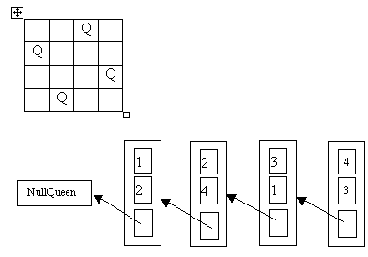
The Linked List of Queen Objects
Board configuration represented by a linked list of Queen objects
Fields of RealQueen:
column
row
neighbor
Designed by Timothy Budd
http://web.engr.oregonstate.edu/~budd/Books/oopintro3e/info/slides/chap06/java.htm
Notes:
Draw UML for RealQueen, NullQueen, Queen interface.
The queen in each column is represented by a RealQueen object
with column, row, and neighbor (to the left)
Neighbor of the RealQueen in column 1 is a special NullQueen object
Simplifies the code for the RealQueen methods
Uses polymorphism for base cases
Queen interface implemented by both

Slide 4
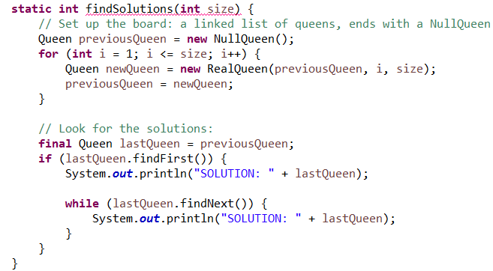
Top-level solution code (I removed the solutionCount code to make this slide simpler)

Slide 5
Queen Interface Methods
findFirst()
findNext()
canAttack(int row, int col)
Already Implemented by NullQueen (does this implementation make sense to you?)
Your job (15 points extra credit if you do it before the end of class):
Understand the job of each of these methods.
Javadoc from the Queen interface can help
Fill in the (recursive) details in the RealQueen class
Debug
Submit to dropbox on Moodle by the end of your class period.
More details on next slides
Notes:
Sketch the basic idea of the methods, then explain how they come together.
Or, show Main.findSolutions() and use that to infer what findFirst and findNext do. Can confirm it by looking at javadoc for Queen.

Slide 6
In-class implementation exercise:
For 15 extra-credit HW points, submit a solution by the end of your class period today.
Submit a ZIP file that contains all of the Java source files.
If you work with a partner, one of you should submit it; include both of your usernames in the name of your ZIP file.
See the next slides for algorithm details.

Slide 7
Outline of the algorithm
Each queen sends messages directly to its immediate neighbor to the left (and recursively to all of its left neighbors)
Return value provides information concerning all of the left neighbors:
Example: neighbor.canAttack(currentRow, col)
Message goes to the immediate neighbor, but the real question to be answered by this call is
"Hey, neighbors, can any of you attack me if I place myself on this square of the board?"

Slide 8
More algorithm outline
Queen asks its neighbors to find the first position in which none of them attack each other
Found? Then queen tries to position itself so that it cannot be attacked.
If the rightmost queen is successful, then a solution has been found! The queens cooperate in recording it.
Otherwise, the queen asks its neighbors to find the next position in which they do not attack each other
When the queens get to the point where there is no next non-attacking position, all solutions have been found and the algorithm terminates
And recursion does its magic!

