Slide 1
MA/CSSE 473 Day 28
Hashing review
B-tree overview Dynamic Programming
Notes:
No class was due to instructor dental emergency.

Slide 2
MA/CSSE 473 Day 28
HW 11 is a good one to try to earn an extra late day. It is shorter than most assignments.
Take-home exam available by Oct 29 (Friday) at 9:55 AM, due Nov 1 (Monday) at 8 AM.
Student Questions
Hashing summary
B-Trees – a quick look
Dynamic Programming
Convex Hull Late Day until Saturday at 8 AM
Convo schedule Monday:
Section 1: 9:35 AM
Section 2: 10:20 AM

Slide 3
Take-Home Exam
Available no later than 9:55 AM on Friday October 29. Due 8 AM Monday, Nov 2
Two parts, each with a time limit of 3-4 hours
exact limit will be set after I finish writing questions.
Measured from time of ANGEL view of problems to submission back to ANGEL drop box.
Covers through HW 12 and Section 8.2.
A small number of problems (3-5 in each part)
For most problems, partial credit for good ideas, even if you don't entirely get it.
A blackout on communicating with other students about this course during the entire period from exam availability to exam due time.

Slide 4
Some Hashing Details
The next slides are from CSSE 230.
They are here in case you didn't "get it" the first time.
We will not go over all of them in detail in class.
If you don't understand the effect of clustering, you might find the animation that is linked from the slides especially helpful.

Slide 5
Collision Resolution: Linear Probing
When an item hashes to a table location occupied by a non-equal item, simply use the next available space.
Try H+1, H+2, H+3, …
With wraparound at the end of the array
Problem: Clustering (picture on next slide)

Slide 6
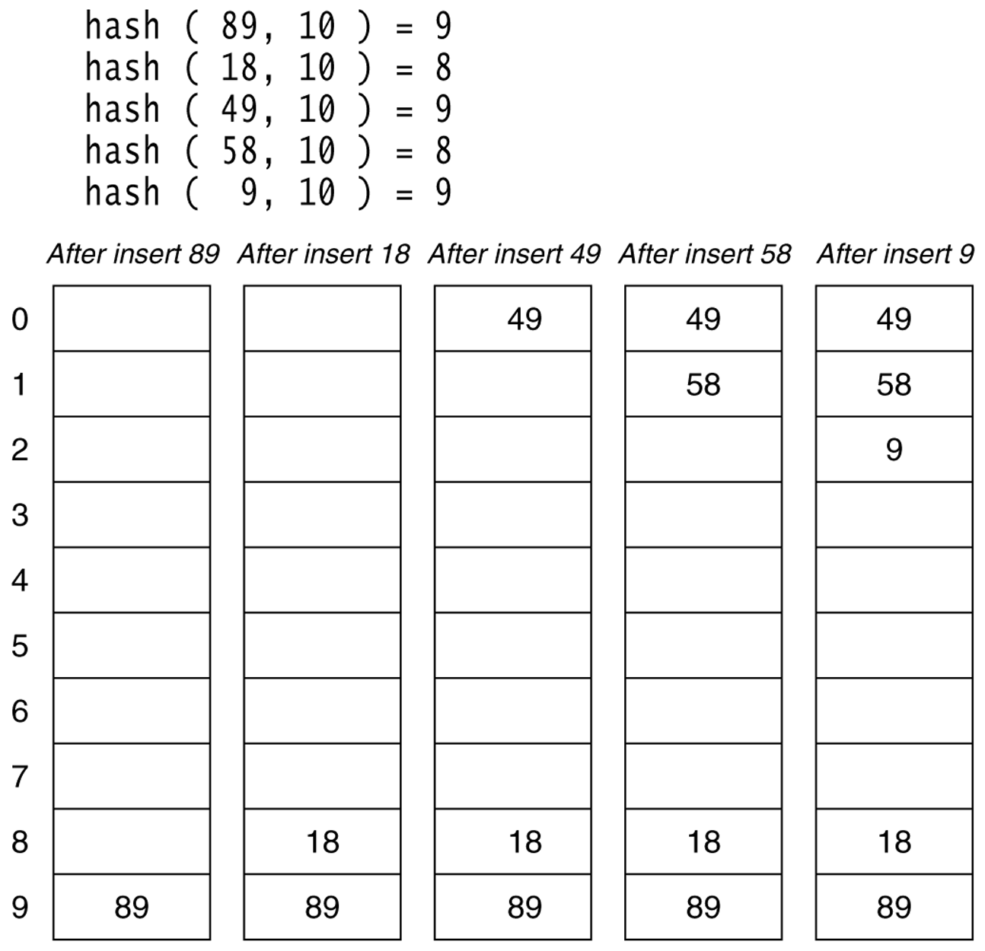
Weiss Figure 20.4
Linear probing hash table after each insertion
Animation: http://www.cs.auckland.ac.nz/software/AlgAnim/hash_tables.html
Q1a
Data Structures & Problem Solving using JAVA/2E Mark Allen Weiss © 2002 Addison Wesley

Slide 7
Analysis of linear probing
Dependent on the load factor, λ, which is the ratio of the number of items in the table to the size of the table. Thus 0 ≤ λ ≤ 1.
For a given λ, what is the expected number of probes before an empty location is found?
For simplicity, assume that all locations are equally likely to be occupied, and equally likely to be the next one we look at. Then the probability that a given cell is empty is 1 - λ, and thus the expected number of probes before finding an empty cell is (write it as a summation). |
For example, if λ is 0.75, the expected value is 4.

Slide 8
Analysis of linear probing (continued)
The "equally likely" probability is not realistic, because of clustering
Large blocks of consecutive occupied cells are formed. Any attempt to place a new item in any of those cells results in extending the cluster by at least one item
Thus items collide not only because of identical hash values, but also because of hash values that happen to put them into the cluster
Average number of probes when λ is large:
0.5 [ 1 + 1/(1- λ)² ].
For a proof, see Knuth, The Art of Computer Programming, Vol 3: Searching Sorting, 2nd ed, Addision-Wesley, Reading, MA, 1998.
What are the values for λ = 0, 0.5, 0.75, 0.9?
When λ approaches 1, this gets bad!
But if λ is close to zero, then the average is near 1.0

Slide 9
So why consider linear probing?
Easy to implement
Simple code has fast run time per probe
Works well when load factor is low
It could be more efficient just to rehash using a bigger table once it starts to fill.
What is often done in practice: rehash to an array that is double in size once the load factor reaches 0.5
What about other fast, easy-to-implement strategies?

Slide 10
Quadratic probing
With linear probing, if there is a collision at H, we try H, H+1, H+2, H+3,... until we find an empty spot.
Causes (primary) clustering
With quadratic probing, we try H, H+1². H+2², H+3²,...
Eliminates primary clustering, but can cause secondary clustering.
Q1b

Slide 11
Hints for quadratic probing
Choose a prime number for the array size
If the array used for the table is not more than half full, finding a place to do the insertion is guaranteed , and no cell is probed twice
Suppose the array size is p, a prime number greater than 3
Show by contradiction that if i and j are ≤ ⌊p/2⌋, and i≠j, then H + i² ≢ H + j² (mod p).
Use an algebraic trick to calculate next index
Replaces mod and general multiplication with subtraction and a bit shift
Difference between successive probes:
H + (i+1)² ⁼ H + i² + (2i+1) [can use bit-shift for the multiplication].
nextProbe = nextProbe + (2i+1); if (nextProbe >= P) nextProbe -= P;
Q2
Notes:
Suppose i≠j, and H + i² (mod P) ≡ H + j² (mod P).
Then (H + i²) -(H + j²) ≡ 0 (mod P)
(i-j)(i+j) ≡ 0 (mod P). But neither 0 < (i + j) < P, so i=j, a contradiction.

Slide 12
Quadratic probing analysis
No one has been able to analyze it
Experimental data shows that it works well
Provided that the array size is prime, and is the table is less than half full

Slide 13
Other approaches to collision resolution
Double hashing
A second hash function is used to calculate an offset d to use in probing. Try locations h+d, h+2d, h+3d, etc
Separate chaining
Rather than an array of items, we use an array of linked lists. When multiple items hash to the same location, we add them to the list for that location
Picture on next slide
No clustering effect
But we use space for the links(that space could have been used to make the array larger).
If many items have the same hash code, the chains can become long.
Q1c

Slide 14
Hashing with Chaining

Slide 15
Analysis: Hashing with Chaining
With chaining, the load factor may be > 1.
Assume a hash function that distributes keys evenly in the table. If there are n keys in the table (backed by an array of size m), the average chain should be λ elements long
So it takes constant time to compute the hash function plus λ /2 to search within the chain.
If λ ≈ 1, this is VERY fast
But there is the extra space for the pointers, which could have been used to make the table larger if open addressing was used

Slide 16
B-trees
We will do a quick overview here.
For the whole scoop on B-trees (Actually B+ trees), take CSSE 433, Advanced Databases.
Nodes can contain multiple keys and pointers to other to subtrees

Slide 17
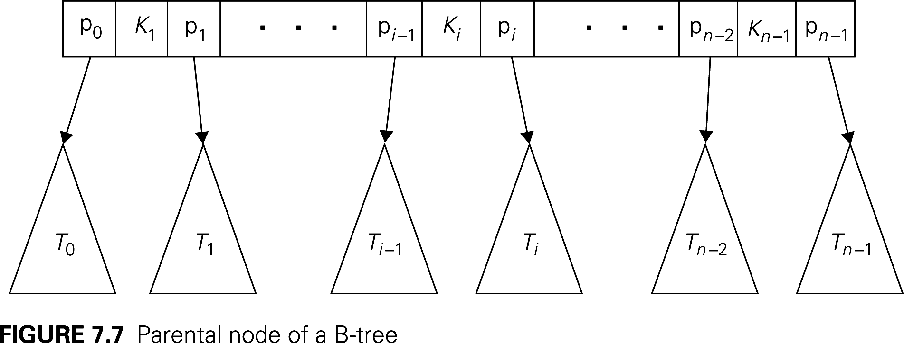
B-tree nodes
Each node can represent a block of disk storage; pointers are disk addresses
This way, when we look up a node (requiring a disk access), we can get a lot more information than if we used a binary tree
In an n-node of a B-tree, there are n pointers to subtrees, and thus n-1 keys
All keys in T_{i} are ≥ K_{i} and < K_{i+1} K_{i} is the smallest key that appears in T_{i}

Slide 18
B-tree nodes (tree of order m)
All nodes have at most m-1 keys
All keys and associated data are stored in special leaf nodes (that thus need no child pointers)
The other (parent) nodes are index nodes
All index nodes except the root have between ⎡m/2⎤ and m children
root has between 2 and m children
All leaves are at the same level
The space-time tradeoff is because of duplicating some keys at multiple levels of the tree.
Example on next slide

Slide 19
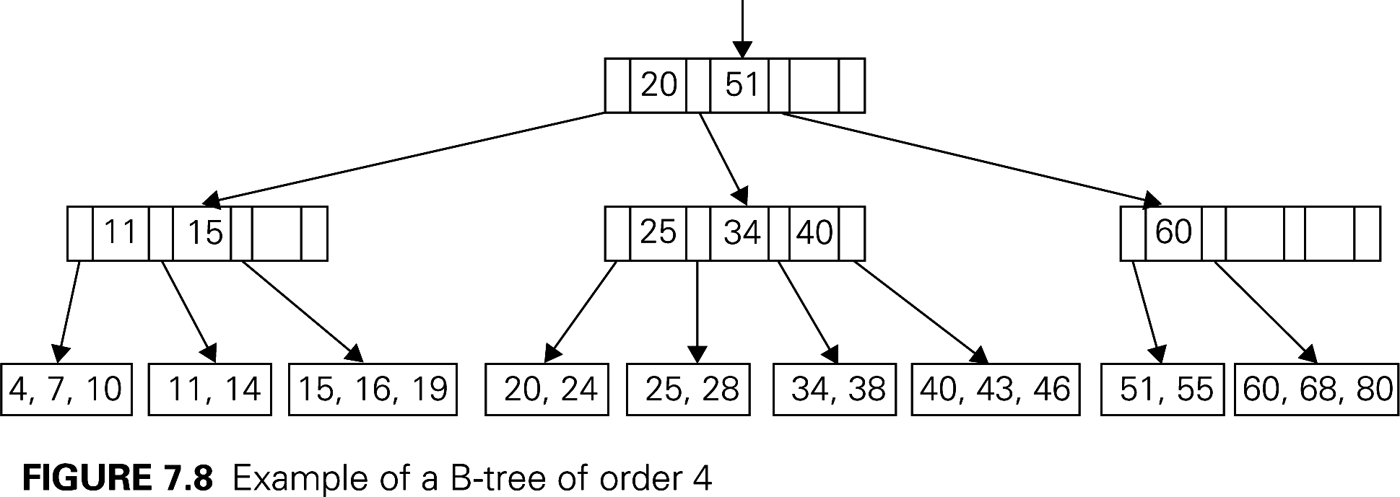
Example B-tree(order 4)

Slide 20
B-tree Animation
http://slady.net/java/bt/view.php?w=800&h=600

Slide 21
Search for an item
Within each parent or leaf node, the items are sorted, so we can use binary search (log m), which is a constant with respect to n, the number of items in the table
Thus the search time is proportional to the height of the tree
Max height is approximately log_{⎡m/2⎤} n
Exercise for you: Read and understand the straightforward analysis on pages 273-274
Insert and delete are also proportional to height of the tree

