Slide 1
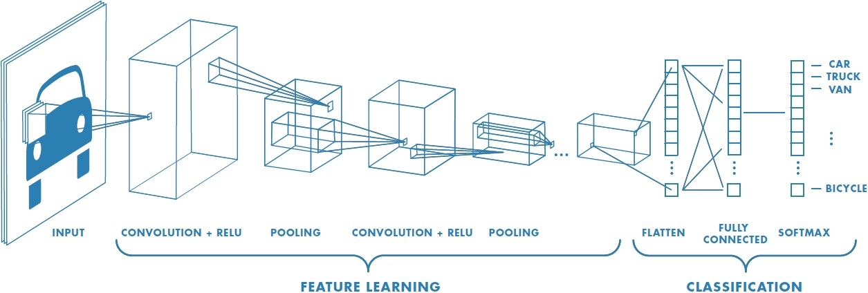
Deep Learning and Convolutional Neural Nets
Matt Boutell
boutell@rose-hulman.edu
Image Credit: https://www.mathworks.com/discovery/convolutional-neural-network.html
Notes:
Both

Slide 2
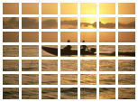
Background: we are detecting sunsets using the classical image recognition paradigm
Classifier (1hidden layer)
Human- engineered feature extraction
feature vector
Class [-1, 1]
Support vector machine
Build model (choose kernel, C)
Train (quadratic programming optimization with Lagrange multipliers bounded by BoxConstraints)
Predict the class of a new vector by taking the weighted sum of functions of the distances of the vector to the support vectors
7x7x6 =294
Grid-based Color moments
384x256x3
Notes:
Dave

Slide 3
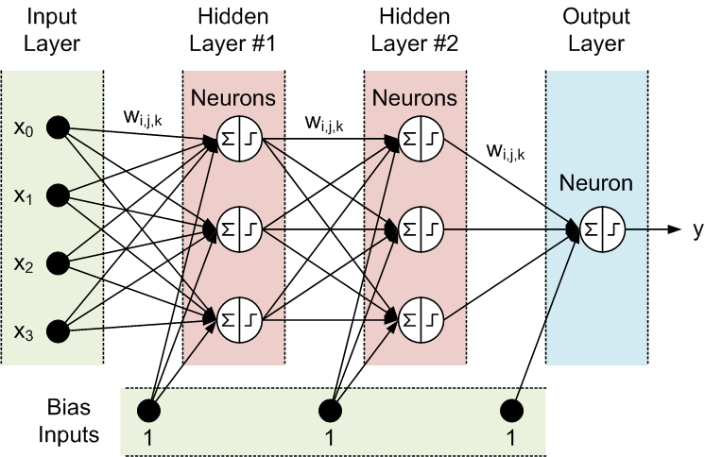
Reminder: Basic neural network architecture
“Shallow” net
Width
Each neuron p_{i} = f(x)
Or a layer is p = f(x)
Depth
http://tx.shu.edu.tw/~purplewoo/Literature/!DataAnalysis/three%20activation%20functions.files/NN1.gif
Notes:
General case is fully connected between each layer.
Width of each layer can vary.

Slide 4
Background: We could swap out the SVM for a traditional (shallow) neural network
Classifier (1-3 layers)
Human- engineered feature extraction
feature vector
Class (0-1)
Neural net
Build model (1-2 fully-connected hidden network layers)
Train (backpropagation to minimize loss)
Predict the class of a new vector by extracting features and forward-propagating the features through the neural network
7x7x6 =294
Grid-based Color moments
384x256x3
But the choice of features we extracted may limit accuracy
Notes:
Dave

Slide 5
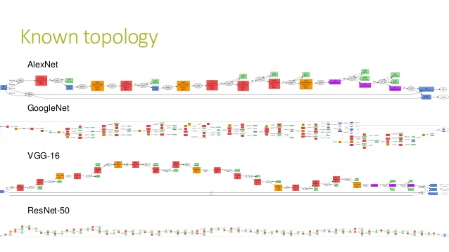
Deep learning is a vague term
“Deep” networks typically have 10+ layers.
For example, 25, 144, or 177 (we’ll use some of these!)
That’s many weights to learn.
And more choices of architectures.
Should layers be fully connected?
How to train them fast enough?
Fig: https://www.slideshare.net/Geeks_Lab/aibigdata-lab-2016-transfer-learning

Slide 6
Deep learning is a new paradigm in machine learning
Deep networks learn both which features to use and how to classify them.
There are millions of parameters
https://www.mathworks.com/discovery/convolutional-neural-network.html
Notes:
Dave

Slide 7
Deep learning is an old idea that is now practical
In 2012, a deep network was used to win the ImageNet Large Scale Visual Recognition Challenge (14M annotated images), bringing the top-5 error rate down from the previous 26.1% to 15.3%.
Deep networks keep winning and improving each year.
Why?
Faster hardware (GPUs)
Access to more training data (www)
Algorithmic advances
www.deeplearningbook.org/
Olga Russakovsky*, Jia Deng*, Hao Su, Jonathan Krause, Sanjeev Satheesh, Sean Ma, Zhiheng Huang, Andrej Karpathy, Aditya Khosla, Michael Bernstein, Alexander C. Berg and Li Fei-Fei. ImageNet Large Scale Visual Recognition Challenge. IJCV, 2015.
Notes:
Dave

Slide 8
Image classification network layers come in several types
Convolution, ReLU, Pooling
https://www.mathworks.com/discovery/convolutional-neural-network.html
Notes:
Dave

Slide 9
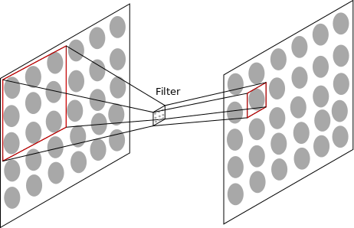
Image classification network layers come in several types
Convolution of filters with input.
AJ Piergiovanni, CSSE463 Guest Lecture https://docs.google.com/presentation/d/15Lm6_LTtWnWp1HRPQ6loI3vN55EKNOUi8hOSUypsFw8/
Notes:
Dave

Slide 10
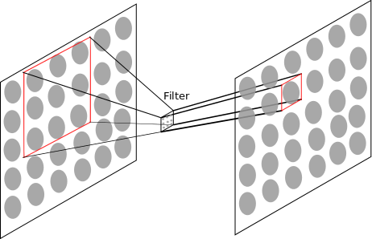
Image classification network layers come in several types
Convolution of filters with input
Notes:
Dave

Slide 11
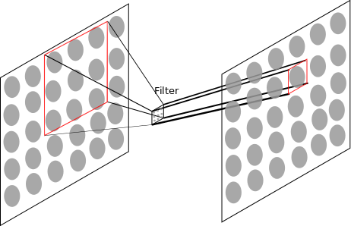
Image classification network layers come in several types
Convolution of filters with input. A set of 3x3 weights must be learned for each filter. But the same 3x3 filter connects every 3x3 patch in the first layer with every corresponding neuron in the next. We usually have 10+ such filters per level.
Notes:
Dave

Slide 12
Convolutional layers learn familiar features
The first layer filters learn edges and opponent colors,
Higher level filters learn more complex features
Example Filters
Kunihiko Fukushima, “Neocognitron: A self-organizing neural network model for a mechanism of pattern recognition unaffected by shift in position”
2
Notes:
TODO: Bring in more visualizations (even from MATLAB)

Slide 13
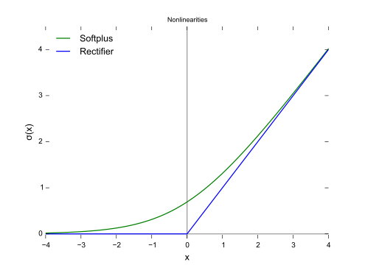
Image classification network layers come in several types
Without nonlinearity, layers collapse.
ReLU (rectified linear unit, blue “Rectifier” in the figure) is one of the simplest non-linear transfer functions.
This is transfer function #3:
Simple (fast). What is derivative?
Can you re-write using max? g(x) = max(______, ______)
CC0, https://en.wikipedia.org/w/index.php?curid=48817276
Notes:
g(x) =
\begin{cases}
x \text{ if } x >= 0\\
0 \text{ otherwise }
\end{cases}

Slide 14
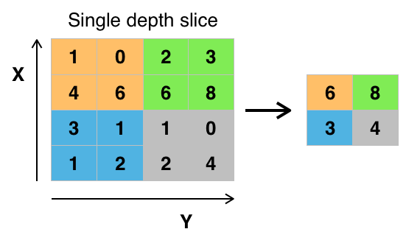
Image classification network layers come in several types
Because we learn multiple filters at each level, the dimensionality would continue to increase. The solution is to pool data at each layer and downsample.
Types:
Max-pooling
Average-pooling
Subsampling only
Example of max-pooling.
https://commons.wikimedia.org/wiki/File:Max_pooling.png#filelinks
Notes:
Dave

Slide 15
Putting it all together
Q7-8
Convolution, ReLU, Pooling
https://www.mathworks.com/discovery/convolutional-neural-network.html
Notes:
Dave

Slide 16
Gradient Descent
Goal is to find the min or max of a function
In calculus, solve
f’(x) = 0
What if f’(x) can’t be solved for x?
Start at some point x, where f’(x) exists
Next slides from AJ Piergiovanni, CSSE463 Guest Lecture https://docs.google.com/presentation/d/15Lm6_LTtWnWp1HRPQ6loI3vN55EKNOUi8hOSUypsFw8/

Slide 17
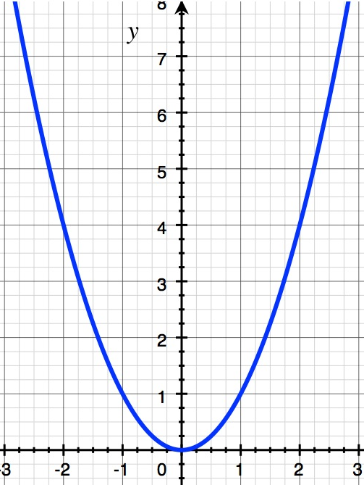
Gradient Descent

Slide 18
Gradient Descent

Slide 19
Gradient Descent

Slide 20
Gradient Descent

Slide 21
Gradient Descent

Slide 22
Gradient Descent

Slide 23
Gradient Descent

Slide 24
Gradient Descent
5

Slide 25
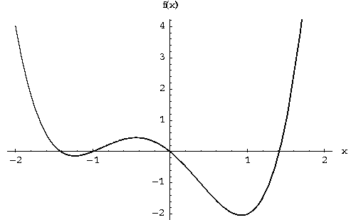
Gradient Descent - Local Min

Slide 26
Gradient Descent - Local Min

Slide 27
Gradient Descent - Local Min

Slide 28
Putting it all together
Convolution, ReLU, Pooling
Build model (many layers)
Train (gradient descent to minimize error function)
Predict the class of a new vector by forward propagation through the network
https://www.mathworks.com/discovery/convolutional-neural-network.html
Notes:
Dave

Slide 29
Stochastic Gradient Descent
Gradient descent uses all the training data before finding the next location.
Stochastic gradient descent divides the training data into mini-batches, which are smaller than the whole data set
Trains faster
Often converges much faster
But may not reach as optimal location as gradient descent
So 1 epoch (1 pass through the data set) is made of many mini-batches.

Slide 30
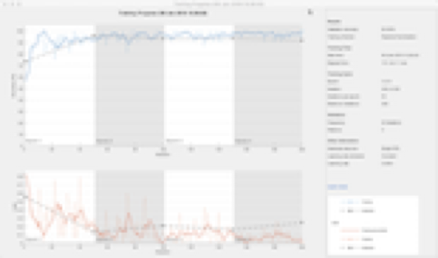
Training a neural network
Inputs:
the training set (set of images)
the network architecture (an array of layers)
the options that include hyper-parameters:
options = trainingOptions('sgdm',...
'MiniBatchSize',32,...
'MaxEpochs',4,...
'InitialLearnRate',1e-4,...
'VerboseFrequency',1,...
'Plots','training-progress',...
'ValidationData',validateImages,...
'ValidationFrequency',numIterationsPerEpoch);
Output: a trained network (with learned weights)
Notes:
Dave

Slide 31
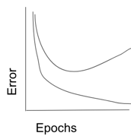
Training a neural network
Why do we need 3 sets of data?
We know about training and test sets; what is the validation set used for? Hyper-parameters!
Train
Validation
Test
Notes:
Dave

Slide 32
Note: CNNs can classify 1D signals, like chromatograms, as well.
0.00 Hi No-peak 0.17 No-peak 0.83 Small-peak 0.00 Peak
Each box is a matrix of weights or intermediate values (of neurons)
Notes:
(5 min) Architecture: Conv net, will discuss filter banks, nonlinear activation, max-pooling, classification, and that learned filters are . [The most purely-ML technical part of the talk, so I'll want to dwell here longest, relating it to successful use of ConvNets in image recognition] Filter banks learn things like smoothing, 1D, 2D.

Slide 33
Note: CNNs can classify 1D signals, like chromatograms, as well.
768
100x1
100x16
30
50x16
25x32
4
12x64
0.00 Hi No-peak 0.17 No-peak 0.83 Small-peak 0.00 Peak
Boutell and Julian, MSACL 2019
Softmax
Convolution: learn (3x1) filters x16, ReLU (nonlinear)
Max-pool
Conv (3x16)x32, ReLU, MP
Conv (3x32)x64, ReLU, MP
Flatten
Fully-connected
Extract Features
Classify
Notes:
(5 min) Architecture: Conv net, will discuss filter banks, nonlinear activation, max-pooling, classification, and that learned filters are . [The most purely-ML technical part of the talk, so I'll want to dwell here longest, relating it to successful use of ConvNets in image recognition] Filter banks learn things like smoothing, 1D, 2D.

Slide 34
Limitations
Deep learning is a black box - the learned weights are often not intuitive
They require LOTS of training data.
Need many, many (millions) images to get good accuracy when training from scratch
Notes:
Dave

Slide 35
Overcoming limitations: transfer learning
Some researchers have released their trained networks.
AlexNet, GoogleNet, ResNet-x, or VGG-19.
Why would we do this? # images, speed, accuracy.
Can you use them directly?
Transfer: Can you swap out and re-train the classification layers for your problem?
Can you run the feature extraction part only and save the activations for an SVM to classify?
Or do you need to start from scratch?
These options are the basis for the next lab and the sunset detector
MATLAB docs
Notes:
Dave

Slide 36
Questions?
Notes:
Dave

Slide 37
Visualizing CNNs
This next section is the senior thesis work of AJ Piergiovanni, RHIT CS/MA (2015), now studying deep learning at Indiana University.
Alternative: new results presented in Stanford course.
AJ Piergiovanni, CSSE463 Guest Lecture https://docs.google.com/presentation/d/15Lm6_LTtWnWp1HRPQ6loI3vN55EKNOUi8hOSUypsFw8/

Slide 38
Deconvolutional neural network
Deconvolutional
Network
Convolutional
Network
Layer Above Reconstruction
Pooled Maps
switches
Remove Bias and Unpool
Pooling, rectification and bias
Deconvolve
Convolution
Reconstruction
Layer Below Pooled Maps
Source code

Slide 39
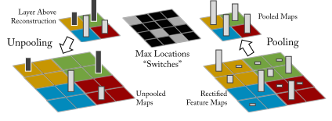
Inverting max-pooling
To invert max-pooling, switches are used to store where the max value is from
Some data is lost, but this preserves the max values, which are what affected the feature in the higher levels
Zeiler, M.D. & Fergus, R. Visualizing and Understanding Convolutional Networks.

Slide 40
Convolution
Takes the output from the convolution and convolves it with the transpose of the filters to reconstruct the input
Convolve with each filter
Two outputs
One reconstructed output
Input
Convolve with transposed filters
CNN
Deconvolutional Network

Slide 41
t-SNE
T-distributed Stochastic neighbor embedding (Wikipedia)
Unsupervised dimensionality reduction technique
Minimizes the difference between probability distributions
Maps high dimensional data to 2D space by preserving the density of the points
L.J.P. van der Maaten and G.E. Hinton. Visualizing High-Dimensional Data Using t-SNE.

Slide 42
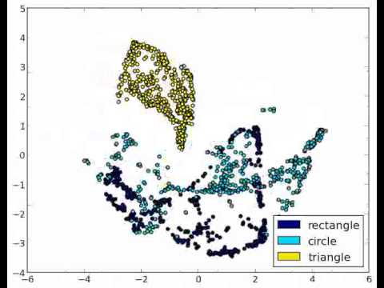
t-SNE

Slide 43
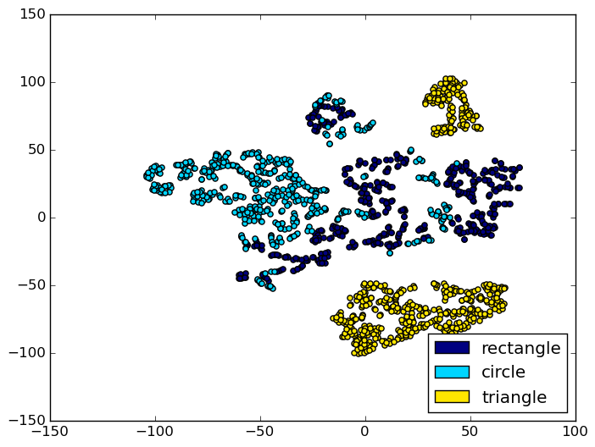
3-shape classification
Trained a CNN to classify images of rectangles, circles and triangles.

Slide 44
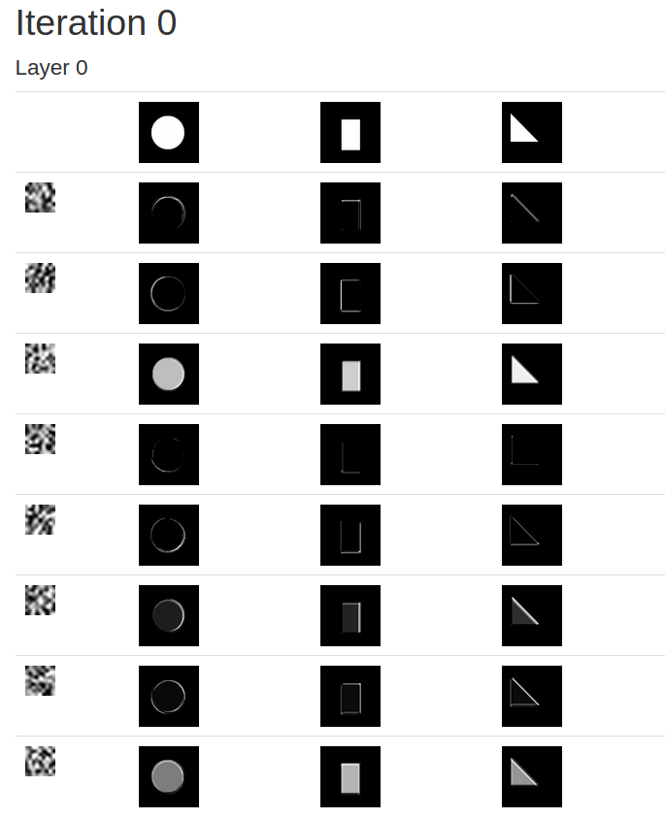
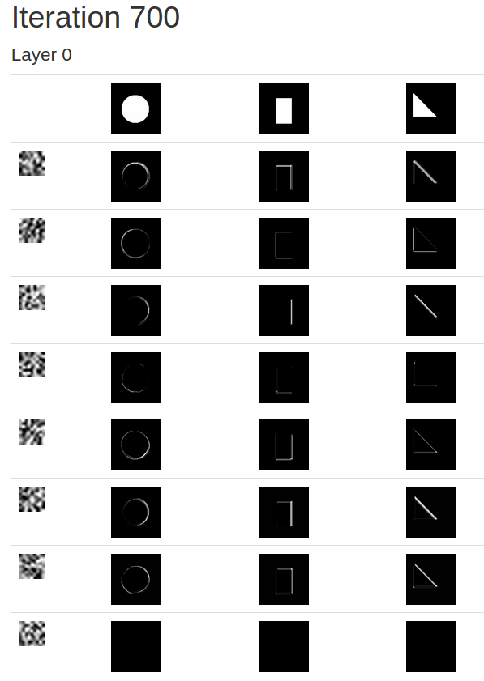

Slide 45
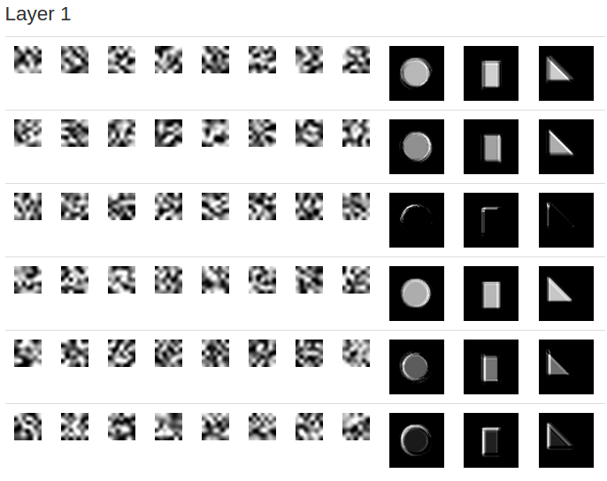
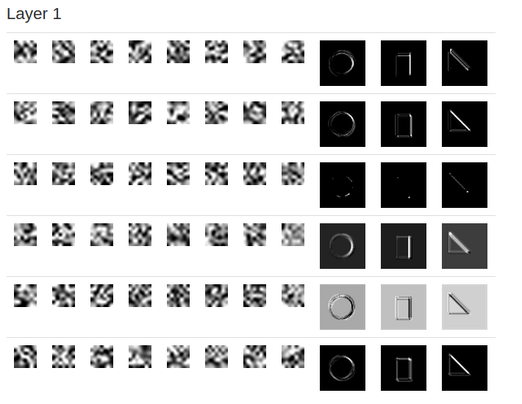
Notes:
Learns curves and corners

Slide 46
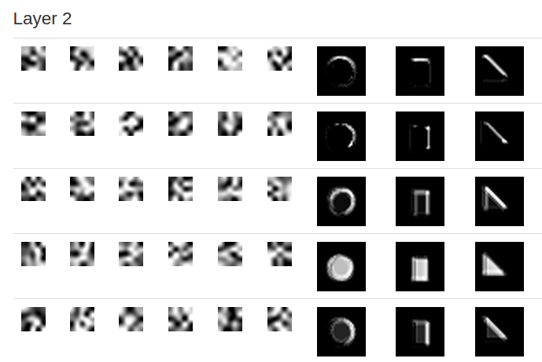
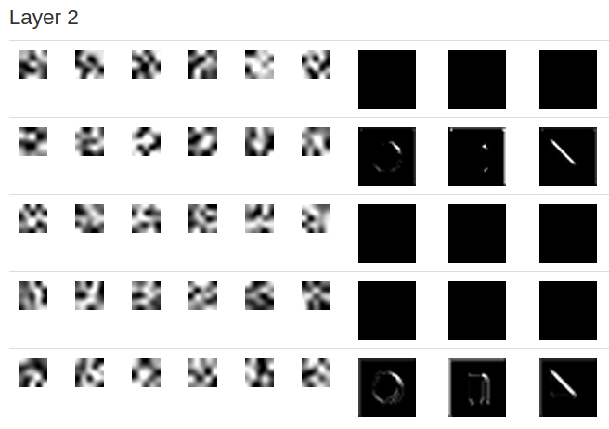
Notes:
Some similar since rela numbers, positive and negative

Slide 47
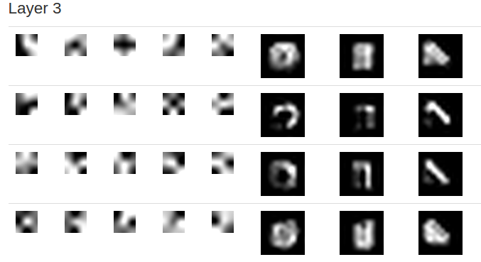
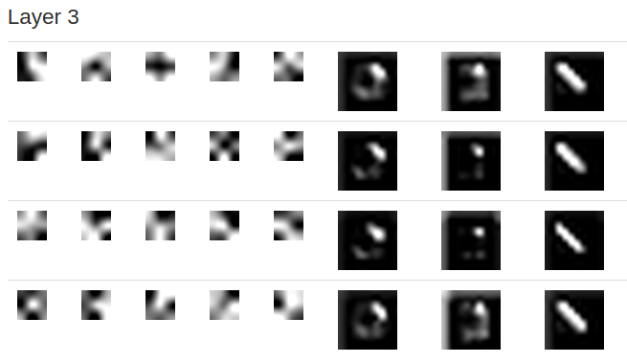
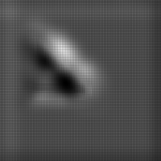
Reconstructed Inputs:
Notes:
Most discriminative

Slide 48
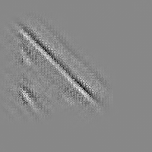
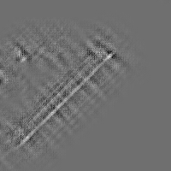
More deconvolution
Notes:
Visualizing features

Slide 49
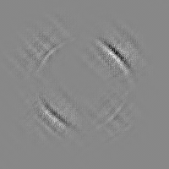
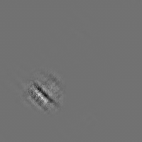
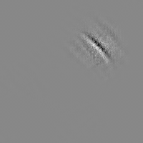
Notes:
4 filters on left. Final layer on right.

Slide 50
Title
Text
Notes:
Dave

