Slide 1
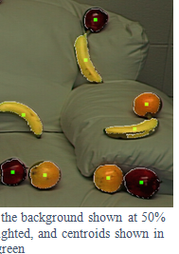
CSSE463: Image Recognition Day 6
Yesterday: Local, global, and point (neighborhood = only the pixel itself) operators use different context, but all
operate on entire image,
changing one pixel at a time!!
Lab is due
Fruit-finder deadline Friday, 11:00pm
Please leave time for a solid write-up
Nice example of how to show results:
See rubric online for other standards
Questions?
Today: edge features (another local operator)
Sonka 5.3
Q1-2

Slide 2
There are 2 types of programmers in the world:
1. Those who prefer 1-based indexing
1. Those who prefer 0-based indexing
Thanks to 463 student John Krasich for clarifying this for us.
Notes:
Thomas Root was the first one to point out…

Slide 3
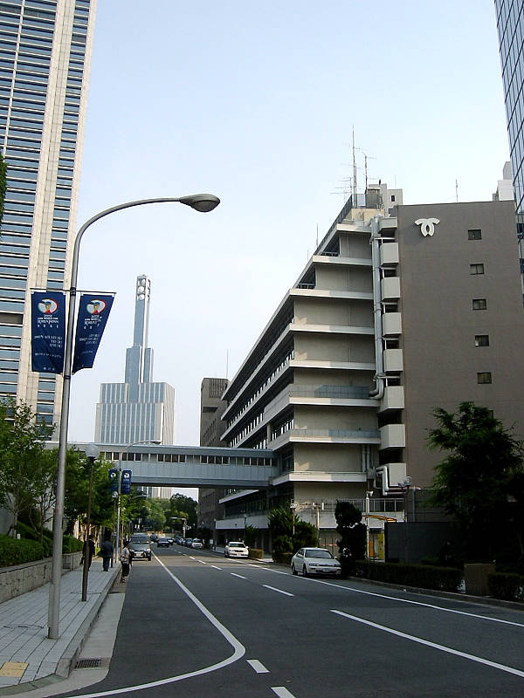
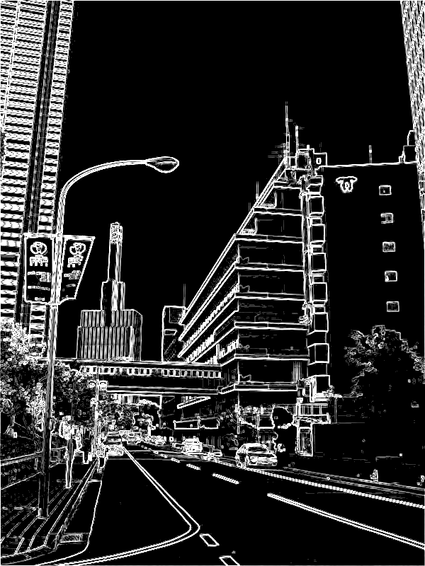
Edge Features – Why?
“Edginess” (# edges) and their directions can give you info about the scene content
Orientation of the image
Natural vs. manmade images
Edges can be used to segment the image.
Color information is usually used as well.
Specifically, boundaries occur where the chroma and/or luminance change (drastically).
We could use to enhance the fruit-finder in a later assignment (not now).

Slide 4
Outline for next 2 sessions
Concept: How to find “edges” in 1D signal
Edges in 2D images
Limitations
Edges vs edgels, Canny edge detector

Slide 5
Intuition: Finding edges
Image
What’s an edge?
How to find changes in intensity?
How to find first derivative?
Intensity
First deriv.

Slide 6
Finding derivatives (1D)
Let y be intensity of point at location x
Def:
Fix Δx = 1 pixel
dy/dx = y₂-y₁
f: [0 0 0 0 0 50 50 50 50 0 0 0 0 0];
f’:[ 0 0 0 0 50 0 0 0 -50 0 0 0 0 ];
Correlate image with filter [-1,1] to find positions of change.
Edges “between” pixels.
What is significance of magnitude of first deriv. ?

Slide 7
Applying Filters
Example for differential with Δx = 2 pixels:
(Better; no output “between” pixels)
Image
5 | 8 | 9 | 1 | 2 | 2 | 1 | 2 | 1 | 3 | 1 | 3
-½ | 0 | ½
-½ | 0 | ½
-½ | 0 | ½
Mask
Output
2
-3.5
-3.5
…
Could you do
Ramps? Impulse? Step edges? (on quiz)
Properties
If no contrast?
Q3,4

Slide 8
Why should the values in an edge filter sum to 0?
What if they didn’t?
Consider running it on a homogeneous region: 40, 40, 40, 40, 40, 40
Q5

Slide 9
2D Edges
Local operators
Prewitt operators
Sobel masks
Roberts 2x2 cross-operators
Gradient: magnitude
Gradient direction

Slide 10
Edge gradient
Vector pointing in direction of greatest positive change.
We want its magnitude and direction
∇f
f_{y}
f_{x}

Slide 11
1. Find partials using filters
Note that this is 1D filter, but averaged over 3 rows (for df/dx) or 3 cols (for df/dy) and with 1/6 factored out to allow integer multiplication
Q6,7

Slide 12
2. Find edge gradient magnitude
Definition: the gradient, , is the vector pointing in the direction of greatest change.
To find its magnitude:
Q2

Slide 13
3. Find edge gradient direction
tan⁻¹(y,x)
Matlab’s atan2(y,x) gives full range, [-π, π]
dir=arctan(-1,0) = -π/2
dir=arctan(0,1)= 0
dir=arctan(0,-1) = π
dir=arctan(1,0)= π/2
Direction is thus the angle formed by the x-axis and the line “pointing towards” light region.
Q3-4

Slide 14
Review: filters to reduce noise
From last slide from Day 5 class
To get the output at a single point, take cross-correlation (basically a dot-product) of filter and image at that point
To filter the whole image, shift the filter over each pixel in the original image
This is a 3x3 version of which filter?

