Slide 1
CSSE463: Image Recognition Day 2
Roll call
Announcements:
Reinstall Matlab if you are having problems: Lab 1 has directions.
Angel has drop box for Lab 1
Bonus points to first person to find errors in course materials!
Tomorrow: more Matlab how-to (bring laptop)
Last class we discussed:
Today: Color and color features
Questions?

Slide 2
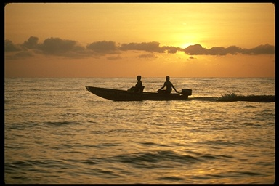
Pixels to Predicates
1. Extract features from images
2. Use machine learning to cluster and classify
Color
Texture
Shape
Edges
Motion
Principal components
Neural networks
Support vector machines
Gaussian models

Slide 3
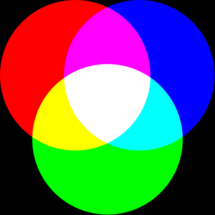
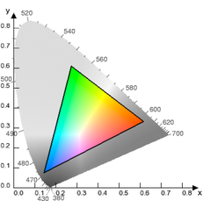
Basics of Color Images
A color image is made of red, green, and blue bands.
Additive color
Colors formed by adding primaries to black
Comments from graphics?
RGB mimics retinal cones in eye.
RGB used in sensors and displays
Why “16M colors”?
Why 32 bit?
Source: Wikipedia

Slide 4
Basics of Color Images
Each band is a 2D matrix
Each R, G, or B value typically stored in a byte.
Range of values?
The 4th byte is typically left empty
Allows for quicker indexing, because of alignment
Reserved for transparency (in graphics)
How much storage is required for a 4 megapixel color image (uncompressed)?
Q1-2
Notes:
16MB

Slide 5
Color Features (statistics from images)
1. Color histograms
2. Color moments
3. Color coherence vectors
Related to the feature types
Some color spaces “work better”
Spatial components can help
Q3

Slide 6
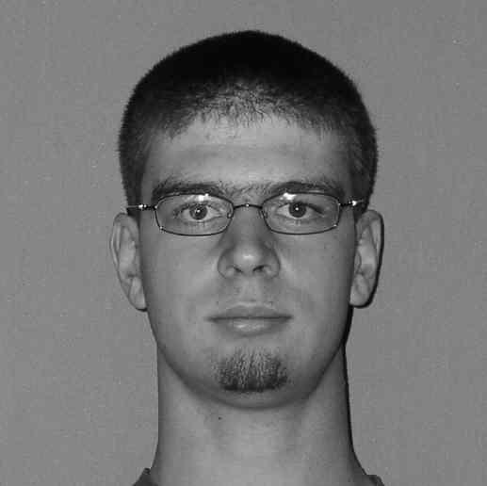
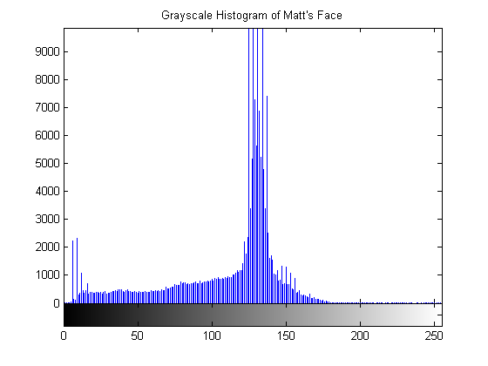
Color histograms
Gives distribution of colors
Sample to left is for intensities only
Pros
Quantizes data, but still keeps lots of info
Cons
How to compare two images?
Spatial info gone
Histogram intersection (Swain and Ballard)

Slide 7
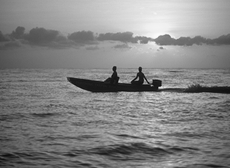
Color moments
Central moments are statistics
1st order = mean
2nd order = variance
3rd order = ____
4th order = ____
Some have used even higher order moments, but less intuitive
For color images, take moments of each band
skew
kurtosis
m₁ = 116.3
m₂ = 1152.9
m₃ = -70078
m₄ = 7.4 million
m₁ = 132.4
m₂ = 2008.2
m₃ = 4226
m₄ =12.6 million
Q4

Slide 8
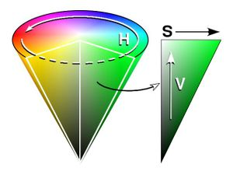
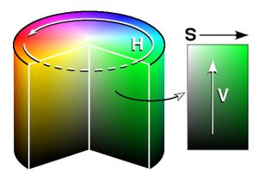
HSV color space
Hue-saturation-value (HSV) cone
also called HSI (intensity)
Intuitive
H: more than “what color”: it’s the position on the spectrum!
S: how vibrant?
V: how light or dark
“Distance” between colors
Must handle wraparound of hue angle correctly (0 = 2π)
Matlab has method to convert from rgb to hsv, can find formula online.
Source: Wikipedia
Q5

Slide 9
Other color spaces
LST
L = luminance: L = R + G + B
S and T are chroma bands.
S: red vs. blue: S = R – B
T: green vs. magenta: T = R – 2G + B
(Typically, we then normalize these to the same scale)
These 3 are the principal components of the RGB space (PCA and eigenvectors later in course)
Slightly less intuitive than HSV
No problem with wraparound
Others
YIQ (TV signals), QUV, Lab, LUV
Q6

Slide 10
Spatial component of color
Break image into parts and describe each one
Can describe each part with moments or histograms
Regular grid
Pros?
Cons?
Image regions
Pros?
Cons?
Q7

Slide 11
Additional reading
Color gamuts
http://en.wikipedia.org/wiki/Gamut
Color coherence vectors
Extension of color histograms within local neighborhoods
Used in:
A. Vailaya, H-J Zhang, and A. Jain. On image classification: City images vs. landscapes. Pattern Recognition 31:1921-1936, Dec 1998.
Defined in:
G Pass, R Zabih, and J Miller. Comparing images using color coherence vectors. 4th ACM Conf. Multimedia, pp 65-73, Boston, 1996.

Slide 12
ICME Sunset Paper
Answer quiz questions
We’ll answer some in-class as time allows.
Q8-10

